Slide 1
Agile and DevOps
UNIT 1

Slide 2
Introduction to Agile

Slide 3
Agile versus traditional method comparisons and process tailoring Software Process Models
Self Revision as it is repeated

Slide 4
Introduction to Agile and its methodologies:

Slide 5
What Is Agility?
It encourages team structures and attitudes that make communication (among team members, between technologists and business people, between software engineers and their managers) more facile.
It emphasizes rapid delivery of operational software and de-emphasizes the importance of intermediate work products (not always a good thing);
it adopts the customer as a part of the development team and works to eliminate the “us and them” attitude that continues to pervade many software projects;
it recognizes that planning in an uncertain world has its limits and that a project plan must be flexible.

Slide 6
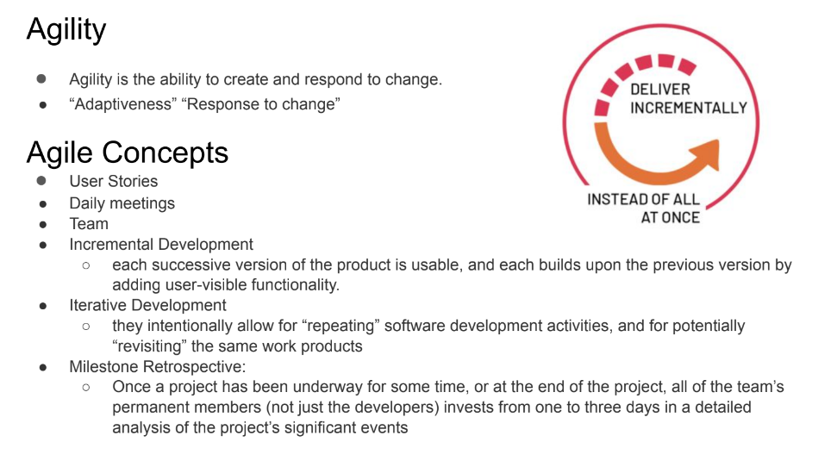

Slide 7
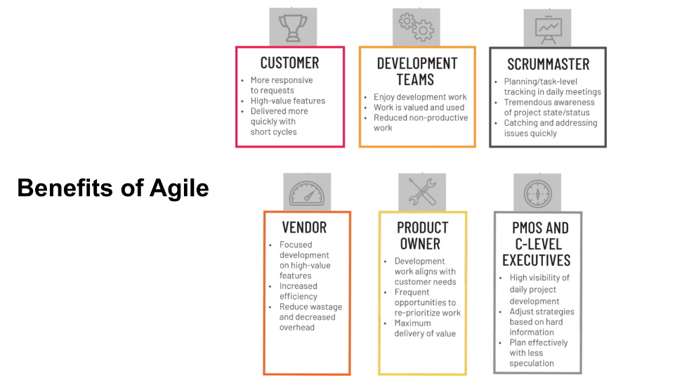

Slide 8
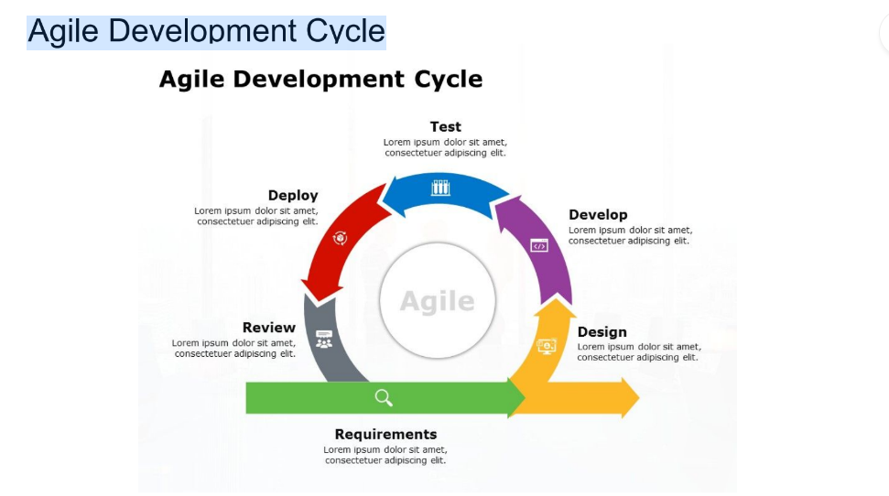

Slide 9
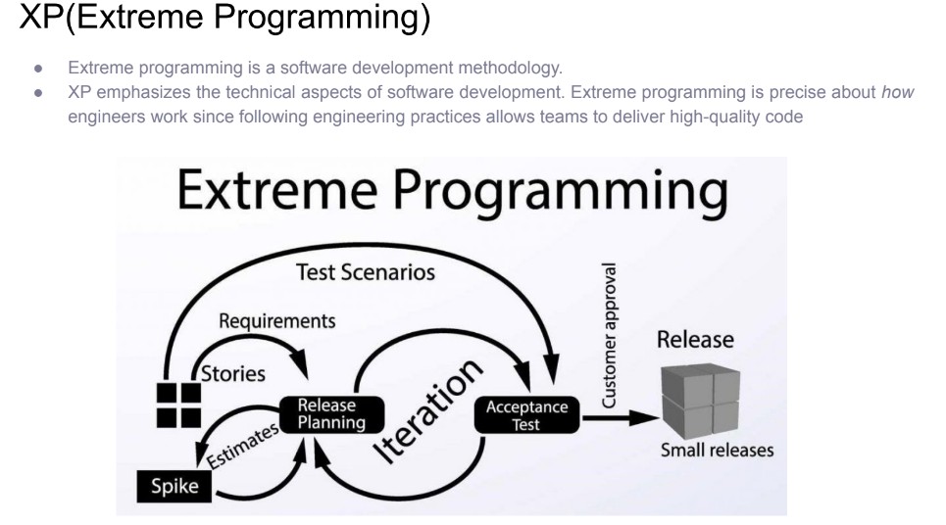
Agile Process Models: 1. Extreme Programming
Extreme Programming uses an object-oriented approach (Appendix 2) as its preferred development paradigm and encompasses a set of rules and practices that occur within the context of four framework activities: planning, design, coding, and testing.

Slide 10
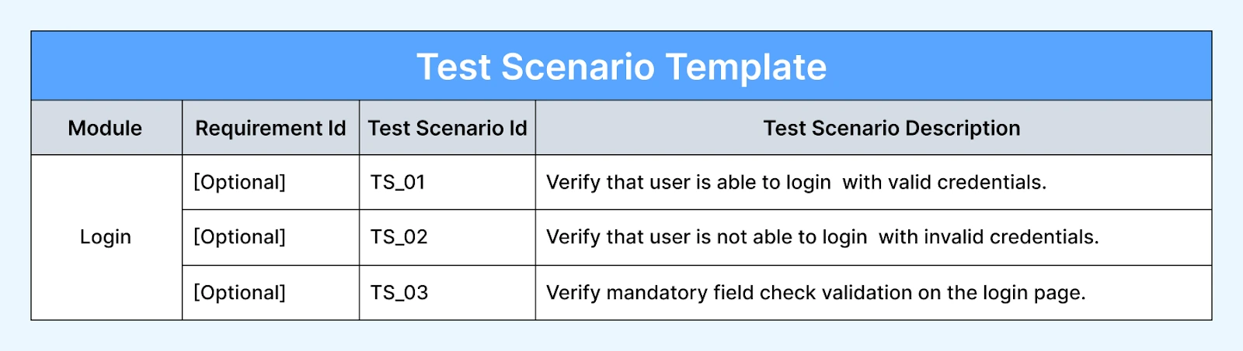
Refactoring is the process of changing a software system in such a way that it does not alter the external behavior of the code yet improves the internal structure.
It is a disciplined way to clean up code that minimizes the chances of introducing bugs.
Refactoring means that design occurs continuously as the system is constructed.
Spike: A Task to research about the issue and solve the issue.
Test scenarios: A situation under which test cases needed to be made.

Slide 11
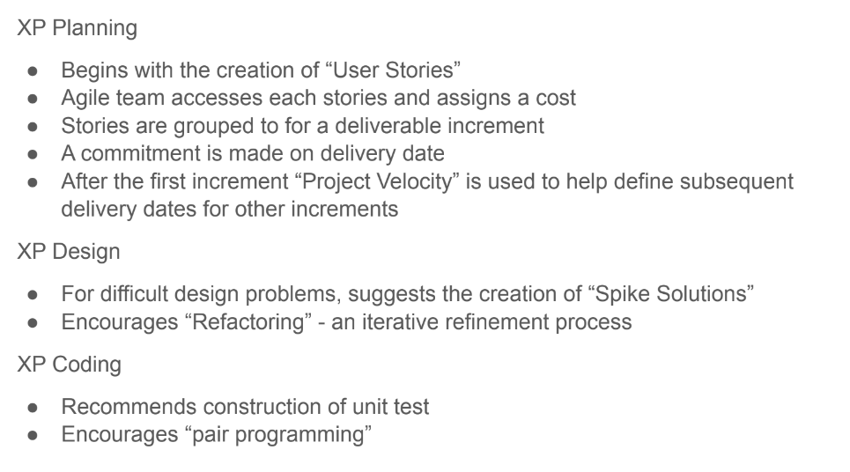

Slide 12
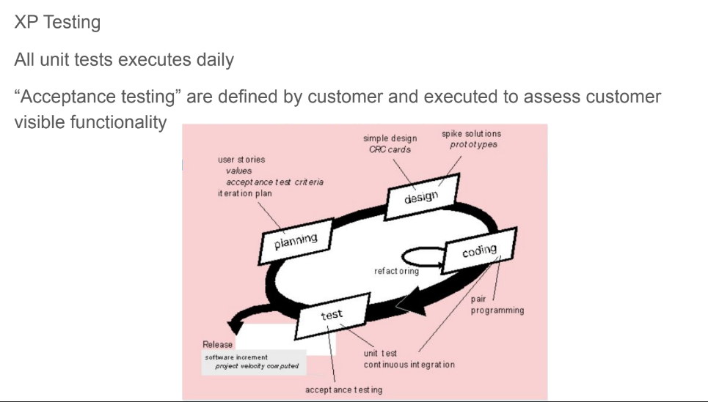

Slide 13
2. Scrum
Scrum is a management framework that teams use to self-organize and work towards a common goal. It describes a set of meetings, tools, and roles for efficient project delivery. Much like a sports team practicing for a big match, Scrum practices allow teams to self-manage, learn from experience, and adapt to change.
Scrum principles are consistent with the agile manifesto and are used to guide development activities within a process that incorporates the following framework activities: requirements, analysis, design, evolution, and delivery.
Scrum emphasizes the use of a set of software process patterns [Noy02] that have proven effective for projects with tight timelines, changing requirements, and business criticality.
People often think scrum and agile are the same thing because scrum is centered around continuous improvement, which is a core principle of agile. However, scrum is a framework for getting work done, whereas agile is a philosophy.
The key difference between Agile and Scrum is that Agile is a philosophy about how to successfully deliver software to a customer, while Scrum is a proven methodology for software development teams to follow.

Slide 14
Scrum is the type of Agile framework. It is a framework within which people can address complex adaptive problem while productivity and creativity of delivering product is at highest possible values. Scrum uses Iterative process. Silent features of Scrum are:
Scrum is light-weighted framework
Scrum emphasizes self-organization
Scrum is simple to understand
Scrum framework help the team to work together

Slide 15
Scrum process flow
Backlog—a prioritized list of project requirements or features that provide business value for the customer. Items can be added to the backlog at any time (this is how changes are introduced). The product manager assesses the backlog and updates priorities as required.
Sprints—A Sprint is a time box of one month or less. A new Sprint starts immediately after the completion of the previous Sprint. It consist of work units that are required to achieve a requirement defined in the backlog that must be fit into a predefined time-box14 (typically 30 days). Changes (e.g., backlog work items) are not introduced during the sprint. Hence, the sprint allows team members to work in a short-term, but stable environment.
Scrum meetings—are short (typically 15 minutes) meetings held daily by the Scrum team. Three key questions are asked and answered by all team members:
• What did you do since the last team meeting?
• What obstacles are you encountering?
• What do you plan to accomplish by the next team meeting?

Slide 16
4. Demos—deliver the software increment to the customer so that functionality that has been implemented can be demonstrated and evaluated by the customer. It is important to note that the demo may not contain all planned functionality, but rather those functions that can be delivered within the time-box that was established.
Who is a team leader?
A team leader, called a Scrum master, leads the meeting and assesses the responses from each person. The Scrum meeting helps the team to uncover potential problems as early as possible. Also, these daily meetings lead to “knowledge socialization” and thereby promote a self-organizing team structure.

Slide 17
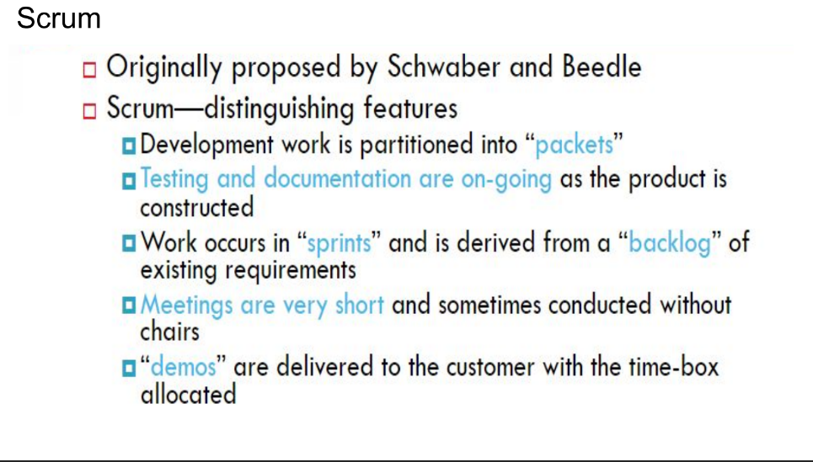
Short Notes on Scrum Process Flow

Slide 18
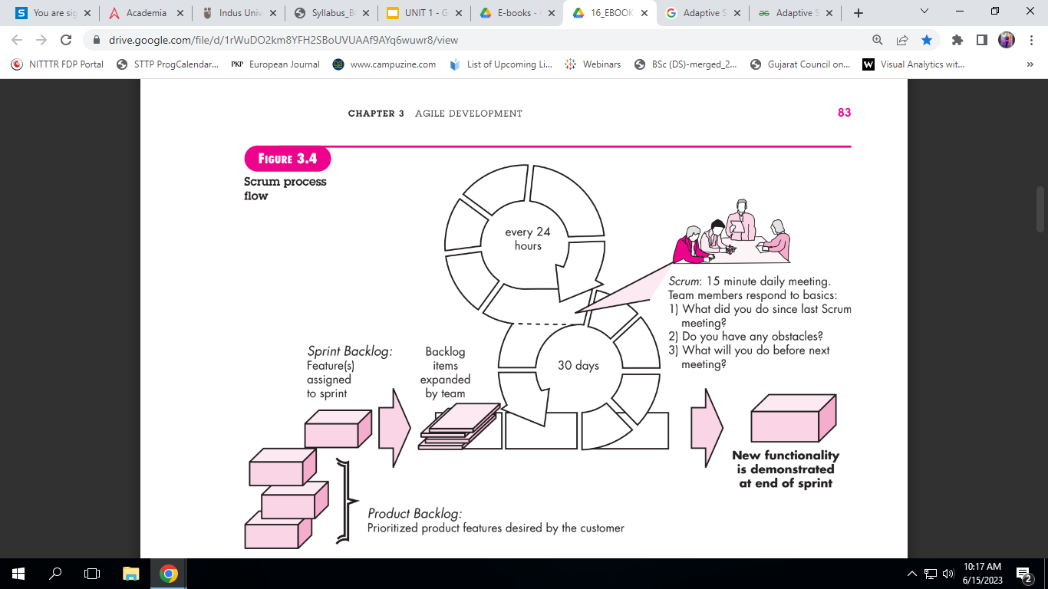

Slide 19
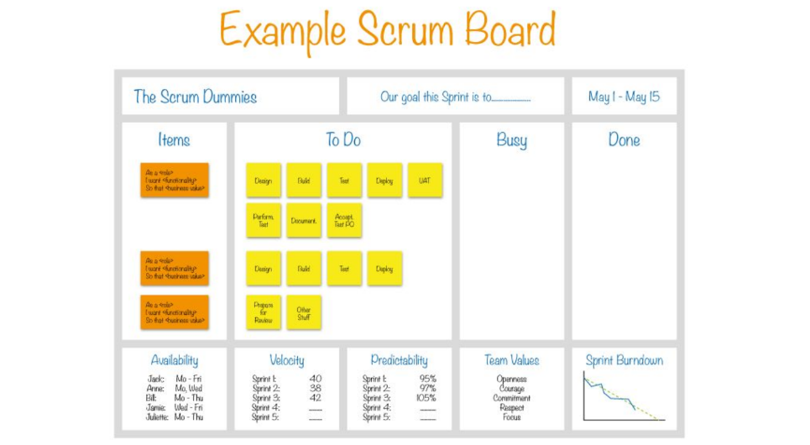

Slide 20
Advantage of using Scrum framework:
Scrum framework is fast moving and money efficient.
Scrum framework works by dividing the large product into small sub-products. It’s like a divide and conquer strategy
In Scrum customer satisfaction is very important.
Scrum is adaptive in nature because it have short sprint.
As Scrum framework rely on constant feedback therefore the quality of product increases in less amount of time
Disadvantage of using Scrum framework:
Scrum framework do not allow changes into their sprint.
Scrum framework is not fully described model. If you wanna adopt it you need to fill in the framework with your own details like Extreme Programming(XP), Kanban, DSDM.
It can be difficult for the Scrum to plan, structure and organize a project that lacks a clear definition.
The daily Scrum meetings and frequent reviews require substantial resources.

Slide 21
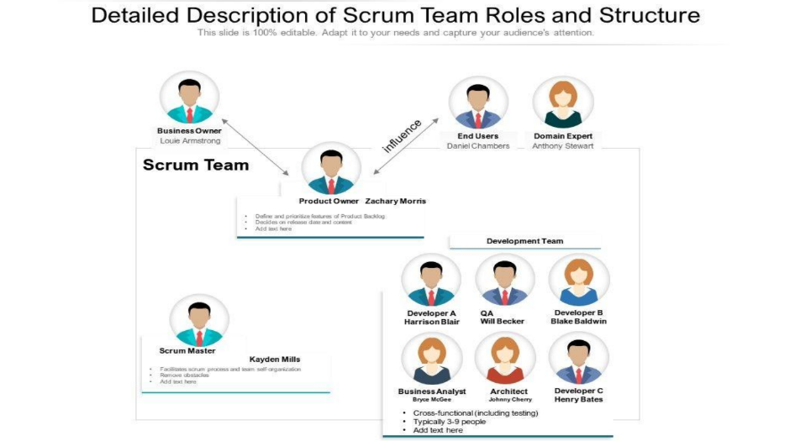

Slide 22
Lean
“Lean” is a quality improvement and management philosophy that began in manufacturing.
In project management there are wastes like excessive documentation, excessive planning and control, unproductive meetings, avoidable rework, excessive definition of detailed requirements, unproductive multi-tasking. Lean PM eliminates these wastes.
It works on five components:
Understand what the customer really wants and considers important.
Find all the steps needed to create the product or service and remove unnecessary activities.
Deliver products or services when customers need them, without delays.
Encourage employees to share ideas and give them responsibility to improve work.
Keep looking for ways to make processes better and more efficient all the time.

Slide 23
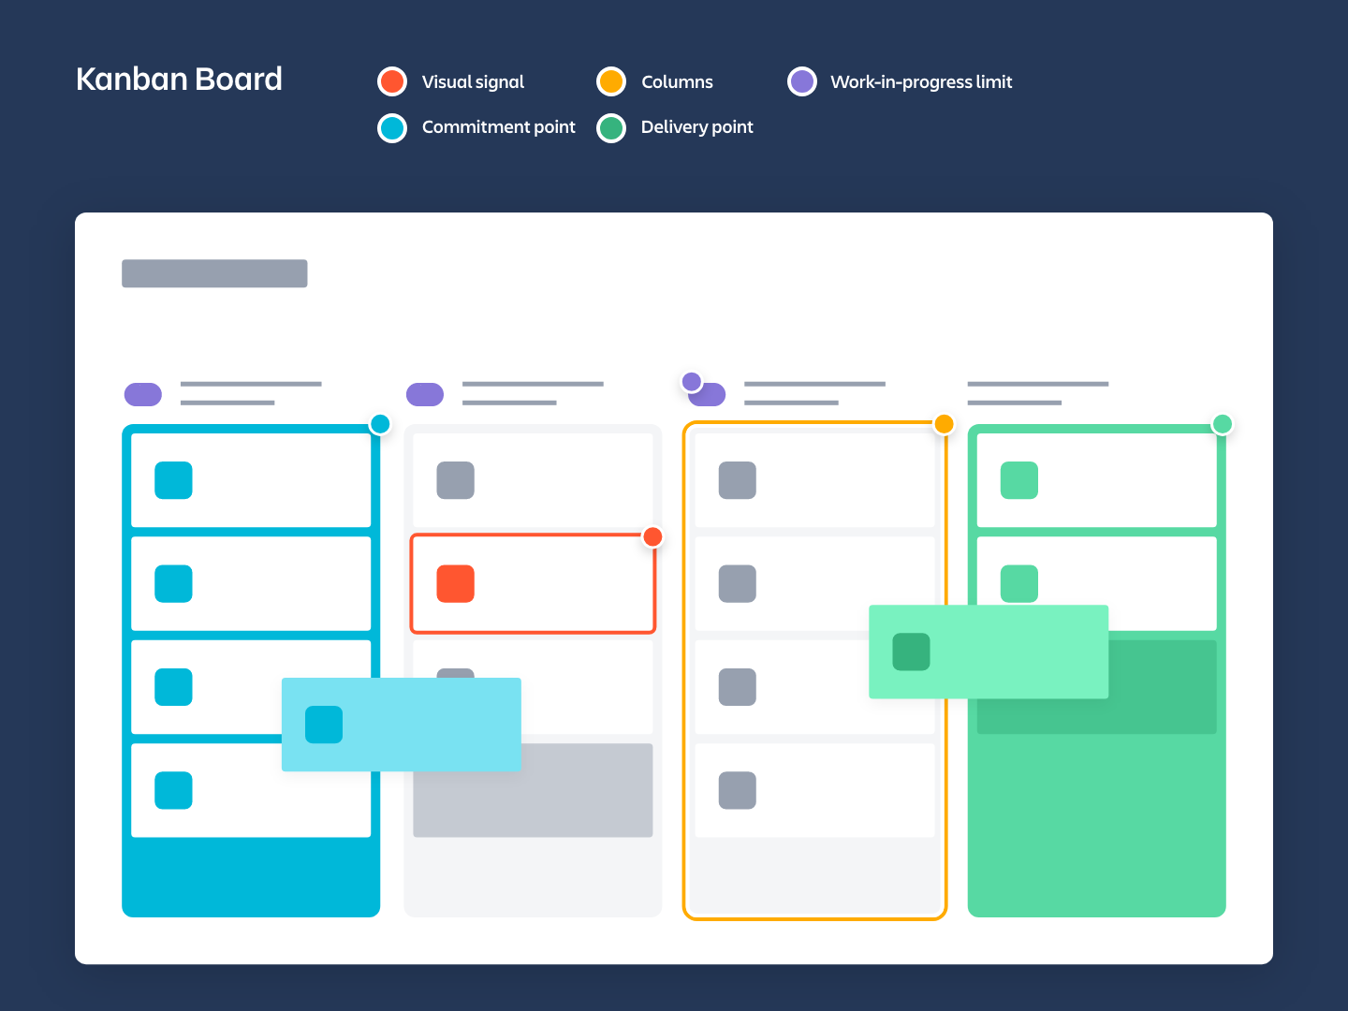
Kanban Board
A kanban board is an agile project management tool designed to help visualize work, limit work-in-progress, and maximize efficiency (or flow). It can help both agile and DevOps teams establish order in their daily work.
Kanban boards use cards, columns, and continuous improvement to help technology and service teams commit to the right amount of work, and get it done.
Visual Signals: Cards on the Kanban board show tasks and help everyone see what work is being done.
Columns: Columns represent different stages of work, such as To Do, In Progress, and Done.
Work In Progress (WIP) Limits: WIP limits set the maximum number of tasks allowed in a stage at one time to avoid overload and identify bottlenecks.
Commitment Point: The point where a team selects an idea from the backlog and starts working on it.
Delivery Point: The stage where the completed product or service is delivered to the customer. The time from commitment to delivery is called Lead Time.

Slide 24
An Agile team
An Agile team is a group of employees, contractors, or freelancers responsible for executing an Agile project. Agile teams are typically co-located and often wholly dedicated to the project during its timeline, with no obligations to other projects.
An Agile team needs every person required to produce the end product or service. The team is typically cross-functional, and roles will vary depending on the project’s needs and the type of Agile framework chosen.

Slide 25
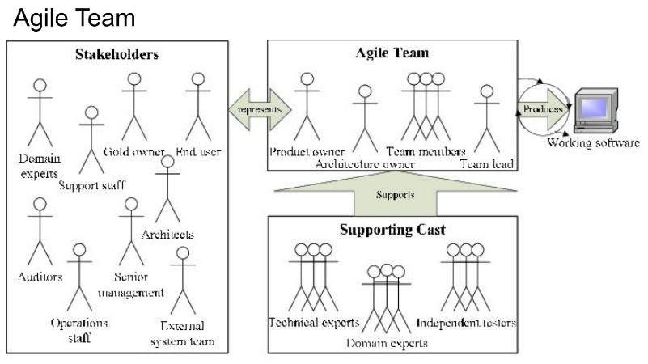

Slide 26
Agile Manifesto:
It is a foundation guide for the modern software development created in 2001 to promote the flexibility, collaboration and customer focused delivery. There are four core values:
Individuals over processes and tools.
Working software over documentation
Customer collaboration over contract negotiation
Responding to change over following a plan.
It works on 12 principals.

Slide 27
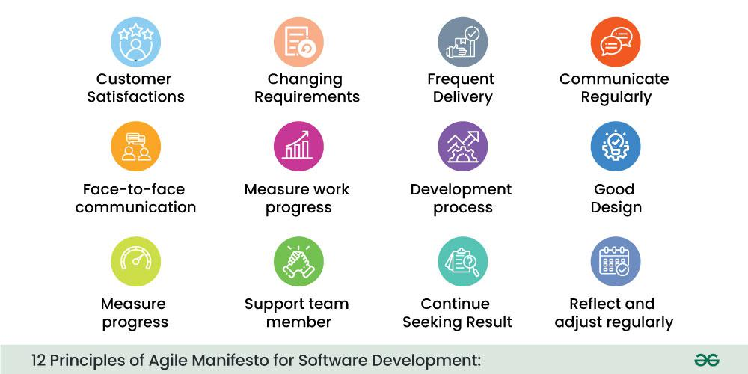
12 principles of agile manifesto

Slide 28
Product Inception: Product vision, stakeholders, initial backlog creation

Slide 29
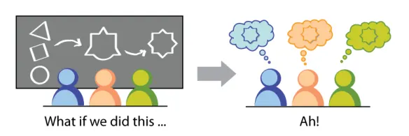
Product Inception
Product Inception is the phase where the team establishes the core product vision, aligns cross-functional stakeholders, and builds the initial product backlog.
It is the phase in the product life cycle where stakeholders aligns, define the core problem, and establish a shared vision before any code is written.
It focuses on : 1. Define why, who and what 2. Determining the scope 3. Align cross-functional teams.
Common methodologies:
1. Lean inception 2. Design sprints .

Slide 30
Product vision
Desired output of the product inception is to Align on goals, vision, and context for a project/product/feature set so a team can make intelligent decisions while executing.
It describes what the product aims to achieve and why it exists.
The main purpose of the product vision are:
1. Aligns everyone on the product goals
2. Provide direction for decision- making.
3. Communicates value to customers and stakeholders.
Vision statement: For [target customers], who [need/problem], the [product name] is a [product category] that [key benefit]. Unlike [competitor/alternative], our product [unique differentiator].
Example:
For university students who struggle to manage assignments, the StudyPlanner app is a productivity tool that organizes schedules and deadlines in one place. Unlike generic calendar apps, it provides academic-specific planning features

Slide 31
2. Stakeholders
Internal Stakeholders:
Product Owner
Product Manager
Development Team
UX/UI Designers
QA Team
Marketing Team
Sales Team
Senior Management
External Stakeholders:
Customers
End Users
Investors
Regulatory Bodies
Partners and Vendors

Slide 32
Stakeholder Matrix:
Stakeholder | Interest | Influence | Engagement
Product Owner | High | High | Manage closely
Customers | High | Medium | Regular feedback
Executives | Medium | High | Keep satisfied
Vendors | Low | Medium | Monitor

