Slide 1
Unit 2
MCA0302

Slide 2
2.1 - Agile requirements that include the user persona, story mapping, user stories, 3Cs, INVEST, acceptance criteria, sprints, requirements, product backlog and backlog grooming

Slide 3
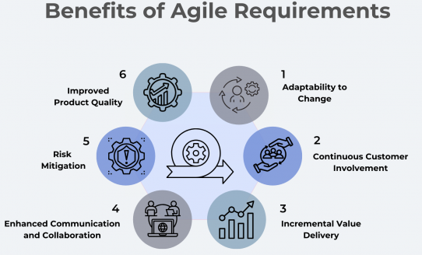
Agile Requirements
A flexible, user-centric approach to defining project features. Agile requirements are fluid and responsive.
How to Collect Agile Requirements?
Stakeholder Collaboration and Goal Determination
User Stories and Narrowing Requirements
Iteration and Continuous Refinement
Finalization and Unique Identifiers
Review with Product Teams and Leadership

Slide 4
Types of agile requirements:
User Stories
Agile teams express requirements from an end-user perspective through user stories. These stories help assess feature importance, break down complex functionalities, and guide product development to meet user needs.
These stories facilitate communication by articulating the end-user perspective, fostering a cohesive approach to feature prioritization and development alignment with user needs.
Functional Requirements (FRs)
Agile functional requirements pinpoint specific functions or features the final product must possess. Teams utilize these to outline steps for product development, establish goals, and set benchmarks to track progress.
Examples: features like a customer feedback form on a landing page for past invoices
Non Functional Requirements (NFRs)
Nonfunctional requirements, or quality attributes, define the expected performance of a solution. Areas such as usability, security, reliability, and overall system performance fall under NFRs.
These requirements ensure the product behaves as intended, protecting against unauthorized access, ensuring reliability, and measuring user satisfaction.

Slide 5
Acceptance Criteria
Acceptance criteria define how to test or measure the success of a user story. These criteria establish metrics to assess project success, such as improvements in customer retention or specific speed benchmarks for product dispatch.
User Acceptance Tests
User acceptance tests provide scenarios for testing specific product or service features. These tests help teams and clients understand how features work and verify if solutions meet customer needs.
For instance, a user acceptance test for a confirmation email feature may include visiting the registration website, filling out a form, and confirming email receipt.

Slide 6
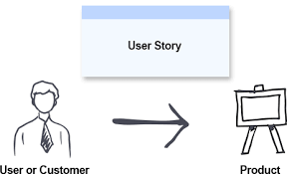
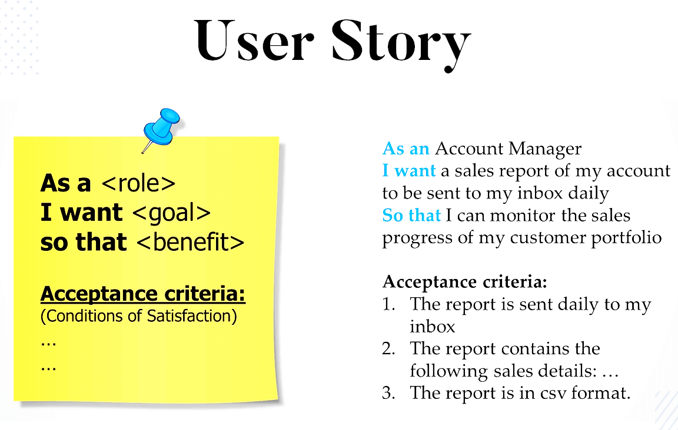
User Story:
A user story is a short, simple description of a feature told from the perspective of the user.
Notes:
Reference: https://www.justinmind.com/blog/examples-user-story-best-practices/

Slide 7
User Persona and Story Mapping
User stories can bring user personas(a fictional representation of a typical user of a product ) to life, involving these fictional yet real-life-based personas in the project. having representatives of thousands or millions of users guiding the development team on what they need, rather than the team simply imagining it. User stories can combine to form user story maps, a productive agile technique where all stories are organized to create a development timeline and a priority list.
User persona Example:
Ms .Priya Patel, MCA Student
Her Goal: Find books quickly, check due dates, pay fine if applicable
Challanges: Limited time to visit library, difficulty finding needed books
Motivations: Save time, Access study materials quickly.
“I want to find the right book in lesser clicks instead searching it on book shelves”

Slide 8
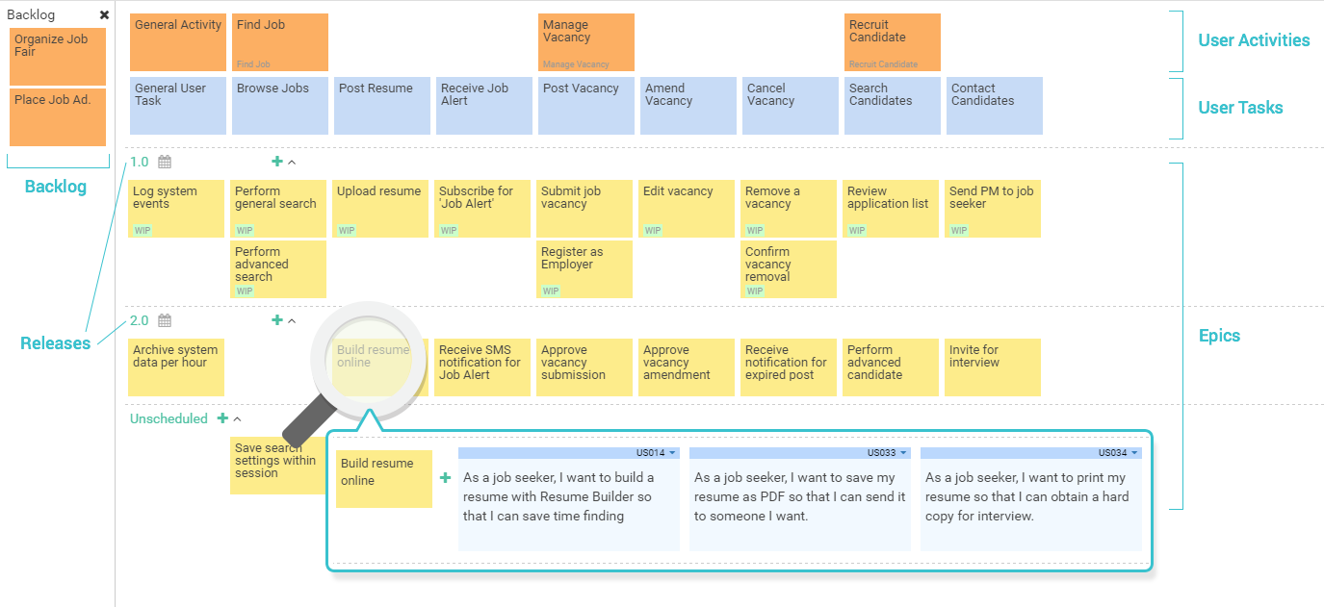
Techniques for Writing User Stories
User Persona Mapping: a technique that involves creating a detailed profile of the user for whom the story is being written. This helps to ensure that the user story is focused on the needs of the user and that it accurately reflects their goals and motivations.
Story Mapping: a technique that involves visualizing the user’s journey through the software product. This helps to ensure that the user story is part of a larger narrative and that it fits into the overall product roadmap.
Acceptance Criteria: These are the specific conditions that must be met in order for the user story to be considered complete. By defining acceptance criteria up front, teams can ensure that the user story is well-defined and that everyone is on the same page.

Slide 9
3 Cs of User Story
Confirmation:
(Acceptance Criteria):
The conditions that must be met for the story to be considered "done"
Card:
The physical or digital sticky note (e.g., in Jira) that displays the basic "Role-Action-Benefit" sentence
Conversation:
The verbal discussion between the product team and developers to clarify details, edge cases, and scope.

Slide 10
Example of User story with acceptance criteria
Online Library Management System
User Story: Find a book
As <a library member> I want to <search for book as title, author and category>
so that <i can find quickly find the book available>
Acceptance criteria
Scenario 1: Search by Book Title
Given: User on the search page
When: User enters valid title in search
And: clicks the search button
Then: System should display all books matching that title.
Scenario 2: Search by Book author
Given: User on the search page
When: User enters valid author name in search
And: clicks the search button
Then: System should display all books matching that author Name.
Scenario 3: Search by Book category
Given: User on the search page
When: User enters valid category in search
And: clicks the search button
Then: System should display all books matching that category.

Slide 11
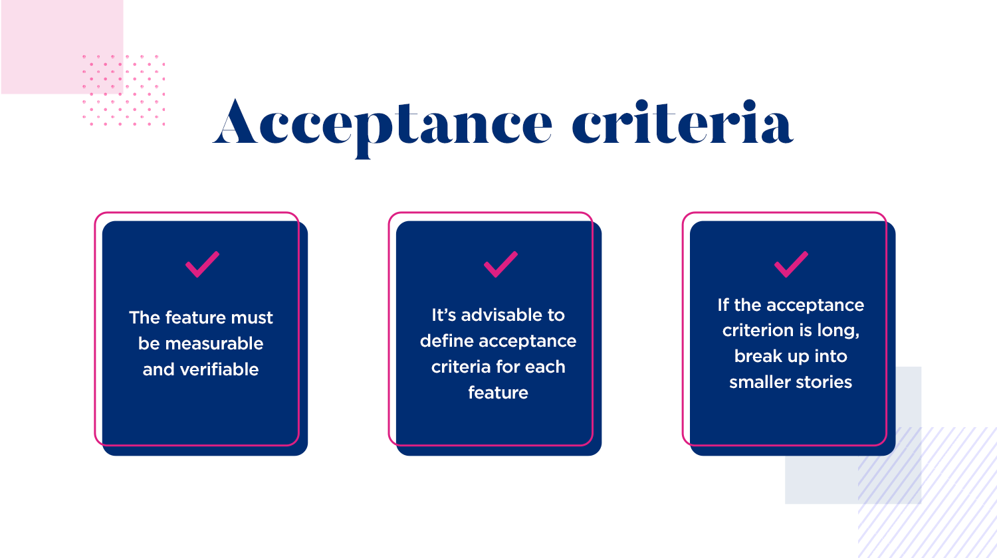
Scenario 4: No matching result
Given: User on the search page
When: User enters title, author, or category that does not exist
And: clicks the search button
Then: System should display “No result found”.
Scenario 5: Search is empty
Given: User on the search page
When: User enters nothing in the search box.
And: clicks the search button
Then: System should display “Enter Data”

Slide 12
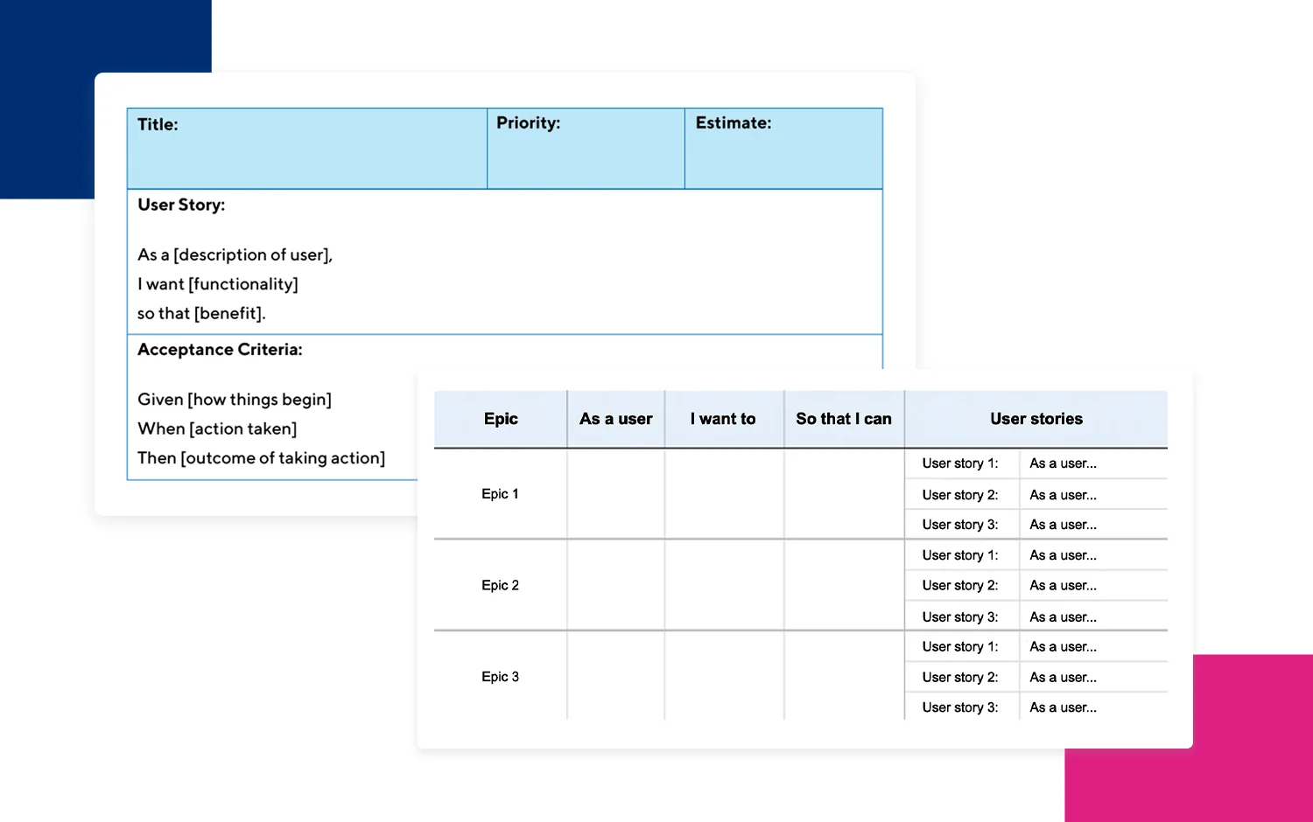
Template

Slide 13
INVEST
I- Independent
N- Negotiable
V- Valuable
E- Estimable
S- Small
T- Testable

Slide 14
Example:
A Story:
AS A USER I WANT WHOLE PAYMENT SYSTEM TO BE UPDATED
AN INVEST Story:
AS A CUSTOMER,
I WANT TO SAVE MY CREDIT CARD,
SO THAT I CAN CHECK OUT FASTER

Slide 15
Independent - Can be built without other payment methods
Negotiable- Discuss which Card Type, so it is negotiable
Valuable - Faster check out= Less cart abandonment
Estimable- Development Team can size it → 3 story points to be added only
Small- Fits in 1 sprint
Testable- Add to cart, saves, Appear on next Check Out

Slide 16
Product backlog and backlog grooming
A product backlog is a list of the new features, changes to existing features, bug fixes, infrastructure changes, or other activities that a team may deliver in order to achieve a specific outcome.
The product backlog is the single authoritative source for things that a team works on. That means that nothing gets done that isn’t on the product backlog.
Product backlog items take a variety of formats including user stories.
Backlog Grooming/ Refinement:is the ongoing process of reviewing, organizing, and improving items in a product backlog so they're ready for future development work.
Goals
Ensure backlog items are clear and well-defined.
Prioritize work based on business value and urgency.
Break large features (epics) into smaller user stories.
Remove outdated or duplicate items.
Estimate effort and identify dependencies

Slide 17
Example:
Example: “Improve Reporting Dashboard”
After Grooming: “User Story: "As a manager, I can filter reports by date range."
Acceptance Criteria defined
Estimated: 5 story points
Priority: High
Dependencies identified
Benefit: A well-groomed backlog makes sprint planning faster and helps teams deliver more predictable outcomes.

Slide 18
AGILE Tracking Tool: JIRA
Jira is the leading agile project management and issue-tracking software developed by Atlassian .
Key Agile Concepts in Jira :
1. Epics: Large chunks of work or major features that are broken down into smaller, manageable chunks.
2. Stories: Shorter requirements or functional pieces of work written from the perspective of the end-user.
3. Tasks & Subtasks: The detailed, day-to-day activities required to complete a story.
4. Backlog: A prioritized list of all work (epics, stories, bugs) to be completed for the project.
5. Sprint: A set time frame (usually 1-4 weeks) where a specific amount of work from the backlog is completed and made ready for review.

Slide 19
2. Boards and Views :
Scrum Boards: Used for iterative sprint planning. Teams commit to a set of issues and work to clear them during the sprint cycle.
Kanban Boards: Ideal for continuous workflows. It uses drag-and-drop columns (e.g., To Do, In Progress, Done) to limit work-in-progress and visualize bottlenecks.
Timeline (Roadmaps): Used for higher-level planning to map out dependencies, track progress against release dates, and keep teams aligned
3. Core Tracking Mechanics
Issues: In Jira, any piece of work (a task, bug, or story) is called an issue.
Workflows: The progression of an issue from creation to completion. Default statuses include To Do, In Progress, and Done, though these are customizable (e.g., adding Code Review or Testing).
Collaboration: Team members can leave comments, add attachments, and mention colleagues using '@' to notify them directly about an issue

Slide 20
Agile Reporting and Analytics
Jira offers out-of-the-box reports to measure team performance, predict future delivery times, and analyze sprint outcomes:
Burndown Chart: Tracks the total amount of work remaining in a sprint over time.
Velocity Chart: Measures the amount of work (usually in Story Points) a team successfully completes per sprint.
Cumulative Flow Diagram: Shows the number of issues in each status to help visualize work in progress and stability.

Slide 21
Definition of Done & Definition of Ready
Definition of Done: The definition of done in Agile scrum defines the criteria to be met for a product increment or a sprint to be considered as 'Done'. The definition of done is part of the sprint review process and sets the criteria for a completed backlog item in a sprint to be considered releasable. It helps to deliver the best quality and avoid any re-work and bugs after delivery. This applies to the end of the sprint for passing all quality standards and delivery guidelines.
Components:
Code Completion: Front-end and Back-end codes for all User Stories are fully completed and all coding standards are followed.
Working Functionalities: All functionalities needed for the user stories are completed and working as expected.
Performance Optimization: Verify if no bottlenecks in performance and all performance optimizations are completed.
Code Review: Code sent for peer review. The code is reviewed and approved by another team member.
Testing: Once all tasks are completed, the code is unit-tested and passes all tests from the QA side.
Documentation: All documentation completed including user guides and developer notes.
Build Completed: Build completed with no errors for all completed code with no missing components.
Code Merged: All the completed code with everything working as expected is merged to the main branch.
Stakeholders Communication: Once the tasks are completed and deployed, the status is updated to all stakeholders.
Deployment Completion: Work completed has been merged and deployed in the staging server and tested, if applicable.
Approval by Product Manager: All completed user stories, issues,, and tasks are reviewed, and approved by the Product Manager.

Slide 22
Definition of Ready: The definition of ready establishes the conditions for a backlog item to enter a sprint. This is part of the product backlog refinement process. It helps in smooth sprint planning and execution. It aims to reduce ambiguity and uncertainty. This is set at the beginning of a sprint to include fully ready and qualified backlog items to be included in the upcoming Sprint.
Criteria for Definition of Ready
Well-defined Scope: The user story or product backlog has a well-defined scope, and is clear, concise, and negotiable.
Acceptance Criteria: All user stories or product backlog items should have acceptance criteria. The acceptance criteria for each product backlog item are clearly defined and testable.
No Dependencies: User stories are Independent and all dependencies are identified and resolved.
Tasks Estimation: All user stories should be estimated. The user story is estimated for the effort and complexity of the work.
Prioritized: All user stories are prioritized. The team has agreed on the priority and the business value of the user stories.
Small User Stories: The user stories must be broken down into small, estimable units. It is confirmed that the user story should be small and can be completed within a sprint.
Resources Identification: For completing user stories adequate resources are needed. All the required resources are identified and available.
Stakeholder Communication and Approval: The definition of ready should be shared and available for access by all stakeholders. All the stakeholders are informed and have agreed upon.

Slide 23
Estimation Technique in Agile
Estimation is the process of finding an estimate, or approximation. It is an Art of guessing. Estimation includes four main factors - money, effort, resources, and time needed to build a specific system or product. The main objectives for doing estimations include Relative Estimation, discussions to get more information on items whose estimations need to be done and ensuring the commitment and enthusiasm of the whole team towards the tasks assigned to them.
Dot Voting
T-Shirt Size
Planning Poker
The Bucket System
Large/Uncertain/Small
Relative Estimation
Story Points
Estimation Based on Velocity

Slide 24
SAFe
SAFe (Scaled Agile Framework) is a framework used to apply Agile principles across large organizations involving multiple teams working on the same product or project.
SAFe => Agile + Lean + DevOps at Enterprise Scale. It enables large organizations to manage and coordinate multiple Agile teams efficiently
Why SAFe?
Agile works well for small teams.
Large organizations have many teams that need coordination.
SAFe helps align teams with business goals.
Improves collaboration, quality, and faster delivery.
Key Features
Scales Agile practices across the enterprise.
Combines Agile, Lean, and DevOps principles.
Supports continuous improvement and innovation.

Slide 25
Four Core Values of SAFe
Alignment: Ensures all teams work toward common business objectives.
Built-in Quality: Quality is maintained throughout development rather than tested at the end.
Transparency: Promotes open communication and visibility across teams.
Program Execution: Focuses on delivering valuable solutions consistently.
SAFe Principles
Take an economic view.
Apply systems thinking.
Build incrementally with fast feedback.
Base milestones on objective evaluation.
Organize around value.

Slide 26
Four Levels of SAFe
1. Team Level (Developers, core team members → team of 9-10 people)
Agile teams use Scrum, Kanban, or XP.
Deliver working software in short iterations.
2. Program Level(PI Planning → Program Implement Planning) min. 2 days
Multiple teams collaborate through an Agile Release Train (ART).
3. Large Solution Level
Coordinates multiple ARTs for complex systems.
4. Portfolio Level → Product managers, executives)
Aligns projects and investments with business strategy.
Agile Release Train (ART)
A long-lived team of Agile teams.
Typically consists of 50–125 people.
Delivers value in synchronized iterations.
Acts as the primary vehicle for value delivery.
Notes:
Works on principle → Many Teams → 1 Product

Slide 27
Example:
Sprint 1: Implementing UPI in banking Application
Sprint 2: Implement Rewards
Possible with SAFe??---> implementation of UPI with rewards
Team Level:
Hence require a big size of team players
Team 1 : UPI Transfer
Team 2: Point Calculation
In sprints

Slide 28
Program level:
Teams meet every 10 days / two weeks so that work can be aligned. They plan together in PI Planning for two days minimum
Large solution : Number of tasks remaining counted , number of days remaining counted so that next level can be achieved.
Portfolio level: Decides UPI and rewards are the top priority for this quarter rather than any other functionality

Slide 29
Scrum@Scale
a framework developed by Jeff Sutherland to scale Scrum across multiple teams working on large and complex projects.
It helps organizations coordinate many Scrum teams while maintaining the simplicity and flexibility of Scrum.
IN Scrum@Scale → typical flow/ cycle goes as:
Two iterations flow at the same time: 1. For the Agile (Scrum teams) 2. Product Owner’s team.
In between the Epics are the mediators which works with both product owner and Scrum master.
Need for Scrum@Scale:
Large projects require multiple Scrum teams.
Teams need coordination and communication.
Ensures alignment with organizational goals.
Maintains Agile values at enterprise scale.

Slide 30
Feature | Scrum@Scale | SAFe
Approach | Lightweight | Structured & Comprehensive
Focus | Scrum-based scaling | Agile + Lean + DevOps
Complexity | Simple | More complex
Roles | Fewer additional roles | Multiple specialized roles
Best For | Organizations already using Scrum | Large enterprises with many teams

Slide 31
Agile Forecasting and Project Management
Agile Project Management is a modern project management approach that focuses on delivering value incrementally through short development cycles known as iterations or sprints. Unlike traditional project management methods where all requirements are gathered upfront, Agile embraces changing requirements and continuous customer feedback.
Characteristics of Agile Project Management
Iterative and Incremental Development
Customer Collaboration
Continuous Feedback
Adaptive Planning
Self-organizing Teams
Frequent Delivery of Working Software
Forecasting in Agile helps organizations predict:
Project completion dates
Required resources
Release schedules
Budget utilization
Product delivery timelines

Slide 32
Big Visible Information Radiators
Big Visible Information Radiator (BVIR) is a term that was first coined by Alistair Cockburn in his book, Agile Software Development. The term was used to describe a physical display of project information that is visible to everyone in the team.
The idea behind the BVIR was to provide a way for teams to quickly and easily access project information, such as progress, tasks, and goals, without having to search through multiple documents or systems. The BVIR was designed to be a central hub of information that could be easily accessed and updated by the team. The BVIR was also intended to be a visual representation of the project, allowing teams to quickly identify areas of progress and areas that need improvement.
Characteristics
Easily visible to everyone
Updated frequently
Displays current project status
Encourages collaboration
Reduces unnecessary meetings

Slide 33
Types of Information Radiators
Task Board (Kanban Board): Displays tasks in different stages of completion.
Sprint Burndown Chart: Shows remaining work versus time to Monitor sprint progress and Identify delays early.
Velocity Chart: Displays story points completed during previous sprints to Forecast future work and Analyze team performance.
Release Burnup Chart: Shows cumulative completed work against total project scope. It will Promotes transparency, Improves communication, Supports quick decision-making, and Enhances team accountability

Slide 34
Velocity
Sprint velocity is a speedometer for your Agile project, providing unparalleled insight into the work capacity of your Agile and software development teams.
By tracking the amount of work a team completes in each sprint, velocity helps teams set realistic goals and forecast future progress. Understanding sprint velocity empowers teams to plan more effectively, identify bottlenecks early, and continuously improve their delivery process.
How to Calculate Velocity in Agile?
Choose a Time Frame: You must choose a particular sprint duration for your calculation because velocity is usually determined for each sprint.
Identify Completed Work: Examine the completed tasks or user stories from the sprint. These should to be tasks that were initiated and completed throughout the sprint period.
Assign Story Points: Give each completed user story or task, or some other measurement. The relative difficulty or effort needed for each item is indicated by the story points.

Slide 35
Sum the Points: Add up the total number of story points completed by the team during the sprint.
Velocity = Total story points completed in a sprint / Number of sprints
Factors Affecting Velocity: Team experience, Technical complexity, Requirement changes, Team size, Technical debt, Availability of resources
Benefits of Velocity in Agile: Predictability, Resource Allocation, Performance Measurement

Slide 36
Release and Iteration Planning in Agile methodology
There are 3 levels of planning in Agile. They are
Release Planning,
Iteration Planning and
Daily Planning.
These planning meetings help the Scrum Master, Product Owner and the rest of the team in understanding how the product will be delivered, the complexity involved and their day to day responsibility in the delivery of the product, among other things.

Slide 37
Release Planning in Agile Development
Release Planning is usually performed during the Sprint zero, where there is no product increment delivered.
The whole Sprint is dedicated for planning the next release.
It is a way of looking ahead on defining what the release goal is, what features that need to delivered during the release, defining the release backlog, breaking features and epics into user stories, writing acceptance criteria for all stories, and estimating the user stories.
Release planning also helps team members in defining the test strategy and test approach planning for all iterations.
Release plans may change based on new stories added or deleted.
The status of the release is tracked prospectively every sprint to understand what it takes to meet the release
At the start of the release planning, the Product Owner sets the release goal and release time frame. The Product Owner also collaborates with the team (see Collaborative User Story Creation), based on the user stories the team performs high architecture evaluation and high level effort estimation in agile.
Testers are involved in release planning and perform the following activities:
Write User stories and acceptance criteria
Seek clarification on those user stories where there is insufficient information.
Determine the high level test strategy for the whole release
Point out any testing risks they might occur
Do a high level test planning
Define the number of test levels to be performed.

Slide 38
Iteration Planning in Agile Development
Iteration 1 planning is done after release planning.
The team pulls the stories into the sprint backlog from the product backlog and groups them into independent tasks of fewer 8 hours each.
They also performs risk assessment of stories and decides on a light weight plan on how to address the risks as the sprint moves forward.
The team asks questions to the Product Owner on clarifications that might make them to understand the stories in more realistic way.
The number of stories that the team pulls in the sprint may depend on team’s capacity or velocity (if known).
The capacity planning is done in hours and the velocity planning is done in story points.
The team makes a commitment to the sprint backlog and changes the sprint backlog as it emerges.
The testers are also involved in the iteration and can contribute to the same in the following ways:
Breaking user stories into testing tasks
Determining test coverage of every story
Creating acceptance tests for user stories
Estimate the testing tasks like creating test strategy, test plans and test cases specific to user stories
Understand and plan for automating user stories and support various levels of testing

Slide 39
Release plans are not static documents and they are liable to change as the external and internal factors change as the iteration executions take place.
The release plans may also change due to various internal factors like delivery team capabilities, velocity of the team and technical competencies.
The examples of external factors are change in target segments, threat from substitutes, change triggered by superior competitor product.
The release dates may be adjusted or scope may be cut down to adjust for the changes.
As per Scrum, no changes are allowed during the sprint by the Product Owner.
The Product Owner cannot add new stories to the sprint backlog during the sprint and distract the team from the executing the sprint goal.
Release and iteration planning broadly helps the team to prepare test planning checklist related to the following items:
The team members responsible for testing
The scope of testing and testing goals to be carried out
The test environment that needs to be setup
The test data to be collected that helps the testing team
The sequence of test activities, dependencies and interfaces related to testing
Any project related quality tests that surface during testing

Slide 40
Daily Planning / Standup Meeting in Agile Development
Daily Planning meeting in agile are also called as ‘Stand up meetings‘. This is where the development team and testing team meets daily to discuss:
What progress in the assigned task they made yesterday
What tasks they have planned to do today
Is there any impediment or obstacle that prevents them from completing the task
In addition to these details each member has to tell that how long they are going to take to complete the assigned task within the sprint.
If any remaining or pending task of any member of the team is not completed in that particular sprint then they share such details in the daily meetings.
Accordingly the pending task(s) from the previous sprint are taken care in the next sprints.
Likewise if there are any changes in the requirement from the customers or any build issues or any blocking issues then such details are also discussed in the meetings.

Slide 41
Epics and Stories and Initiatives
Epic and user stories are hierarchical structures in Agile that organize work from high-level objectives to actionable tasks.
Stories are small, sprint-sized tasks, while epics group related stories under a larger goal, and initiatives encompass multiple epics.
This structure enables teams to balance flexibility with strategic alignment and clear reporting.
Learn to break down large goals into epics and stories to improve tracking, communication, and delivery.
On an agile team, stories are something the team can commit to finish within a one- or two-week sprint. Oftentimes, developers would work on dozens of stories a month.

Slide 42
Epics, in contrast, are few in number and take longer to complete. Teams often have two or three epics they work to complete each quarter.
In the same way that epics are made up of stories, initiatives are made up of epics. Initiatives offer another level of organization above epics. In many cases, an initiative compiles epics from multiple teams to achieve a much broader, bigger goal than any of the epics themselves. While an epic is something you might complete in a month or a quarter, initiatives are often completed in multiple quarters to a year.

Slide 43
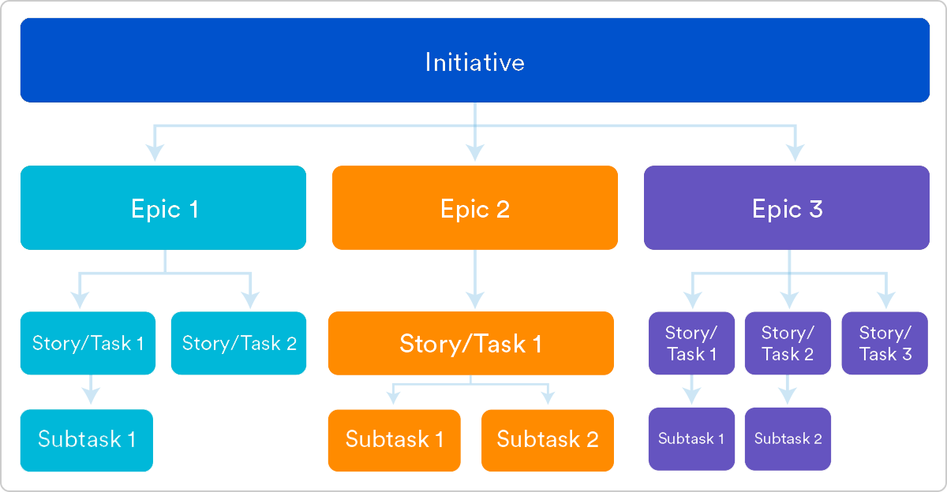

Slide 44
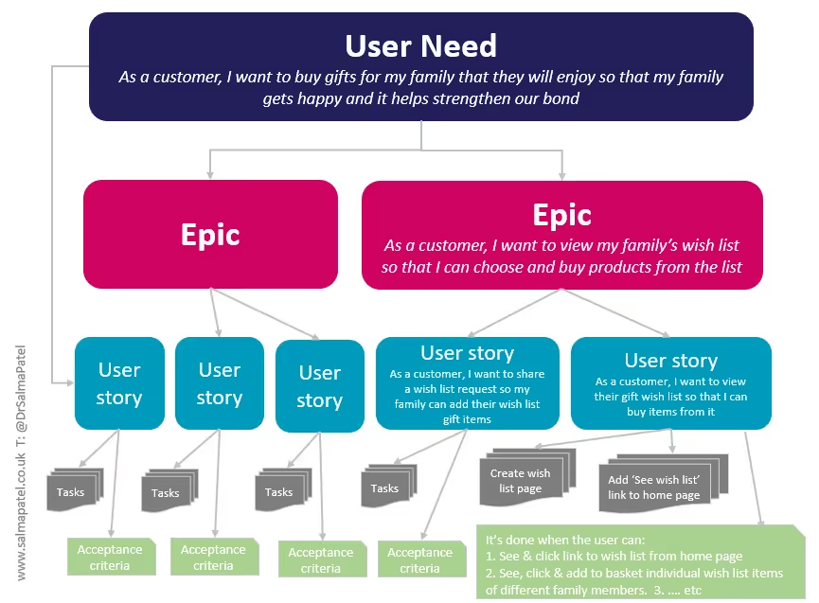

Slide 45
Prioritizing Stories In Agile
Prioritizing stories in agile involves dynamically ordering the product backlog so that the team delivers the highest business value to the end user as soon as possible.
It relies on balancing business value, development effort, dependencies, and urgency rather than working on tasks simultaneously.
MoSCoW (Criticality):
Must-have (M): These are non-negotiable core features to be done immediately.
Should-have (S): These are necessary but not critical. Ideally, they will be done now, but could be deferred to the next sprint.
Could-have (C): These are nice to have but not vital. Consider them when higher-priority items are addressed.
Won’t-have (W): These are deprioritized features, either because they are low value or irrelevant to the current project phase.
KANO Model (user satisfaction): A way to prioritize stories based on how customers feel, not just “Important or not”
Basic needs: These are the core essentials users expect. Think of basic math functions in a calculator app.
Performance needs: These features increase user happiness when they work. Imagine AI solving math problems in the app.
Excitement needs: These delightful extras make users go “wow.” But if they’re absent, users won’t throw a fit. It’s like snapping a pic of a math problem and getting the answer handed to you.

Slide 46
Bucket | Means | Example “Food Delivery App”
Must have | Project fails without it | Login, Add to cart, payment
Should have | Important, but can wait till 1 sprint | Apply Coupon, Tracking
Could have | Nice to have if the time left | Dark mode, Rate rider
Won’t have | Not in this release / never | Chat with chef
MosCoW to filter, then use Kano to sort “Must + Should” stories

Slide 47
Weighted Shortest Job First (used to sequence work for maximum economic benefit)
Weighted Shortest Job First (WSJF) is one of the most widely used prioritization techniques that helps decide what to work on first so that you get the most value in the shortest amount of time. In SAFe, WSJF helps in figuring out priorities by comparing how much delay it would cost the company versus how long the job will take. It is more about doing the most valuable things faster.
WSJF = Cost of Delay / Job size
With this formula, it is evident that any work item with maximum Cost of delay directly influences the priority i.e work items with higher value gets picked up first and work item with minimum job size indirectly influences the value i.e, small work item gets picked up first.

Slide 48
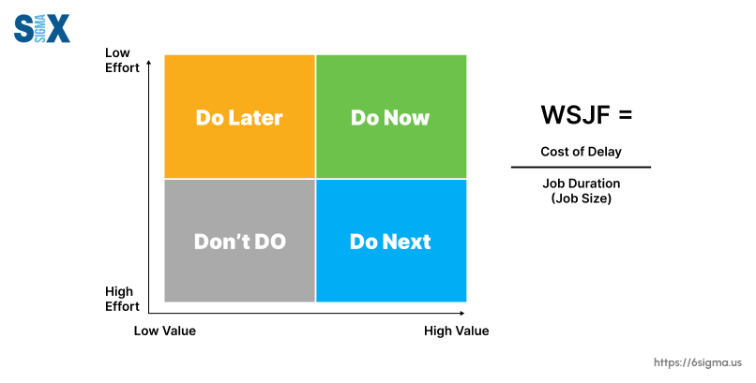
Example:
Module: Checkout Payment Redesign
User/Business Value: 13
Time Criticality: 8
Risk Reduction/Opportunity Enablement: 3
Job Size: 5
Calculation:
CoD = 13 + 8 + 3 = 24
WSJF = 24/ 5 = 4.8
AI Chatbot Integration (Score: 8)
New Aesthetic Dark Theme (Score: 6)
Checkout Payment Redesign (Score: 4.8)
*AI Chatbot first yields the maximum economic return relative to the time invested

Slide 49
Difference between WSJF in Agile and traditional prioritization methods
WSJF prioritizes work items based on economic values while traditional techniques like MOSCOW, RICE etc is based on stakeholder opinions, urgency and perspectives
WSJF is quantitative while other techniques like Must have, Should have could be subjective
WSJF minimises economic loss against traditional techniques which are most driven by compliance, deadlines and stakeholder demands
WSJF promotes shorter jobs deliver value faster while traditional techniques may prioritise longer projects with perspective based importance
WSJF promotes dynamic prioritization of work based on data points whereas traditional techniques may tend to not change once the priority is fixed

