Slide 1
Unit 3
MCA0302

Slide 2
What is a Sprint?
A sprint is a time-boxed effort to complete a specific set of work. It is typically one to four weeks in duration. Sprints are a key part of the Scrum framework and provide a structure for iterative, incremental product development. The sprint begins with a sprint planning meeting, where the team sets a goal for the sprint and identifies the work that needs to be done to achieve that goal. The team then works together to complete the work during the sprint. At the end of the sprint, the team holds a retrospective meeting to review what went well and what could be improved.

Slide 3
Need for the sprint .
Makes project more manageable: Breaking the project into sprints makes it more manageable, allowing the team to produce high-quality work.
Flexibility: Sprints give teams the flexibility to adapt to changes.
Supports product owner: Sprints supports the product owner to create a roadmap of the product to be developed.

Slide 4
Sprint workflow and process :
Product Backlog : This is the list of set tasks that must be completed before the product is released. It is built by the product owner. The product owner gives a list of prioritized items to the scrum master and scrum team.
Sprint Planning: It is a collaborative event where the team answers questions like what work can be done in this sprint and how the chosen work will be done. Here the team discusses the top-priority user stories, which focus on features like the type of end user, what they want and why they want it.
Sprint backlog : This list is agreed upon by the entire team and defines what the development team will complete during the sprint.
Daily Scrum : The team checks in during the daily scrum also known as standup about the work progress. The goal here is to address the challenges that would impact the team's ability to deliver the sprint goal.
Increment/Demo: At the end of a sprint cycle two meetings are held:
Sprint review: Sprint review is the team's opportunity to showcase their work to stakeholders and team members before it is moved for production.
Sprint retro: This is the meeting at the end of the sprint cycle where the team identifies areas of improvement for the next sprint.

Slide 5
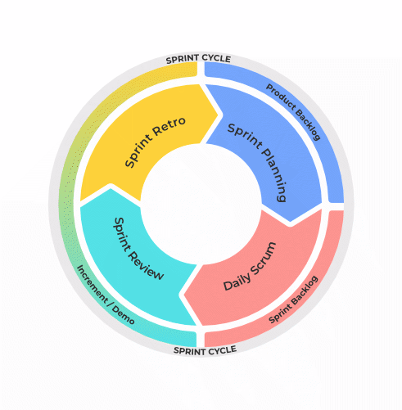
SPRINT CYCLE

Slide 6
What is an Iteration ?
An iteration is a development cycle in which work is completed on a specific set of features or functions. It typically lasts between one and four weeks. Each iteration begins with an iteration planning meeting, where the team decides which work will be completed during that time period. Team members then commit to completing that work by the end of the iteration. At the end of the iteration, the team holds an iteration review meeting, where they demo the work that was completed and get feedback from stakeholders. The goal is for each iteration to result in a shippable product increment.

Slide 7
What is an Increment ?
In software development, an increment is a completed and usable piece of work that adds value to the product. An increment is usually delivered at the end of each sprint in a Scrum project.
The main characteristic of an increment is that it is done and can be used, even if it’s not yet perfect. This means that increments must meet certain quality criteria, such as being tested and free of bugs.
The increment must also be usable by the customer or end-user, even if it doesn’t have all the features they want.
The goal of delivering an increment at the end of each sprint is to get feedback from customers as early as possible so that any necessary changes can be made before too much work has been done on the product.

Slide 8
Sprint vs Iteration vs Increment
 | Sprint | Iteration | Increment
Definition | A sprint is a time-boxed effort to complete a set of predetermined work. | An iteration is a single development cycle within a project. | An increment is the result of an iteration and contains all new or changed work items which have been completed.
Length of time | 1 week | 1-4 weeks | 1 month
Purpose | Sprints are used to achieve specific goals within a project. | Iterations are used to implement features and functionality. | Increments are used to deliver working software at the end of each sprint.
Scope | Sprints have a fixed scope, meaning that the goals for the sprint are set at the beginning and cannot be changed. | Iterations may have a variable scope, meaning that the goals for the iteration can be changed as the iteration progresses. | Increments always have the same scope as the sprints they are part of.
Work completed | At the end of a sprint, all of the work for that sprint should be completed. | At the end of an iteration, some of the work for that iteration may be completed. | Increments always contain all of the work for that sprint.
Deliverables | At the end of a sprint, the deliverables are typically a demo of the completed work and a retrospective report. | At the end of an iteration, the deliverables may be a demo of the completed work, a retrospective report, and/or code. | Increments always contain working software.
Testing | Sprints typically include testing as part of the work to be completed. | Iterations may or may not include testing as part of the work to be completed. | Increments always include testing as part of the work to be completed.
Changes | Sprints typically have a very limited number of changes that can be made. | Iterations may have a few more changes that can be made. | Increments always contain all of the changes for that sprint.
Documentation | Sprints typically do not include documentation as part of the work to be completed. | Iterations may include documentation as part of the work to be completed. | Increments always include documentation as part of the work to be completed.
Sign-off | At the end of a sprint, the project manager, product owner, and team members will sign off on the work completed. | At the end of an iteration, the project manager, product owner, and/or team members may sign off on the work completed. | Increments always require sign-off from the project manager, product owner, and team members.
Go/No-Go | At the end of a sprint, the project manager, product owner, and team will decide whether or not to continue with the project based on the work completed. | At the end of an iteration, the project manager, product owner, and/or team may decide to continue with the project or not based on the work completed. | Increments always require a go/no-go decision from the project manager, product owner, and team.

Slide 9
Sprint Velocity in Scrum:
How to Measure and Improve Performance ?
Sprint velocity measures the amount of work a team completes in a sprint, typically using story points.
Tracking velocity helps teams forecast future capacity, plan sprints, and identify opportunities for improvement.
Factors like team size, skill, and story complexity influence velocity, which should be averaged over multiple sprints.
Monitor and review velocity trends to set realistic sprint goals and continuously improve team performance.

Slide 10
How to calculate velocity in Scrum ?
You typically calculate sprint velocity at the end of each sprint by totaling the story points or other units of measurement for all fully completed user stories.
Here is the step-by-step process of how to calculate velocity in Scrum:
1. Plan a sprint
Before a sprint begins, outline and assign points to all the user stories in the product backlog. For instance:
Assign user authentication: 5 points
Add payment gateway integration: 8 points
Implement search functionality: 3 points
Develop a user profile page: 13 points
Implement email notifications: 2 points
Optimize database queries: 21 points
Create an admin dashboard: 5 points
The team should commit to completing user stories in the upcoming sprint based on the average velocity from previous sprints and other factors, such as holidays or external dependencies. For example, if the average velocity is 15 points with no holidays or external dependencies, the team could commit to user stories totaling around 15 points for the next sprint.

Slide 11
2. List completed user stories
Create a list of all the fully completed user stories at the end of each sprint. These should be stories that have met their acceptance criteria and that the Scrum Master and Product Owner have approved.
If a user story is 90% done, it is not fully complete. The team should move it to the next sprint and re-evaluate the points based on the remaining tasks.
3. Check story points
The team should have already assigned story points to each completed user story. If story points need re-evaluation, this is the time to do it.
For instance, let's say the team has completed three user stories in the current sprint assign user authentication, add payment gateway integration, and implement search functionality. You could assign those tasks with the following story points:
Assign user authentication: 5 points
Add payment gateway integration: 8 points
Implement search functionality: 3 points

Slide 12
4. Sum points to find velocity
Next, you must total the story points for all the completed user stories. The sum of the story points represents the sprint velocity.
In the above scenario, the total would be 5 points + 8 points + 3 points = 16 points, which is the velocity for this sprint.
5. Average velocity
Calculating the average sprint velocity over the number of sprints the team completes can provide a more reliable measure for future sprints. This measure benefits newly formed teams or those that have changed in size or structure.
For example, if the velocities for the last three sprints were 14, 16, and 15, the average velocity would be (14 + 16 + 15) / 3 = 15 points.

Slide 13
Sprint / Iteration Planning Meeting
A Sprint Planning Meeting (in Scrum) or Iteration Planning Meeting (in Agile methodologies) is a meeting conducted at the beginning of a sprint/iteration to determine the work that will be completed during that time period.
Objectives
Define the Sprint Goal.
Select items from the Product Backlog that will be developed.
Break selected items into tasks.
Estimate effort and allocate responsibilities.
Create the Sprint Backlog.
Participants
Product Owner – Presents and prioritizes backlog items.
Scrum Master – Facilitates the meeting.
Development Team – Estimates effort and commits to the work.

Slide 14
Inputs
Product Backlog
Team Capacity
Previous Sprint Results
Project Requirements and Priorities
Activities
Review and discuss prioritized backlog items.
Clarify requirements and acceptance criteria.
Estimate effort for each item.
Select achievable work for the sprint.
Create a detailed Sprint Backlog and plan.
Example:
If a sprint duration is two weeks, the team may select user stories such as User Login, Password Reset, and Profile Management, estimate the effort required, and commit to completing them within the sprint.
Outputs
Sprint Goal
Sprint Backlog
Task Breakdown
Team Commitment for the Sprint
Benefits
Establishes a clear understanding of sprint objectives.
Improves team coordination and resource allocation.
Helps identify risks and dependencies early.
Increases predictability and transparency.

Slide 15
Planning Guidelines and Development
1. Sprint Planning Guidelines
Sprint Planning is the first activity of a sprint where the team decides what work will be completed during the upcoming sprint and how it will be accomplished.
Guidelines for Sprint Planning
a) Define a Clear Sprint Goal
Establish a specific and measurable objective for the sprint.
Ensure all team members understand the goal.
b) Prioritize the Product Backlog
Select high-priority user stories and requirements.
Focus on delivering maximum business value.
c) Assess Team Capacity
Consider team availability, skills, holidays, and ongoing commitments.
Avoid overcommitting work.

Slide 16
d) Estimate Work Accurately
Use techniques such as Story Points, Planning Poker, or Ideal Days.
Estimate effort and complexity for each task.
e) Break Down User Stories into Tasks
Divide large stories into manageable tasks.
Assign responsibilities where appropriate.
f) Identify Dependencies and Risks
Recognize external dependencies and potential obstacles.
Plan mitigation strategies.
g) Create the Sprint Backlog
Finalize the list of stories and tasks to be completed during the sprint.
Obtain team commitment.
Outcome of Sprint Planning: Sprint Goal, Sprint backlog, Team commitment, Estimated Timeline

Slide 17
2. Sprint Development
Sprint Development is the phase where the development team works on the selected backlog items and creates a potentially shippable product increment.
c) Testing
Perform unit testing, integration testing, and system testing.
Fix identified defects.
d) Daily Scrum Meetings
Conduct short daily meetings (usually 15 minutes).
Discuss:
What was completed yesterday?
What will be done today?
Are there any impediments?
Activities During Sprint Development
a) Designing
Create system architecture, database design, UI mockups, and technical specifications.
b) Coding
Develop features according to user stories and acceptance criteria.
Follow coding standards and best practices.

Slide 18
e) Continuous Integration
Frequently integrate code changes into a shared repository.
Detect and resolve conflicts early.
f) Monitoring Progress
Use Scrum boards, Kanban boards, and Burndown Charts.
Track task completion and sprint progress.
g) Quality Assurance
Review code.
Ensure adherence to requirements and quality standards.
Output of Sprint Development
Completed User Stories
Tested Features
Potentially Shippable Product Increment
Updated Documentation

Slide 19
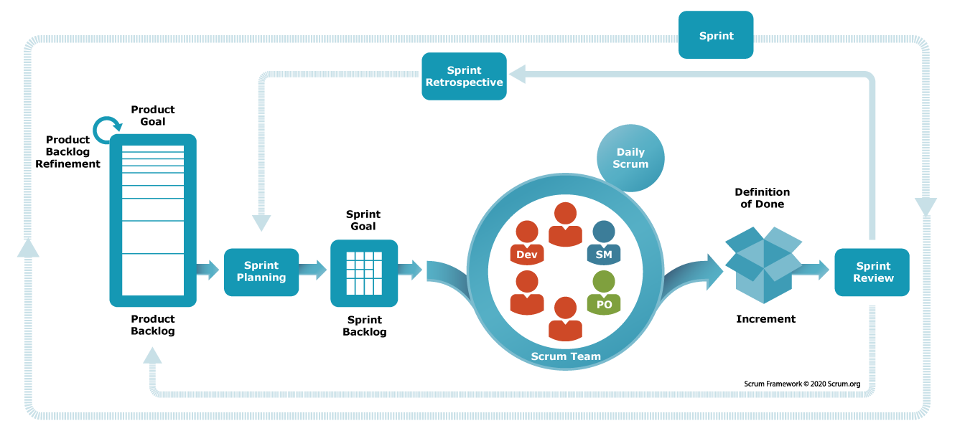
Benefits of Proper Sprint Planning and Development
Improved project visibility.
Better team collaboration.
Faster delivery of working software.
Reduced project risks.
Higher product quality.
Increased customer satisfaction.
Flow of a Sprint

Slide 20
Testing and Daily Stand-up Meetings
1. Sprint Testing
Sprint Testing is the process of verifying and validating the functionality developed during a sprint to ensure that it meets the specified requirements and quality standards.
Objectives of Sprint Testing
Ensure developed features work correctly.
Identify and fix defects early.
Verify that user stories meet acceptance criteria.
Maintain product quality throughout development.

Slide 21
Types of Testing in a Sprint
a) Unit Testing
Tests individual components or modules.
Usually performed by developers.
Ensures each unit functions correctly.
b) Integration Testing
Verifies interaction between different modules.
Detects interface and communication issues.
c) System Testing
Tests the complete integrated system.
Ensures the system meets functional requirements.
d) Acceptance Testing
Validates whether the feature satisfies customer or Product Owner expectations.
Based on predefined acceptance criteria.

Slide 22
e) Regression Testing
Ensures new changes do not negatively affect existing functionality.
Re-tests previously working features.
Sprint Testing Process
Review user stories and acceptance criteria.
Create test cases and test data.
Execute tests.
Record and report defects.
Fix defects and retest.
Verify completion before sprint review.
Benefits of Sprint Testing
Early defect detection.
Improved software quality.
Reduced development costs.
Increased customer satisfaction.
Faster release cycles.

Slide 23
2. Daily Stand-up Meetings (Daily Scrum)
A Daily Stand-up Meeting is a short, time-boxed meeting conducted every day during the sprint to track progress and coordinate team activities.
Objectives
Synchronize team efforts.
Share progress updates.
Identify obstacles or blockers.
Plan work for the next 24 hours.
Participants
Development Team
Scrum Master
Product Owner (optional)
Duration
Usually 15 minutes.
Conducted at the same time and place each day.

Slide 24
Three Key Questions
Each team member answers:
What did I complete yesterday?
What will I work on today?
Are there any impediments or blockers?

Slide 25
Example
Developer A:
Completed login module yesterday.
Will start password reset feature today.
No blockers.
Benefits of Daily Stand-up Meetings
Improves communication and collaboration.
Provides visibility into project progress.
Identifies issues early.
Enhances accountability.
Helps keep the sprint on track.
Tester B:
Tested registration functionality.
Will perform regression testing today.
Waiting for deployment environment access.

Slide 26
Relationship Between Testing and Daily Stand-ups
Testing progress is discussed during daily stand-ups.
Testers can report defects and blockers immediately.
Developers and testers coordinate fixes quickly.
Helps maintain continuous quality throughout the sprint.
Sprint Workflow
Sprint Planning → Development → Testing → Daily Stand-up Meetings → Sprint Review → Sprint Retrospective → Next Sprint
Both Sprint Testing and Daily Stand-up Meetings are essential Agile practices that ensure continuous progress, high-quality software, and effective team collaboration.

Slide 27
Progress Tracking and Velocity Tracking
1. Progress Tracking in a Sprint
Progress Tracking is the process of monitoring and measuring the advancement of work during a sprint to ensure that the team is on track to achieve the sprint goal.
Objectives
Monitor task completion.
Identify delays and bottlenecks.
Ensure sprint goals are achieved on time.
Improve team transparency and accountability.
Methods of Progress Tracking
a) Sprint Backlog Monitoring
Track the status of tasks assigned during sprint planning.
Update task progress regularly.

Slide 28
b) Task Board (Scrum Board/Kanban Board)
Tasks are categorized into:
To Do
In Progress
Testing
Done
This provides a visual representation of project progress.
c) Burndown Chart
Displays the amount of remaining work versus time.
Helps determine whether the team is progressing according to plan.
Ideal burndown lines indicate expected progress.
d) Daily Stand-up Meetings
Team members share updates and identify blockers.
Enables quick corrective actions.
e) Sprint Reviews
Evaluate completed work at the end of the sprint.
Compare actual achievements with planned objectives.

Slide 29
Benefits of Progress Tracking
Early detection of issues.
Better project visibility.
Improved decision-making.
Increased likelihood of meeting deadlines.
Enhanced team collaboration.

Slide 30
2. Velocity Tracking
Velocity Tracking measures the amount of work completed by a team during a sprint. It helps predict how much work can be completed in future sprints.
Definition of Velocity
Velocity is the total number of Story Points (or other estimation units) completed during a sprint.
Formula
Velocity = Total Story Points Completed in a Sprint

Slide 31
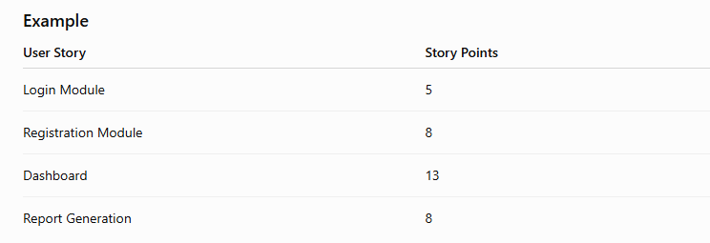
Velocity = 5 + 8 + 13 + 8 = 34 Story Points
The team's velocity for that sprint is 34 story points.

Slide 32
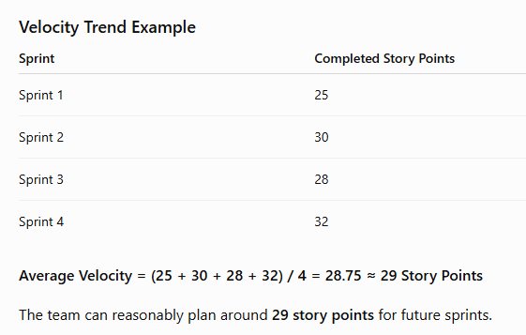

Slide 33
Benefits of Velocity Tracking
Improves sprint planning accuracy.
Helps forecast project completion dates.
Measures team productivity.
Identifies performance trends.
Supports continuous improvement.
Limitations
Velocity should not be used to compare different teams.
Focus should be on consistent delivery, not maximizing velocity.
Changes in team size or complexity can affect velocity.

Slide 34
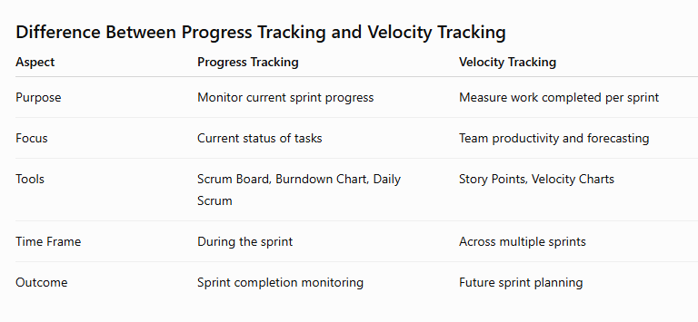

Slide 35
Monitoring and Controlling
Monitoring and Controlling in Agile Scrum involves continuously tracking sprint progress, identifying problems, implementing corrective actions, and ensuring the sprint remains aligned with its goals.
1. Burn Down Charts
A Burn Down Chart is a graphical tool used to track the amount of work remaining in a sprint over time.
Purpose
Monitor sprint progress.
Compare actual progress with planned progress.
Predict whether sprint goals will be achieved on time.
Identify delays and bottlenecks early.
Components of a Burn Down Chart
X-Axis: Time (Days of Sprint)
Y-Axis: Remaining Work (Story Points/Hours)
Ideal Line: Expected rate of completion.
Actual Line: Actual remaining work.

Slide 36
Types of burndown charts:
1. Sprint burndown chart
Use a sprint burndown chart for short-term sprint focus (one iteration) and tracking sprint progress. It works best when the team is working from a sprint backlog and wants day-to-day visibility.
2. Epic burndown chart
Use an epic burndown chart to track progress against a single epic across multiple sprints. Atlassian notes this view helps teams see how quickly they’re working through an epic and how work added/removed impacts overall progress.
3. Release or product burndown chart
Use a release burndown chart to track delivery across multiple sprints toward a release/version. This is helpful for release forecasting and longer-horizon stakeholder reporting.
A release burndown chart tracks progress across multiple sprints or milestones, making it valuable

Slide 37
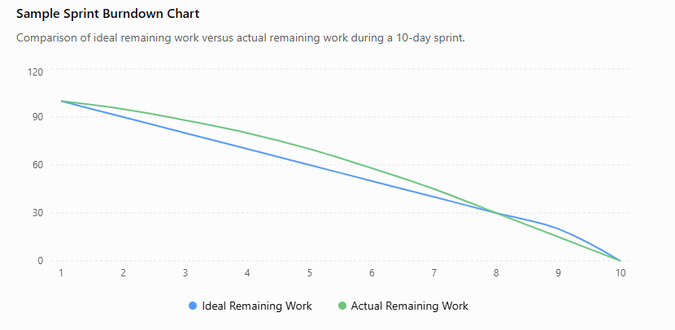
Example Burn Down Data

Slide 38
Interpretation
If the actual line is above the ideal line, the team is behind schedule.
If the actual line is below the ideal line, the team is ahead of schedule.
If both lines meet at zero, the sprint goal has been achieved.
Benefits
Provides visual progress tracking.
Improves transparency.
Enables early corrective actions.
Helps forecast sprint completion.

Slide 39
2. Inspect and Adapt (Fishbone Model)
Inspect and Adapt is a continuous improvement practice in Agile where teams regularly evaluate their work and make adjustments to improve performance and quality.
Objectives
Identify root causes of problems.
Improve team productivity.
Enhance product quality.
Promote continuous learning.

Slide 40
3.Fishbone (Cause-and-Effect) Diagram
The Fishbone Diagram (also called the Ishikawa Diagram) is used to identify the root causes of issues.
Common Categories
People
Lack of skills
Communication gaps
Resource shortages
Process
Poor planning
Unclear requirements
Inefficient workflow
Technology
Tool limitations
System failures
Integration issues
4. Materials/Requirements
Incomplete user stories
Changing requirements
5. Environment
Infrastructure problems
External dependencies

Slide 41
Example
Problem: Sprint delivery delayed
Possible Causes:
People → Inadequate training
Process → Poor estimation
Technology → Build failures
Requirements → Frequent scope changes
Steps in Inspect and Adapt
Review sprint results.
Identify issues and bottlenecks.
Analyze root causes using Fishbone Diagram.
Define improvement actions.
Implement changes in the next sprint.
Benefits
Continuous improvement.
Better team performance.
Reduced recurring problems.
Increased customer satisfaction.

Slide 42
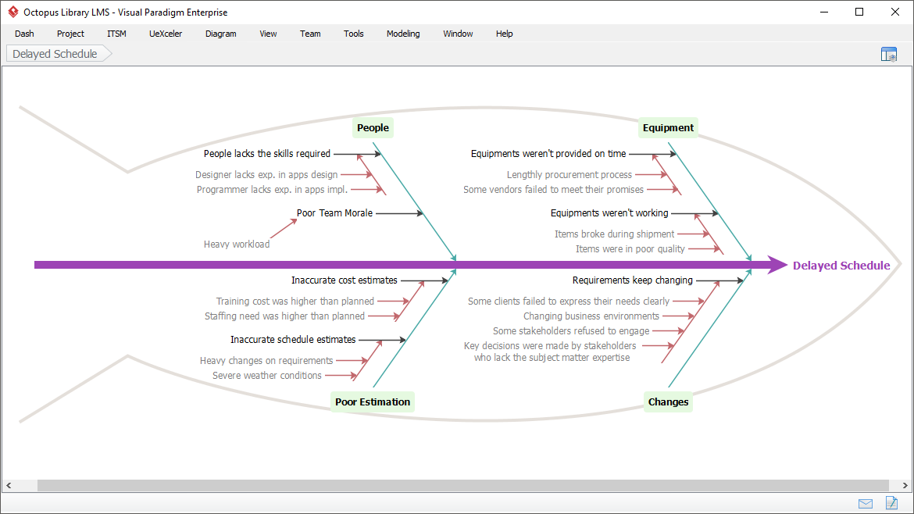

Slide 43
4. Agile Release Train (ART)
An Agile Release Train (ART) is a concept from the Scaled Agile Framework (SAFe) that aligns multiple Agile teams to deliver value together on a regular schedule.
Definition
An Agile Release Train is a long-lived team of Agile teams (typically 5–12 teams) that plans, commits, develops, and deploys solutions together.
Characteristics
Consists of multiple Agile teams.
Works toward a common business goal.
Operates on a synchronized schedule.
Delivers value through regular releases.

Slide 44
Key Roles
Release Train Engineer (RTE)
Facilitates ART activities.
Removes obstacles.
Coordinates teams.
Product Management
Defines vision and priorities.
Maintains the Program Backlog.
System Architect
Provides technical guidance.
Ensures architectural consistency.
Agile Teams
Develop, test, and deliver features.

Slide 45
Agile Release Train Cycle
Program Increment (PI) Planning
Sprint Planning
Development & Testing
System Demo
Inspect and Adapt Workshop
Release of Product Increment
Benefits of Agile Release Train
Improves coordination among teams.
Aligns business and technical goals.
Enhances productivity and quality.
Enables large-scale Agile implementation.
Supports predictable delivery schedules.

Slide 46
Testing:

Slide 47
Functional testing
Object property coverage
• (such properties which changes at run time like OK Button)
• For example: for any form, value of two dropdown boxes should be
different
DB Testing
• Huge testing- a whole team is required for doing this.
• Because dependencies and relationships are included

Slide 48
• DB Function testing(Insert, update, delete from table; correct DB,
correct table)
• DB Structure testing (validation of tables, size of data, relation
between tables of DB, links between them etc., functions,
procedures, schemas – kind of unit testing)
Error handling coverage
• Proper error handling messages
• Invalid input messages – should be short and understandable.

Slide 49
Calculation
• Takes a lot of times to cover
• Used for financial and banking applications majorly
• Needed to check if the data is passing to the correct destinations or
not.
Links
• Access of link is working or not.
• Link to the valid website/ document/ webpage or anything.
Cookies etc.
• Related to cookies
• If it is accessible, deletable or not.

Slide 50
Usability Testing
●Also known as UX (user Experience) testing
●Used to check how easy and user-friendly the software
application is
●Generally focuses on user’s ease of using application,
flexibility of application to handle the controls and ability of
application to meet its objectives.
●It gives answer to such questions:
●Where to click next?
●Which page needs to be navigated?
●Which icon represents what?
●Session time not sufficient
●Error messages are not properly displayed

Slide 51
How to perform usability testing
I.Planning – goals of usability tests are determined
II.Recruiting – recruit a tester/ team member
III.Usability testing – test cases are executed
IV.Data Analysis – data is analysed to derive meaningful
inferences
V.Reporting – findings of the usability test is shared with all
users like designers, clients etc.

Slide 52
Methods of usability testing
●Laboratery usability testing
●It is performed in front of observers, this testing is performed
in a dedicated separate laboratory
●Role of observer is to observe overall behaviour of the tester.
●Both are present at same physical location
●Remote usability testing
●Both are remotely located.
●tester’s voice, screen activity, facial expressions are
measured using automated software

Slide 53
Security testing
●Helps to uncover vulnerabilities, threats, risks in a software
application and prevents malicious attacks from intruders
●The purpose is to find out all loopholes and weaknesses of the
software system that result in loss of information, revenue at
the hands of employees or outsiders of the organization.
Focus Areas of security testing:
●Network security
●System software security
●Client-side application Security
●Server-Side application Security

Slide 54
Types of Security testing
●Vulnarability scanning testing:
●It is performed with the help of automated software to scan a
system to detect the known vulnerability patterns.
●Security scanning testing:
●It is the identification of network and system weaknesses.
Later on it provides solutions for reducing these defects or
risks.
●Penetration testing:
●It is attack from malicious hacker. It includes analysis of a
particular system to examine for potential vulnerabilities from a
malicious hacker that attempts to hack the system

Slide 55
●Risk assessment:
●Here, testing of security risks are observed and analysed.
Three categories are classified: Low, Medium, High
●Security Auditing
●It is internal inspection of application and operating system for
security defects.
●Ethical hacking
●The purpose is to expose security flaws in the organization
system.
●Posture Assessment
●It combines security scanning,ethical hacking and risk
assessment to provide security.

