Slide 1
MCA0302
UNIT 4
DevOps

Slide 2
What is DevOps
DevOps is a software engineering methodology that combines Development (Dev) and Operations (Ops) to improve collaboration, automate workflows, and deliver software rapidly and reliably.
The traditional software development approach often creates a gap between developers and operations teams. Developers focus on creating software, while operations teams manage deployment and maintenance. DevOps bridges this gap through automation and continuous collaboration.
DevOps is a culture and set of practices that enable organizations to deliver applications and services at high velocity through automation, continuous feedback, and collaboration.

Slide 3
In DevOps, the term Operations (Ops) refers to all activities involved in managing, maintaining, and supporting software applications after they are developed.
Types of Operations in DevOps
Infrastructure Management: Configuring servers, Managing cloud instances, Network administration, Storage management
Application Deployment: Installing applications, Configuring deployment pipelines, Releasing software updates
System Monitoring: CPU monitoring, Memory monitoring, Application uptime monitoring, Error tracking
Security Management (DevSecOps): Access control, Vulnerability scanning, Security patches, Firewall configuration
Configuration Management: Server configuration, Application settings, Environment variables
Incident and Problem Management: Troubleshooting application crashes, Resolving server failures, Managing outages
Backup and Disaster Recovery: Database backups, Recovery planning, Data restoration
Container and Cloud Operations: Docker container management, Kubernetes cluster management, Cloud resource allocation

Slide 4
DevOps Team Responsibilities
Development (Dev): Writing code, creating features, unit testing, fixing bugs, software design, code review.
Operations (Ops): Managing servers, Deploying applications, Monitoring systems , Security management, Backup & recovery, Infrastructure management
Suppose a company develops an Online Shopping Application:
Development Team (Dev):
Creates login module
Develops payment system
Fixes software bugs
Operations Team (Ops):
Deploys application on servers
Monitors website availability
Manages databases
Handles security and backups
Ensures the application runs 24×7

Slide 5
Goals of DevOps
Faster software delivery
Improved software quality
Continuous testing and deployment
Better collaboration between teams
Reduced deployment failures
Faster recovery from failures

Slide 6
Core Practices of DevOps
CI/CD (Continuous Integration / Continuous Deployment): The practice of automatically testing and deploying code updates to production without manual intervention.
Infrastructure as Code (IaC): The ability to manage and provision computing infrastructure through machine-readable definition files rather than physical hardware configuration.
Containerization: Packaging software along with its entire environment (dependencies, libraries) so it can run consistently on any computing infrastructure.
Essential Tools
Version Control: Git & GitHub
CI/CD Pipelines: Jenkins, GitHub Actions, or Azure DevOps
Infrastructure as Code: Terraform, Ansible
Container & Orchestration: Docker and Kubernetes
Monitoring & Observability: Prometheus, Grafana

Slide 7
Continuous Integration and Continuous Delivery CI/CD
CI/CD is a DevOps practice that automates the process of building, testing, and deploying software. It helps teams deliver high-quality software faster and more reliably.
CI (Continuous Integration) focuses on integrating code changes frequently into a shared repository.
CD (Continuous Delivery/Continuous Deployment) focuses on automatically preparing and releasing software to production.
CI Process
Developer writes code
Code is committed to Version Control System (Git)
CI server detects changes
Automated build is triggered
Automated tests are executed
Feedback is provided to developers
CD Process
Code passes CI stage
Application is deployed to staging environment
Additional testing is performed
Manual approval (optional)
Deployment to production

Slide 8
CI/CD Pipeline
Code Development
↓
Source Repository (Git)
↓
Continuous Integration
(Build + Unit Testing)
↓
Artifact Creation
↓
Continuous Delivery
(Staging Deployment)
↓
Acceptance Testing
↓
Production Deployment
Feature | Continuous Delivery | Continuous Deployment
Human Approval Required | Yes | No
Production Release | Manual Trigger | Automatic
Risk Level | Lower | Higher
Deployment Frequency | Frequent | Very Frequent
Conclusion: CI/CD is a DevOps methodology that automates software integration, testing, and deployment to enable rapid, reliable, and continuous delivery of applications.

Slide 9
Jenkins
Jenkins Pipeline
Developer Commit
↓
Git Repository
↓
Jenkins Pipeline Trigger
↓
Build Stage
↓
Test Stage
↓
Package Stage
↓
Deploy Stage
↓
Production
It is an open-source automation server used for Continuous Integration (CI) and Continuous Delivery (CD). It automates software building, testing, and deployment processes.
Pipeline:
Jenkins Pipeline is a collection of automated steps that define the software delivery process.
Types of Jenkins Pipelines:
Declarative Pipeline : Uses a structured syntax.
Scripted Pipeline : Provides greater flexibility using Groovy scripting.

Slide 10
Declarative Pipeline
pipeline {
agent any
stages {
stage('Build') {
steps {
echo 'Building Application'
}
}
stage('Test') {
steps {
echo 'Running Tests'
}
}
stage('Deploy') {
steps {
echo 'Deploying Application'
}
}
}
}
Scripted Pipeline
node {
stage('Build') {
echo 'Build Started'
}
stage('Test') {
echo 'Testing Started'
}
stage('Deploy') {
echo 'Deployment Started'
}
}

Slide 11
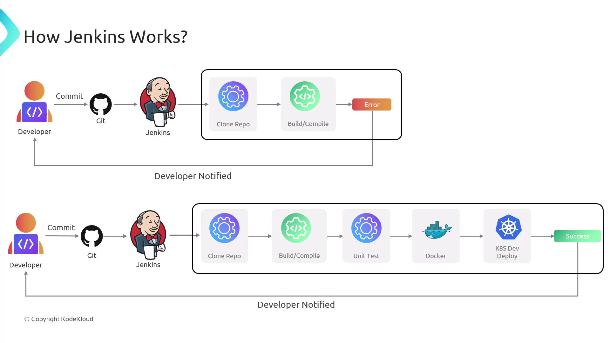
Setting Up Jenkins Runners (Agents)
What are Jenkins Agents?
Agents (formerly called slaves) are machines that execute Jenkins jobs.
Why Use Agents?
Distribute workload
Parallel execution
Faster builds
Platform-specific testing

Slide 12
Docker Containers
It is a containerization platform that packages applications and dependencies into lightweight containers.
Basic Commands:
docker pull nginx (To pull image)
docker run -d -p 80:80 nginx (To Run container)
docker ps (To view containers)
docker stop <container_id> (To stop the containers)
Docker client
Docker Engine
Containers

Slide 13
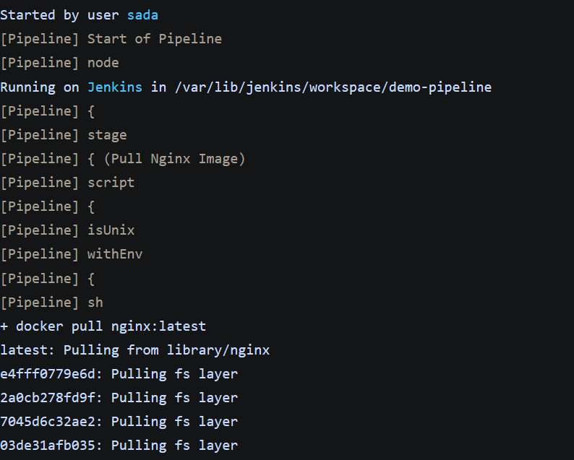

Slide 14
Docker in jenkin’s pipeline
pipeline {
agent any
stages {
stage('Build Docker Image') {
steps {
sh 'docker build -t myapp .'
}
}
stage('Run Container') {
steps {
sh 'docker run -d myapp'
}
}
}
}

Slide 15
Container Orchestration
Container orchestration automates:
Deployment
Scaling
Networking
Load Balancing
Container Management
When many containers are running, manual management becomes difficult. Orchestration tools solve this problem.
Need for Container Orchestration
Consider an e-commerce application consisting of: Frontend Service, Backend Service, Database Service, Payment Service, Authentication Service. Each service may run in multiple containers.
Managing all these containers manually would involve:
Starting and stopping containers, Monitoring failures
Scaling during peak traffic, Updating software versions, Managing networking

Slide 16
Kubernetes
It is an open-source container orchestration platform used to automate the deployment, scaling, management, and monitoring of containerized applications. It was originally developed by Google and is now maintained by the Cloud Native Computing Foundation.
As organizations increasingly use containers (such as those created with Docker), managing hundreds or thousands of containers manually becomes difficult. Kubernetes provides a centralized platform to manage these containers efficiently.

Slide 17
1. Control Plane (Master Node)
Scheduler
Responsible for assigning Pods to available worker nodes.
Functions:
Checks resource availability
Selects the best node
Balances workloads
API Server
Entry point of Kubernetes
Receives commands from users
Communicates with all cluster components
etcd
A distributed key-value database.
Stores:
Cluster configuration
Node information
Deployment information
Secrets and configuration data
Controller Manager
Monitors cluster state and ensures the desired state matches the actual state.
Example: If 3 Pods are required but only 2 are running, it automatically creates another Pod.

Slide 18
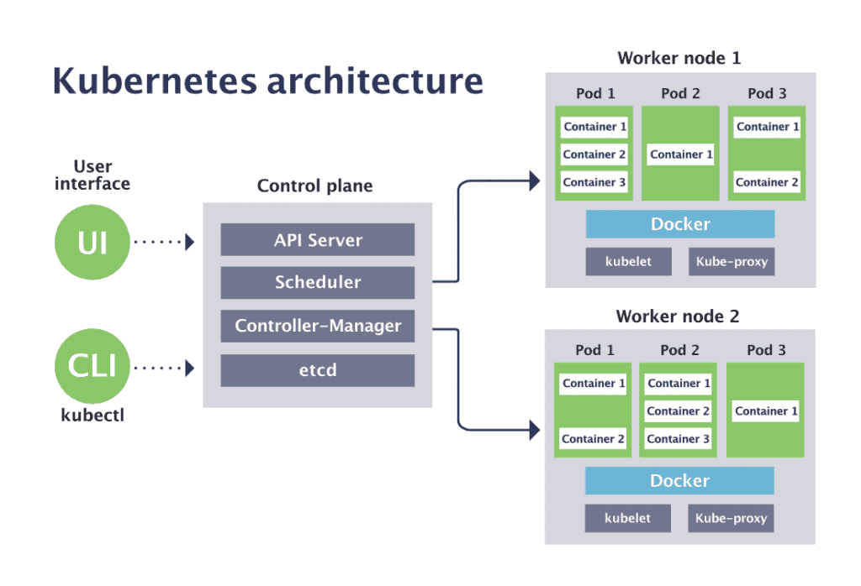
2. Worker Nodes
a) Kubelet
Communicates with Control Plane
Starts and manages containers
Reports node status
Sends heartbeat
b) Pods
smallest deployable unit in Kubernetes.
c) Kube Proxy
Handles networking and load balancing between Pods.
d) Container Runtime
Docker

Slide 19
Kubernete Networking
Every Pod gets:
Unique IP Address
Internal communication capability
Networking Features:
Pod-to-Pod Communication: Pods communicate directly.
Service Discovery: Applications locate other services automatically.
Load Balancing: Traffic distributed among Pods.

Slide 20
Advantages of Kubernetes
Open Source
Platform Independent
Automatic Scaling
Self-Healing
High Availability
Load Balancing
Rolling Updates
Efficient Resource Utilization
Multi-Cloud Support
Large Community Support
Limitations of Kubernetes
Steep learning curve
Complex initial setup
Requires monitoring and management
Additional infrastructure costs
Security configuration can be challenging
Real-World Applications of Kubernetes
Many leading companies use Kubernetes for large-scale application deployment:
Google
Netflix
Spotify
Airbnb
Adobe

Slide 21
Continuous monitoring with Nagios
Nagios?
Nagios is a continuous monitoring tool that monitors hosts, services, applications, and network devices, detects failures, sends alerts, and provides reports for maintaining high system availability.
Nagios provides two options for monitoring:
Agent-based: Independent agents are installed on servers to collect data, which is then sent to the Nagios server.
Agentless: Uses existing protocols to gather data without installing additional software on servers. Both methods monitor critical system metrics like file system usage, CPU performance, and service status.

Slide 22
Why Continuous Monitoring is Important
Continuous monitoring helps organizations by:
Detecting failures immediately
Reducing system downtime
Improving service availability
Preventing major failures
Tracking system performance
Enhancing security monitoring
Supporting proactive maintenance
Meeting Service Level Agreements (SLAs)

Slide 23
Monitoring process in nagios:
Nagios Web Interface (GUI): The Nagios Web Interface is a user-friendly dashboard where administrators can see the real-time status of all monitored resources. It helps users quickly check the status of different services, get alerts, and track performance over time. Accessible through any modern web browser, this interface is crucial for real-time monitoring and fixing issues easily.
Alert Notifications (SMS and Email): One of Nagios' key features is its ability to alert administrators when something critical happens. These alerts can be sent through SMS or email, based on the settings. If a resource or service reaches a critical point, like low disk space or a service going down, Nagios quickly sends a notification to ensure the issue gets addressed right away

Slide 24
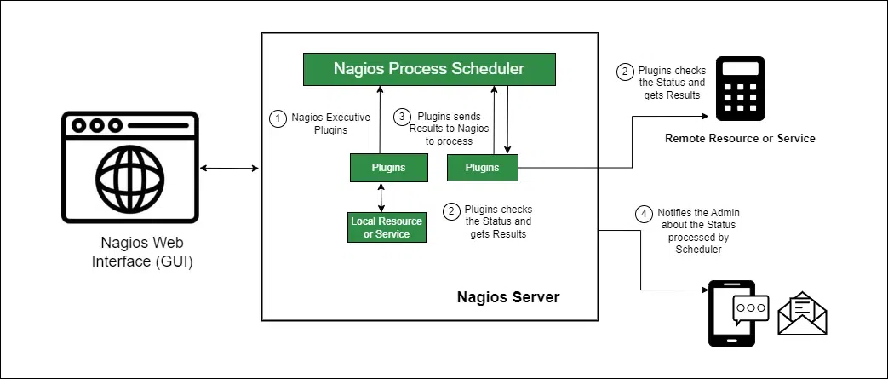

Slide 25
Nagios in a DevOps Environment
When used alongside Docker and Kubernetes:
Application is deployed to Kubernetes.
Nagios continuously checks:
Node health
Pod availability
Service response times
Resource consumption
If a pod crashes or a node becomes unavailable, Nagios generates alerts.
Operations teams can respond quickly before users are affected.

Slide 26
Introduction to DevOps on Cloud
DevOps on Cloud combines DevOps practices with cloud infrastructure to automate the entire software delivery lifecycle. One of the main ways cloud computing and DevOps are related is through the concept of infrastructure as code. It is basically Infrastructure as a Service (IaaS).
# | Traditional IT | Cloud DevOps
1 | Manual server setup | Automated provisioning
2 | Limited scalability | Elastic scaling
3 | Long deployment cycles | Rapid deployments
4 | High infrastructure cost | Pay-as-you-use model
5 | Manual monitoring | Automated monitoring

Slide 27
 | Function | Tools
1 | Version Control | Git, GitHub
2 | CI/CD | Jenkins, GitHub Actions
3 | Containerization | Docker
4 | Orchestration | Kubernetes
5 | Infrastructure as Code | Terraform, Ansible
6 | Monitoring | Nagios, Prometheus, Grafana
7 | Cloud Platforms | AWS, Azure, GCP
Advantages of DevOps on Cloud
Faster software delivery
Automated deployments
Improved collaboration
Better scalability and reliability
Reduced operational costs
Continuous monitoring and feedback
Enhanced security through automation

Slide 28
DevOps Lifecycle on Cloud
PLAN
Monitor
Code
Operate
CLOUD
Build
Deploy
Test
RELEASE

