Slide 1
SUMMARY
ML ASSIGNMENT
NAME : Jenil Patel
Email id : jenilpatel2424@gmail.com
Github link : https://github.com/Jenil245
LinkedIn : https://www.linkedin.com/in/jenilpatel31/

Slide 2
MODEL
MODEL EXPLORED : Bernoulli Naïve Bayes, CatBoost
MODEL SELECTED : CatBoost
MODEL TRAINING ACCURACY : 67.55%
MODEL VALIDATION ACCURACY: 66.68%
ABOUT CatBoost :
CatBoost Model follows boosting tree approach which is optimized for categorical data.
Based on parameters and data, model encodes categorical and textual data into numerical values

Slide 3
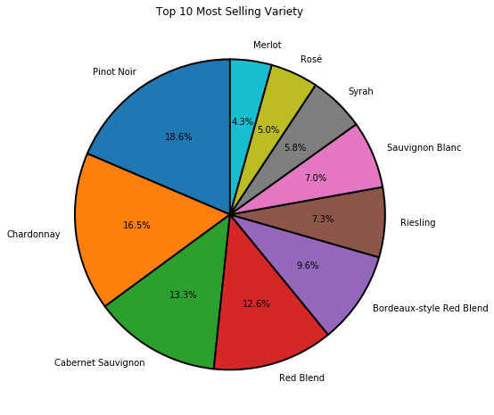
Top Variety By Sold Precentage

Slide 4
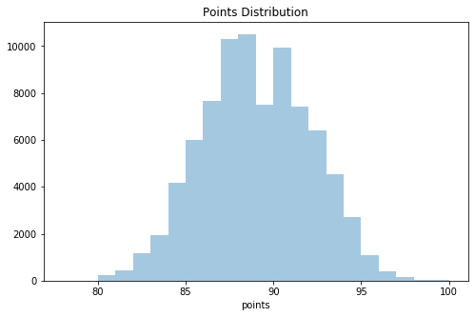
Points-Range

Slide 5
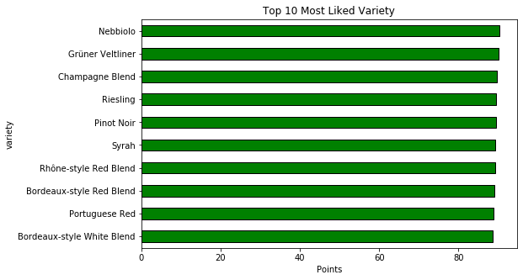
Most-Liked Variety

Slide 6
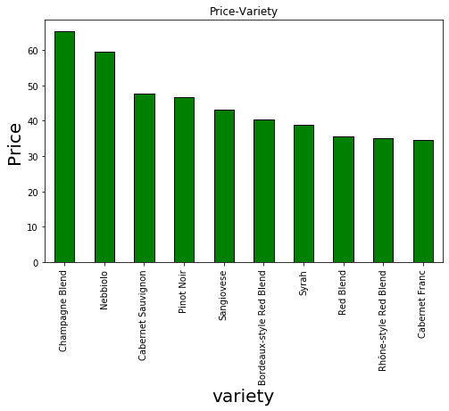
Most Expensive Variety

Slide 7
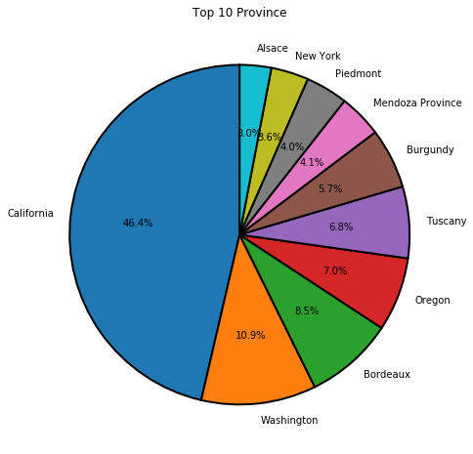
Top Province By Wine Sold percentage

Slide 8
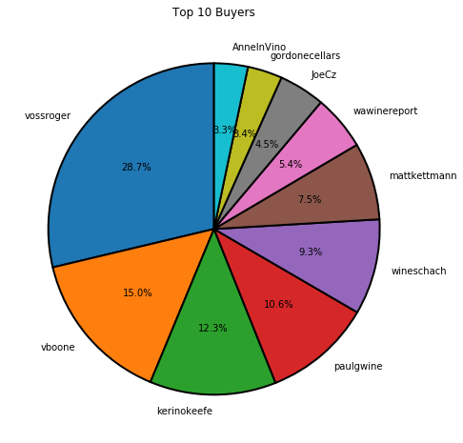
Top Buyers by order percentage

Slide 9
Findings & Suggestions
All wine varieties has roughly good points. Minimum points given by users around 80 so overall quality of wine is good.
Users preferred to buy wines under 500 price, So It would be better to keep low stock on expensive wines.
46% of wines sold were produced in California, so it would be good choice to have a warehouse in California to reduce transportation cost.
Based on top buyers chart, You can decide discounts and offers to users who are not frequent buyers.
Based on selling chart, you can optimize your inventory.
Based on Most Liked variety you can recommend this wines to existing users.

