Slide 1
BDT Final Project
Facebook Posts Analysis
Ling Sun 986265

Slide 2
Facebook Posts Analysis - inspirations
For a single account, What the most common words used in all of the posts
For a single account, how many posts posted each year?
For a single account, what are the most commented posts?
What are the most liked posts?
Who are my ‘best friends’?
…...

Slide 3
Develop Environment
OS : mac OS high Sierra Version 10.13.4
Hadoop 2.6.5
Apache Spark 2.6
Hive 2.3.1
Python 3.6.4
Kafka 1.1.0

Slide 4
Problems
Failed to install Hadoop
Failed to start namenode server
Failed to start hive metastore
Until last Sunday, I got the dev environment set
Spark didn’t connect with Hive successfully
Don’t know anything about Python
……there will be more to be found

Slide 5
Data Flow
Using Facebook Graph API and Http to request real-time streaming data
Receiving and parsing data
Sending data to Kafka
Using Spark Streaming to read data from Kafka
Saving data to Hive
Using Spark SQL to query and analysis
Using Plotly to visualize data

Slide 6
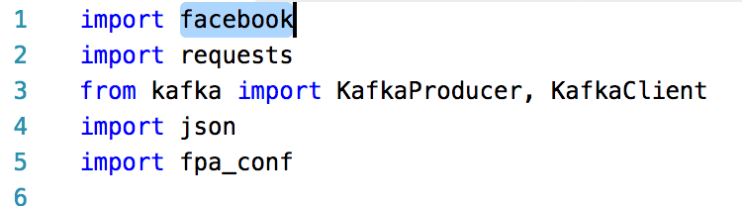
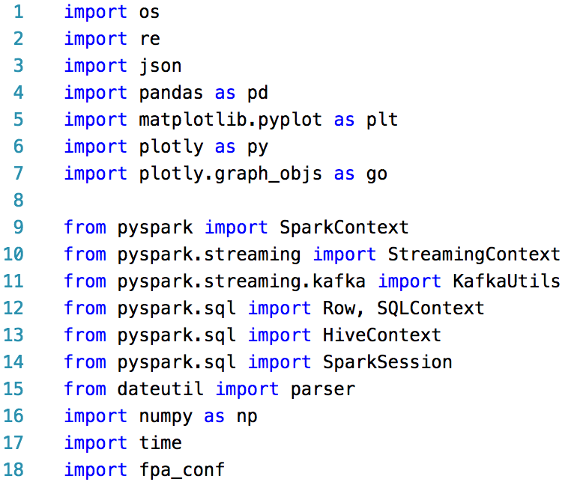
Code - Python Libs

Slide 7
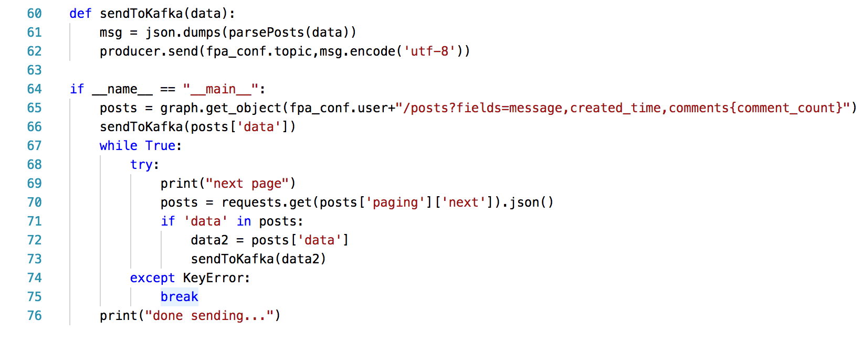
Code - Producer

Slide 8
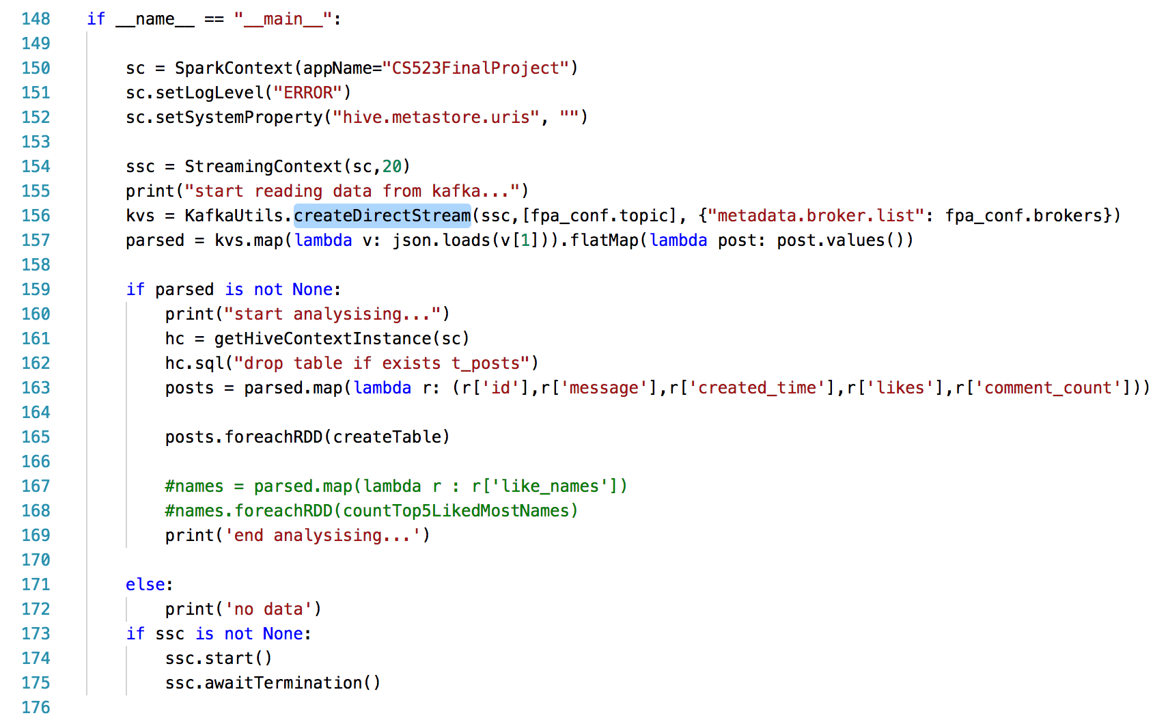
Code - Consumer

Slide 9
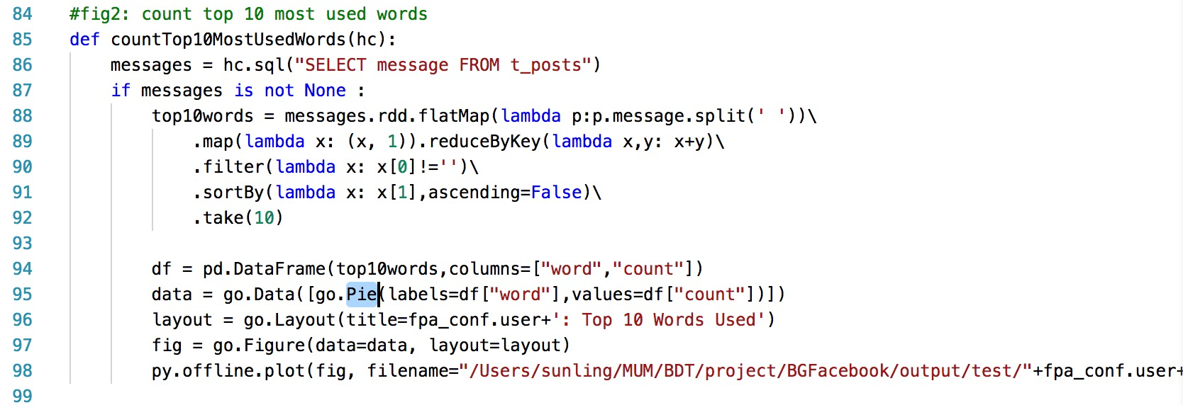
Code - Consumer

Slide 10
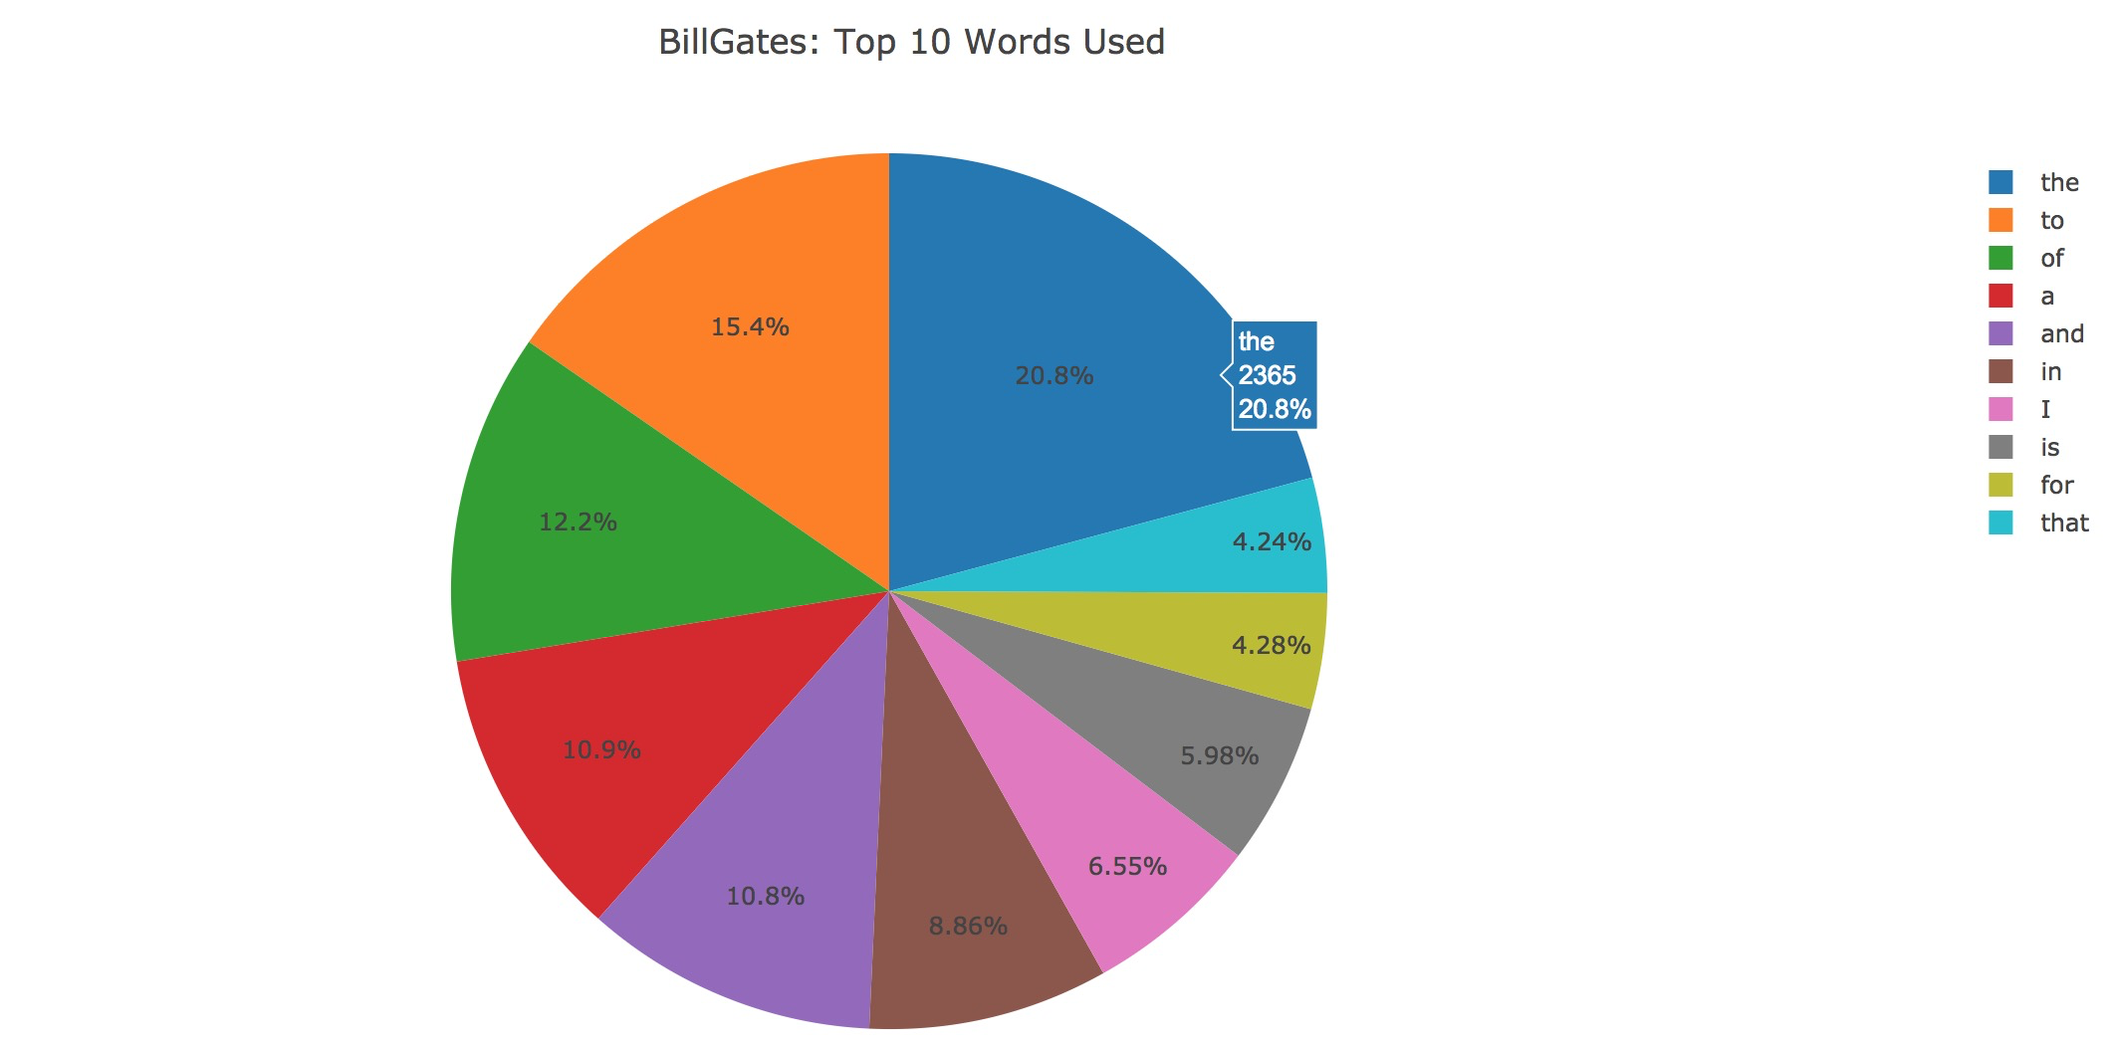

Outputs - Pie
https://www.facebook.com/BillGates/

Slide 11
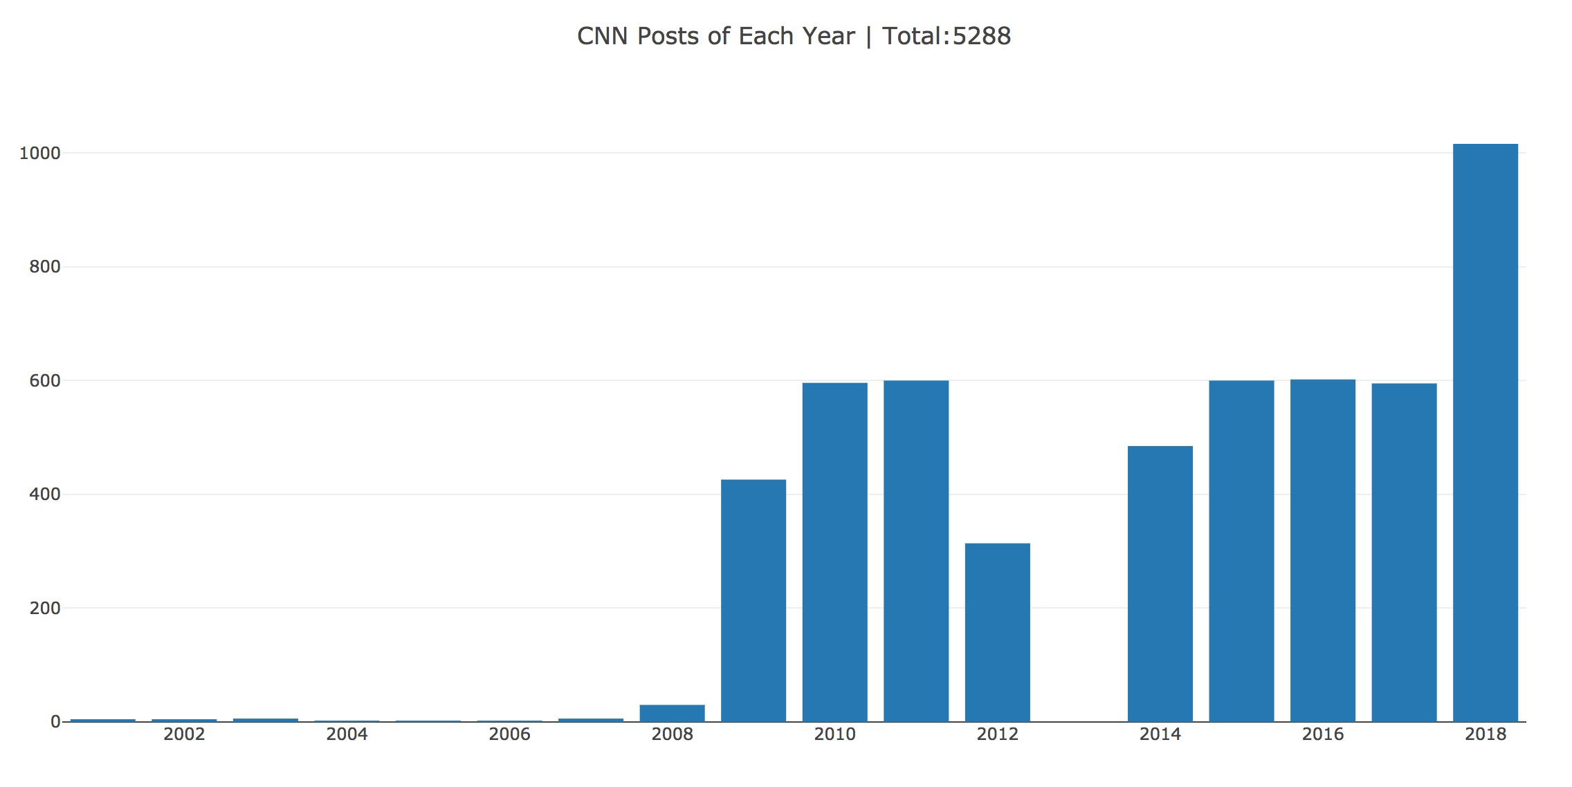

Outputs - Bar
https://www.facebook.com/cnn/

Slide 12
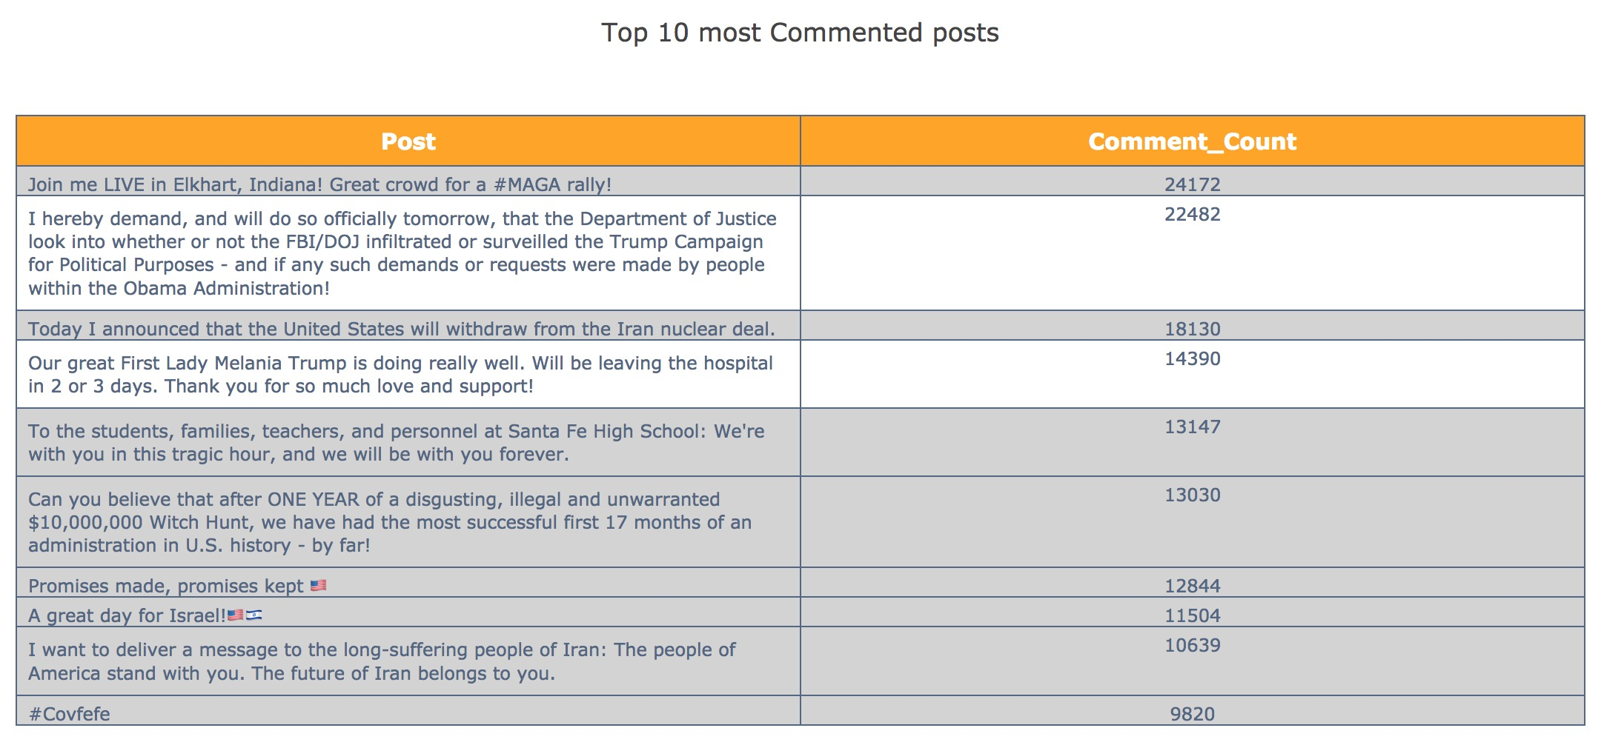
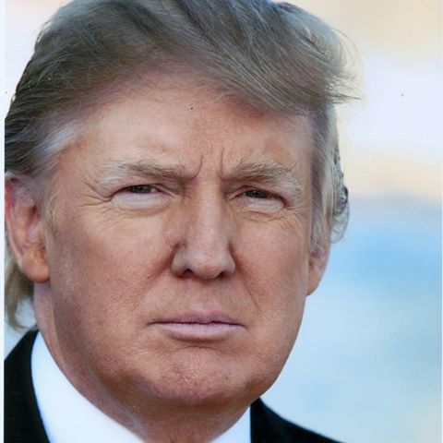
Outputs - Table
https://www.facebook.com/DonaldTrump/

Slide 13
Demo
#start hadoop
cd /usr/local/Cellar/hadoop-2.6.5/
sbin/start-dfs.sh
sbin/start-yarn.sh
#start hive metastore
hive --service metastore
#start Kafka, mysql, spark
brew service kafka start
……
# run consumer
spark-submit --jars /usr/local/Cellar/kafka/1.1.0/libexec/libs/spark-streaming-kafka-assembly_2.11-1.6.1.jar /Users/sunling/MUM/BDT/project/BGFacebook/BGConsumer.py
# run producer
python /Users/sunling/MUM/BDT/project/BGFacebook/BGProducer.py

Slide 14
Any Questions? Thank you !

