Slide 1
AIRLINE BOOKING MANAGEMENT SYSTEM
Presented By :- Group 34
Rachit Kumar Singh - 202118015
Jenil Doshi - 202118034
Akanksha Porwal - 202118017
Dipshi Jain - 202118018
Abhishek Singh - 202118004

Slide 2
FUNCTIONAL REQUIREMENTS
Functional Requirements (click here)

Slide 3
ENTITY RELATIONSHIP DIAGRAM (ERD)
ERD (click here)

Slide 4
RELATIONAL MODEL
Relational Model

Slide 5
SQL - DDL STATEMENTS
DDL (click here)

Slide 6
SQL - DML STATEMENTS
DML (click here)

Slide 7
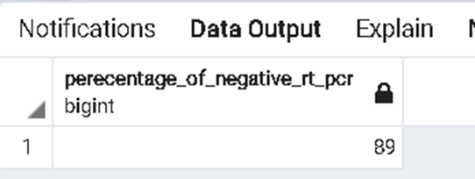
QUERIES
What Percentage of passengers have negative RT-PCR?
-> SQL:
select distinct (select count(rt_pcr)from covid19_data where rt_pcr='false' )*100 / (select count(b_id) from covid19_data)
as Perecentage_of_negative_RT_PCR from covid19_data;
-> Output:

Slide 8
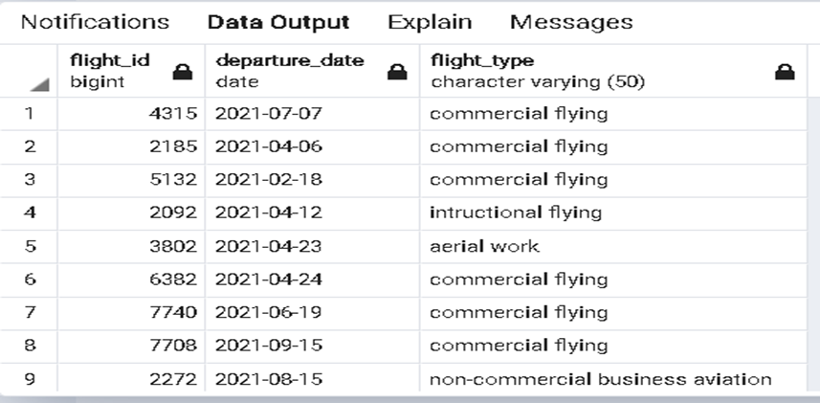
2.) Display flight_ID,Departure_date,flight_type of all flights whose ticket price is less than 8000?
-> SQL:
select flight_id,departure_date,flight_type from flight f natural join booking b
natural join flight_details fd where fd.prices>8000;
-> Output:

Slide 9
3.) Revenue of Airlines by Month?
-> SQL:
select extract(MONTH from departure_time ) as months,sum(prices) over (partition by a_name order by extract(MONTH from departure_time ) ),a_name from airlines
natural join flight
natural join flight_details
group by a_name,extract(MONTH from departure_time ),prices;

Slide 10
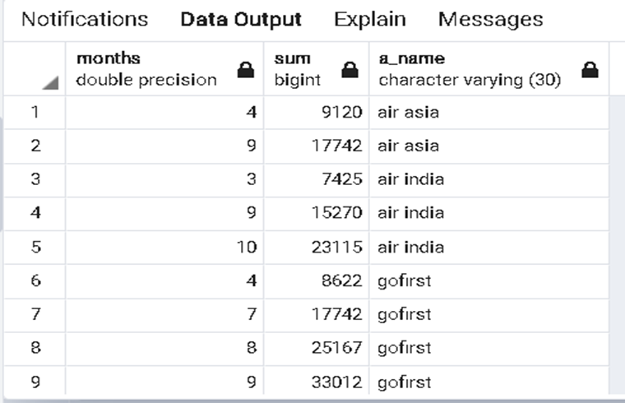
-> Output:

Slide 11
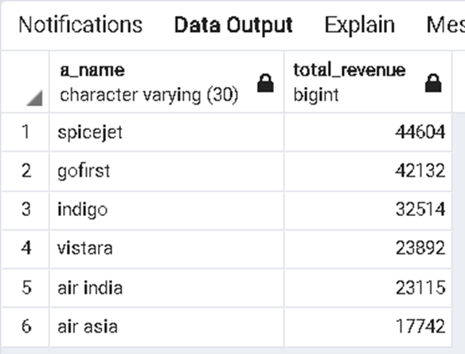
4.) Total Revenue generated by each airline?
-> SQL:
select a_name,sum(prices) as total_revenue from airlines
natural join flight
natural join flight_details group by a_name
order by total_revenue desc;
-> Output:

Slide 12
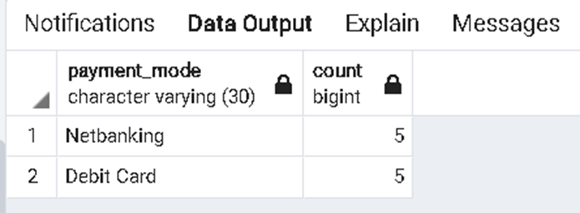
5.) Most preferred payment mode?
-> SQL:
select payment_mode,count(transaction_id) from payment group by payment_mode
order by count desc limit 2;
-> Output:

Slide 13
OTHER QUERIES
Queries (click here)

Slide 14
CONCLUSION
The Airline reservation system has been a way of minimizing the clerical work, which is almost a routine and consumes the most precious time.
This AIRLINE RESERVATION SYSTEM has been an attempt to help the user to minimize his workload along with minimizing the paper works and saving of time.
Almost all the difficulties of manual reservation have been removed by this system. To wind up let me welcome all the suggestions and other improvements, which the system needs so that it covers all the needs if the user in the user way.

Slide 15
THANK YOU !!

