Slide 1
Water Quality Prediction
Jenil Doshi 202118034
Rachit Kumar Singh 202118015

Slide 2
Introduction
Water is the most significant resource of life, crucial for supporting the life of most existing creatures and human beings. But as the development is increasing, we are exploiting water by wasting it and treating with harmful materials which make the water impure and unfit for use. Due to this reason, knowing the water quality is necessary.
WQI value Ratings of water quality
91-100 Excellent
71–90 Good
51–70 Medium
26–50 Bad
0–25 Worse

Slide 3
Dataset
The dataset we have used has features like ‘Location’, ‘Temperature’, ‘Oxygen Level’, ‘PH level’, ‘Conductivity’. The dataset collected in of Indian rivers and the measurements are the average values measured over a period of time.
It has 534 rows and 10 features. We’ve also used a geographical locations dataset for visualization purpose, just to be geographically clear about the water quality in India state wise.

Slide 4
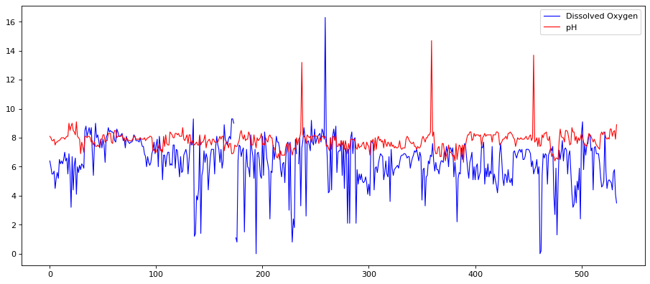
Amount of dissolved oxygen and PH level in river waters

Slide 5
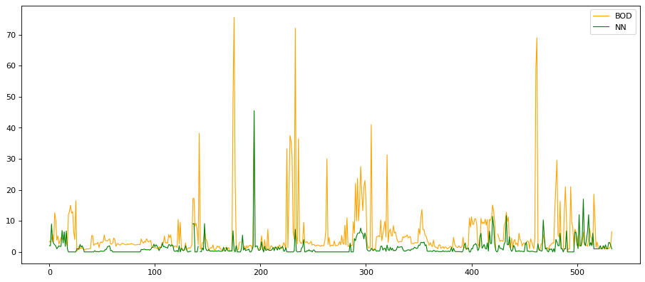
Biochemical Oxygen Demand and Nitrate Level

Slide 6
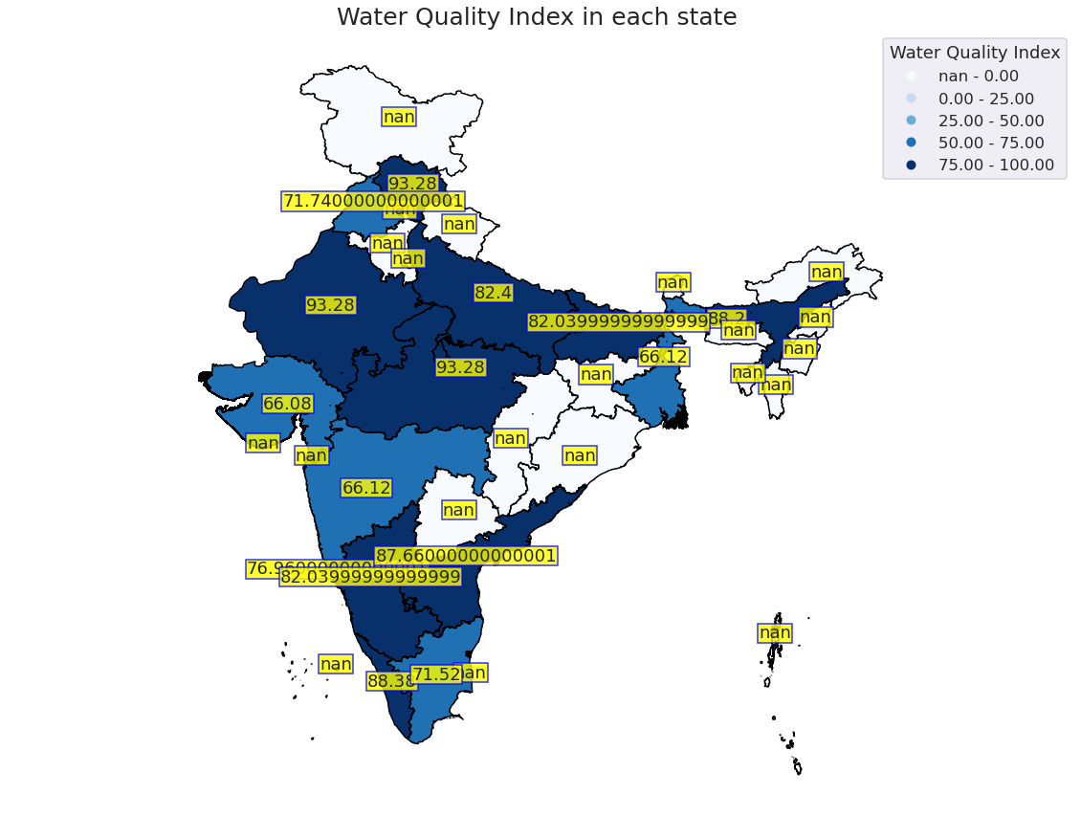

Slide 7
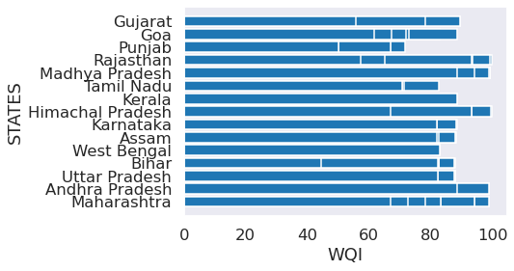
Water Quality State Wise

Slide 8
Linear Regression
Linear regression analysis is used to predict the value of a variable based on the value of another variable. The variable you want to predict is called the dependent variable. The variable you are using to predict the other variable’s value is called the independent variable.
Linear regression models are relatively simple and provide an easy to interpret mathematical formula that can generate predictions. Linear regression can be applied to various areas in business and academic study.

Slide 9
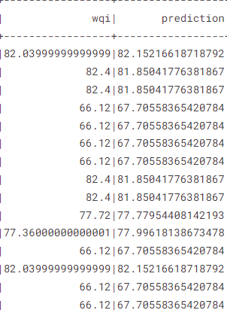
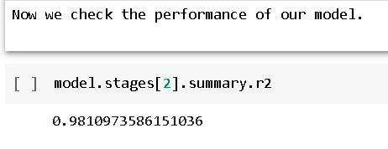
Accuracy of the Model

Slide 10
Conclusion
We successfully perform Water Quality Prediction using an Supervised Learning algorithm, using Linear Regression. Using Linear Regression, we got 98% accuracy.
Water is the most essential natural resource for humans to survive. But due to the ill habits of humans only, it gets impurified. And this impurified water when consumed has many ill effects on human body.

Slide 11
Future Work
In future, certain features like categorizing the water types at different levels can be used in order to dive deeper in this problem. We can create an application stating the water quality index of each state and the methods to prevent this by motivating the people to make their city, state and therefore the Country cleaner.
Awareness is a big issue in India, people are not aware, so this can be used to create an awareness among the people.

Slide 12
THANK YOU!

