Slide 1

Employment Data Analysis Using Excel
Student Name : Jeniliya .M
Register No : 312215013
Department : Commerce
College : Soka Ikeda College of Arts and Science for Women

Slide 2
Project Title
Employee Performance Analysis Using Excel

Slide 3

Agenda
Problem statement
Project overview
End users
Our solution and Proposition
Data description
Modelling Approach
Result and Disscussion
Conclusion

Slide 4

Problem Statement
1. What is the average salary by department?
2. Which department has the highest turnover rate?
3. What is the relationship between tenure and salary?
4. Are there any gender disparities in performance ratings?
5. Which job titles have the highest average performance ratings?
6. What is the average age of employees by department?
7. Are there any correlations between performance ratings and salary increases

Slide 5

Project Overview
TO ANALYSE AND EVALUATE EMPLOYEE PERFORMANCE IDENTIFY AREAS OF STRENGTH AND IMPROVEMENT AND PROVIDE INSIGHTS FOR INFORMED DECISION MAKING

Slide 6
Who Are The End Users ?
1. Managers and Supervisors 4. Employees Themselves
2. Human Resources (HR) 5. Team Leaders
3. Executive and Senior Leadership
1.Managers and Supervisors : They use to analysis to provide feedback, set goals, and make
decisions about promotions and development needs.
2.Human Resources(HR) : HR utilizes performance data to design training programs, align
recruitment with organizations needs ,and manage employee relations.
3.Executive&SeniorLeadership:They use the insights to align performance with strategic objectives,
assess overall organizational effectivess and high-level decisions.
4.Employees Themselves : They receives feedback from the analysis to understand their
performance,identify areas for improvement, and plan their career.
5.Team Leaders : They apply performance analysis to improve team dynamic allocate resources
effectively,and enhance overall team productivity.

Slide 7

Dataset Description
We took the employee datas from kaggle website. We have 26 features totally.But, We used only 9 of the features.We entered the name of the employees in Alphabetical order. And we also enterd the employee type in Alphabetical order.We entered the performance level of the employee in Numerical value.We entered the gender of the employees as Male/Female.We entered the data of employee rating in Numerical value.We entered the Business unit in Alphabetical order.

Slide 8
THE WOW IN OUR SOLUTION
=IFS(Z2>=5,"VERY HIGH",Z2>=4,"HIGH",Z2>=3,"MED",TRUE,"LOW") - to calculate employee performance PIVOT TABLE - summaryGRAPH - data visuvalization

Slide 9

MODELLING
DATA COLLECTIONS:
1.Dashboard
2.By formatting the dataset
FEATURES COLLECTIONS:
1.Data is collected from the dashboard
2.Formatting the data to find the employees performance level
DATA CLEANING:
1.Identifying the missing values
2.Filter outing the missing values
PERFORMANCE LEVEL:
1.Employees High Performance Level
2.Employees Low Performance Level
SUMMARY:
1.Categories the performance level of the employ
r

Slide 10
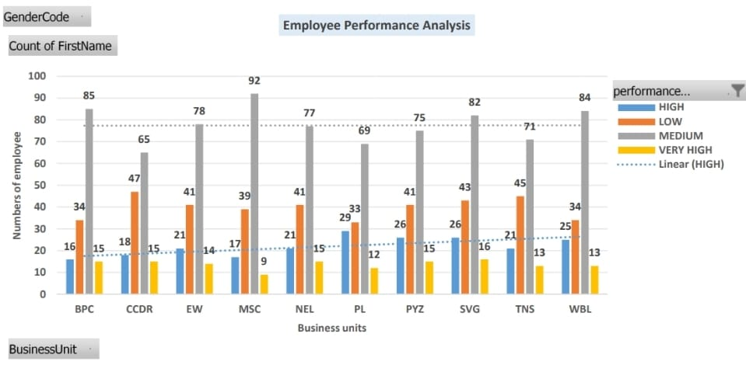
RESULTS

Slide 11

Conclusion
In overall, majority employees got “Medium” level in their performance level.
2.In BPC, Employees performed in average level.
3.In CCDR & NEL, the employees got the medium level of performance level.
4.In EW, The employees got the medium and average level of performance level in
their business unit and their to know the performance of their performing level.
5. Based on the conditional formatting formula the excel sheet is formatting the solution
to find the performance level of the majority employees performance .

