Slide 1
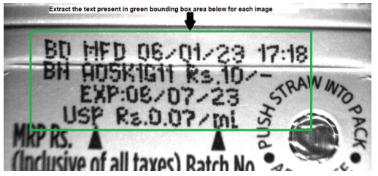
Task 2 Extracting Text from Image
I’ve coded a path to the image and the program displays the text present in the image.
Drive Link : https://drive.google.com/file/d/1oc7BmDmyxRpAujUAdgQWvPeObNQq3nDC/
By
Jenina Angelin D

Slide 2
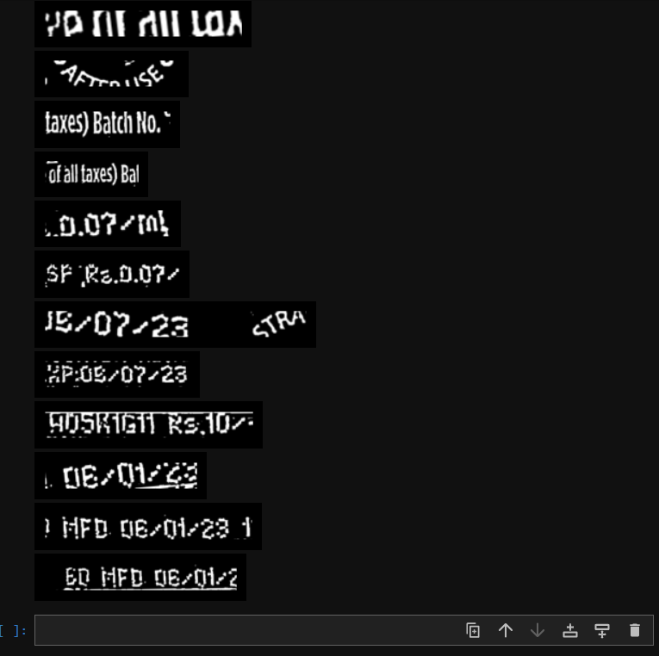
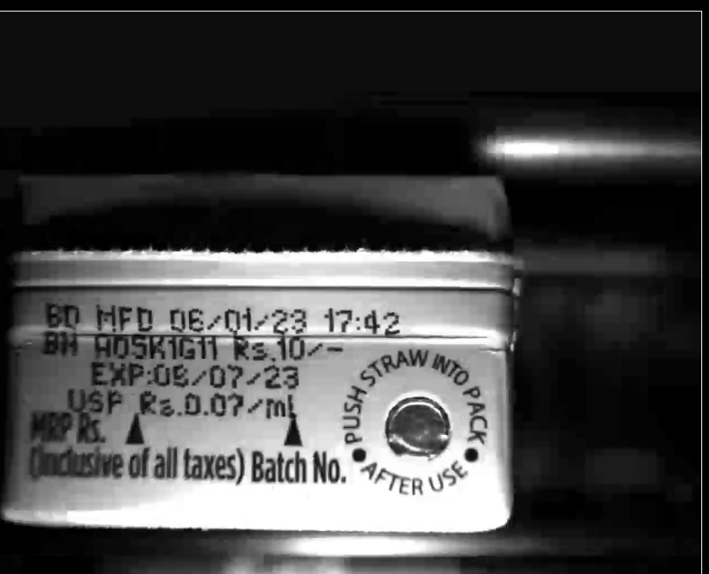
Image 6 Obtained Manufactured Date and Cost

Slide 3
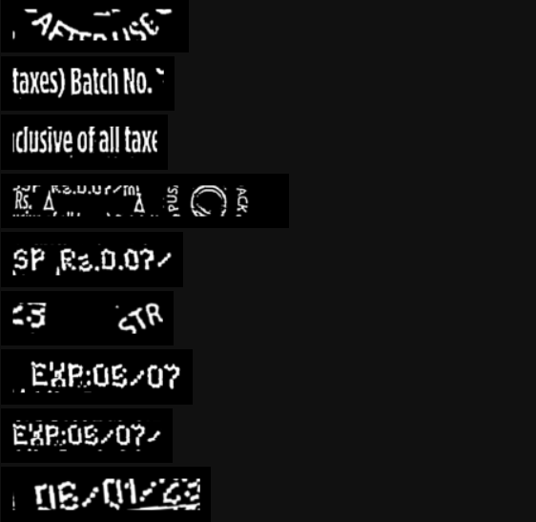
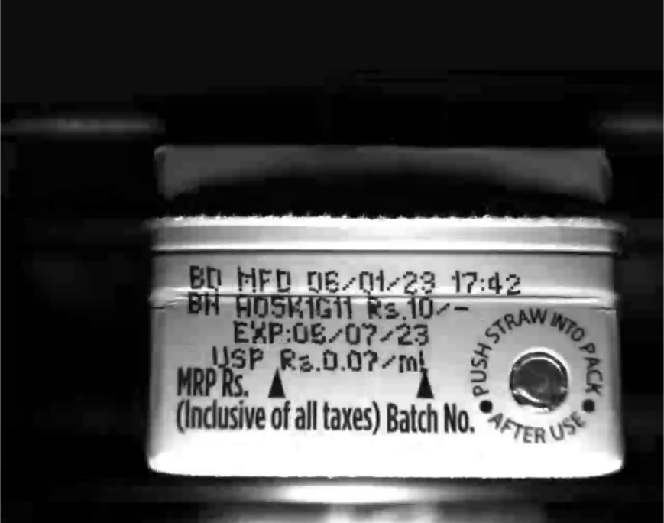
Image 7 Obtained Cost

Slide 4
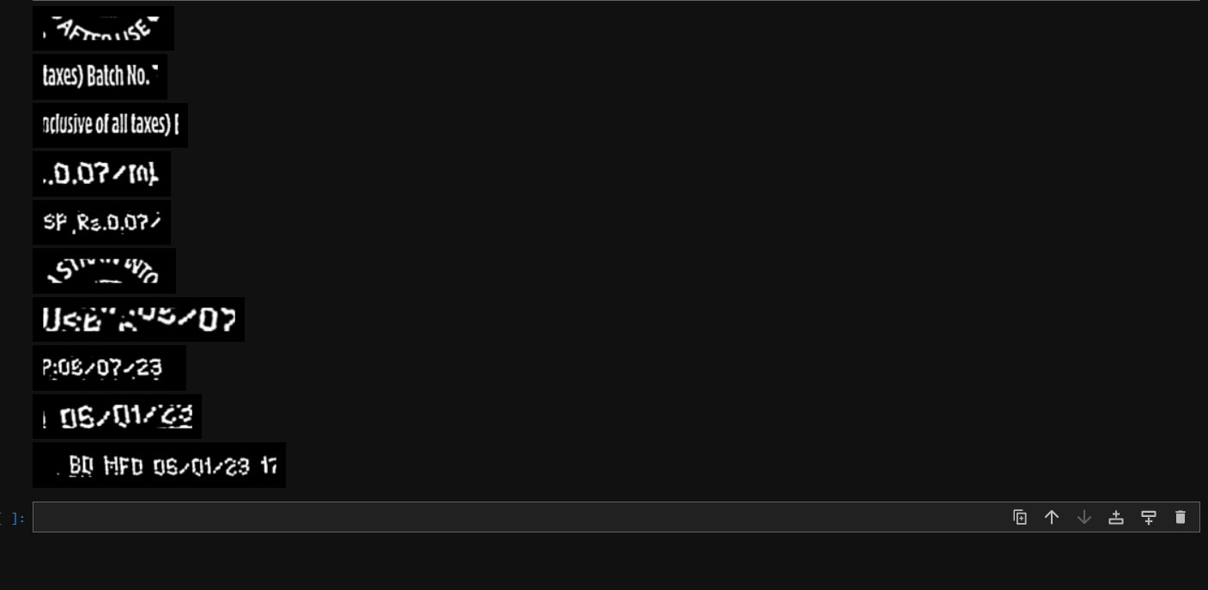
Image 2 acquired Manufactured date

Slide 5
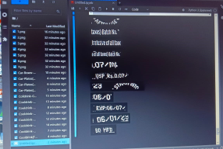
Image 1 Initial Implementation

