Slide 1
Applying AI to Healthcare
Jenine John, MD
October 19, 2023

Slide 2
Overview
Overview of AI
Applications of AI to Healthcare
Assessing Performance of AI tools

Slide 3
Background
Cardiology Fellowship
Stony Brook University Hospital
Cardiac Imaging Research Fellowship
Brigham and Women’s Hospital
Healthcare AI Research Fellowship
Brigham and Women’s Hospital
BWH Innovation Fellowship
Biofourmis (remote patient monitoring)

Slide 4
Healthcare AI
Technical aspects of AI techniques
Application of AI techniques to healthcare

Slide 5
Overview of AI

Slide 6
AI
Simulating human abilities
Machine Learning
AI by learning from data
Deep Learning
ML by using deep neural networks

Slide 7
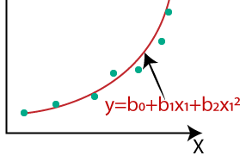
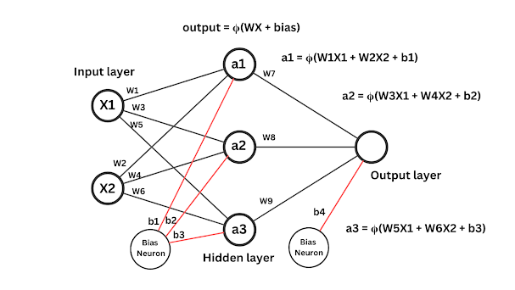
Deep Learning allows highly complex predictive models
Regression model
Here are 10 measurements from a patient’s echocardiogram. What is the probability they will develop heart failure?
Neural Network model
Here is a clip from the patient’s echocardiogram. Based on these 1 million pixels, what is the probability they will develop heart failure?
https://medium.com/analytics-vidhya/understanding-polynomial-regression-5ac25b970e18
https://www.pycodemates.com/2023/01/multi-layer-perceptron-a-complete-overview.html

Slide 8
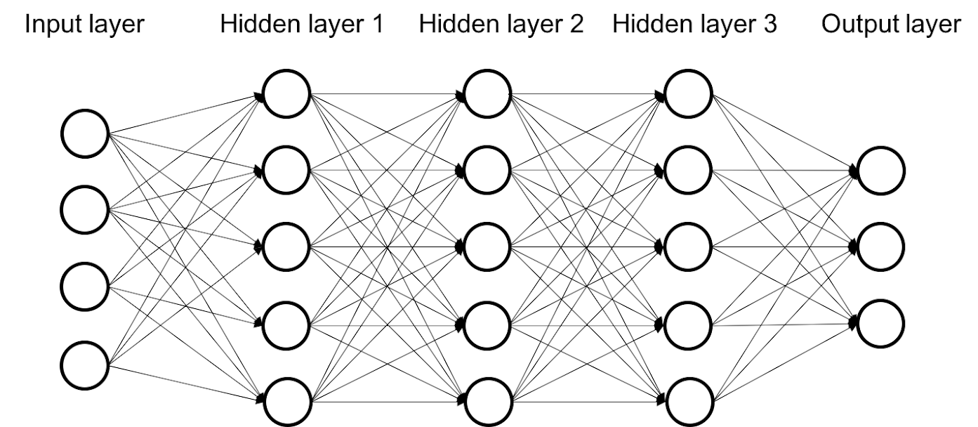
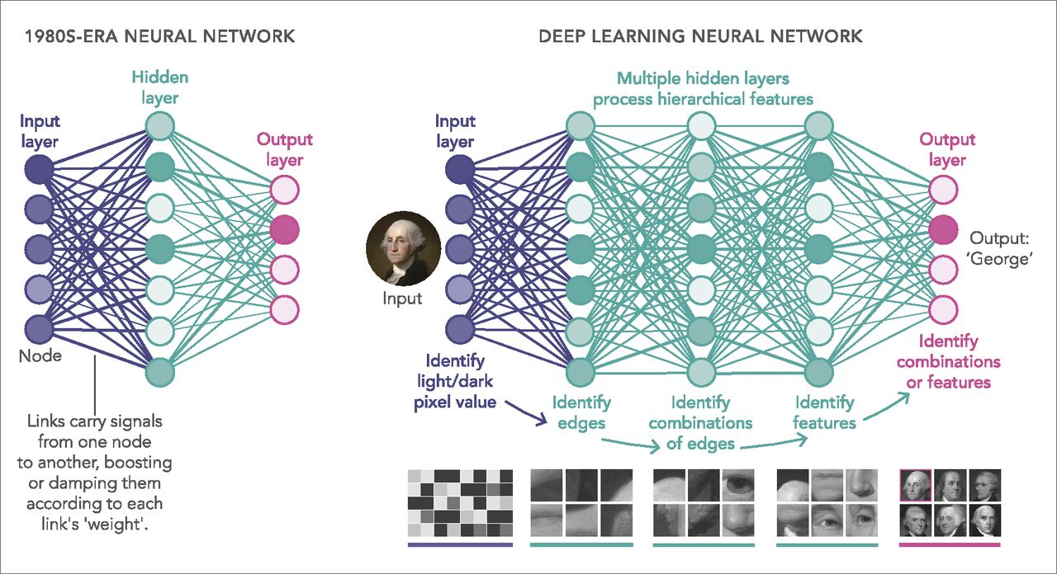
Deep Learning: President Identifier
Architecture
Skeleton of model created by data scientist
Training Dataset
1,000 different pictures of US presidents with their names
Training process
Algorithm learns to find patterns in the pictures that help predict the name

Slide 9
https://www.pnas.org/doi/10.1073/pnas.1821594116

Slide 10
Applications of AI to Healthcare

Slide 11
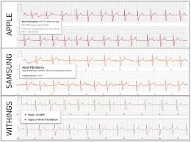
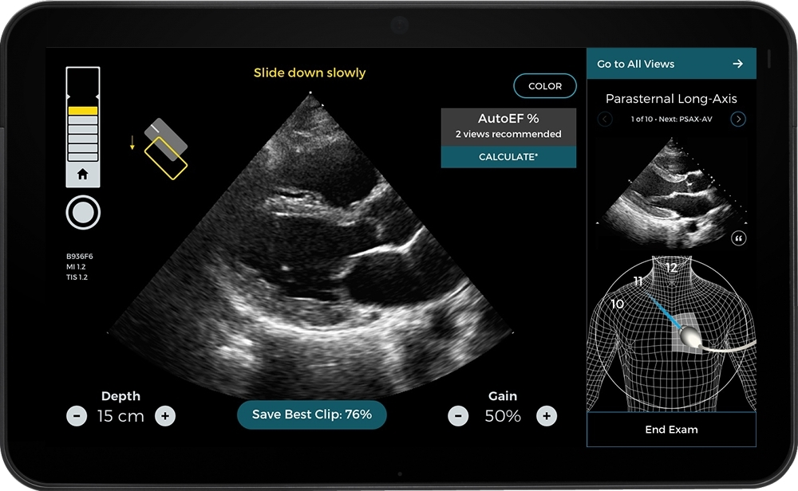
AI in Healthcare
Improve what we already do
Allow us to do things we couldn’t before
https://www.frontiersin.org/articles/10.3389/fcvm.2022.836375/full
https://www.businesswire.com/news/home/20210812005104/en/Butterfly-Network-and-Caption-Health-Announce-Exclusive-Strategic-Partnership-to-Enable-Earlier-Disease-Detection-and-Management-With-AI-Based-Guidance-and-Diagnostics

Slide 12
AI in Healthcare
Over 500 FDA-approved AI tools
#1: Radiology (including cardiac imaging) - ~75%
#2: Cardiology - ~11%
Many more AI tools that are not FDA regulated (e.g. administrative tools)
Despite this, most physicians may not consider themselves as using AI
Low level of implementation
Replacement of non-AI tools with AI tools may be seamless
Many tools have AI versions and non-AI versions
Sepsis prediction score
Automated radiology measurements
Analysis of remote patient monitoring data
Predicate for >1/3 of FDA 510(k)-cleared AI tools is a non-AI tool

Slide 13
Challenges
Challenging to acquire the right data to create AI models
Need datasets that are:
Large enough
Appropriate - representative of all the settings the tool will be used in
Have information in a consistent format (variables may vary across institutions)
Groups addressing: Nightingale Health, MAIDA, Atropos, Rhino Health
Challenging to choose AI tools to implement
Difficult to figure out what tools are available and popular - Process sometimes relies on clinical champions
Often unclear how well a tool performs
Groups addressing: ACR AI Central, Dandelion Health
Challenging to implement AI tools
Outdated hardware and software
Limited interoperability across different software
Limited IT dept capabilities
Challenging to gain clinician acceptance
Clinicians often wary of new tech, especially after poor experiences with prior software
Fear of clinicians being replaced (“Augmented Intelligence” is a term being used more)
Unclear legal ramifications of following/not following AI-generated advice

Slide 14
Assessing Performance of AI Tools

Slide 15
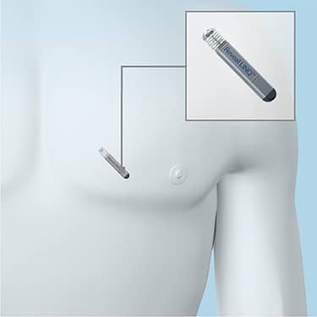
Considerations Broadly Applicable to Health Tech Tools
Technical performance vs clinical performance
Meaningful metrics
Accounting for human-machine interaction
Outcome impact
Impact of low-hanging fruit like remote monitoring for arrhythmias
Improvement from the tool? Or from simultaneous improvements in workflow?
https://www.londoncardiovascularclinic.co.uk/cardiology-info/investigation/reveal-deviceloop-recorder

Slide 16
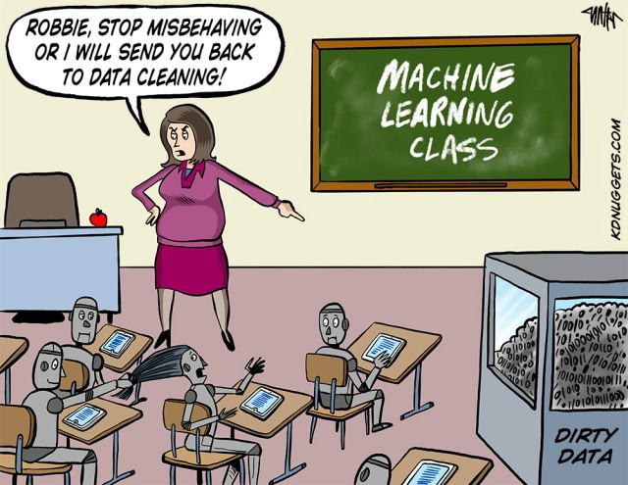
Considerations Applicable To Data-Driven Tools
The data used to create the model:
Inadequately cleaned
Uses variables inappropriately
Not representative of all the settings the tool will be used in

Slide 17
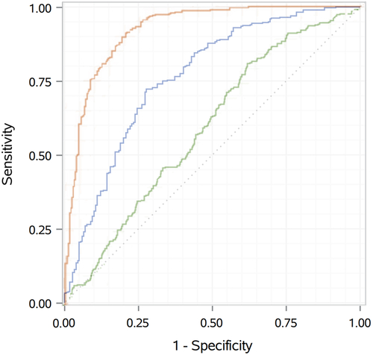
Considerations Applicable To Data-Driven Tools
The data used to create the model:
Excludes low-quality samples
Has inadequate coverage of values that will be encountered in practice
Hypertrophic cardiomyopathy (HCM) and healthy
HCM, severe hypertension, aortic stenosis, healthy
Is no longer as applicable to the current clinical environment (model drift / model shift)
Has insufficient samples of a particular sex or self-reported race - can lead to algorithmic bias
Sanders, W. JACC Advances (2023)

Slide 18
Algorithmic Bias
Can be problematic to include self-reported race in algorithms
STS cardiac surgery risk score
Can be problematic to simply disregard self-reported race in algorithms
Optum risk score - Who should get additional support to lower healthcare costs?
Black patients traditionally have poor surgery outcomes
Race-specific patterns encoded into (non-AI) model
Black patients discouraged from surgery because high risk
Black patients have lower future healthcare costs
Black patients have lower risk score, so receive fewer resources
Vyas, D. NEJM (2020)
Obermeyer, Z. Science (2019)

Slide 19
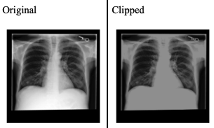
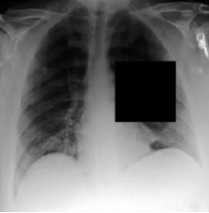
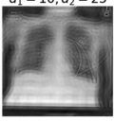
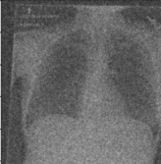
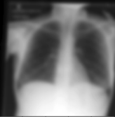
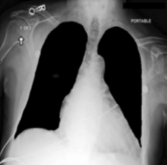
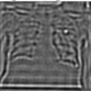
Algorithmic Bias
May be impossible to remove race as a feature within a model
Gichoya, J. Lancet Digital Health (2022)

Slide 20
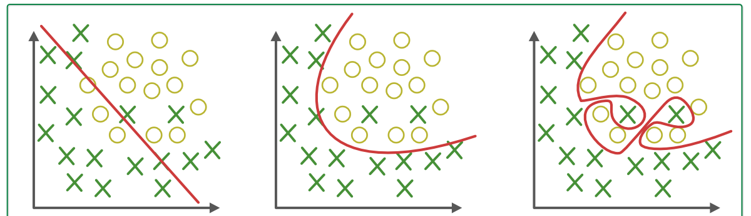
Considerations Specific to AI
Frequent issue: Overfitting
Underfitting
Appropriate Fitting
Overfitting
(poor generalization)
https://www.geeksforgeeks.org/underfitting-and-overfitting-in-machine-learning/

Slide 21
Overfitting
Dataset
Training set
Validation set
Test set
Assess performance on unseen data to help ensure overfitting doesn’t happen (generalizability preserved)
Assess performance on unseen data
Test set performance may be artificially inflated
- Can use test dataset over and over -> overfitting to test dataset
- Similar studies from same patient used in training set and test set
External Validation Dataset

Slide 22
Advantages of External Validation
Not affected by overfitting to test set
Not affected by some types of mistakes during model development
Ensures generalizability to another healthcare setting, which may have different:
Patient demographics
Disease prevalence
Treatment approaches (e.g. outcomes may be different at academic center that is aggressive with procedures)
Available data points (deep learning generally doesn’t handle missing data well)
Hardware / Software (e.g. different radiology vendors)

Slide 23
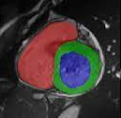
Adequate Evaluation of AI Model
Class Imbalance
Overall performance metrics
Condition subgroups
Class imbalance may lead to poor subgroup performance
Demographic subgroups
Edge cases
Failure cases
Sinus rhythm
A Fib
V. Tach
Cardiac MRI segmentation

Slide 24
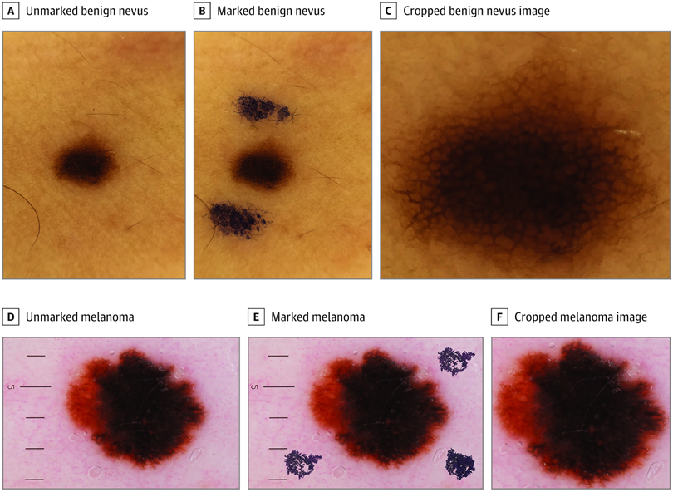
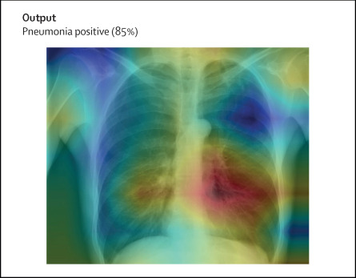
Explainability
Trade-off between performance and explainability
Unintended features may be encoded within the “black box”
If a priest visits a patient, then the patient is likely to die soon
If a chest x-ray is done in the patient’s room, the patient has a higher probability of having pneumonia
If a patient has labs drawn at night, they have a higher probability of having sepsis
If a freckle has presurgical markings, then it is probably melanoma
Explainability methods
many argue for these, because AI models may occasionally fail in unexpected ways
do not fully explain individual model predictions
may be misleading and provide false reassurance
Winkler, J. JAMA Dermatology (2019)
Ghassemi, M., Lancet Digital Health (2021)

Slide 25
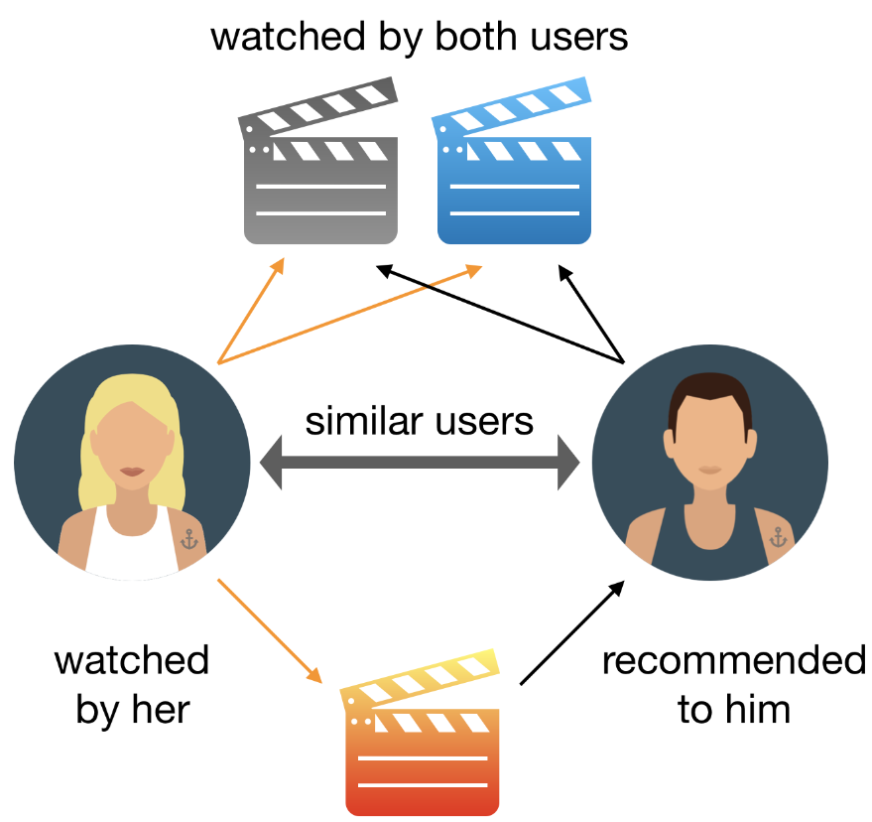
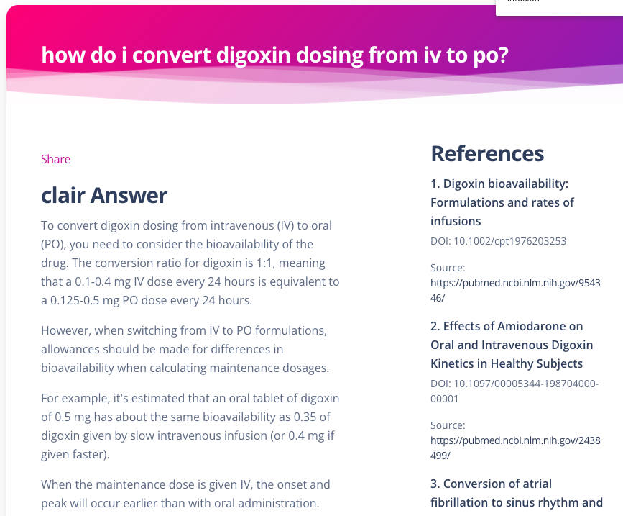
Considerations Not Yet Addressed by FDA
Generative AI – hallucinations
Online learning – continuously updating model

Slide 26
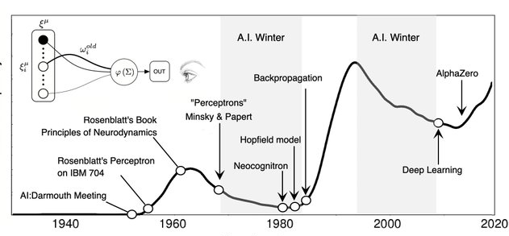
Putting Healthcare AI Into Perspective
Still potential for AI winter in healthcare?
Stimulating investments into data infrastructure, upgrading technology, improving workflows
ASCVD risk score for coronary heart disease – uses 13 variables, based on decades-old data
How have advances in medical care in the past decades changed risk?
How does use of this risk score affect risk?
Is the risk same for a patient at a large academic medical center and a patient at a small rural clinic?
How accurate is this score for patients with kidney disease?
How accurate is this score for minority races?
How do social determinants of health affect risk?
https://twitter.com/ricard_sole/status/1497306702181548039

Slide 27
Questions?

Slide 28
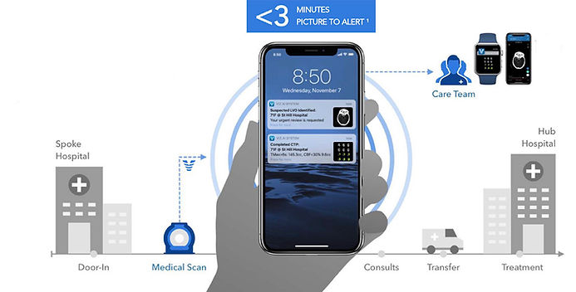
AI in Healthcare Examples
Viz.AI – triaging – low downside risk, high upside potential

Slide 29
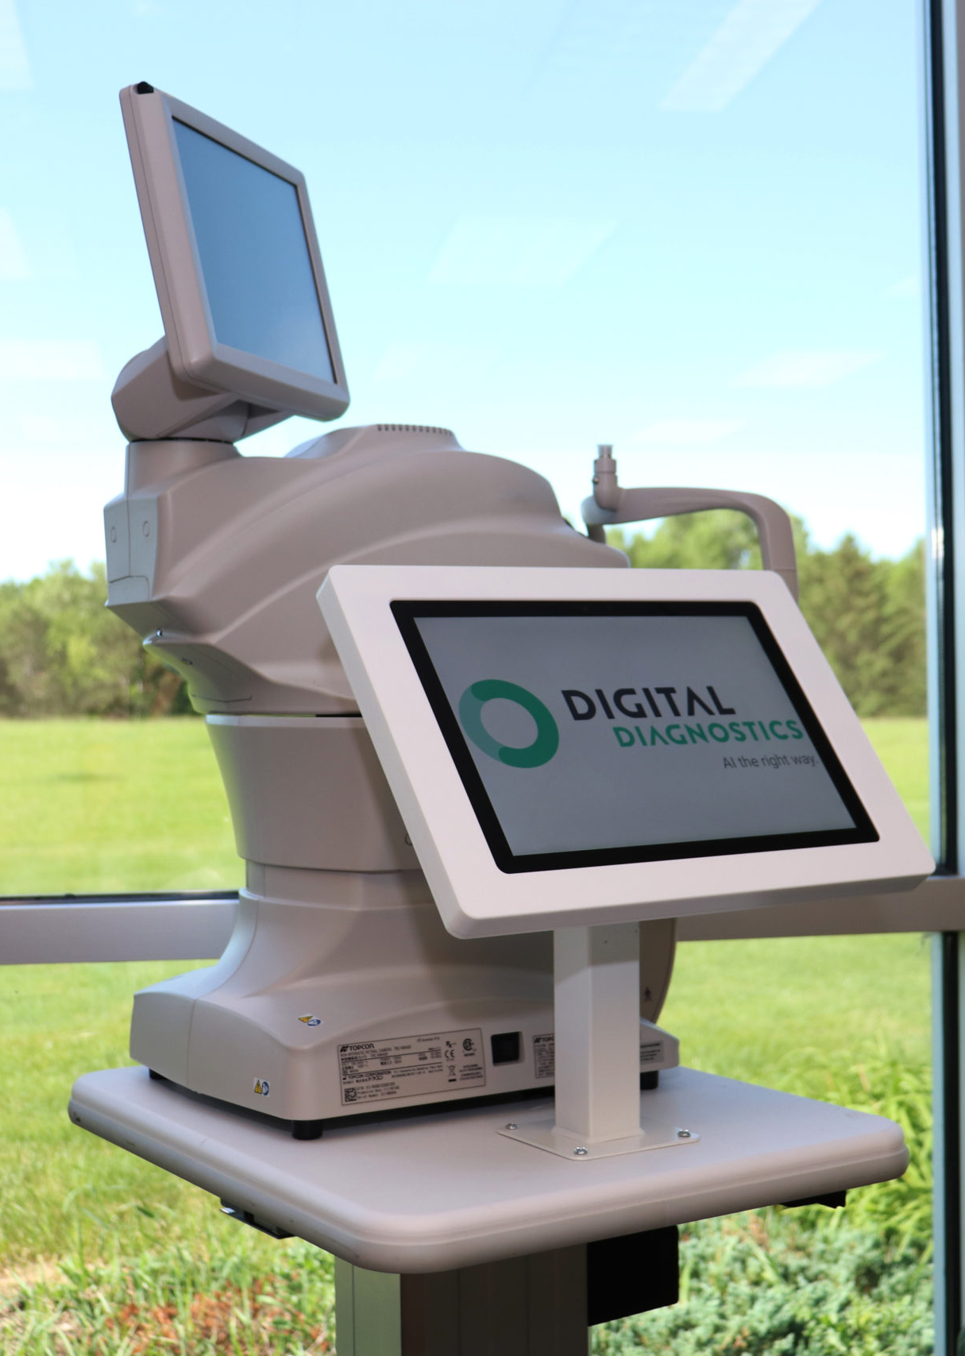
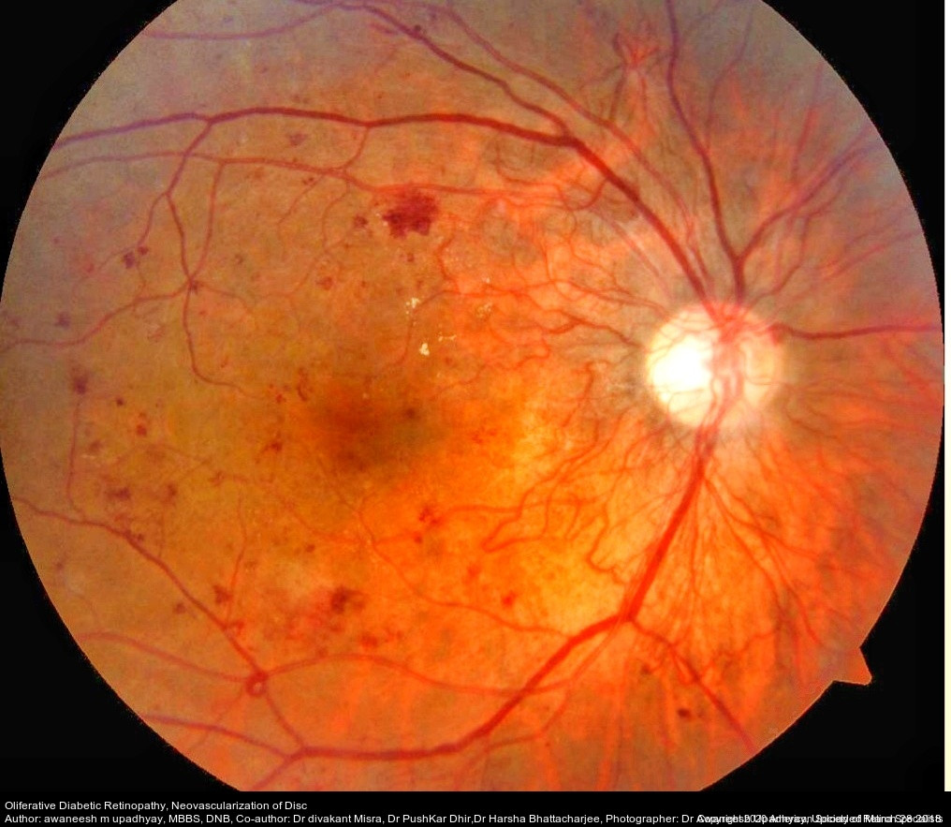
AI in Healthcare Examples
LumineticsCore (previously IDx-DR)
First FDA-approved autonomous healthcare AI product
Uses proprietary camera – no vendor variability

Slide 30
AI in Cardiology Examples
More robust predictive models
Is this person likely to develop X issue?
Do this patient’s remote monitoring signals look like those from someone who is becoming ill?
Large Language Models
Drafting clinician notes
Explaining info to patients
Cardiovascular imaging
Automated measurements
Improved image post-processing
Motion correction for heartbeats and breathing
Simulation of contrast-enhanced images
Future potential uses
Extracting information from images that is not visible to human eye
Evaluating CT for heart muscle that is not getting enough blood
Integrating information across two different modalities – e.g. echocardiogram and CT

Slide 31
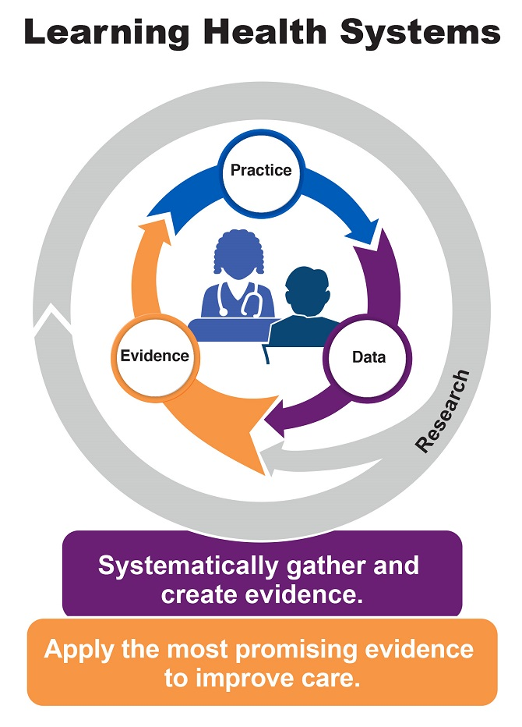
AI in Healthcare
Improve what we already do
Assist with repetitive tasks
Avoid errors or missed diagnoses
Improve management in the “gray zones” of medicine by setting up Learning Health Systems
Allow us to do things we couldn’t before
Diagnose conditions at earlier stages
Novel tools such as a tool to guide novice users to perform an echocardiogram
Draft clinical notes
https://www.ahrq.gov/learning-health-systems/about.html
https://www.businesswire.com/news/home/20210812005104/en/Butterfly-Network-and-Caption-Health-Announce-Exclusive-Strategic-Partnership-to-Enable-Earlier-Disease-Detection-and-Management-With-AI-Based-Guidance-and-Diagnostics

