Slide 1
Software Testing Fundamentals
Objectives: • Understand the concept of Software Testing • Understand the importance of Quality Software Software Quality, Definition of Software Testing, Role of Testing Failure, Error, Fault, Defect, Bug Terminology

Slide 2
Software Testing Fundamentals
Objectives: Objectives of Testing Test Case When to Start and Stop Testing of Software (Entry and Exit Criteria) Skills for Software Tester Quality Assurance and Quality Control Verification and Validation V Model

Slide 3
Software Quality, Definition of Software Testing Role of Testing
1 Software Quality : Definition(s) of Quality: Predictable degree of uniformity, dependability at low cost and suited to market. Degree to which a set of inherent characteristics of the product / service fulfills the requirement. Ability to a product or service that bears upon its ability to satisfy implied or expressed need

Slide 4
Software Quality, Definition of Software Testing Role of Testing
Quality is: Fitness for use, i.e. Usability of software. Conformance to specification Judgment of the customer /user about the attributes of a product. Meet customer as per national/ international standards Fulfill customers need as max as possible. Software quality is: the degree to which a system, component, or process meets specified requirements.

Slide 5
Fundamental principles of testing are:
Find defects before customers find them out. Exhaustive testing not possible; Program testing can only show the presence of defects, never their absence. Testing applied all through the software life cycle Understand the reason behind the test. Tests develop immunity and have to be revised constantly.

Slide 6
Fundamental principles of testing are:
8. Testing encompasses defect prevention. 9. Testing is a fine balance of defect prevention and defect detection. 10. Intelligent and well-planned automation - Benefits of testing. 11. Requires talented, committed people who work in teams.

Slide 7
Goals of Software Testing
Software Testing: Testing produces reliability and quality Quality leads to customer satisfaction | Immediate Goals: Bug Discovery Bug Prevention | The major objectives of Software testing are as follows: Finding defects which may get created by the programmer while developing the software. Gaining confidence in and providing information about the level of quality. To prevent defects. To make sure that the end result meets the business and user requirements. To ensure that it satisfies the BRS that is Business Requirement Specification and SRS that is System Requirement Specifications. To gain the confidence of the customers by providing them a quality product.
 | Long-term Goals: Reliability Quality Customer satisfaction Risk Management
 | Post-Implementation Goals: Reduced maintenance cost Improved testing process

Slide 8
Roles And Responsibilities of A Test Leader
Involved in the planning, monitoring, and control Derives the test objectives, organizational test policies, test strategies and test plans. Estimate the testing, and management to acquire the necessary resources. Recognize when test automation is appropriate, select the tools, and ensure training of the team. Testers lead, guide and monitor the analysis, design, implementation and execution of the test cases, test procedures and test suites.

Slide 9
Roles And Responsibilities of A Test Leader
Ensure proper configuration management of the test-ware produces traceability of the tests. Schedule the tests for execution and monitor, measure, control and report on the test progress, the product quality status and the test results. Write summary reports on test status. Test leaders also known as Test Manager or Test Coordinator

Slide 10
Bug Terminology
Bug: defined in simple term as any error or mistake that leads to the failure of the product or software either due to the specification problem or due to communication problem, regarding what is developed and what had to be developed.

Slide 11
Bug Terminology
Bug Terminology: Failure, Error, Fault The various terms related to software failure with respect to the area of application are listed as Defect, Variance, Fault, Failure, Problem, Inconsistency, Error, Feature, Incident, Bug, and Anomaly. i. Problem, error, and bug are probably the most generic terms used. ii. Anomaly, incident, and variance don’t sound quite so negative and infer more unintended operation than an all-out failure.

Slide 12
Causes Of Software Defects
Some of them are: Faulty requirements definition Client-developer communication failures Deliberate deviations from software requirements Logical design errors Coding errors

Slide 13
Causes Of Software Defects
6. Non-compliance with documentation and coding instructions 7. Shortcomings of the testing process 8. User interface and procedure errors 9. Documentation errors

Slide 14
Test Scenario and its design aspect
Test cases are written using test scenario. It describes each transaction and expected result of each transaction included in test scenario. Test cases are executed through test data. Actors (Person, system, hardware, or software) are taking part in transaction. (Simple, Complex, Average Actors), Transactions represent the interactions of the actors with system under testing. Test case characteristics: Accurate, Economical, Real, and reusable, Traceable to requirements, Appropriate … etc.)

Slide 15
How to write a good test case?
Test Case: Test case is an important document from validation of system perspective. These must be written at each stage of validation from unit test till acceptance testing. Basic principles of writing a good test case are: Must be testable. What is to be done when to wait for system to do it? Inform tester each transaction displayed/ replied by the system on screen at each step.

Slide 16
Basic principles of writing a good test case
4. Use simple conversational language for writing test case, which improves clarity and avoid communication losses. 5. Use consistent names of fields must be used in place of generic names. Any change in field name must be incorporated in test cases. 6. Tester should aware windows basics. 7. Order of the test cases must follow business scenario. Avoid time wastage.

Slide 17
Common Mistakes in writing test cases
Making test cases too long and combining two or more test cases in single test should be avoided Incomplete, incorrect, and incoherent test cases can create confusion and frustrate testers. Steps should be made very clear in test case steps. Test case changes must be updated in software user interface. Define pass/fail criteria correctly, i.e. test are successful or not, there is a defect or not?

Slide 18
Testing Activities
Essential activities in Testing: Maintain test strategy, test plan, test scenario and test cases in a location so that they are available to concerned people when required for test artifacts. Follow configuration management standards, and reasons for updates, Test cases used for testing must be reviewed before using them.

Slide 19
Entry and Exit Criteria related to Testing
Sample Criteria For Component Testing
Entry Criteria | Exit Criteria
Periodic unit test progress report showing 70% completion rate | No extreme and critical outstanding defects in features
Stable build with basic features working | All 100% components test executed with at least 98% pass ratio.
Component test cases can ready for execution | Component test progress report and defect trends sorted based on features and analyzed
--- | Component level performance and load testing report and analysis of the same

Slide 20
Exit Criteria for Validation Testing
When to Start and Stop Testing of Software (Entry and Exit Criteria) Process model - way to represent any given phase of software development that prevent and minimize the delay between defect injection and defect detection/correction. Entry criteria –specifies when that phase can be started also included are the inputs for the phase. Tasks or steps that need to be carried out in that phase, along with measurements that characterize the tasks. Verification, which specifies methods of checking that tasks have been carried out correctly. Exit criteria, which stipulate the conditions under which one can consider the phases as done and included are the outputs for only the phase. This is known as the Entry Task Verification exit or EVTX model which offers several advantages for effective verification and validation. Clear entry criteria make sure that a given phase does not start prematurely.

Slide 21
Exit Criteria for Validation Testing
All test scripts have been executed. All Software Planning Resolutions have been satisfactorily resolved. (Resolution could include bugs being fixed, deferred to a later release, determined not to be bugs, etc.) All parties must agree to the resolution. This criterion could be further defined to state that all high-priority bugs must be fixed while lower-priority bugs can be handled on a case-by-case basis. All documentation associated with the software (such as SRS, test documents) has been updated to reflect changes made during validation testing. The test report has been reviewed and approved.

Slide 22
Software quality assurance
Software engineering is systematic, disciplined and quantitative approach at its core, makes the software engineering environment a good infrastructure for achieving SQA objectives. The methodologies and tools applied, to a considerable extent, the level of quality to be expected from the software process and the maintenance services.

Slide 23
Software quality assurance is:
Software quality assurance is: A systematic, planned set of actions necessary to provide adequate confidence that the software development process or the maintenance process of a software system product conforms to established functional technical requirements as well as with the managerial requirements of keeping the schedule and operating within the budgetary confines. A planned and systematic pattern of all actions necessary to provide adequate confidence that an item or product conforms to established technical requirements. A set of activities designed to evaluate the process by which the products are developed or manufactured. Contrast with: quality control

Slide 24
Quality Assurance | Quality Control
Concentrates on the process of producing the product. | Concentrates on specific product
Defect-prevention oriented. | Defect-detection and correction-oriented
Usually done throughout the life cycle. | Usually done after the product is build
This is usually a staff function | This is usually a line function
i.e. Reviews and Audits | i.e. Software testing at various levels.

Slide 25
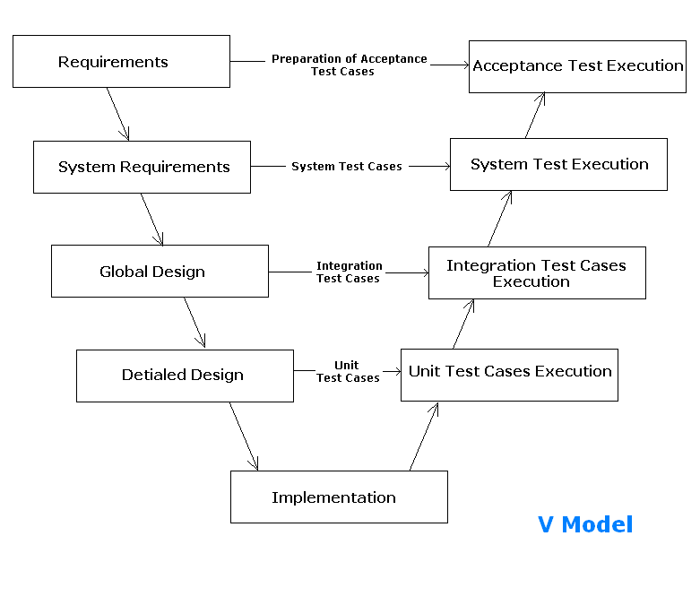
V-Model

Slide 26
V-Model
It is also known as Verification and Validation model. Under the V-Model, the corresponding testing phase of the development phase is planned in parallel. So, there are Verification phases on one side of the ‘V’ and Validation phases on the other side. The Coding Phase joins the two sides of the V-Model.

Slide 27
V-Model - Verification Phases
Several Verification phases in the V-Model :- Business Requirement Analysis System Design Architectural Design (High Level Design (HLD)) Module Design (Low Level Design (LLD)) Coding Phase.

Slide 28
V-Model - Validation Phases
Different Validation Phases (Levels of Testing ):- Unit Testing Unit tests designed in the module design phase are executed on the code during this validation phase. Unit testing is the testing at code level and helps eliminate bugs at an early stage, though all defects cannot be uncovered by unit testing. 2. Integration Testing Integration testing is associated with the architectural design phase. Integration tests are performed to test the coexistence and communication of the internal modules within the system.

Slide 29
V-Model - Validation Phases
3. System Testing System testing is directly associated with the system design phase and check the entire system functionality and the communication of the system under development with external systems. Software and hardware compatibility issues can be uncovered during this system test execution. 4. Acceptance Testing Acceptance testing is associated with the business requirement analysis phase and involves testing the product in user environment. Acceptance tests uncover the compatibility issues with the other systems available in the user environment. It also discovers the non-functional issues such as load and performance defects in the actual user environment.

Slide 30
V-Model : Application
The following pointers are some of the most suitable scenarios to use the V-Model application. Requirements are well defined, clearly documented and fixed. Product definition is stable. Technology is not dynamic and is well understood by the project team. There are no ambiguous or undefined requirements. The project is short.

Slide 31
V-Model : Advantages
The advantages of the V-Model method are as follows − This is a highly-disciplined model and Phases are completed one at a time. Works well for smaller projects where requirements are very well understood. Simple and easy to understand and use. Easy to manage due to the rigidity of the model. Each phase has specific deliverables and a review process.

Slide 32
V-Model : Disadvantages
High risk and uncertainty. Not a good model for complex and object-oriented projects. Poor model for long and ongoing projects. Not suitable for the projects where requirements are at a moderate to high risk of changing. Once an application is in the testing stage, it is difficult to go back and change a functionality. No working software is produced until late during the life cycle.

Slide 33
Advantages / Disadvantages & usage of V-Model
When to use the V-model:
The V-shaped model should be used for small to medium sized projects where requirements are clearly defined and fixed. The V-Shaped model should be chosen when ample technical resources are available with needed technical expertise.

Slide 34
Attribute of test case suite
Project Name Test suite ID and name Version date, number, and author of test case Approval and distribution date Revision history with reasons for updates Environment pre-requisites
Attribute for each test case
Test pre-condition | Priority
Test sequence | Test data
Traceability to test scenario | Steps to reproduce
Test case name and number | Expected results
Types of testing | Actual results
Objectives | Test result
Valid/Invalid conditions | Remarks

Slide 35
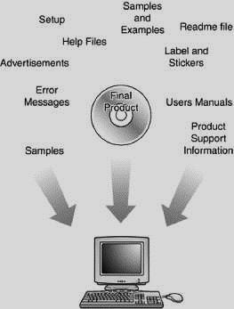
What Parts Make Up a Software Product?

