Slide 1
Software Testing Fundamentals
Objectives: Software Development Life Cycle SDLC Models Waterfall Model Iterative Model Agile Model Agile SCRUM Model (Concepts, Artefacts, Meetings, Roles) STLC role of testers, and where they fit in the whole picture Testing Career progression

Slide 2
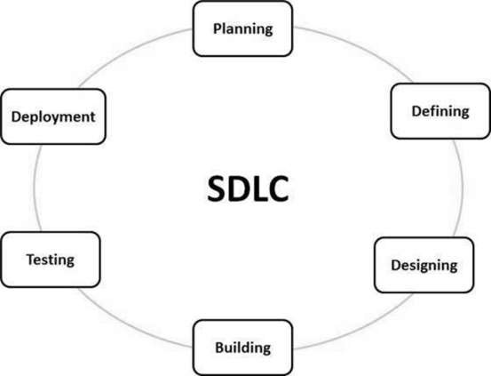
Software Development Life Cycle
The life cycle defines a methodology for improving the quality of software and the overall development process.

Slide 3
Software Development Life Cycle
Software Development Life Cycle consists of the following stages 1: Planning and Requirement Analysis 2: Defining Requirements 3: Designing the Product Architecture 4: Building or Developing the Product 5: Testing the Product 6: Deployment and Maintenance

Slide 4
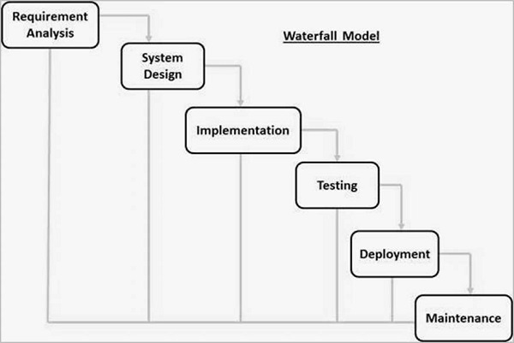
SDLC Models
In this Waterfall model, typically, the outcome of one phase acts as the input for the next phase sequentially.

Slide 5
SDLC Models
Waterfall Model : In this SDLC Model all phases are cascaded to each other in which progress is seen as flowing steadily downwards (like a waterfall) through the phases. The next phase is started only after the defined set of goals are achieved for previous phase and it is signed off, so the name "Waterfall Model". In this model, phases do not overlap.

Slide 6
SDLC Models
Waterfall Model – Application Every software developed is different and requires a suitable SDLC approach to be followed based on the internal and external factors. Some situations to use of Waterfall model is most appropriate are − Requirements are very well documented, clear and fixed. Product definition is stable. Technology is understood and is not dynamic. There are no ambiguous requirements. Ample resources with required expertise are available to support the product. Or The project is short.

Slide 7
SDLC Models
Waterfall Model: Advantages Simple and easy to understand and use Easy to manage due to the rigidity of the model. Each phase has specific deliverables and a review process. Phases are processed and completed one at a time. Works well for smaller projects where requirements are very well understood. Clearly defined stages. Well understood milestones. Easy to arrange tasks. Process and results are well documented.

Slide 8
SDLC Models
Waterfall Model: Disadvantages No working software is produced until late during the life cycle. High amounts of risk and uncertainty. Not a good model for complex and object-oriented projects. Poor model for long and ongoing projects. Not suitable for the projects where requirements are at a moderate to high risk of changing. So, risk and uncertainty is high with this process model. It is difficult to measure progress within stages. Cannot accommodate changing requirements. Adjusting scope during the life cycle can end a project.

Slide 9
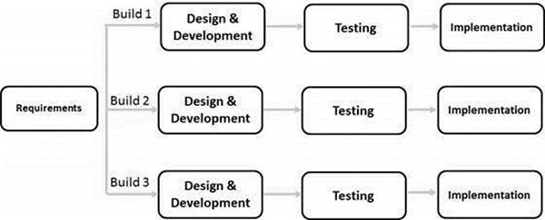
SDLC Models
Iterative Model Iterative process starts with a simple implementation of a subset of the software requirements and iteratively enhances the evolving versions until the full system is implemented.

Slide 10
SDLC Models
Iterative Model : At each iteration, design modifications are made and new functional capabilities are added. The basic idea behind this method is to develop a system through repeated cycles (iterative) and in smaller portions at a time (incremental). The key to a successful use of an iterative software development lifecycle is rigorous validation of requirements, and verification & testing of each version of the software against those requirements within each cycle of the model.

Slide 11
SDLC Models : Iterative Model : Application
This model is most often used in the following scenarios − Requirements of the whole system are clearly def. and understood. Major requirements must be defined; however, some functionalities or requested enhancements may evolve with time. A new technology is being used and is being learnt by the development team while working on the project. Resources with needed skill sets are not available and are planned to be used on contract basis for specific iterations. There are some high-risk features and goals may vary in the future.

Slide 12
SDLC Models : Iterative Model : Advantages
Some working functionality can be developed quickly and early in the life cycle. Results are obtained early and periodically. Parallel development can be planned. Progress can be measured. Less costly to change the scope/requirements. Testing and debugging during smaller iteration is easy.

Slide 13
SDLC Models : Iterative Model : Advantages
Easier to manage risk - High risk part is done first. With every increment, operational product is delivered. Issues, challenges and risks identified from each increment can be utilized/applied to the next increment. Risk analysis is better. It supports changing requirements. Initial Operating time is less. Better suited for large and mission-critical projects. During the life cycle, software is produced early which facilitates customer evaluation and feedback.

Slide 14
SDLC Models : Iterative Model : Disadvantages
More resources may be required. Although cost of change is lesser, but it is not very suitable for changing requirements. More management attention is required. System architecture or design issues may arise because not all requirements are gathered in the beginning of the entire life cycle. Not suitable for smaller projects. Management complexity is more. End of project may not be known which is a risk. Highly skilled resources are required for risk analysis. Projects progress is highly dependent upon the risk analysis phase.

Slide 15
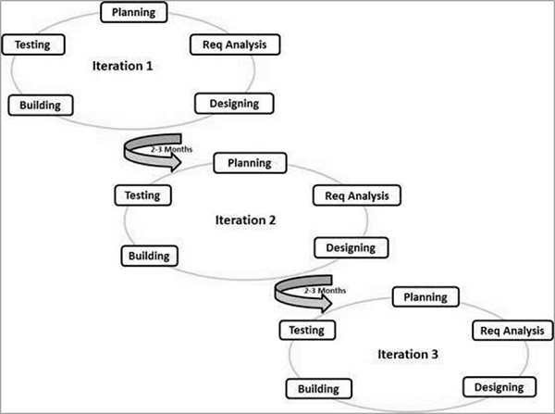
SDLC Models : Agile Model

Slide 16
SDLC Models : Agile Model
Agile SDLC model is a combination of iterative and incremental process models with focus on process adaptability and customer satisfaction by rapid delivery of working software product. Agile Methods break the product into small incremental builds. These builds are provided in iterations. Each iteration typically lasts from about one to three weeks.

Slide 17
SDLC Models : Agile Model
Every iteration involves cross functional teams working simultaneously on various areas like − Planning Requirements Analysis Design Coding Unit Testing and Acceptance Testing. At the end of the iteration, a working product is displayed to the customer and important stakeholders.

Slide 18
SDLC Models : Agile Model
Agile Manifesto principles − Individuals and interactions − In Agile development, self-organization and motivation are important, as are interactions like co-location and pair programming. Working software − Demo working software is considered the best means of communication with the customers to understand their requirements, instead of just depending on documentation. Customer collaboration − As the requirements cannot be gathered completely in the beginning of the project due to various factors, continuous customer interaction is very important to get proper product requirements. Responding to change − Agile Development is focused on quick responses to change and continuous development.

Slide 19
SDLC Models : Agile Model : Advantages
Is a very realistic approach to software development. Functionality can be developed rapidly and demonstrated. Resource requirements are minimum. Suitable for fixed or changing requirements Delivers early partial working solutions. Minimal rules, documentation easily employed. Enables concurrent development and delivery within an overall planned context. Little or no planning required. Easy to manage and gives flexibility to developers.

Slide 20
SDLC Models : Agile Model : Disadvantages
An overall plan, an agile leader and agile PM practice is a must without which it will not work. Strict delivery management dictates the scope, functionality to be delivered, and adjustments to meet the deadlines. Depends heavily on customer interaction, so if customer is not clear, team can be driven in the wrong direction. There is a very high individual dependency, since there is minimum documentation generated. Transfer of technology to new team members may be quite challenging due to lack of documentation.

Slide 21
Agile SCRUM Model
Scrum is an efficient framework. It is based on agile principles. This will help you understand - agile development in general and Scrum in specific. Concepts Artifacts Meetings Roles

Slide 22
Agile SCRUM Model : Concepts
Agile development Is based on iterative incremental development, requirements and solutions evolve with team collaboration. It recommends a time-boxed iterative approach, and encourages rapid and flexible response to change. It is a theoretical framework and does not specify any particular practice that a development team should follow.

Slide 23
Agile SCRUM Model : Concepts
Scrum It is the most popular agile framework, which concentrates particularly on how to manage tasks within a team-based development environment. Scrum uses iterative and incremental development model, with shorter duration of iterations. Scrum is relatively simple to implement and focuses on quick and frequent deliveries. The Scrum framework consists of Scrum Teams and their associated roles, events, artifacts, and rules

Slide 24
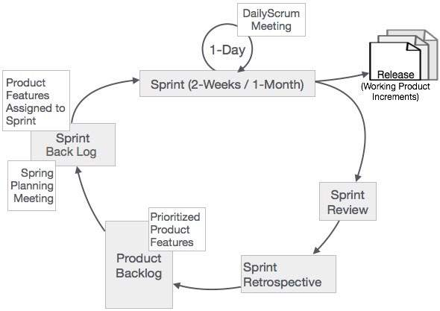
Agile SCRUM Model : Concepts
Scrum Process Framework All events are time-boxed events, such that every event has a maximum duration.

Slide 25
Agile SCRUM Model : Concepts
Sprint The heart of Scrum is a Sprint, a time-box of two weeks or one month during which a potentially releasable product increment is created. A new Sprint starts immediately after the conclusion of the previous Sprint. Sprints consist of :- Sprint planning, daily scrums, the development work, the Sprint review, and the Sprint retrospective.

Slide 26
Agile SCRUM Model : Events & Meetings
In Sprint planning, the work to be performed in the Sprint is planned collaboratively by the Scrum Team. The Daily Scrum Meeting is a 15-minute time-boxed event for Scrum Team to synchronize the activities and create a day plan. A Sprint Review is held at the end of the Sprint to inspect the Increment and make changes to the Product Backlog, if needed. The Sprint Retrospective occurs after the Sprint Review and prior to the next Sprint Planning. In this meeting, the Scrum Team is to inspect itself and create a improvement plan for next sprint.

Slide 27
Agile SCRUM Model : Events
The vital events of scrum are- The Sprint Sprint Planning Daily Scrum Meetings The Sprint Review The Sprint Retrospective

Slide 28
Agile SCRUM Model : Events - Sprint Planning
The work to be performed in Sprint is planned in this meeting. This Meeting is of duration of maximum of 4 hours for two weeks sprints and 8 hours for one month Sprints. The responsibility of the Scrum Master is to ensure that the meeting takes place and that all the required attendees are present and understand the purpose of the scheduled meeting.

Slide 29
Agile SCRUM Model : Events - Sprint Planning
Sprint Planning focuses on - What needs & can be delivered in the Sprint Increment? How will the work needed for the execution of Sprint be achieved? The inputs to this meeting are - The Product Backlog The latest product Increment Projected capacity of the Team during the Sprint Past performance of the Team

Slide 30
Agile SCRUM Model : Events – Daily Scrum
Daily Scrum Meeting is a 15-minute meeting for the Team, to quickly understand the work. This meeting is also referred to as Daily Stand up Meeting. During the meeting, each Team member explains - What did he do yesterday that helped to meet the Sprint Goal? What will he do today to help the Team to meet the Sprint Goal? Does he see any impediments that prevent him or the Team from meeting the Sprint Goal?

Slide 31
Scrum Events – Sprint Review
A presentation of the increment i.e. getting released is reviewed. Here, the Scrum Team and the stakeholders collaborate. The objective is to obtain feedback and progress unitedly. The Sprint Review is 2 hours for two week sprints and 4 four hours for one month sprints. The Scrum Master ensures that - The meeting takes place. The participants understand the purpose. The meeting is focused on the required agenda and done within the duration.

Slide 32
Scrum Events – Sprint Retrospective
This occurs after the Sprint Review and prior to the next Sprint Planning. This is usually a on1 hour meeting for two-week duration sprints and a 3 hour meeting for one month duration Sprints. This is an opportunity for the Scrum Team to introspect and improve within the Scrum process framework to make the next Sprint outcome more effective. The purpose of the Sprint Retrospective is to- Combine the learnings from the last Sprint, with regards to people, relationships, process, and tools. Identify the major items that went well and potential improvements. Creation of a plan for implementing improvements to increase product quality.

Slide 33
Agile SCRUM Model : Artifacts
The minimum required artifacts in a scrum project :- Product Backlog (User Stories) Sprint Backlog Burn-Down Chart Increment

Slide 34
Agile SCRUM Model : Artifacts
User story structure- As a <Type of User>, I want <To Perform Some Task>, So that <I can achieve some goal/benefit/value>. Example: Consider scenario of a Bank Customer withdrawing cash from ATM. User Story: Customer’s Cash Withdrawal As a Customer, I want to withdraw cash from an ATM, So that I don't have to wait in line at the Bank

Slide 35
Agile SCRUM Model : Artifacts
User Story Acceptance Criteria acceptance criterion for User Story Customer’s Withdrawal of Cash. Acceptance Criterion 1: Given that the account is creditworthy And the card is valid And the dispenser contains cash, When the customer requests the cash Then ensure the account is debited And ensure cash is dispensed And ensure the card is returned.

Slide 36
Agile SCRUM Model : Artifacts
User Story Acceptance Criteria acceptance criterion for User Story Customer’s Withdrawal of Cash. Acceptance Criterion 2: Given that the account is overdrawn And the card is valid When the customer requests the cash Then ensure the rejection message is displayed And ensure cash is not dispensed And ensure the card is returned.

Slide 37
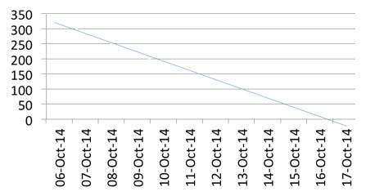
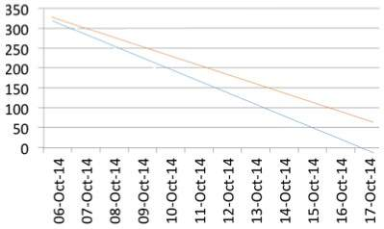
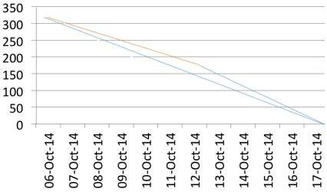
Agile SCRUM Model : Artifacts
Scrum burn-down Charts- consider a 2-week sprint - Sprint Duration: 2 Weeks No. of Days per Week: 5 No. of Hrs. per Day: 6 No. of Resources: 6 work done as planned work gets delayed team stretches to meet timeline

Slide 38
Agile SCRUM Model : Roles
ScrumMaster :- The ScrumMaster is the keeper of the scrum process. He/she is responsible for- making the process run smoothly removing obstacles that impact productivity organizing and facilitating the critical meetings

Slide 39
Agile SCRUM Model : Roles
Product Owner :- Is the sole person responsible for managing the Product Backlog. Product Backlog management includes- Expressing Product Backlog items clearly. Ordering the Product Backlog items to best achieve goals. Optimizing the value of the work the Team performs. Ensuring that the Product Backlog is visible, transparent, and clear to all, and shows what the Team will work on further. Ensuring that the Team understands items in the Product Backlog to the level needed.

Slide 40
Agile SCRUM Model : Roles
The Team :- The Team is self-organizing and cross-functional which comprises of analysts, designers, developers, testers, etc. To develop a software product, we require all the roles and that is the essence of scrum - the team will function in collaboration. Cross-functional teams have all competencies needed to accomplish the work without depending on others not part of the team, and thus time and effort can be saved.

Slide 41
STLC (Software Testing Life Cycle)
In the early stage of STLC, while the software or the product is developing, the tester can analyze and define the scope of testing, entry and exit criteria and also the Test Cases. It helps to reduce the test cycle time along with better quality. As soon as the development phase is over, the testers are ready with test cases and start with execution. This helps to find bugs in the initial phase.

Slide 42
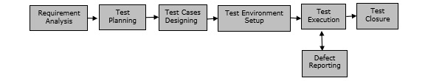
STLC (Software Testing Life Cycle)
6 major phases of STLC − Requirement Analysis − When the SRD is ready and shared with the stakeholders, the testing team starts high level analysis concerning the AUT (Application under Test). Test Planning − Test Team plans the strategy and approach. Test Case Designing − Develop the test cases based on scope and criteria’s. Test Environment Setup − When integrated environment is ready to validate the product. Test Execution − Real-time validation of product and finding bugs. Test Closure − Once testing is completed, matrix, reports, results documented.

Slide 43
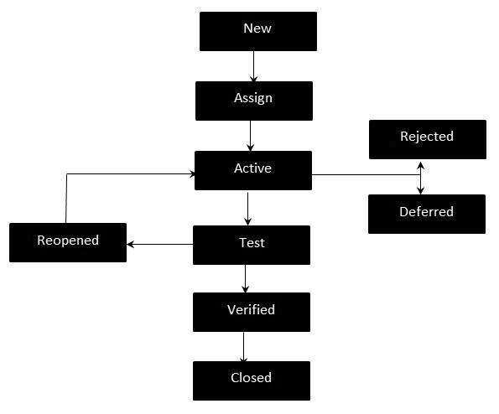
Defect Life Cycle – Workflow

Slide 44
States of a Defect Life Cycle
New − Potential defect that is raised and yet to be validated.
Assigned − Assigned against a development team to be addressed.
Active − The Defect is being addressed by the developer and investigation is under progress. At this stage, there are two possible outcomes – Deferred or Rejected.
Test / Fixed / Ready for Retest − The Defect is fixed and ready for testing.
Verified − The Defect that is retested and the test has been verified by QA.

Slide 45
States of a Defect Life Cycle
Closed − The final state of the defect that can be closed after the QA retesting or can be closed if the defect is duplicate or considered as NOT a defect.
Reopened − When the defect is NOT fixed, QA reopens/reactivates the defect.
Deferred − When a defect cannot be addressed in that particular cycle it is deferred to future release.
Rejected − A defect can be rejected for any of the three reasons – duplicate defect, NOT a Defect, Non Reproducible.

Slide 46
Test Scenario and its design aspect
Test cases are written using test scenario. It describes each transaction and expected result of each transaction included in test scenario. Test cases are executed through test data. Actors (Person, system, hardware, or software) are taking part in transaction. (Simple, Complex, Average Actors), Transactions represent the interactions of the actors with system under testing. Test case characteristics: Accurate, Economical, Real, and reusable, Traceable to requirements, Appropriate, Self standing, Self-cleaning… etc.)

