Slide 1
Software Testing
Objectives: Understand Requirement Traceability Matrix (RTM) Understand the Risk based testing Configuration Management Types of Testing - Functional and non-functional Load, Stress, Volume, Security, Usability, Compatibility, Accessibility, Reliability, Compliance, Sanity Test Design Techniques Test Automation Introduction

Slide 2
Software Testing : RTM
Requirement Traceability Matrix (RTM) :
is a document that maps and traces user requirement with test cases.
It captures all requirements proposed by the client and requirement traceability in a single document, delivered at the conclusion of the Software development life cycle.
Purpose is to validate that all requirements are checked via test cases such that no functionality is unchecked during Software testing.

Slide 3
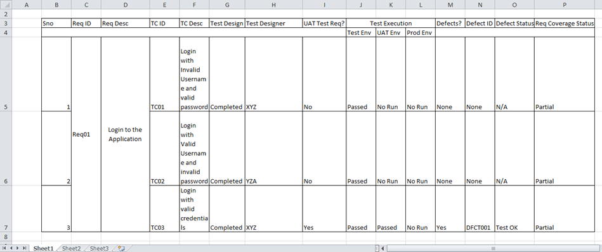
RTM Types & Login to the application(Example RTM)
RTM types :- 1. Forward traceability 2. Backward or reverse traceability 3. Bi-directional traceability ( Forward + Backward)

Slide 4
Software Testing : RTM Advantages
Advantage of Requirement Traceability Matrix :-
  It confirms 100% test coverage
  It highlights any requirements missing or doc. inconsistencies
  It shows the overall defects or execution status with a focus on business requirements
  It helps in analyzing or estimating the impact on the QA team's work with respect to revisiting or re-working on the test cases

Slide 5
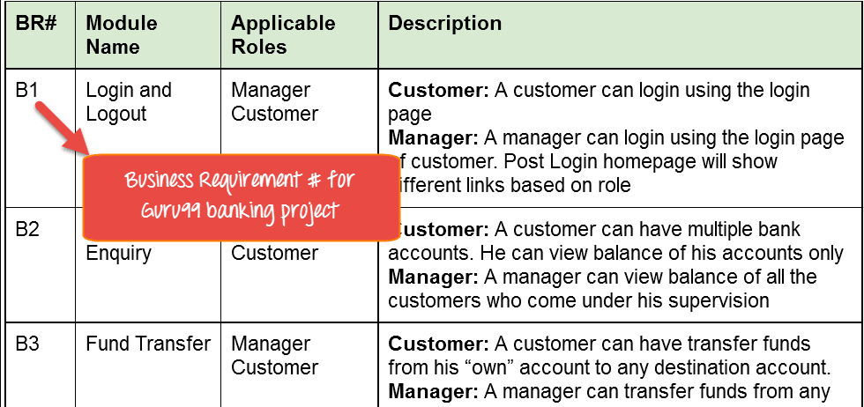
Software Testing : RTM Lab
Consider the following table is as Business Requirement Document for a Banking Project.

Slide 6
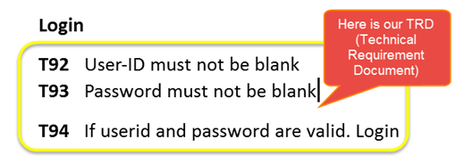
Software Testing : RTM Lab
Let's Go Ahead and create RTM in Testing.
Consider the scenario :-
The customer should be able to login to banking website with the correct password and user#id while manager should be able to login to the website through customer login page.
Below table is our Technical Requirement Document (TRD).

Slide 7
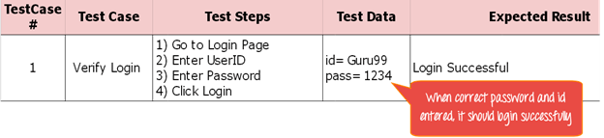
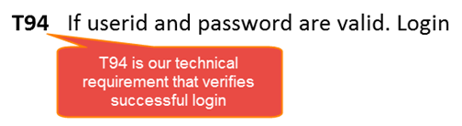
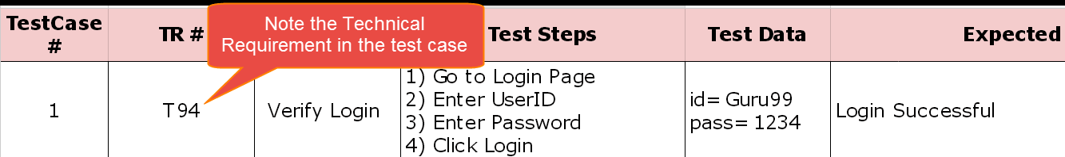
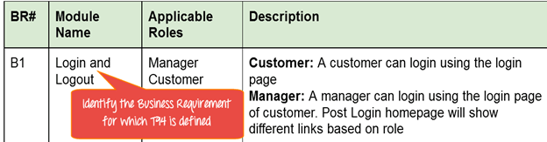
Software Testing : RTM

Slide 8
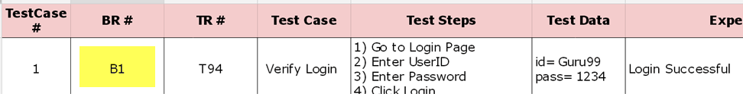
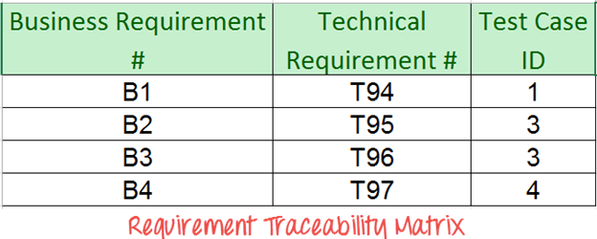
Software Testing : RTM
Do above for all Test Cases. Later Extract the First 3 Columns from your Test Suite. RTM in testing is Ready!
Note the BR in Test Case.

Slide 9
Software Testing : Risk Based Testing
Risk based testing is prioritizing the
feature's, modules and functions of Application Under Test based on impact and likelihood of failures.
It involves assessing the risk based on the :-
    complexity, business criticality, usage frequency,
    visible areas, Defect prone areas, etc.
Risk is the occurrence of an uncertain event with a positive or negative effect on the measurable success criteria of a project. Risks can be positive or negative.

Slide 10
Software Testing : Risk Based Testing
When To Use Risk based testing :-
Projects having time, resource, budget constraints, etc.
Security Testing in Cloud Computing Environments.
New projects with high risk factors like Lack of experience with the technologies used, Lack of business domain knowledge.
Incremental and iterative models, etc.

Slide 11
Software Testing : Risk Based Testing Approach
Documents (SRS, Usecases) are reviewed to find and eliminate errors & ambiguities.
Requirements sign-off's is one of the risk-reduction technique for avoiding the introduction of late changes into the projects.
Any changes to requirements after baselined would involve a change control process and subsequent approvals.
Use a risk register to list the set of identified risks. Update, monitor and track the risks periodically at regular intervals.
High-risk items can be tested by the resource with good domain knowledge experience.

Slide 12
Software Testing : Risk Based Testing Approach
Different test design techniques like decision table technique on high-risk test items and using 'only' equivalence partitioning for low-risk test items can use.
Test cases are executed according priority of the risk item.
Risk-based testing can be used at every level of testing, e.g. component, integration, system, and acceptance testing.
High-risk areas should be most intensively covered.

Slide 13
How To Do Risk Based Testing
Risk Identification
Risk Analysis
Risk Response
Test Scoping
Test Process definition

Slide 14
Configuration Management
A process of establishing and maintaining a product’s performance, functional and physical attributes with its requirements, design, and functionalities through its life.
Configuration Management is a change control process. It helps in managing & controlling the versions of software and hardware configurations. It is used primarily when software requirements change.
Goals Of Configuration Management :-
    Establish system and project product integrity.
    Maintain this integrity throughout the life cycle.

Slide 15
Activities & Items in Configuration Management
Items
Software requirements
Design
Code
Test Cases
Test Scripts
Test Plan
Project Plan
Activities
Configuration item identification
Change Control
Status Accounting
Audits

Slide 16
Configuration Management Board
Change Control is Board
including numbers of people which take important decisions regarding the Configuration Management of Projects.
Project Manager
User representative
Funding Manager
Contractor’s Project Manager
Configuration Manager
Quality Manager
System Engineer
Change Control Process
Change request submitted by the client.
Impact Assessment performed by BA
Recommendation prepared by BA
Report submitted to CCB
CCB deliberates and decides
Approved changes are entered in the configuration management documentation
Traceability matrices are updated

Slide 17
Types Of Testing
Main levels Software Testing
Functional Testing :
* The application is tested by providing input and results are examined to conform to the functionality it was intended for.
* Is conducted on a complete, integrated system to evaluate the system's compliance with its specified requirements
Non-Functional Testing :
* Non-functional testing involves testing a software from the requirements which are non-functional in nature but important .
* such as :- performance, security, user interface, etc.

Slide 18
Types Of Testing
Main levels Software Testing
Functional Testing :
Unit Testing
Integration Testing
System Testing
Sanity Testing
Smoke Testing
Regression Testing
Non-Functional Testing :
Performance Testing
Load Testing
Stress Testing
Volume Testing
Security Testing
Compatibility Testing
Reliability Testing
Usability Testing
Compliance Testing
Accessibility Testing

Slide 19
Type of Testing : Functional
Unit Testing : Performed by the respective developers on the individual units of source code assigned areas to isolate each part of the program and show that individual parts are correct in terms of requirements and functionality.
Integration Testing :The testing of combined parts of an application to determine if they function correctly. Integration testing can be done in two ways: Bottom-up integration testing and Top-down integration testing.
System Testing : tests the system as a whole. The application as a whole is tested rigorously to meets the specified Quality Standards. Performed by a specialized testing team.

Slide 20
Type of Testing : Functional
4. Sanity Testing :To verify new software ver. is performing well enough to accept it for testing effort or not. If app. is crashing for the initial use then the system is not stable enough for further testing.
5. Smoke Testing :Smoke Testing checks that no show stopper defect exists in the build which will prevent the testing team to test the application in detail. It is carried out to a detailed level of any Functional or Regression Testing.
6. Regression Testing : Testing the new changes to verify that the changes made did not affect any other area of the application. It Mitigates risks and increase speed to market the product.

Slide 21
Type of Testing : Non-functional
Performance Testing : This term is often used interchangeably with ‘stress' and ‘load' testing. Performance Testing is done to check whether the system meets the performance requirements.
2. Load Testing :testing the behaviour of a software by applying maximum load in terms of software accessing and manipulating large input data. It can be done at both normal and peak load conditions. automated tools such as Load Runner, AppLoader, Apache JMeter etc.
3. Stress Testing : Stress testing includes testing the behaviour of a software under abnormal conditions. For example, it may include taking away some resources or applying a load beyond the actual load limit.

Slide 22
Type of Testing : Non-functional
4. Volume Testing : The software or application undergoes a huge amount of data and Volume Testing checks the system behaviour and response time of the application when the system came across such a high volume of data. Performed by the Performance Testing team.
5. Security Testing : Testing a software in order to identify any flaws & gaps from security and vulnerability point of view. security testing aspects- Confidentiality, Integrity, Authentication, Authorization, etc.
6. Compatibility Testing : Compatibility testing ensures that software can run on a different configuration, different database, different browsers, and their versions. Performed by the testing team.

Slide 23
Type of Testing : Non-functional
7. Reliability Testing :It checks whether the soft. can perform a failure-free operation for a specified duration and environment.
8. Usability Testing : The usability of a product will be good and the system is usable if it possesses the five factors i.e. efficiency of use, learn-ability, memory-ability, errors/safety, and satisfaction.
Compliance Testing : Kind of an audit on the system to check if all the specified standards met or not. To ensure the compliances are met, regulators board and compliance experts are established.
10. Accessibility Testing : To determine whether the software or application is accessible for disabled (deaf, colour blind, mentally disabled, blind, old age and other disabled groups) people or not.

Slide 24
Testing Methods
1. Black-Box Testing : is the technique of testing without having any knowledge of the interior workings of the application. While performing a this a tester will interact with the system's UI by providing inputs and examining outputs without knowing how and where the inputs are worked upon.

Slide 25
Testing Methods
  2. White-Box Testing : is the detailed investigation of internal logic and structure of the code. White-box testing is also called glass testing or open-box testing.
  3. Grey-box testing : Is a technique to test the application with having a limited knowledge of the internal workings of an application. In software testing, the phrase the more you know, the better carries a lot of weight while testing an application.

Slide 26
Black-Box Test Design Techniques
Test design techniques are used to derive the test cases from the Requirement Specification document and also based on testers expertise : Equivalence Partitioning Boundary Value Analysis Decision Table State Transition Exploratory Testing Error Guessing

Slide 27
Test Design Techniques : Equivalence Partitioning
In Equivalence Partitioning, we divide the test conditions into class. From each group we do test only one condition.
Assumption is all the conditions in one group works in same manner.
A condition from a group works means all conditions works from group It reduces rework and also gives good test coverage.
We save time by reducing total number of test cases.
Example :
A field should accept numeric value. In this case, we split the test conditions as Enter numeric value, Enter alpha numeric value, Enter Alphabets, and so on. Instead of testing 0,1,2…

Slide 28
Test Design Techniques : Boundary Value Analysis
In Boundary value analysis, test conditions as partitions and design the test cases using the boundary values of the partition.
Boundary means where the behaviour of the application varies. Test conditions on both side of the boundary are boundary values. Here we have to get both valid boundaries (from the valid partitions) and invalid boundaries (from the invalid partitions).
Example: If we want to test a field which should accept only amount more than 10 and less than 20 then we take the boundaries as 10-1, 10, 10+1, 20-1, 20, 20+1.

Slide 29
Test Design Techniques : Decision Table
Decision Table is a Cause-Effect Table. This test technique is appropriate for functionalities which has logical relationships between inputs (if-else logic). In Decision table technique, we deal with combinations of inputs. To identify the test cases with decision table, we consider conditions and actions. We take conditions as inputs and actions as outputs

Slide 30
Test Design Techniques : State Transition
Using state transition testing, we pick test cases from an application where we need to test different system transitions. We can apply this when an application gives a different output for the same input, depending on what has happened in the earlier state. Some examples are Vending Machine, Traffic Lights. Vending machine dispenses products when the proper combination of coins is deposited. Traffic Lights will change sequence when cars are moving / waiting

Slide 31
Test Design Techniques : Exploratory Testing
Usually this process will be carried out by domain experts. They perform testing just by exploring the functionalities of the application without having the knowledge of the requirements. While using this technique, testers could explore and learn the system. High severity bugs are found very quickly in this type of testing.

Slide 32
Test Design Techniques : Error Guessing
Error guessing is one of the testing techniques used to find bugs in a software application based on tester’s prior experience. In Error guessing we don’t follow any specific rules. Examples: Submitting a form without entering values. Entering invalid values such as entering alphabets in the numeric field.

Slide 33
Test Automation
In Test Automation test scripts are executed by a software. This compares the actual result with the expected result. It can also automate repetitive tasks which is pre-defined, or additional test execution which is difficult to take up manually. Test Automation actually checks the application after development. Test automation needs less time, money and other resources.

Slide 34
Test Automation
When to Automate? Consider a situation where the bug is fixed in the code and the same feature was used in various modules. It is difficult to check the bug which is fixed, in previous functionality. While carrying out a test pass, regression test is carried out around the bug fixes. This testing execution is done every time a manual test is executed on a functionality. Working effectively will reduce the time and money. In such a situation, we consider Automation.

Slide 35
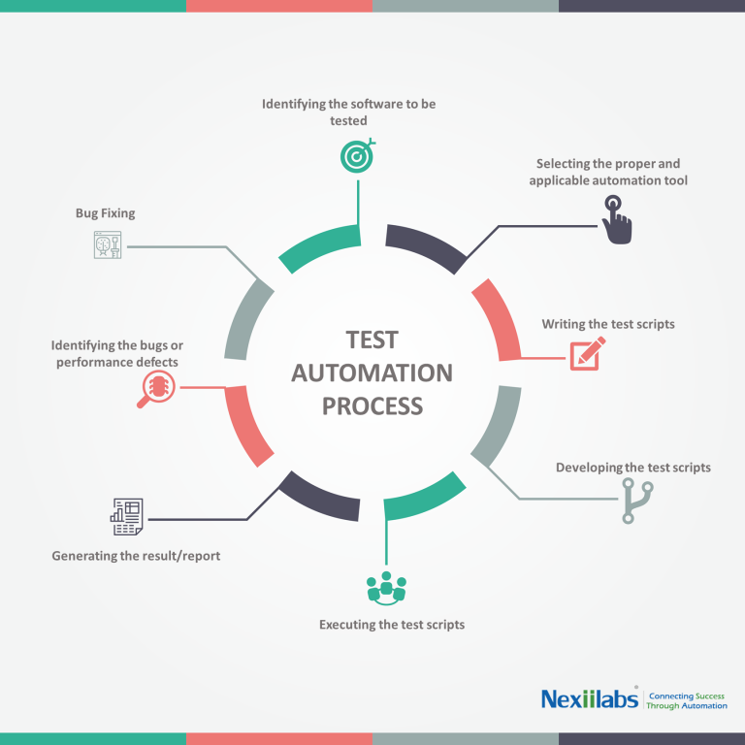
Test Automation Process

Slide 36
Test Automation Process
When starting a test development, its order has to be determined according to the priority. Software tools are used to write the scripts to automate a test process. Automation process involves — • Identifying the software to be tested • Selecting the proper and applicable automation tool • Writing the test scripts • Developing the test scripts • Executing the test scripts • Generating the result/report • Identifying the bugs or performance defects Test Automation Tools : Selenium, Rational Functional Tester, HP LoadRunner. Test automation can be used to test applications on load, performance and stress.

Slide 37
Test Automation
In Test Automation test scripts are executed by a software. This compares the actual result with the expected result. It can also automate repetitive tasks which is pre-defined, or additional test execution which is difficult to take up manually. Test Automation actually checks the application after development. Test automation needs less time, money and other resources.

