Slide 1
MACHINE LEARNING
PROJECT ABSTRACT
PRESENTED BY,
21PW06 - HARITHRA R
21PW08 - JENISA MERLIN D

Slide 2
HATE SPAN DETECTION

Slide 3
DESCRIPTION:
Hate span detection is the task of identifying the specific spans of text in a document that contain hate speech.
This is a more challenging task than simply classifying a text as hate speech or not, as it requires the model to identify the specific words or phrases that constitute the hate speech.
Eg: [Person with disability] are a burden to society.

Slide 4
PROBLEM STATEMENT:
Given a training dataset of text with hate speech spans annotated in BIO format, develop a machine learning model that can identify the start and end indices of hate speech spans in new text.
INPUT: The training dataset will consist of a set of text snippets, each with the information,
i)ID
ii)Text snippet
iii)Start and end indices of hate speech span in text snippet
iv)BIO tag for hate speech span

Slide 5
GOAL:
The machine learning model should output a prediction for the BIO tag for each word in new text.

Slide 6
DATASET:
Kaggle dataset – hatenorm23
https://www.kaggle.com/competitions/hatenorm23/data

Slide 7
TECHNOLOGY USED:
Natural Language Processing (NLP)
Deep learning model
Bidirectional recurrent neural networks (BRNNs)
Transformers

Slide 8
Natural Language Processing:
Named entity recognition is a NLP method that extracts information from text. NER involves detecting and categorizing each word in a statement.
In our model, we used BIO formatting for categorizing the words which tokenizes each word as Begin, inside, Outside according to the hate words detected.

Slide 9
Deep learning Models:
Bidirectional Recurrent Neural Networks (BRNN) is used to process sequential data.
In order for the network to use information from both the past and future context in its predictions, BRNNs process input sequences in both the forward and backward directions.
We have used Bidirectional Encoder Representations from Transformers(BERT) to handle huge amount of data in a sentence.
BERT is like a super-smart computer program that learns to understand the meaning of words in sentences by looking at the words around them. It doesn't just look at one word at a time; it considers the whole sentence.

Slide 10
METHODS:
Collect a training dataset.
Clean and pre-process the data.
Choose a machine learning algorithm.
Train the model.
Evaluate the model.
Deploy the model.

Slide 11
LIBRARIES & PACKAGES:
pyTorch: flexible and dynamic neural network (deep learning model)
Transformers: pretrained models (token classification, text classification, language generation)
AdamW: optimizer
Pandas
Numpy
Tensors: mathematical operations in neural networks

Slide 12
PROGRESS:
Collected dataset from Kaggle
Preprocessed and cleaned the data
Started training the model
Used machine learning as well as deep learning model
Designed front end part
Machine learning model - Logistic Regression (just to understand the classification of BIO tags)
Very low accuracy
Deep learning model - Transformers (BERT model) and BRNN

Slide 13
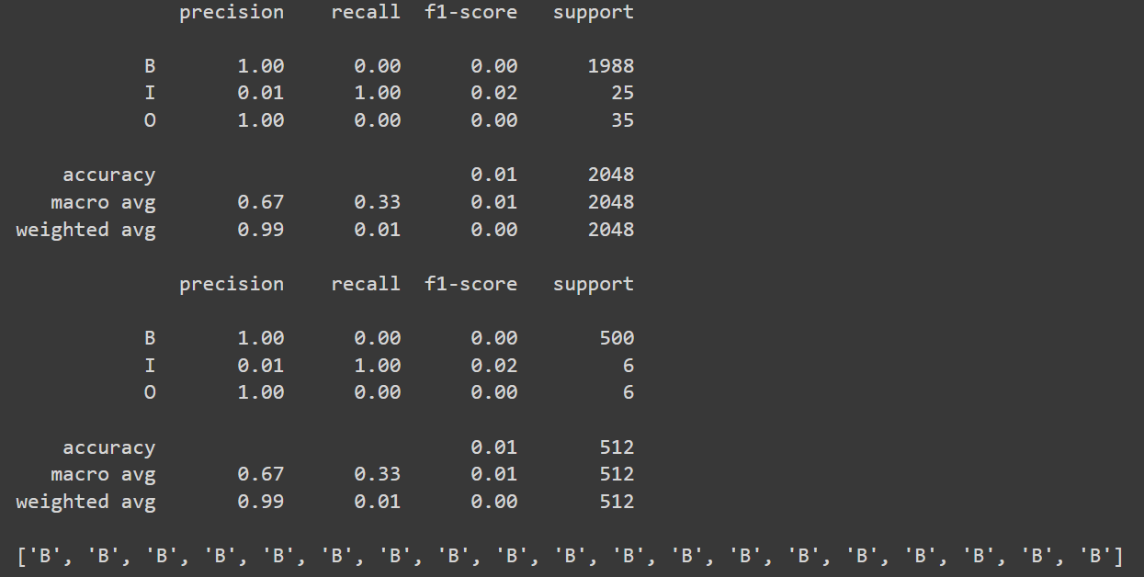
INITIAL WORK:

Slide 14
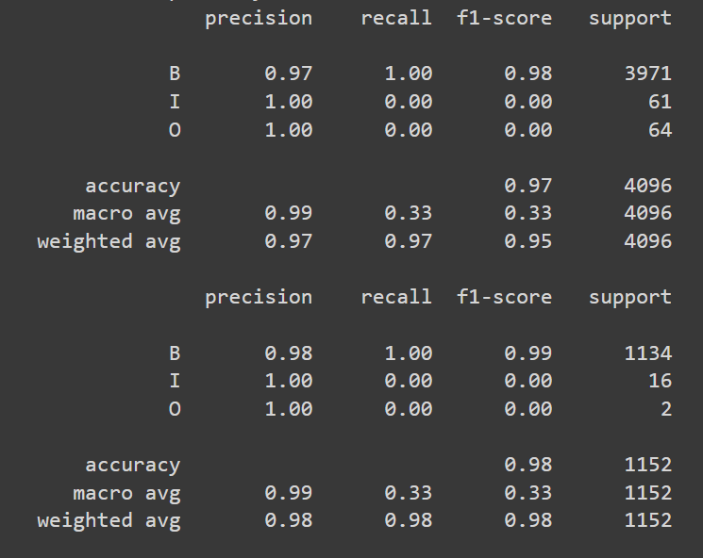
After several training only slight improvement,

Slide 15
CHALLENGES:
Cleaning the data
Data imbalance
Computational resources
More time to train
Difficult to understand and debug
Hyperparameter tuning (batch size, learning rates, no.of epochs)

Slide 16
THANK YOU

