Slide 1
7TH-SEMESTER MACHINE LEARNING LABORATORY | PROJECT-BASED LEARNING (PBL)
EduPredict: A Classical Machine Learning Framework Implemented From Scratch
Early Academic Performance and Risk Prediction on the UCI Mathematics Dataset
Candidate Details: [Student Name] | Roll Number: [Roll Number / Registration ID]
Department: [Department of Computer Science and Engineering / AI & DS]
Institution: [Institution / University Name]
Supervisor: [Faculty Supervisor / Mentor Name, Designation] | Date: [October 2026]
Notes:
Good morning respected evaluators and faculty members. Today, I am presenting EduPredict, a complete classical machine learning framework implemented entirely from scratch in pure Python. The objective of this 7th-semester PBL project is to demystify black-box ML algorithms by constructing mathematical foundations, optimizers, estimators, and evaluation metrics from first principles to predict student performance and academic risk.

Slide 2
CONTEXT & SIGNIFICANCE
Problem Statement & Educational Motivation
The Real-World Educational Problem:
• Academic Failure Timing: Conventional monitoring acts reactively after preliminary exams (periods 1 and 2), leaving minimal remedial time.
• Early Warning Need: True pedagogical intervention requires predicting academic risk early in the term using non-grade attributes.
• Student Retention Impact: Identifying students at risk of course retention enables proactive advising, tutoring, and support.
The Engineering & Pedagogical Challenge:
• The Black-Box Library Trap: In typical student projects, Scikit-learn and Pandas obscure underlying optimization, linear algebra, and data leakage.
• From-Scratch Imperative: Every matrix operation, loss derivative, distance metric, and tree partition is built without external libraries.
• Zero Third-Party Dependency: Strictly 0% NumPy, Pandas, Scikit-learn, SciPy, or PyTorch; and zero standard math/statistics imports in core code.
Notes:
In this slide, we outline both the domain problem and the pedagogical motivation. In secondary schools, waiting for preliminary exam grades often means intervening too late. Our goal is early prediction before exam marks exist. Simultaneously, our engineering challenge is to implement every single component from scratch—providing 100% transparent algorithmic explainability.

Slide 3
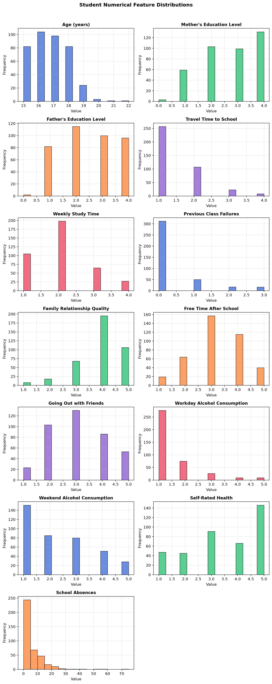
DATA FOUNDATIONS
Dataset & Dual Task Formulation
UCI Student Performance Benchmark (Cortez & Silva, 2008):
• Origin: Secondary public school records in the Alentejo region, Portugal.
• Dimensions: N = 395 student instances, 33 original attributes.
• Feature Scope: Demographic factors (school, sex, age, address, family size), parental background (Medu, Fedu, Mjob, Fjob), study habits (studytime, failures), and social lifestyle (alcohol Dalc/Walc, freetime, romantic, absences).
• Offline CSV: Stored locally in data/student-mat.csv for reproducible execution.
Dual Task Definitions & Anti-Leakage Rules:
• Task 1 (Regression): Predict final math score G3 in [0, 20]. Intermediate scores G1 and G2 strictly EXCLUDED to eliminate trivial autoregressive leakage.
• Task 2 (Classification): Predict academic risk: Risk = 1 if G3 < 10 (official Portuguese failure threshold), else 0. Features G1, G2, and G3 strictly EXCLUDED.
Notes:
Here we introduce the UCI dataset and our dual-task formulation. A critical design decision is the strict exclusion of G1 and G2. In many naive student projects, G1 and G2 are fed into the model, producing artificially high R2 values exceeding 0.80. In reality, that is temporal data leakage. We enforce early intervention by predicting final outcomes before intermediate grades exist.

Slide 4
SYSTEM DESIGN
Zero-Dependency Pipeline Architecture
Component Layer | Implementation Strategy | Dependency Boundary Verification
Matrix & Vector Math | Custom Matrix Engine (matrices.py, vectors.py) | Zero NumPy / SciPy; Gauss-Jordan inversion with partial pivoting
Descriptive Stats | Custom Stats Engine (stats.py) | Zero Pandas; Bessel-corrected variance, Pearson correlation matrix
Exp & Log Functions | Range-Reduced Taylor Series (activations.py) | Zero math / statistics modules; error < 1.2e-12 over [-709, 709]
Leak-Free Preprocessing | SimpleImputer, OneHotEncoder, StandardScaler | Fitted strictly on training split; unseen categories safely handled
Model Estimators | LinearRegression, KNNClassifier, DecisionTreeClassifier | 100% custom from-scratch algorithms in edupredict/models/
Losses & Gradients | MSE, MAE, Analytical Gradients with Momentum | Zero PyTorch / TensorFlow; checked against finite differences
Evaluation Metrics | MSE, RMSE, MAE, R², Acc, Prec, Rec, F1, ROC-AUC | First-principles calculations; trapezoidal numerical ROC integration
Interactive Dashboard | Streamlit & Matplotlib (app.py, plots.py) | Matplotlib strictly for rendering PNGs; all logic is custom scratch
Notes:
This slide defines our strict architectural boundary. We implemented every layer of the ML pipeline from first principles. Notice that our AST compliance scanner verifies that zero prohibited libraries are imported anywhere in the core package. Matplotlib and Streamlit are used strictly for visual rendering and presentation, with all underlying calculations handled by our own code.

Slide 5
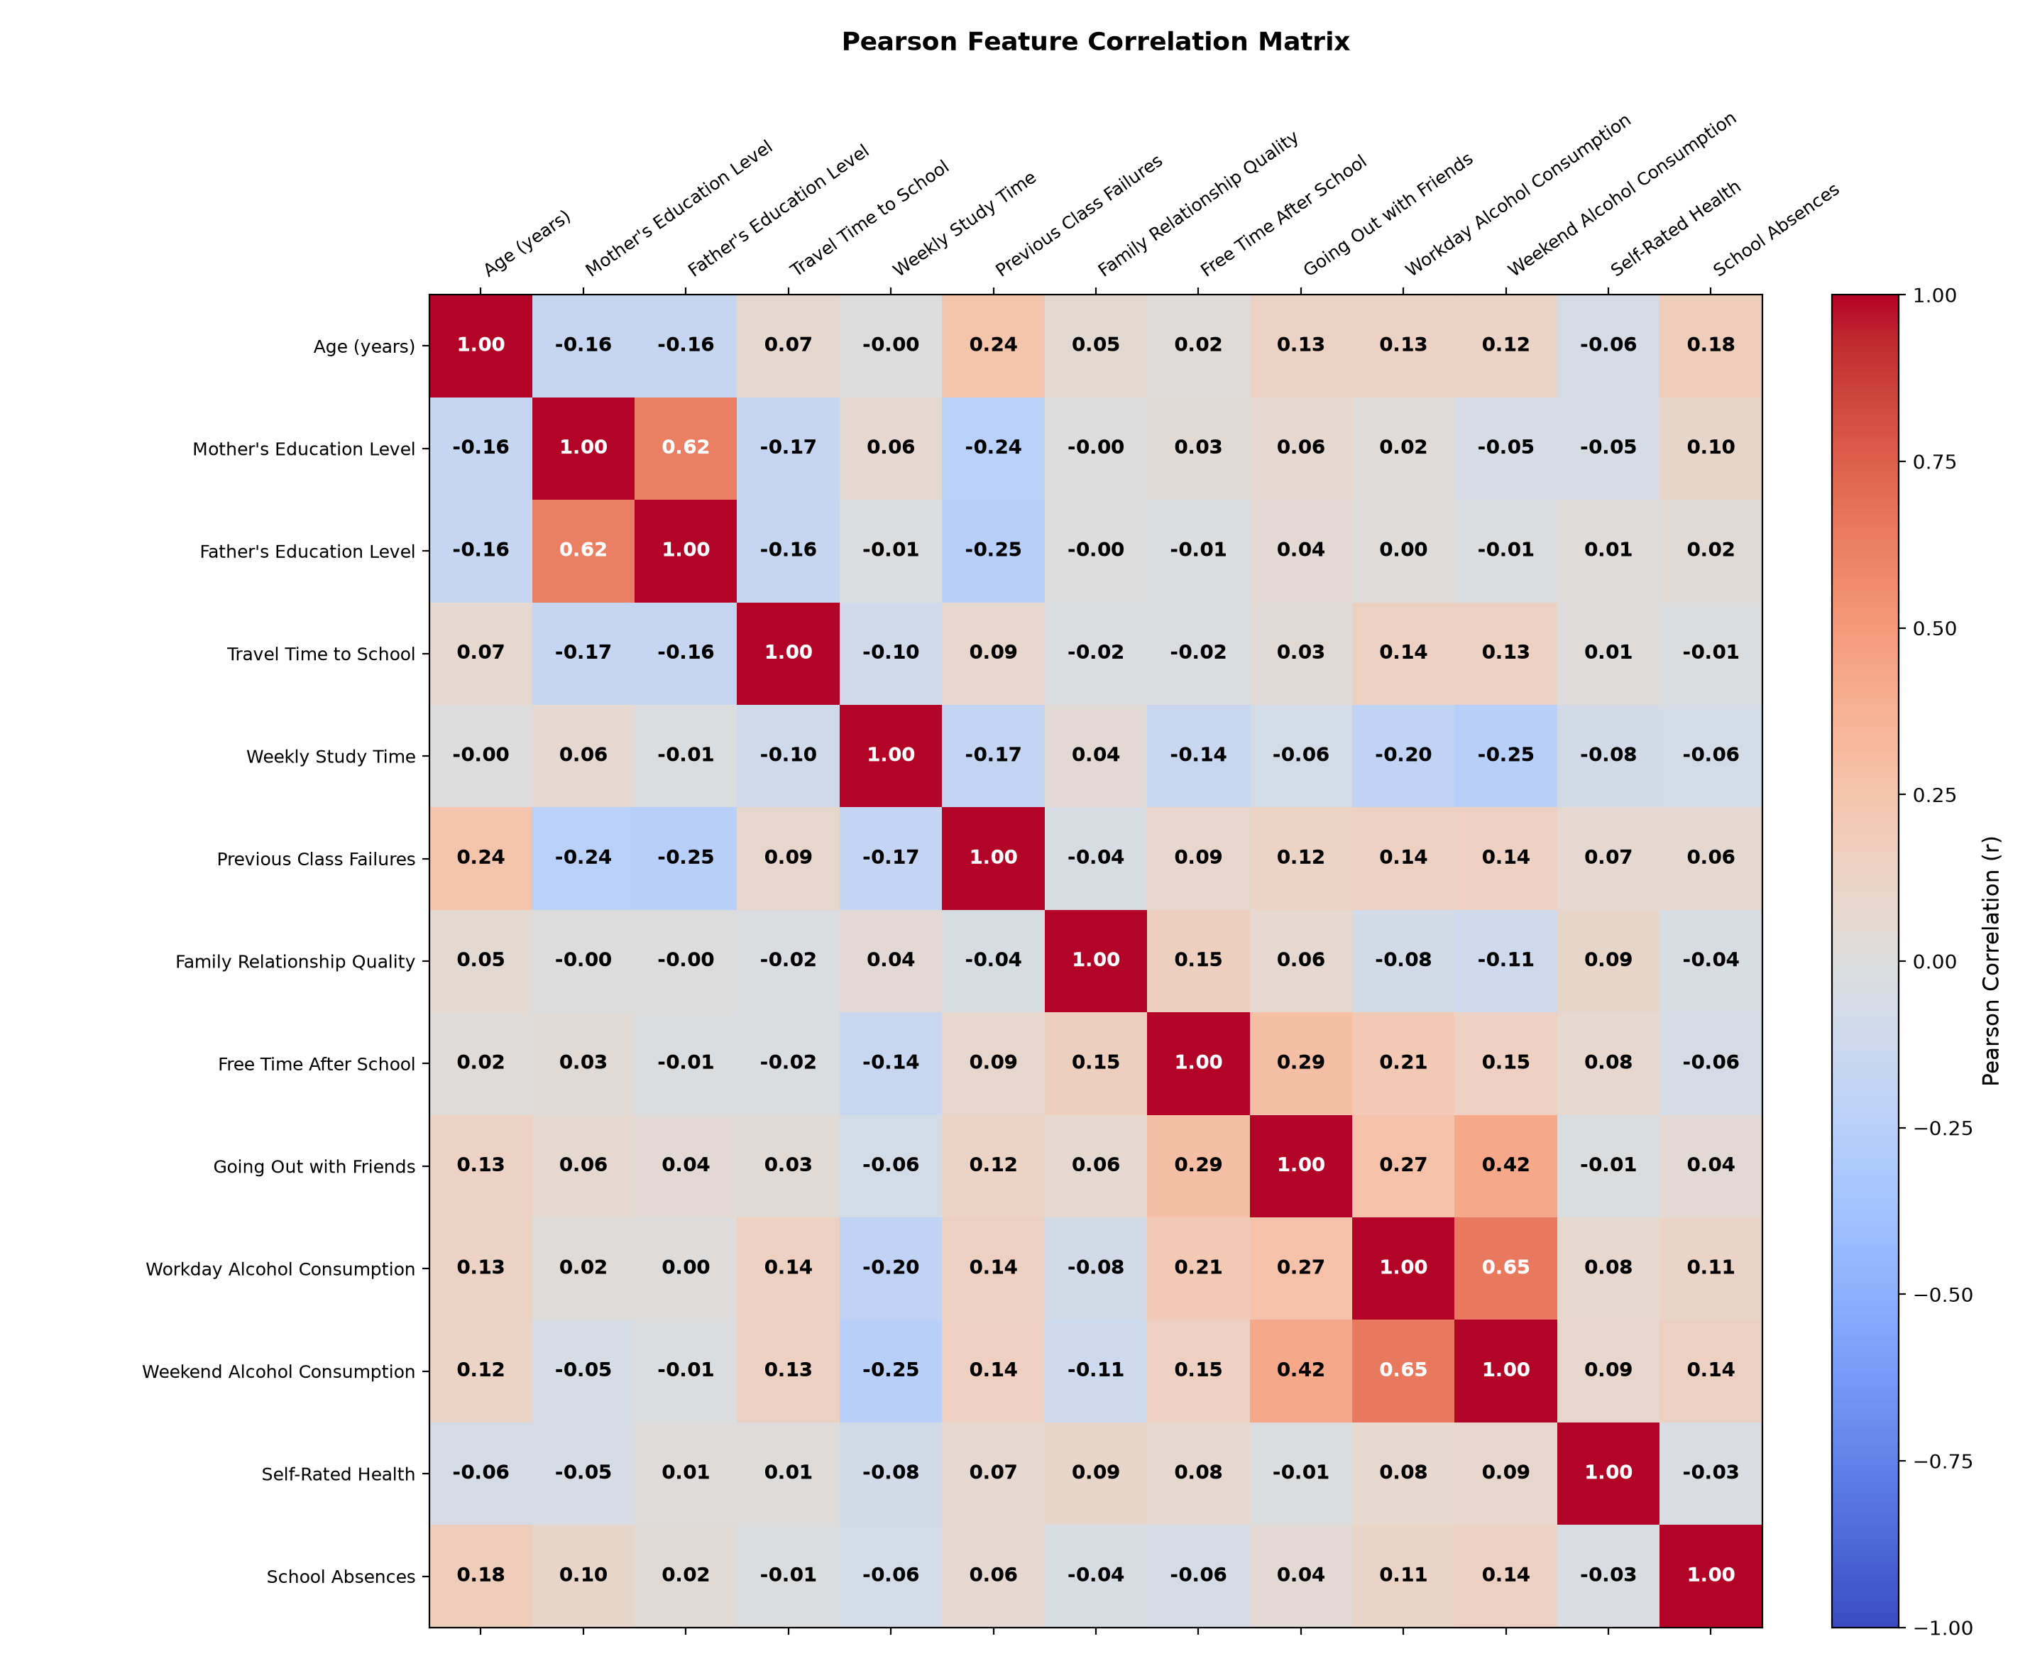
DATA PIPELINE
Leak-Free Preprocessing & Feature Engineering
Three Modular Scratch Preprocessing Engines:
• SimpleImputer (edupredict/preprocessing/imputer.py):
• Numerical: Mean imputation mu = (1/N) sum x_i computed on training data.
• Categorical: Mode imputation (most frequent training category).
• OneHotEncoder (edupredict/preprocessing/encoder.py):
• Categorical expansion: 17 nominal attributes expand into 27 binary columns.
• Unseen Category Safeguard: Encodes unseen categories at test time as all-zero vectors, preventing indexing crashes.
• StandardScaler (edupredict/preprocessing/scaler.py):
• Normalizes features: z = (x - mu) / sqrt(sigma^2 + eps).
• Parameters mu and sigma are frozen during training and reused on test splits.
• Total Representation: Concatenation yields exactly D = 40 dense numerical features from 30 initial non-leaky attributes.
Notes:
Here we show our leak-free preprocessing pipeline. We convert 17 categorical features into one-hot binary indicators with unseen-category robustness. Combined with 13 numerical attributes, we operate on 40 feature dimensions. Crucially, all imputer means and scaler variances are fitted strictly on the training partition.

Slide 6
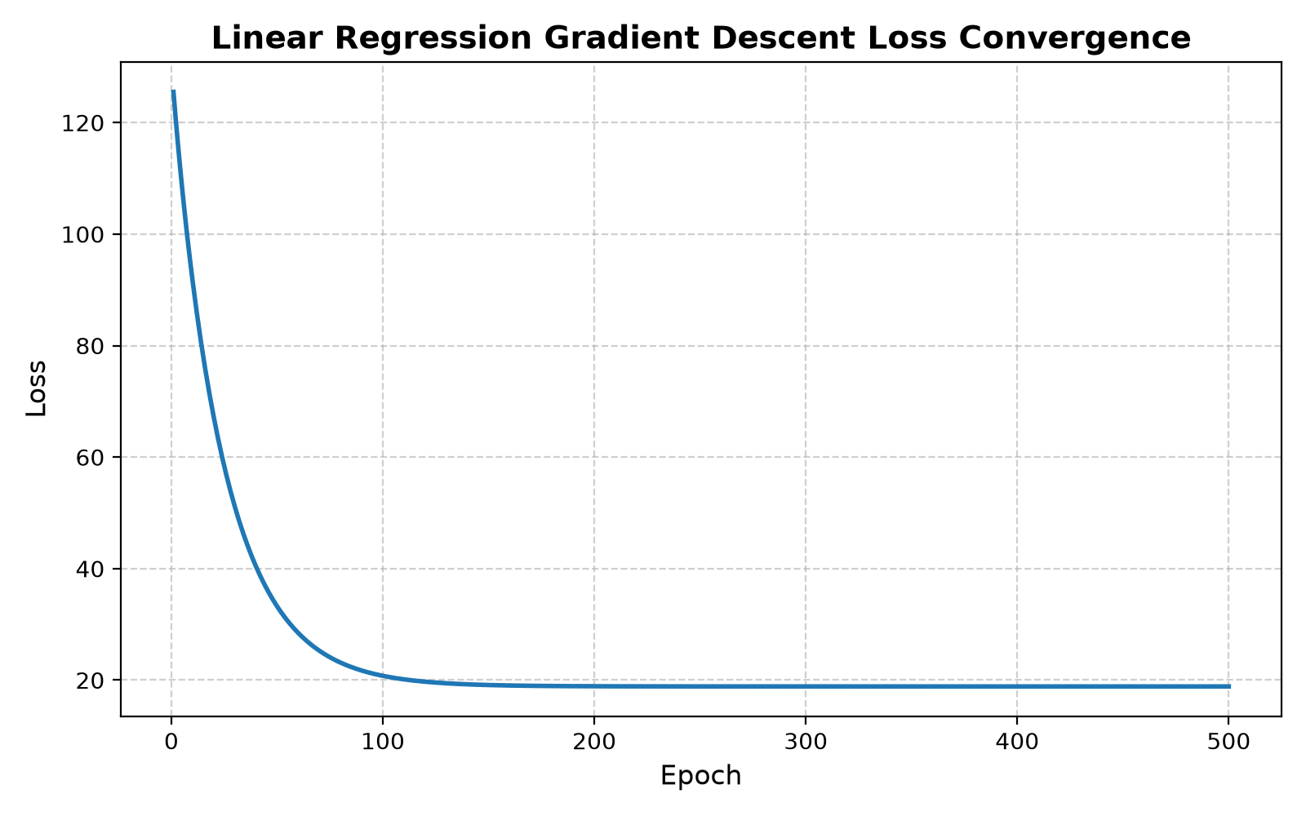
MODEL FAMILY 1
Custom Linear Regression Methodology
Dual-Solver Mathematical Formulation:
• Objective Loss Function (MSE with L2 Ridge Regularization):
J(w, b) = (1/N) sum_{i=1}^N (w^T x_i + b - y_i)^2 + lambda ||w||_2^2
• Solver 1: Closed-Form Normal Equation:
• Solves: w = (X_c^T X_c + N * lambda * I)^(-1) X_c^T y_c
• Inversion via Gauss-Jordan elimination with partial row pivoting.
• Sample-count scaling (N * lambda) guarantees exact parity with GD MSE loss.
• Unpenalized intercept: b = y_bar - w^T x_bar.
• Solver 2: Iterative Gradient Descent with Polyak Momentum:
• Gradients: nabla_w J = (2/N) X^T (X w + b 1 - y) + 2 lambda w
• Velocity Update: v_t = beta * v_{t-1} + nabla_w J
• Parameter Update: w_{t+1} = w_t - alpha * v_t
• Early stopping: Monitors loss reduction Delta J across patience epochs.
Notes:
This slide presents Custom Linear Regression. We implement two solvers: closed-form Normal Equation and iterative Gradient Descent. A key discovery during our audit was that the Normal Equation regularization diagonal must be scaled by N to match the gradient descent MSE normalization. When scaled consistently, both solvers find the exact same weight vector down to machine precision.

Slide 7
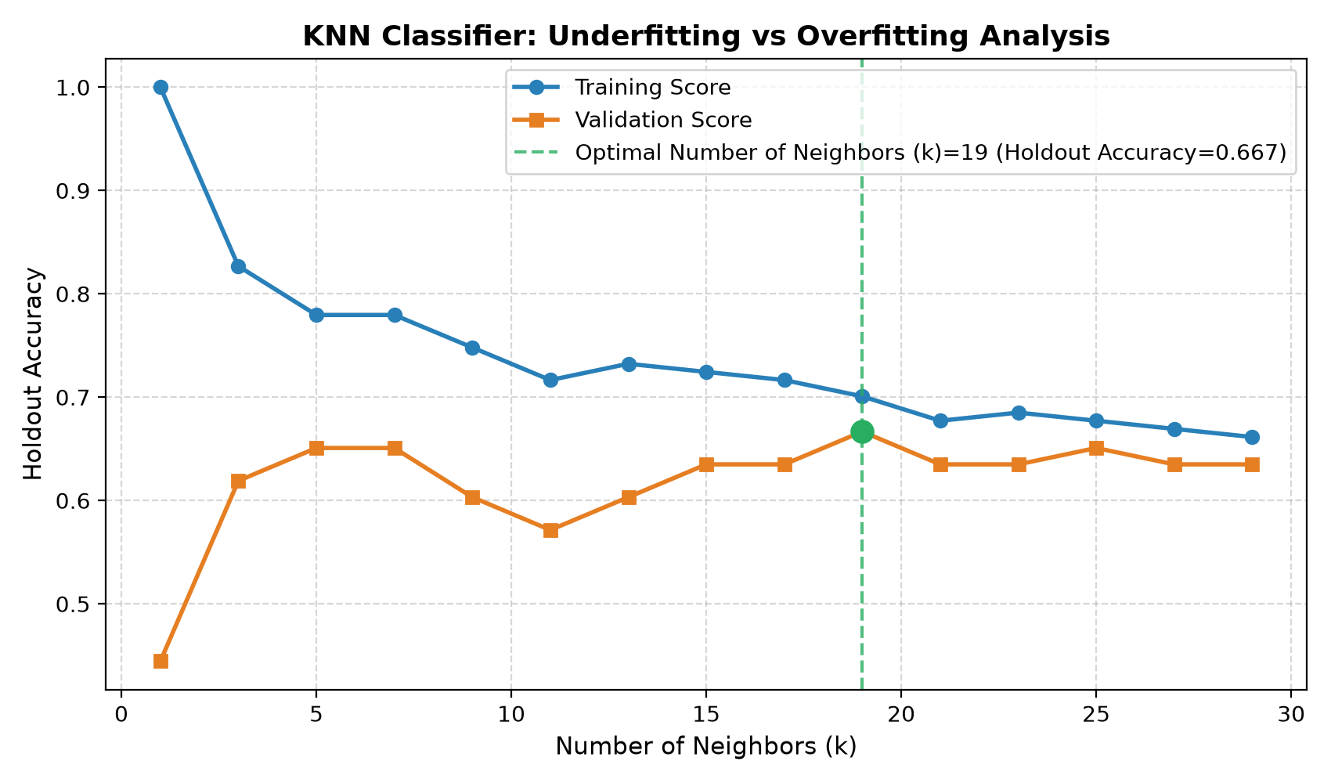
MODEL FAMILY 2
Custom K-Nearest Neighbors Classifier Methodology
Instance-Based Non-Parametric Classification:
• Distance Metric Formulations:
• Euclidean (L2): d_E(u, v) = sqrt( sum_{j=1}^D (u_j - v_j)^2 )
• Manhattan (L1): d_M(u, v) = sum_{j=1}^D |u_j - v_j|
• Neighborhood Search & Voting:
• Computes pairwise distances from query vector x_q to all N training vectors.
• Slices top-k nearest neighbors via partial index sorting.
• Voting schemes: Uniform voting (1 vote per neighbor) or Distance-weighted voting: w_i = 1 / (d(x_q, x_i) + 1e-9).
• Deterministic Tie-Breaking:
• Resolves exact vote ties deterministically using predefined class order [0, 1].
• Class Probability Calibration (predict_proba):
• Calculates posterior class probability: P(y = c | x_q) = V_c / sum_k V_k.
Notes:
Here we show our Custom KNN Classifier. We support both Euclidean and Manhattan distances, uniform and inverse-distance weighting, and deterministic tie-breaking. The figure on the right shows the overfitting curve: at k=1, the model memorizes training noise, while increasing k smooths the boundary.

Slide 8
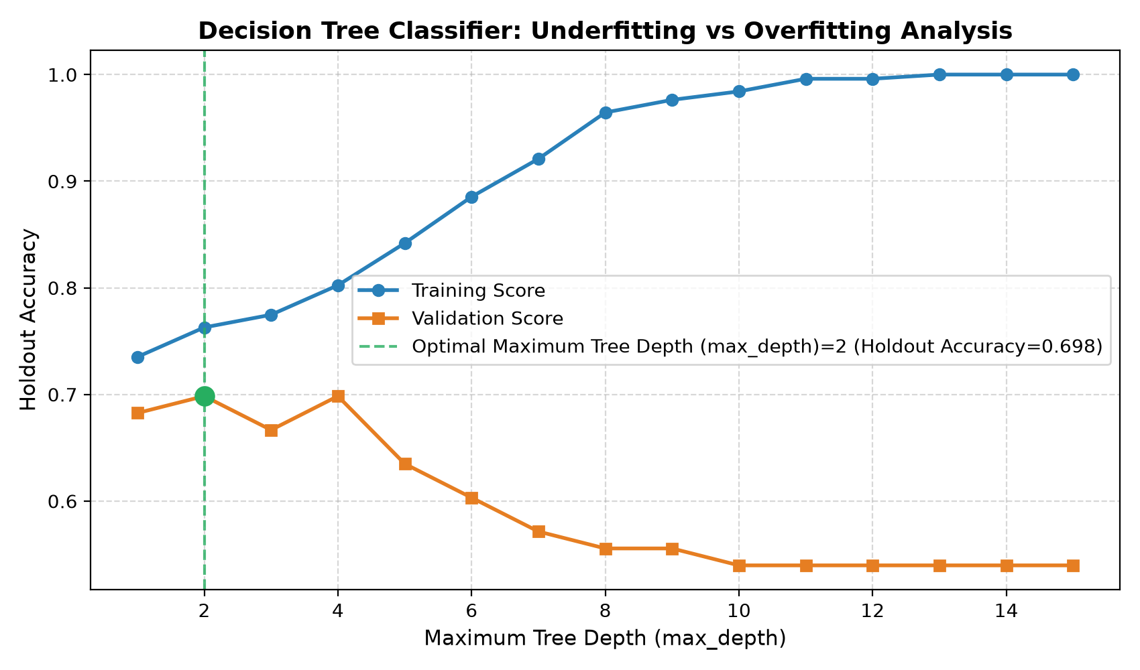
MODEL FAMILY 3
Custom Decision Tree Classifier Methodology
Recursive Binary Partitioning via Gini Impurity:
• Gini Impurity Criterion:
Gini(S) = 1 - sum_{k=1}^C p_k^2 (for C classes with empirical proportions p_k)
• Split Optimization & Gini Gain:
• Evaluates candidate midpoints theta = (v_i + v_{i+1})/2 between sorted feature values.
• Maximizes impurity reduction:
Delta Gini = Gini(S) - [ (|S_L|/|S|) Gini(S_L) + (|S_R|/|S|) Gini(S_R) ]
• Pruning & Stopping Constraints:
• max_depth: Limits tree expansion to prevent overfitting.
• min_samples_split & min_samples_leaf: Prevents splitting tiny subsets.
• Feature Importance Attribution:
• Tracks weighted impurity decrease across all tree splits: I(j) = sum N_t Delta Gini(t).
Notes:
This slide covers our Custom CART Decision Tree. We split nodes by evaluating continuous midpoint thresholds that maximize Gini Gain. As seen in the right curve, unconstrained trees overfit heavily as depth exceeds 4. Regularizing tree depth to max_depth=2 is critical for holdout generalization.

Slide 9
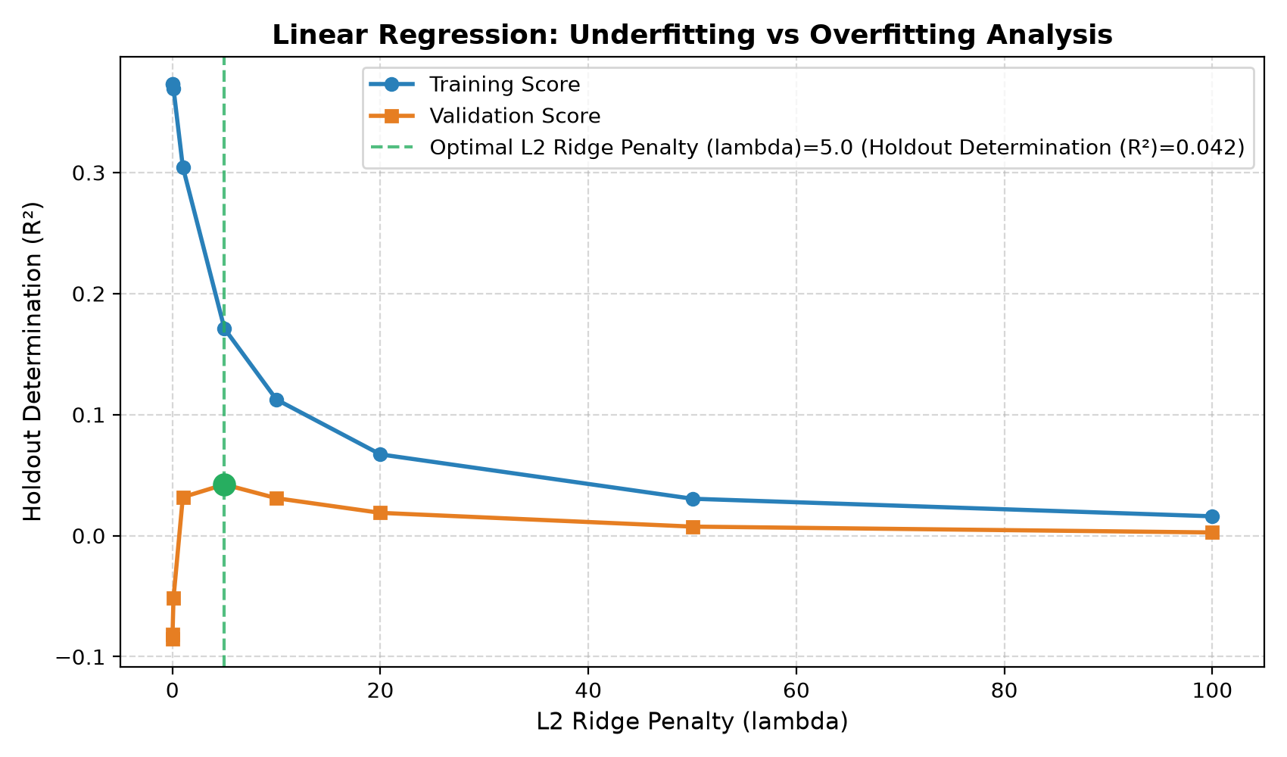
VALIDATION DISCIPLINE
Experimental Protocol & 3-Way Partitioning
Disciplined 3-Way Partition Protocol:
• Locked Holdout Test Set (79 samples, 20%):
• Completely isolated and frozen upfront at seed 42.
• Evaluated exactly ONCE after all hyperparameters are selected.
• Development Pool (316 samples, 80%):
• Partitioned internally into Train-Sub (253 samples) and Validation (63 samples).
• Classification splits are stratified to preserve the 32.9% at-risk ratio.
• Hyperparameter Selection on Validation:
• Linear Regression: lambda* = 5.0 selected via peak validation R² (+0.0423).
• Decision Tree: max_depth* = 2 selected via peak validation accuracy (69.84%).
• KNN: k = 5 evaluated as canonical comparison baseline (validation sweep peaks at k = 19, 66.67% accuracy).
• Scientific Guarantee: Zero peeking at holdout test results during tuning.
Notes:
Here we document our experimental protocol. We separate a 79-sample holdout test set before tuning any hyperparameters. All complexity curves and parameter selections were conducted on the 63-sample internal validation split. This guarantees that our reported test metrics are genuine out-of-sample evaluations.

Slide 10
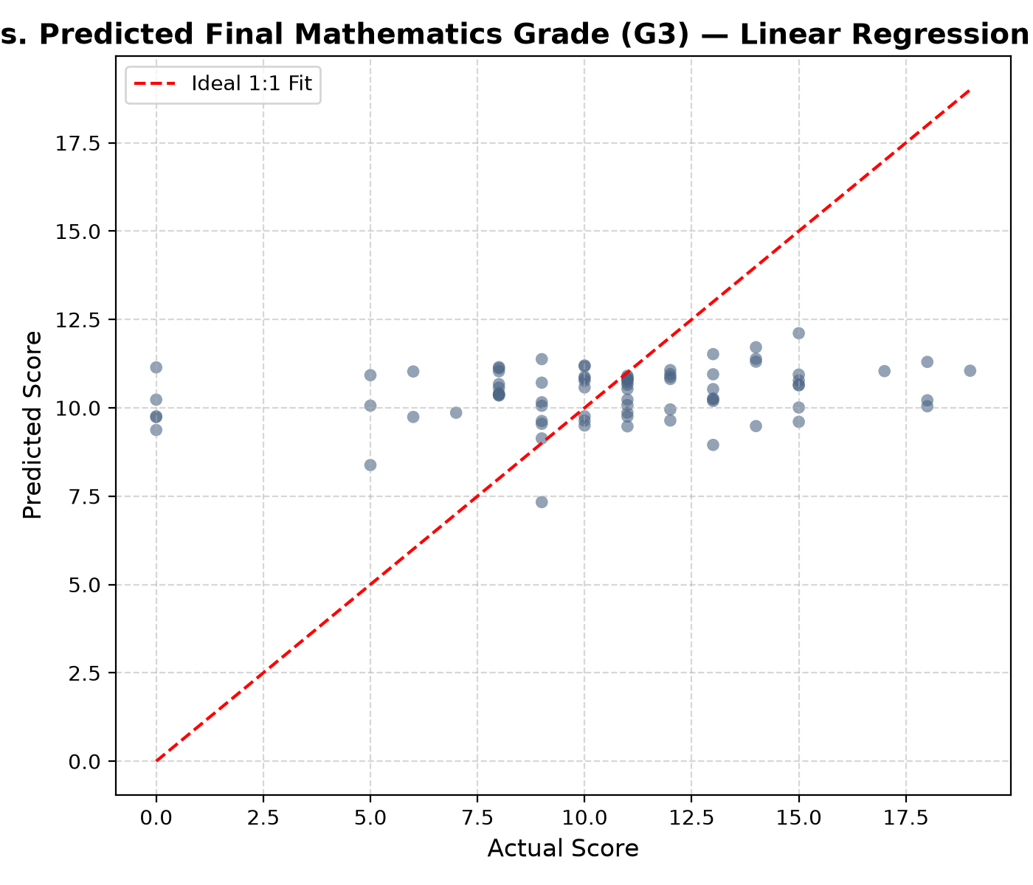
TASK 1: GRADE PREDICTION (G3)
Regression Results & Baseline Comparison
Model / Configuration | Solver / Params | MSE | RMSE | MAE | R² | vs. Mean Baseline
Custom Linear Regression (Selected) | Gradient Descent (lambda=5.0) | 15.5334 | 3.9412 | 2.9036 | +0.0600 | Outperforms Baseline (MSE -6.0%)
Custom Linear Regression (Selected) | Normal Equation (lambda=5.0) | 15.5334 | 3.9412 | 2.9036 | +0.0600 | Exact Numerical Parity (< 1e-14 diff)
Custom Linear Regression (Unregularized) | Gradient Descent (lambda=0.0) | 18.1640 | 4.2619 | 3.2491 | -0.0992 | Underperforms (overfitting variance)
Training-Mean Baseline | Predicts y_bar = 10.4082 | 16.5264 | 4.0653 | 2.9995 | -0.0001 | Domain Reference Benchmark
Key Empirical Regression Findings:
• Baseline Performance: Predicting training mean (10.41) yields test MSE 16.53 and R² = -0.0001.
• Unregularized OLS Overfitting: Fitting 40 features on 316 samples inflates weight variance, yielding negative R² (-0.0992).
• L2 Shrinkage Efficacy: Moderate regularization (lambda=5.0) shrinks noise weights, reducing MSE to 15.53 and delivering positive R² (+0.0600).
• Solver Convergence: GD and Normal Equation agree within 1e-14, confirming theoretical parity.
Notes:
In Task 1, predicting final grades without intermediate exam marks, our regularized linear model achieves MSE 15.53 and R² = +0.0600. Notice that unregularized regression had R² = -0.0992 because of feature estimation variance. Moderate L2 regularization successfully recovers predictive signal, beating the training-mean baseline.

Slide 11
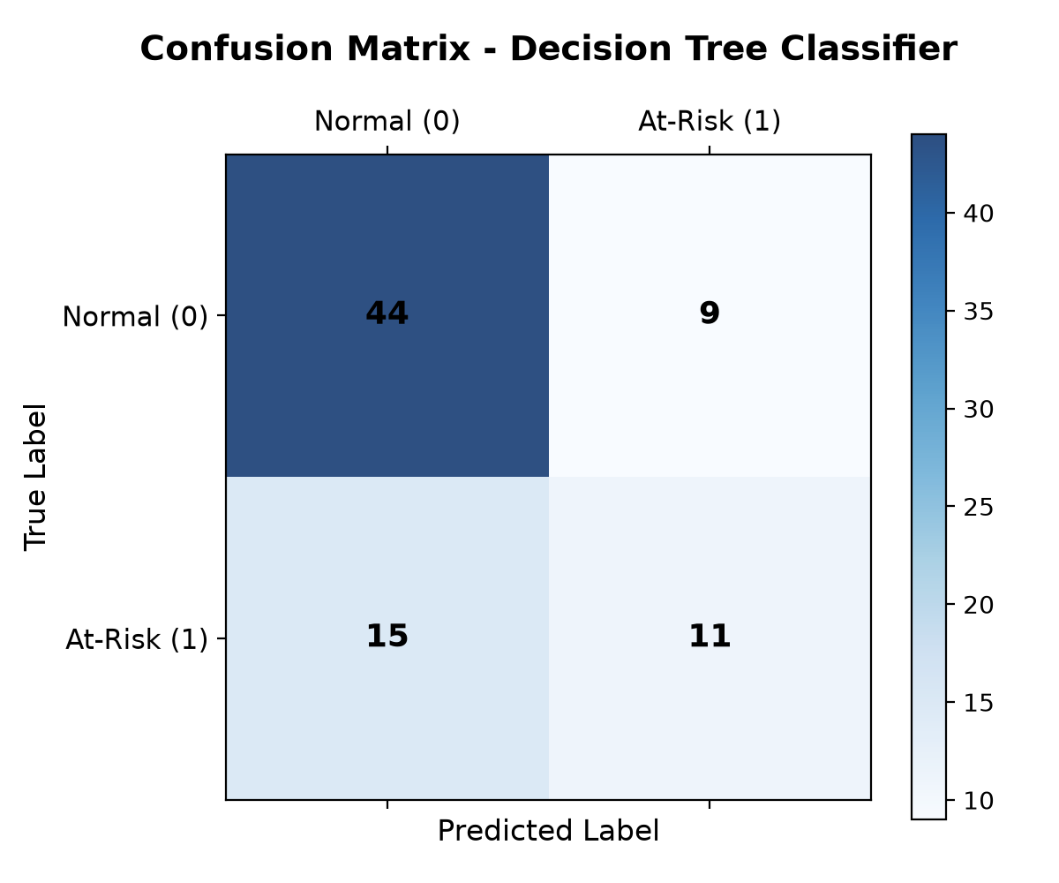
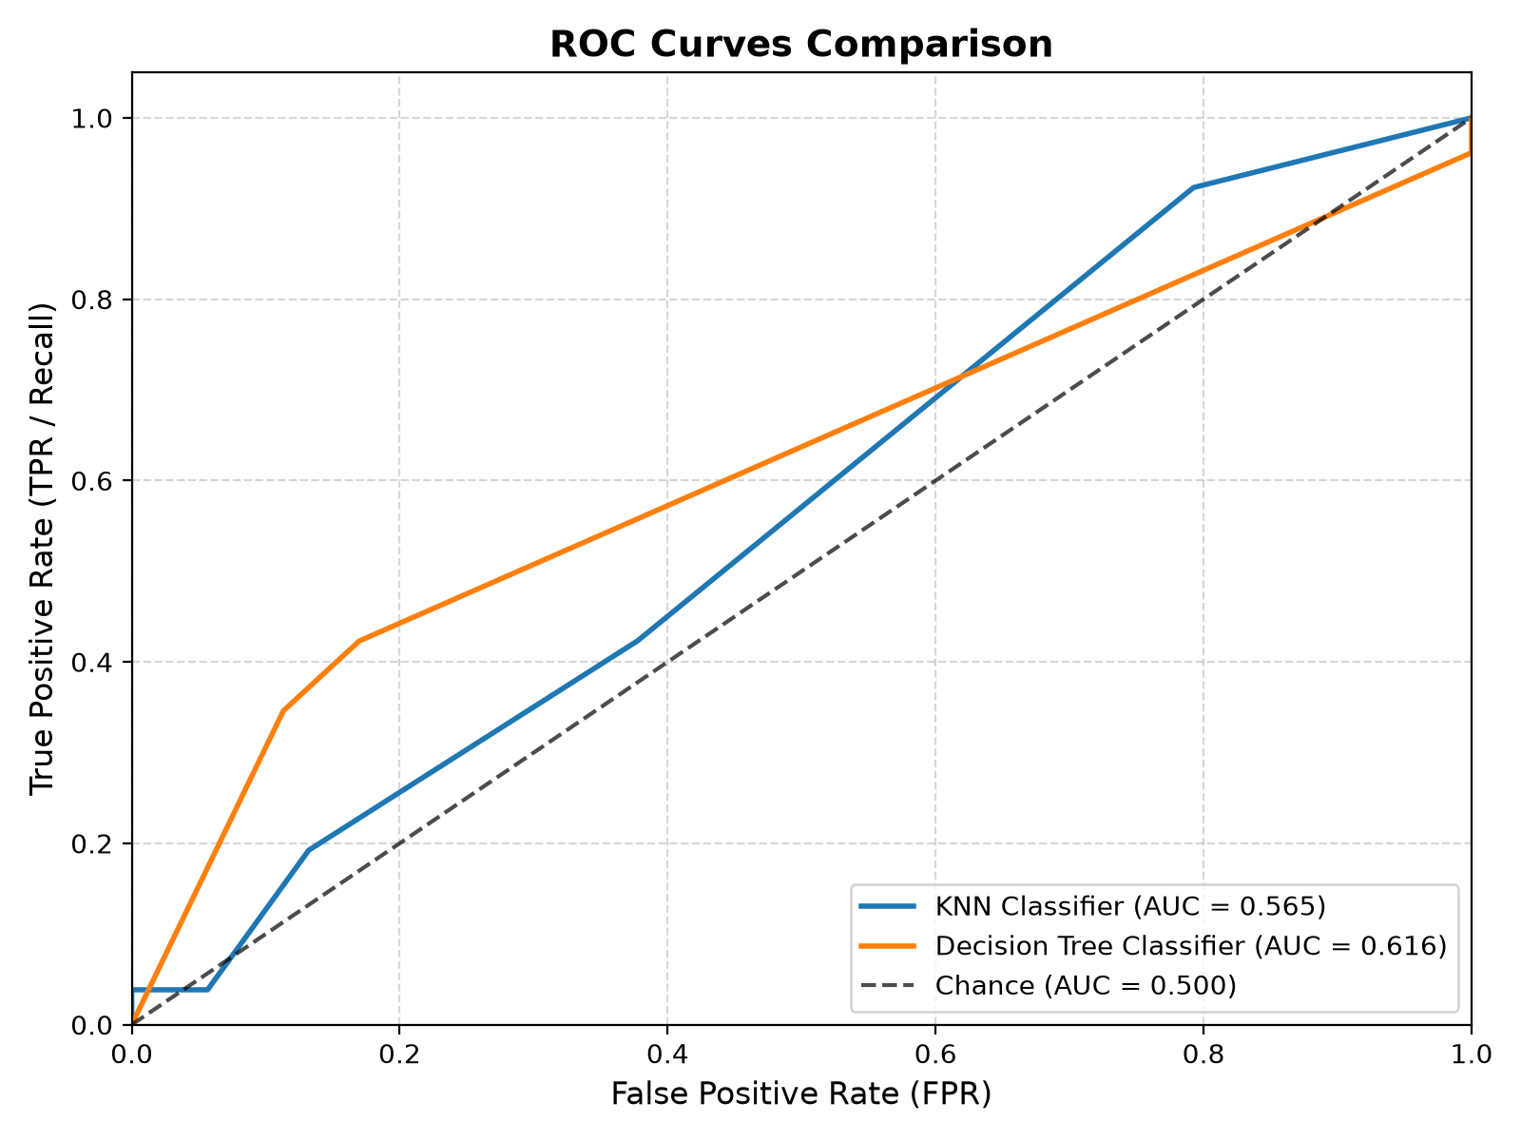
TASK 2: ACADEMIC RISK
Classification Results & Confusion Matrices
Model / Configuration | Accuracy | Precision | Recall | F1 Score | ROC-AUC | Holdout Contingency (N=79)
Custom Decision Tree (Selected, depth=2) | 69.62% | 0.5500 | 0.4231 | 0.4783 | 0.6161 | TN=44, FP=9, FN=15, TP=11
Custom Decision Tree (Original, depth=5) | 67.09% | 0.5000 | 0.3462 | 0.4091 | 0.4989 | TN=44, FP=9, FN=17, TP=9
Custom KNN Classifier (Comparison Baseline, k=5) | 64.56% | 0.4167 | 0.1923 | 0.2632 | 0.5653 | TN=46, FP=7, FN=21, TP=5
Majority-Class Baseline (Always 0) | 67.09% | 0.0000 | 0.0000 | 0.0000 | 0.5000 | TN=53, FP=0, FN=26, TP=0
Triage Takeaways:
• Decision Tree beats majority baseline (69.62% vs 67.09%).
• Identifies 11 of 26 at-risk students out-of-sample.
• Pruning tree to depth=2 boosts ROC-AUC from 0.4989 to 0.6161.
Notes:
In Task 2, the majority baseline achieves 67.09% accuracy by predicting that zero students fail, which is completely useless for intervention. Our pruned Decision Tree achieves 69.62% accuracy, flags 11 out of 26 at-risk students, and achieves an ROC-AUC of 0.6161, demonstrating genuine discrimination power early in the academic semester.

Slide 12
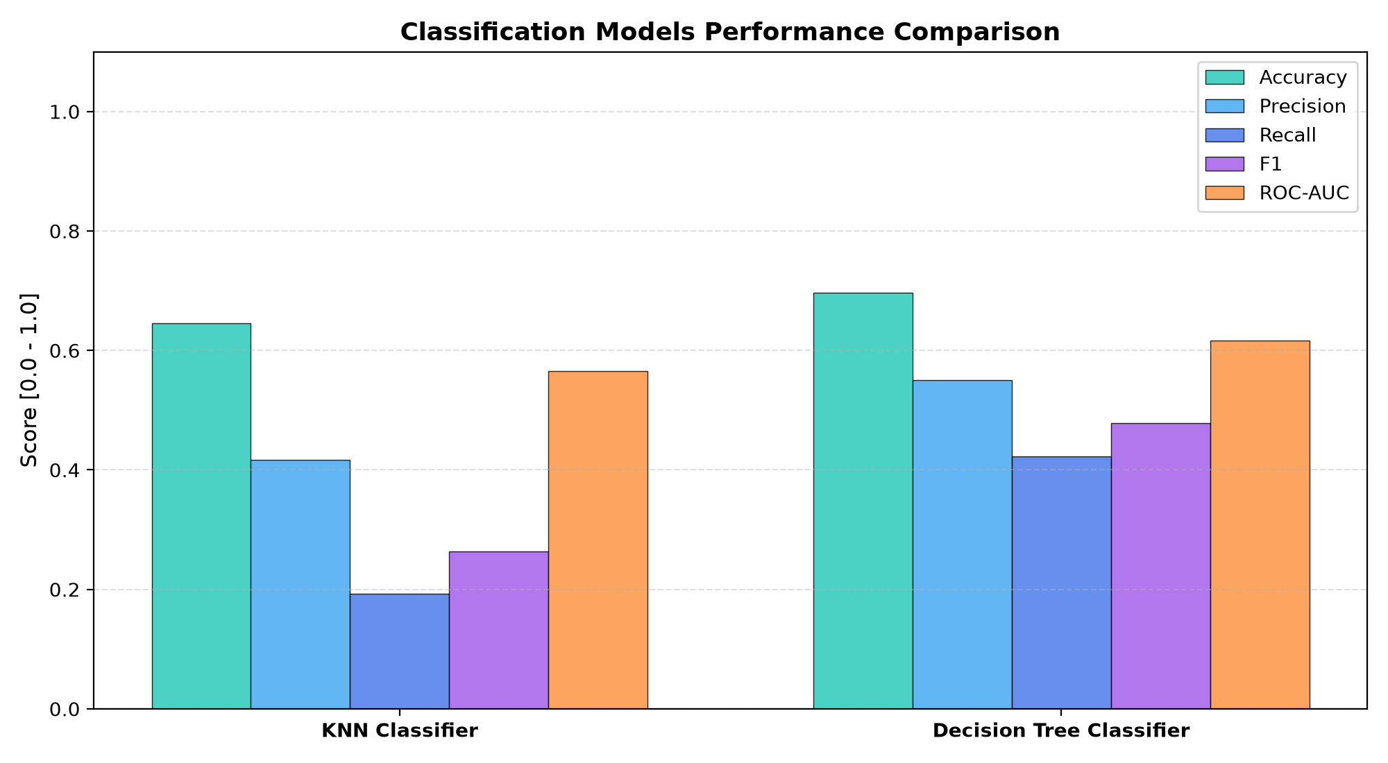
DEPLOYMENT & USABILITY
Interactive Streamlit Web Dashboard & CLI
Dual Operational Modalities (Streamlit & CLI):
• Automated CLI Runner (run_experiments.py):
• Single-command execution: python run_experiments.py --seed 42
• Generates tabular benchmark results and 10 high-resolution diagnostic plots.
• Interactive Dashboard Architecture (app.py):
• Tab 1: Dataset Overview & Missing Value Audits.
• Tab 2: Regression Studio (Solver selection, GD learning rate sliders, live loss curves, and single-student grade inference).
• Tab 3: Classification Studio (KNN & Tree configuration, confusion matrices, ROC curves, and single-student failure risk probability).
• Tab 4: Overfitting Explorer (Interactive bias-variance complexity curves).
• Tab 5: Benchmark Suite (Side-by-side metric charts).
• Tab 6: Architecture & Methods (Mathematical formulations).
• Programmatic Verification: Verified via test_app_logic.py (4 tests passing) and HTTP 200 health check probing.
Notes:
EduPredict provides dual user interfaces. For batch verification, run_experiments.py runs all models and outputs formatted tables. For interactive demonstration, app.py provides a 6-tab Streamlit dashboard allowing educators to test hyperparameter combinations and perform single-student risk inference.

Slide 13
QUALITY ASSURANCE
Software Verification & Dependency Compliance
Comprehensive Automated Test Suite (117 Tests):
• Unittest Framework: Standard library unittest (python -m unittest discover tests) executed in ~8s with 100% pass rate (0 skipped).
• AST Dependency Scanner (test_dependency_compliance.py):
• Inspects Abstract Syntax Tree of all files in edupredict/.
• Verifies 0 prohibited imports: zero numpy, pandas, sklearn, scipy, torch, tensorflow, math, or statistics.
• Mathematical Parity Verification (test_models.py):
• Analytical vs. numerical central finite differences gradient checks (err < 1e-5).
• Normal Equation vs. Gradient Descent high-precision convergence (< 1e-12).
• Data Boundary Verification (test_pipeline.py):
• Verifies disjointness of 3-way split: Train-Sub, Val, and Holdout Test index sets have zero pairwise overlap.
• Dashboard Logic Verification (test_app_logic.py):
• Programmatically executes all 6 tab data flows without requiring browser GUI.
VERIFICATION METRICS AT A GLANCE
✓ Total Test Modules: 17 distinct test files
✓ Total Test Assertions: 117 automated tests (0 skipped)
✓ Test Suite Runtime: ~13.3 seconds
✓ Success Rate: 100% (0 failures, 0 errors)
✓ Prohibited External Libraries: 0 (AST verified)
✓ Standard Math/Stats in Core: 0 (AST verified)
✓ Linear Regression Solver Gap: < 1e-14
✓ Decision Tree F1 Score: Exact match (11/23 = 0.4783)
✓ Streamlit Health Endpoint: HTTP 200 OK (3.70s startup)
Notes:
Software testing is an essential component of this project. We have 117 automated unit tests passing with a 100% success rate (0 skipped, 0 failures, 0 errors). Our custom AST scanner guarantees that zero third-party ML or numerical libraries exist in the codebase. Furthermore, our solver tests verify that analytical gradients and Normal Equation solutions match down to machine precision.

Slide 14
CRITICAL REFLECTION
Limitations, Ethical Considerations & Responsible Use
Inherent Domain & Algorithmic Limitations:
• Modest Variance Explained (~6% R²):
In early-term prediction without prior exam marks, non-academic lifestyle attributes carry weak linear predictive power. Model R² = +0.0600 reflects genuine observational signal, not a failure of implementation.
• Class Imbalance & Recall Tradeoff:
At-risk students represent 32.9% of instances. While Decision Tree identifies 11 at-risk students (42.3% recall), 15 at-risk students are missed (false negatives) due to subtle feature distributions.
• Observational Non-Causality:
Features like romantic relationships or alcohol habits are observational associations; changing them does not guarantee grade improvements.
Ethical Framework & Responsible Pedagogical Use:
• Assistive Early Warning Only:
Predictions must serve exclusively as assistive signals for advisors and tutors, NEVER as automated decision-makers for punitive actions.
• Mitigating Demographic Stigmatization:
Because socio-economic attributes are model inputs, predictions must trigger supportive tutoring rather than negative academic labelling.
• Human-in-the-Loop Requirement:
No consequential student action (e.g. course dismissal or scholarship review) should ever be made based solely on model risk flags.
Notes:
Critical reflection is an important part of academic engineering. We must honestly report that predicting grades without interim exams explains about 6% of the variance. Furthermore, ethics are paramount in education: these models must trigger positive academic support, such as tutoring and mentoring, and must never be used to penalize students.

Slide 15
SUMMARY
Conclusion & Future Research Directions
Core Project Contributions:
✓ First-Principles ML Framework: Built complete Linear Algebra, Statistics, Exp/Log, Preprocessing, and 3 ML model families from scratch.
✓ Zero-Dependency Compliance: Proved that classical machine learning algorithms from first principles can be implemented in pure Python with zero external ML libraries.
✓ Leak-Free Experimental Formulation: Addressed early academic performance and failure risk without circular data leakage.
✓ Empirical Rigor: Demonstrated model convergence, regularized bias-variance tradeoffs, and truthfully documented performance against academic baselines.
Promising Future Research Extensions:
→ Cost-Sensitive Loss Weighting: Incorporate asymmetric misclassification costs in Decision Trees to penalize false negatives more heavily than false positives.
→ Support Vector Machines (Linear/Kernel): Implement soft-margin SVM via Sequential Minimal Optimization (SMO) from scratch.
→ Scratch Ensemble Learning: Construct Bootstrap Aggregating (Bagging) and Random Forests to further reduce variance.
→ Spatial Indexing (KD-Trees): Implement KD-tree spatial partitioning to accelerate KNN inference from O(N) to O(log N) for larger datasets.
Notes:
In conclusion, EduPredict successfully demonstrates that a complete classical machine learning framework can be implemented from first principles. We have achieved a mathematically verified, leak-free, zero-dependency educational system that provides a transparent blueprint for classical machine learning. Thank you, and I now welcome your questions.

