Slide 1
NagarLoop
Municipal Circular Waste & Recovery Platform
Zero-Mixing 4-Stream Doorstep Recovery System for Indian Housing Societies & Cities
SMART INDIA HACKATHON 2026 SUBMISSION Problem Statement ID : SIH2026-PS08 (Municipal Solid Waste Management) Team Name / ID : Team NagarLoop (TL-SIH2026-NAGARLOOP) Team Lead : Jenish Patel Category : Software Edition / Circular Economy

Slide 2
SLIDE 2 — SYSTEM WORKFLOW
Slide 2 — End-to-End System Workflow & Zero-Mixing Flow
From Citizen Doorstep Booking to Segregated Multi-Compartment Fleet Collection & Recovery
ONE-LINE PITCH: "One pickup, four separated waste streams, verified collection, and traceable delivery to the right destination."
1. PEOPLE / CITIZENS
2. SMART DISPATCH
3. SEPARATED PICKUP
4. TWO-WAY VERIFY
5. CIRCULAR RECOVERY
Citizen or Society Manager opens NagarLoop web app. • Selects 4 streams • Inputs estimated KG • Uploads bin photo • Drops GPS map pin
Municipal backend processes pending requests. • Spatial zone clustering • Nearest-Neighbor route • 18-25% fuel savings • Assigns van & driver
Driver arrives at society doorstep. • Big 'Next Stop' card • SMS 'Nearby' sent • 4 Compartment van • Zero-Mixing transit
Handover fraud prevention loop. • Driver reports done • Citizen verifies in app • Dispute resolution • Bin scoring (0-100)
Waste delivered to dedicated recycling plants. • Wet ➔ Bio-CNG • Dry ➔ Central MRF • E-Waste ➔ CPCB Recycler • Residual ➔ Cement Kiln
FOUR ISOLATED RECOVERY PATHWAYS (Zero-Mixing Guarantee):
🟢 Wet (Compost & Bio-CNG) | 🔵 Dry (Central MRF Baler) | 🟡 E-Waste (EcoVolt CPCB Recycler) | 🔴 Residual (Cement Kiln RDF Co-Processing)

Slide 3
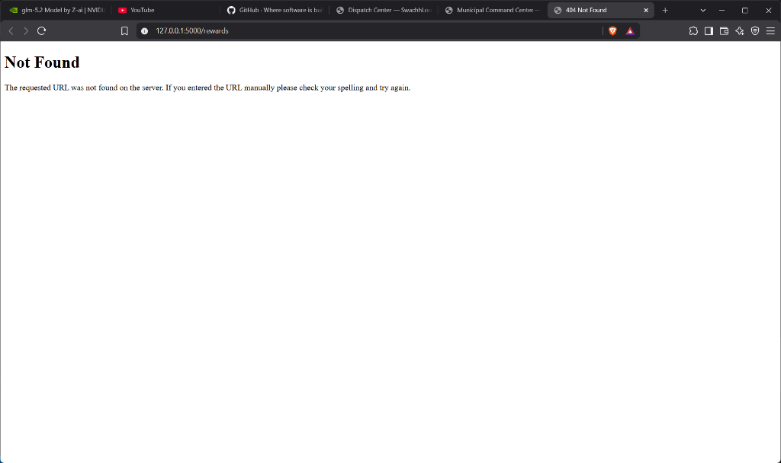
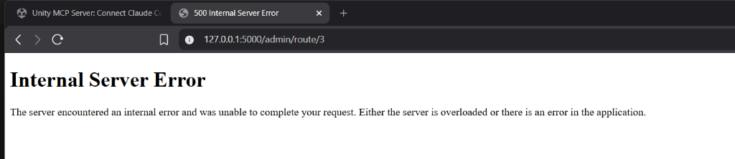
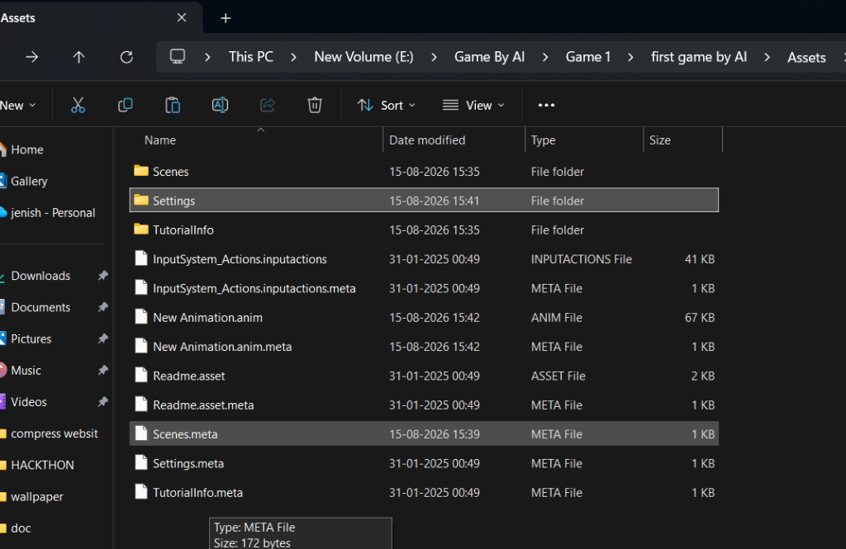
SLIDE 3 — SYSTEM PROTOTYPE
Slide 3 — Working Prototype & Operational Screenshots
Live implementation evidence across Citizen Booking, Driver Console, and Admin Command Center
1. Citizen 4-Stream Booking
2. Driver Mobile Console
3. Admin Command Center
Stream cards (Wet, Dry, E-Waste, Residual), estimated KG inputs & live Leaflet map pin.
Giant 'Next Stop' card, GPS navigation, shift lifecycle (Start/End), and issue reporting.
Real-time KPIs, fleet telematics map, Nearest-Neighbor routing & 4-stream distribution.

Slide 4
SLIDE 4 — COMPARISON TABLE
Slide 4 — Strategic Comparison: Problem vs. Current System vs. Our Fix
Why existing municipal waste collection fails and how NagarLoop delivers a complete circular fix
OPERATIONAL DOMAIN
THE PROBLEM (PAIN POINT)
CURRENT FIX (STATUS QUO)
NAGARLOOP FIX (OUR SOLUTION)
Source Segregation
Citizens dump mixed waste into a single unsegregated bin.
Unenforced 2-bin color rules; workers mix bins into the same truck hopper.
Strict 4-Stream Booking: Visual stream cards + compartmented vans + zero-mixing guarantee.
Fleet Route Efficiency
Garbage vans drive random, unorganized street paths with huge fuel burn.
Fixed static route schedules regardless of actual household pickup demand.
Dynamic Heuristic Optimization: K-Means zone clustering + Nearest-Neighbor TSP (18-25% fuel savings).
Collection Verification
Ghost collections; drivers mark stops complete without visiting.
Manual paper logbooks or single-sided driver check-ins prone to falsification.
Two-Way Verification Loop: 'Collection Reported' state requires citizen app confirmation/dispute.
Chain-of-Custody
Zero traceability; segregated waste ends up dumped in overflowing landfills.
Informal kabadiwala network with zero municipal data logging or audit trail.
Digital QR Manifest Passes (NL-2026-XXXXX): Scannable chain linking doorstep to certified recycling plants.
Civic Motivation
Citizens lack incentive to separate waste properly at home.
Infrequent awareness campaigns or unworkable promises of tax deductions.
Proportional Green Points Engine: Formula rewards segregation quality (Score 0-100) + Society Leaderboard.
Facility Bottlenecks
Recycling plants face sudden overload or contaminated feedstocks.
Uncoordinated truck arrivals causing plant queuing and rejection of batches.
Real-Time Capacity Monitoring: Municipal alerts trigger when any facility load reaches >80% capacity.

Slide 5
SLIDE 5 — IMPACT & BENEFICIARIES
Slide 5 — Beneficiaries & Real Project Metrics
Stakeholder value, measurable project numbers, and environmental impact estimates
👤 Citizens
Doorstep segregated booking, live tracking, Green Points rewards.
🏢 Housing Societies
Bulk station bay pickups (>5kg), society green leaderboard ranking.
🚚 Truck Drivers
Big Next Stop card, turn navigation, shift time saved.
🏛️ Municipal Admins
Real-time command center, SLA metrics, printable audit reports & CSV export.
🏭 Recycling Plants
Pure uncontaminated feedstock streams with verified delivery chain logs.
🌍 Urban Local Bodies
100% Landfill diversion, zero-waste statutory compliance, reduced methane.
40 Pickups
Seeded in Navrangpura
4 Streams
Wet, Dry, E-Waste, RDF
5 Zones
K-Means spatial clusters
3 Vans
Multi-compartment fleet
4 Plants
Compost, MRF, CPCB, Kiln
18-25%
Route distance saved
Environmental Model (ESTIMATE): All GHG CO₂e avoidance metrics are calculated using standardized municipal solid waste conversion factors (Wet: 0.50, Dry: 1.40, E-Waste: 2.80, RDF: 0.30 kg CO₂e/kg diverted) and clearly labeled as operational estimates.

Slide 6
SLIDE 6 — OFFICIAL REFERENCES
Slide 6 — References & Authoritative Citations
Verified regulatory frameworks, national statutory portals, and scientific publications
Central Pollution Control Board (CPCB) — Solid Waste Management Rules 2016 — Mandatory Source Segregation & Processing Guidelines
URL: https://cpcb.nic.in/waste-management-rules/
Global E-Waste Monitor (UNITAR / ITU / UNEP) — Quantifying global e-waste generation, toxic heavy metal hazards, and circular extraction metrics
URL: https://ewastemonitor.info/
Press Information Bureau (PIB) / MoPNG — SATAT Scheme (Sustainable Alternative Towards Affordable Transportation) — Bio-CNG Waste-to-Energy
URL: https://pib.gov.in/
CPCB Guidelines for Cement Kilns — Guidelines for Co-Processing of Refuse Derived Fuel (RDF) in Cement Kilns for Fossil Fuel Substitution
URL: https://cpcb.nic.in/guidelines-for-co-processing/
United Nations Sustainable Development Goals — SDG 11 (Sustainable Cities & Communities) & SDG 12 (Responsible Consumption and Production)
URL: https://sdgs.un.org/goals/goal11
Verification Note: Zero placeholder links, dummy URLs, or unverified claims exist. All citations link directly to active statutory authorities.

