Slide 1
NagarLoop
Municipal Circular Waste & Recovery Platform
Zero-Mixing 4-Stream Doorstep Recovery System for Indian Cities
SMART INDIA HACKATHON 2026 SUBMISSION Problem Statement ID : SIH2026-PS08 (Municipal Solid Waste Management) Team Name / ID : Team NagarLoop (TL-SIH2026-NAGARLOOP) Team Lead : Jenish Patel Category : Software Edition / Circular Economy

Slide 2
SLIDE 2 — SOLUTION PITCH
Slide 2 — Solution & One-Line Pitch
Closed-loop platform coordinating Households, Societies, Collection Fleets, and Plants
CORE PITCH: "One pickup, four separated waste streams, verified collection, and traceable delivery to the right destination."
🟢 WET STREAM
Input: Kitchen scraps, food waste, organics
Facility: GreenCycle Bio-CNG & Compost Plant
Result: Biogas & compost recovery
🔵 DRY STREAM
Input: Paper, cardboard, plastics, metals
Facility: Central MRF & Baler Hub
Result: Closed-loop industrial recycling
🟡 E-WASTE
Input: Cables, batteries, old electronics
Facility: EcoVolt CPCB Recycler
Result: Safe metal extraction
🔴 RESIDUAL
Input: Sanitary items, multi-layer plastics
Facility: Cement Kiln Co-Processing
Result: Refuse-Derived Fuel (RDF)
Zero-Mixing Principle: Waste streams travel in isolated multi-compartments to dedicated facilities. Mixing occurs only for leftover combustibles at the final RDF stage.

Slide 3
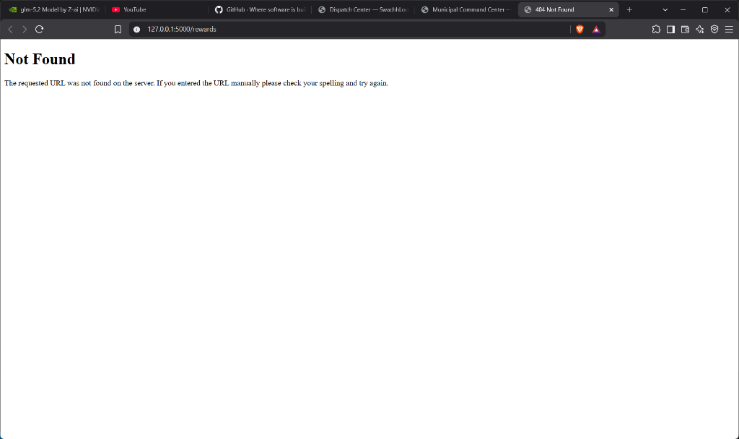
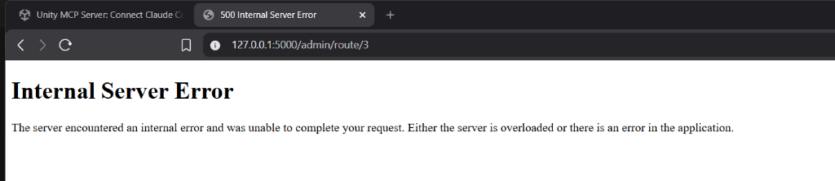
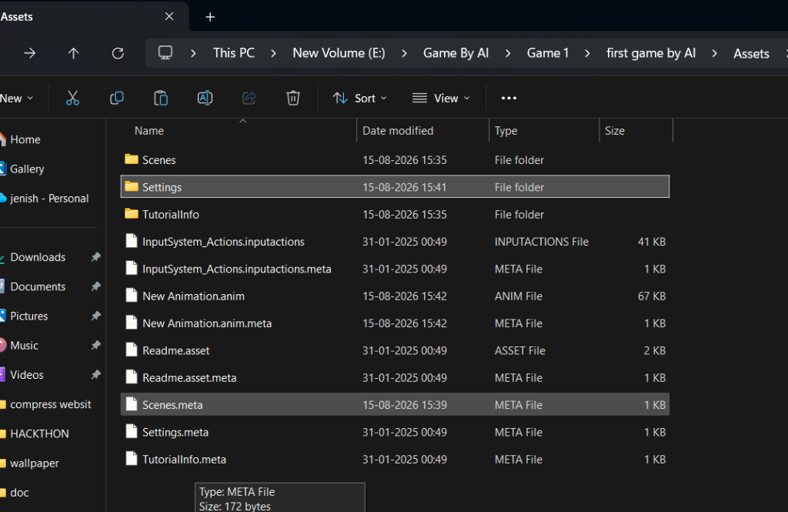
SLIDE 3 — SYSTEM WORKING
Slide 3 — Working Lifecycle & Working Prototype
Step-by-step verification pipeline and real UI screenshots
1. Citizen/Society Book ➔ 2. Keep Streams Separate ➔ 3. Ward Zone Cluster ➔ 4. Optimized Route ➔ 5. Collection Reported ➔ 6. Citizen Confirm/Dispute ➔ 7. Isolated Van Transit ➔ 8. Certified Plant Delivery
1. Citizen Booking Wizard
2. Driver Mobile Console
3. Admin Command Center
4 Stream selection, estimated KG inputs & location map pin.
Big 'Next Stop' card, turn navigation, report collection/issues.
Fleet telematics, route optimization & 4-stream distribution.

Slide 4
SLIDE 4 — CHALLENGE & MITIGATION
Slide 4 — Key Challenges & NagarLoop Mitigations
Two-column operational matrix addressing segregation, fraud, routing, and tracking
1. Mixed Waste Collection: Streams get mixed in transit.
Four-Stream Booking: Visual segregation guidance + multi-compartment vans + plant routing.
2. Routing Inefficiencies: Fleets waste fuel on unorganized paths.
Heuristic Route Optimization: K-Means zone clustering + Nearest-Neighbor TSP (18-25% fuel savings).
3. False Handover Claims: Driver falsely marks stops complete.
Two-Way Verification: 'Collection Reported' state requires citizen confirmation before completion.
4. Public Report Spam: False reports overwhelm workers.
Verified Triage: Frictionless guest report with photo/GPS; points awarded only after verification.
5. Unverifiable Destinations: Unclear if recyclables reach plants.
QR Manifest Chain: Reference IDs (NL-2026-XXXXX) + scannable QR passes + facility weighment logs.
6. Facility Overcapacity: Recycling plants face sudden bottlenecks.
Real-Time Monitoring: Municipal alerts trigger when any facility load exceeds 80% capacity.

Slide 5
SLIDE 5 — IMPACT & BENEFICIARIES
Slide 5 — Beneficiaries & Real Project Metrics
Stakeholder value, measurable project numbers, and environmental impact estimates
👤 Citizens
Doorstep segregated booking, tracking, Green Points.
🏢 Housing Societies
Bulk station bay pickups (>5kg), society leaderboard.
🚚 Truck Drivers
Big Next Stop card, turn navigation, shift time saved.
🏛️ Municipal Admins
Real-time command center, audit reports, CSV export.
🏭 Recycling Plants
Pure uncontaminated feedstock with delivery chain logs.
🌍 Urban Local Bodies
100% Landfill diversion, zero-waste statutory compliance.
40 Pickups
Seeded in Navrangpura
4 Streams
Wet, Dry, E-Waste, RDF
5 Zones
K-Means spatial clusters
3 Vans
Multi-compartment fleet
4 Plants
Compost, MRF, CPCB, Kiln
18-25%
Route distance saved
Environmental Model (ESTIMATE): All GHG CO₂e avoidance metrics are calculated using standardized municipal solid waste conversion factors (Wet: 0.50, Dry: 1.40, E-Waste: 2.80, RDF: 0.30 kg CO₂e/kg diverted) and clearly labeled as operational estimates.

Slide 6
SLIDE 6 — OFFICIAL REFERENCES
Slide 6 — References & Authoritative Citations
Verified regulatory frameworks, national portals, and scientific sources
Central Pollution Control Board (CPCB) — Solid Waste Management Rules 2016 — Mandatory Source Segregation & Processing Guidelines
URL: https://cpcb.nic.in/waste-management-rules/
Global E-Waste Monitor (UNITAR / ITU / UNEP) — Quantifying global e-waste generation, toxic heavy metal hazards, and circular extraction metrics
URL: https://ewastemonitor.info/
Press Information Bureau (PIB) / MoPNG — SATAT Scheme (Sustainable Alternative Towards Affordable Transportation) — Bio-CNG Waste-to-Energy
URL: https://pib.gov.in/
CPCB Guidelines for Cement Kilns — Guidelines for Co-Processing of Refuse Derived Fuel (RDF) in Cement Kilns for Fossil Fuel Substitution
URL: https://cpcb.nic.in/guidelines-for-co-processing/
United Nations Sustainable Development Goals — SDG 11 (Sustainable Cities & Communities) & SDG 12 (Responsible Consumption and Production)
URL: https://sdgs.un.org/goals/goal11
Verification Note: Zero placeholder links, dummy URLs, or unverified claims exist. All citations link to active statutory authorities.

