Slide 1

Developing a recommender system for YELP
Jenish Dobariya, Jorge Fernandez
DePaul University, DSC Capstone

Slide 2

Importance of recommender systems
Personalization: Recommender systems tailor content to individual users’ preferences, providing a personalized experience.
User retention: By continuously offering relevant recommendations, users are more likely to return to the platform, increasing loyalty.

Slide 3

Dataset
Description: The Yelp dataset is a comprehensive collection of data released by Yelp for research. This dataset contains a wealth of information related to businesses, user, reviews, and ratings.
Source: The dataset is available on Kaggle.

Slide 4

Key Features
Business Data
Business ID
Attributes (Good for kids, Parking Available, Takes reservations, etc)
Categories (Restaurants, Shopping, Nightlife, etc)
Review data
Review ID
User ID
Business ID
Stars [Y variable for the project]
Text [Textual content of the review]

Slide 5

Content Based Recommender

Slide 6

Preprocessing
Using
Using only the Text column from the Reviews Dataset.
Handling
Handling Missing Values: Strategies used to handle any missing data points.
Cleaning
Data Cleaning: Removing special characters, stop words, and unnecessary whitespace.
Creating
Creating mean vector: Using word embedding, I create a mean word vector with Glove 50. Adding Sentiment along side word embeddings to predict stars.

Slide 7

Model Building
Overview: Different machine learning models evaluated Linear Regression, SVR, Random Forest Regressor, KNN, Stacked Regressor
Hyperparameter Tuning: Methods used for optimizing model parameters GridSearchCV and RandomSearchCV
Evaluation Metrics: Metrics used to evaluate model performance: MSE, RMSE, MAE

Slide 8
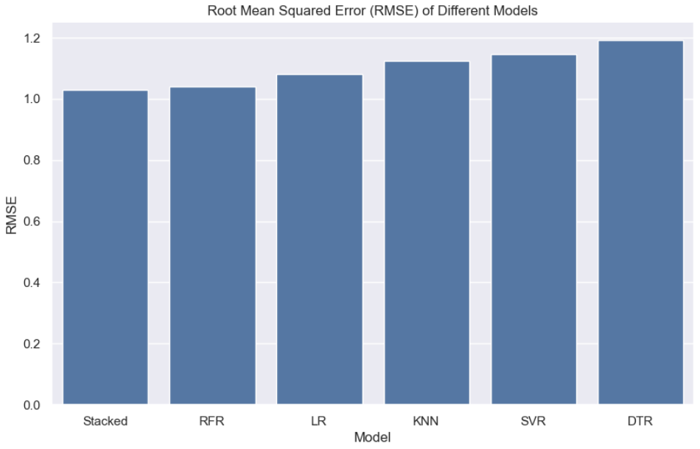

Slide 9
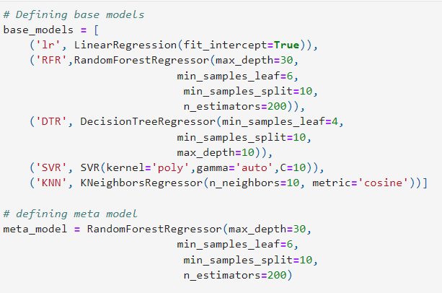
Developing a stack model
The stacked regressor worked slightly better with an RMSE score of 1.02.

Slide 10
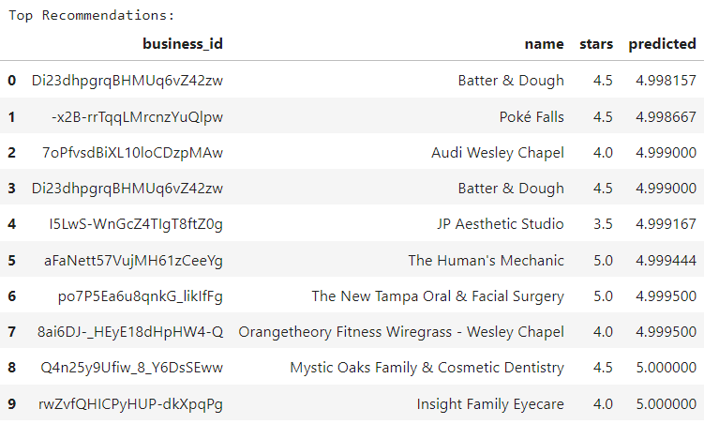
Deployment

Slide 11

Neighborhood-Based Collaborative Filtering

Slide 12
Collaborative Filtering
Definition
Collaborative filtering is a method used in RS to predict a user's preferences based on the preferences of other users. It operates under the assumption that people who agreed in their evaluations of certain items in the past are likely to agree again in the future.
Purpose
Collaborative filtering is popular because it doesn't require any information about the items or users apart from their interactions. It can provide very personalized recommendations based purely on user behavior.
Applications
While most large companies now use a hybrid approach, early Netflix and Amazon both used collaborative filtering.

Slide 13
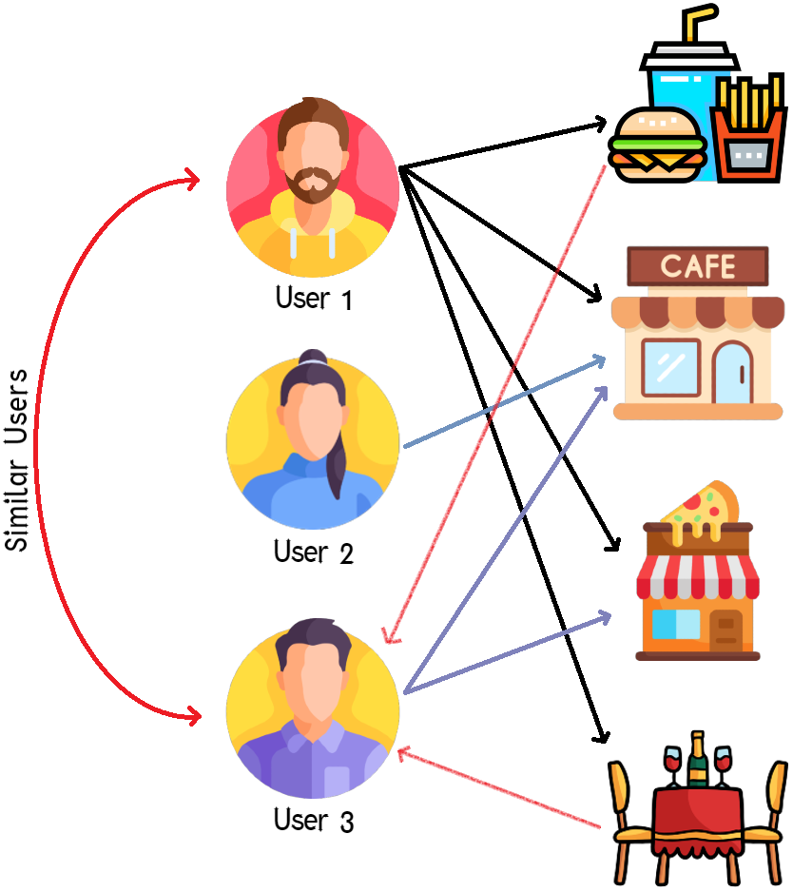
User-User CF
Calculate Similarity
Measure the similarity between users based on their ratings across common items.
Aggregate Ratings
Compute predictions based on the ratings of these similar users
Recommend
Suggest items highly rated by these similar users.
Identify Neighbors
Find peers (users) with the highest similarity scores to the given user.
Icons made by Freepik from www.flaticon.com

Slide 14
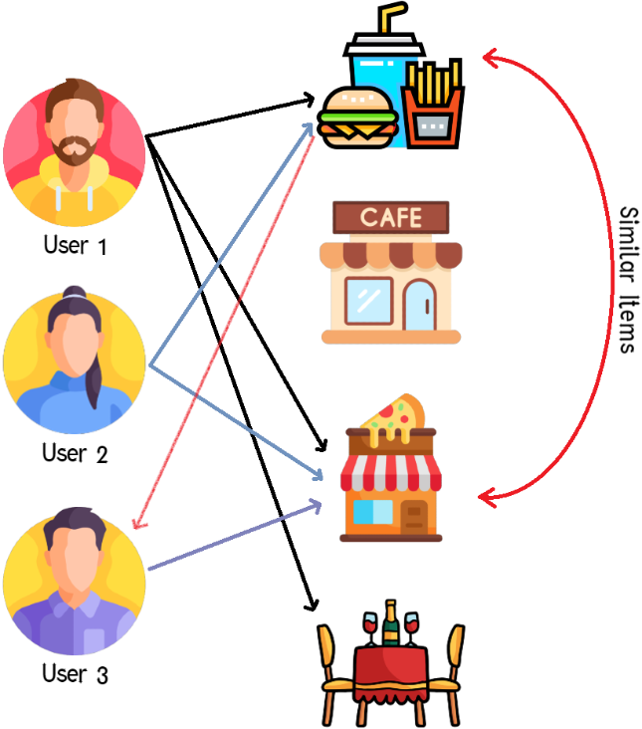
Item-Item CF
Calculate Similarity
Measure the similarity between items based on user ratings across common items.
Aggregate Ratings
Compute predictions for the target items based on the weighted average of ratings from the similar items.
Recommend
Recommend these items which have similar characteristics and are well-received by others.
Identify Neighbors
Identify items that are most similar to those the user has rated highly.
Icons made by Freepik from www.flaticon.com

Slide 15
Pros & Cons
User-User CF
Dynamic: Adapts quickly to changes in user preferences over time.
Cons
Sparsity: Less effective when user interaction data is sparse
Personalization: More personalized recommendations as it matches users with similar preferences.
Pros
Scalability: Computationally intensive, especially with a large number of users.
Item-Item CF
Efficiency: Generally faster for prediction after initial model building - number of items is often less than number of users.
Cons
Cold Start for Items: Difficult to recommend new items without historical data.
Stability: More stable over time - item attributes tend to change less frequently than user preferences.
Pros
Limited Diversity: Tends to recommend similar items, reducing the diversity of recommendations.

Slide 16
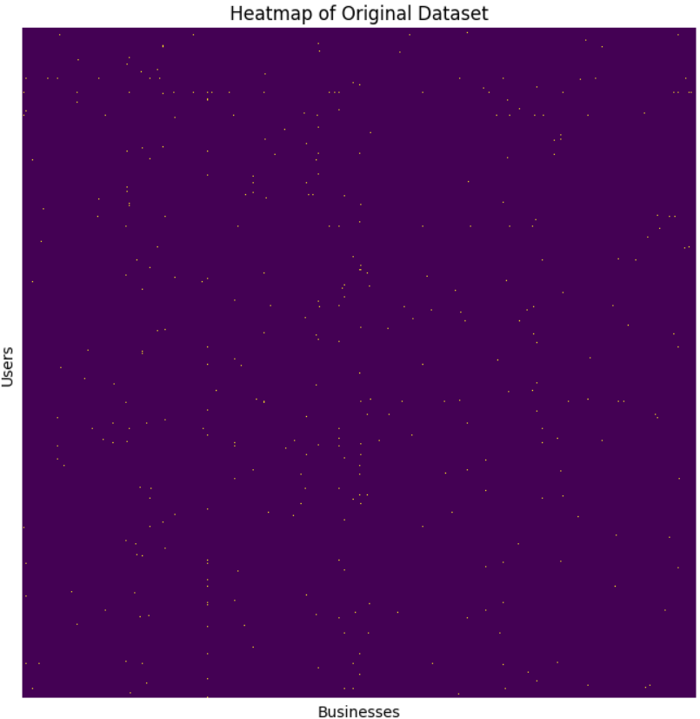
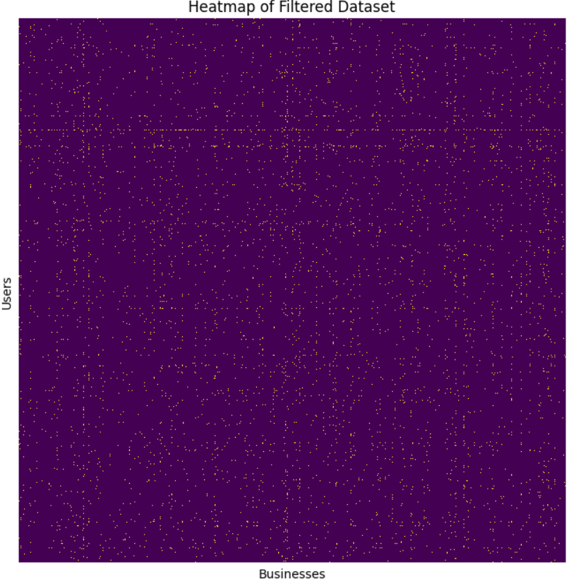
Initial Analysis & Filtering Data
Total Reviews: 466,007
Restaurants: 2,260
Initial Stats:
Users: 201,798
Restaurants: 1,926
Filter Data
Criteria: Users and businesses w/ at least 10 reviews
Focus on reliable user-business interactions by reducing sparsity.
Total Reviews: 95,137
Users: 3,978
New Stats

Slide 17
Train, Val, and Test Splits
Remove these ratings from the training matrix to prevent data leakage.
train_test_split:
sklearn shuffles and splits the data randomly w/o consideration for the sparse structure. This created scenarios where some users/items only appear in the test set
New Split Method:
For each user, retrieve indices of all rated items.
Shuffle these indices to randomize the data selection.
For each user, set 2 test and validation ratings to their respective matrices.
Helps w/ Cold Start Problem
Disjoint sets prevent overlap in user-item pairs across different sets, crucial for accurately assessing the model's performance.
Ensures every user contributes to all data sets.
Creates Disjoint Sets
This approach helps the model learn from a broad user base, reducing the impact of the cold start problem.
Enables realistic evaluations of how well the model can handle unseen data.

Slide 18



Similarity Metrics
Adjusted Cosine Similarity
Adjusts the standard cosine similarity by subtracting the user's average rating from each rating. This accounts for different rating scales used by different users.
Reduces bias due to user-specific rating behavior, focusing more on the relative preferences rather than absolute ratings.
Pearson Correlation
Measures the linear correlation between two variables, adjusted for the mean ratings of each item. It's similar to adjusted cosine but normalizes by the item mean instead of the user mean.
Accounts for item biases, often resulting in more personalized recommendations.
Jaccard Similarity
Computes the similarity between sets by dividing the size of the intersection by the size of the union of the sets. In collaborative filtering, it can be used to measure the similarity between sets of users who have rated items i and j.
Simple to understand and compute; robust against variations in magnitude.

Slide 19
Model Building
Calculate Baseline:
Establish a baseline for rating predictions, used to normalize individual ratings. This will be the global average of ratings in the training data.
Compute User and Item Biases:
Compute biases for users and items based on the deviations of their avg. ratings from the global average, reflecting personal and item-specific tendencies.
User-Based: Predict user u's rating for item i by combining the global avg. with user u's bias & a normalized sum of the weighted ratings from similar users, adjusted for their biases.
K-Nearest Neighbors:
User-Based: Find the k-nearest users to user u based off the precomputed similarity matrix
Item-Based: Find the k-nearest items to item i based off the precomputed similarity matrix
Predictive Model:
Item-Based: Estimate the rating for user u on item i using the global average, item i's bias, & a normalized sum of the deviations of user u's ratings on similar items, each adjusted for their biases.

Slide 20
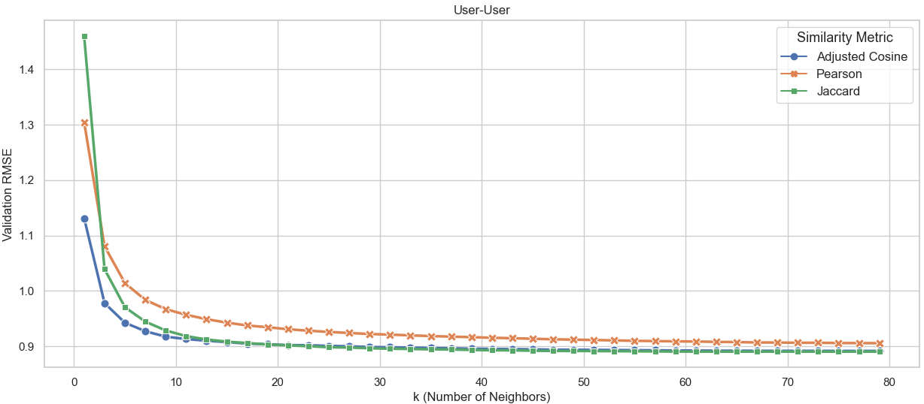
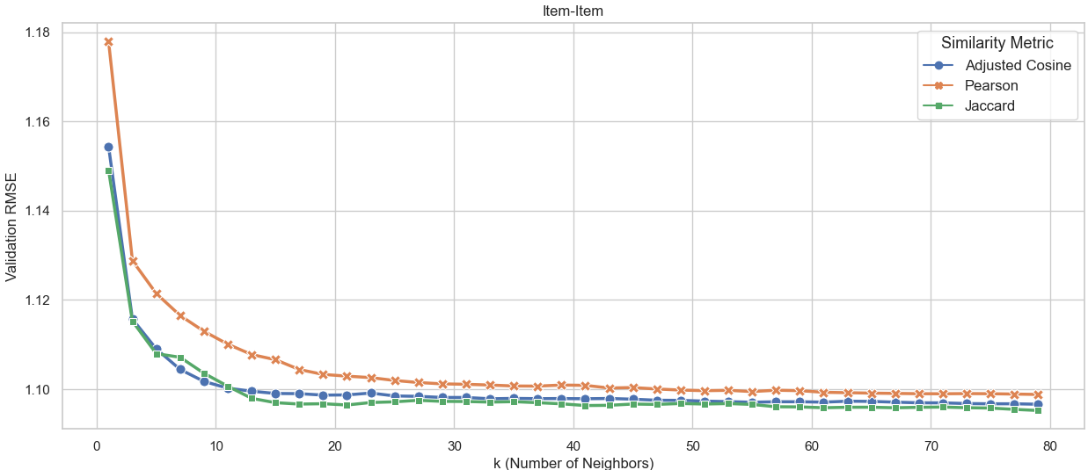
Parameter Optimization
Tuned the size of the neighborhood for both Item- and User- based methods for each similarity metric:
Observations:
After a k of ~10, the improvements in performance are negligible
For user-user, adjusted cosine seems to perform best in this range
For item-item, Jaccard performs best with a k of ~ 20
User-based achieved better performance overall

Slide 21
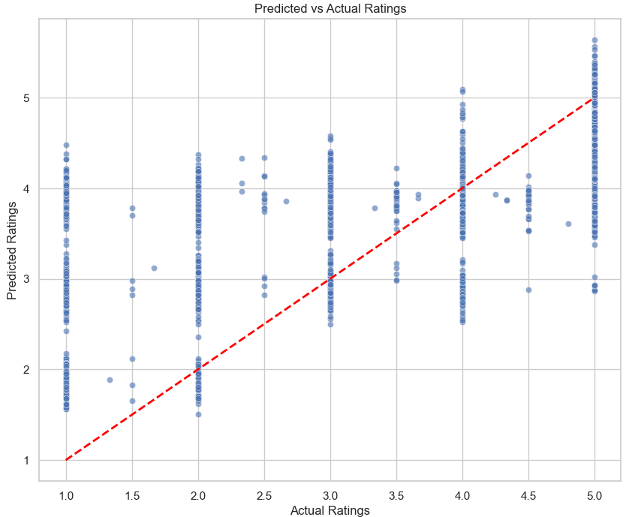
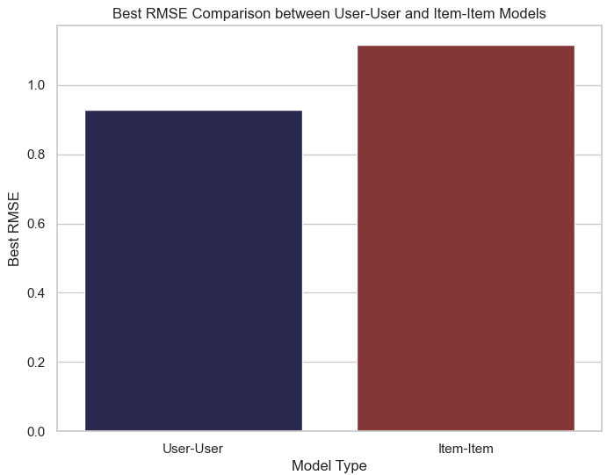
Model Evaluation
Best Model Performance on Test:
User-based w/ Adjusted Cos and k = 20
RMSE: 0.927
Item Based w/ Jaccard Similarity and k=20
RMSE: 1.11

Slide 22
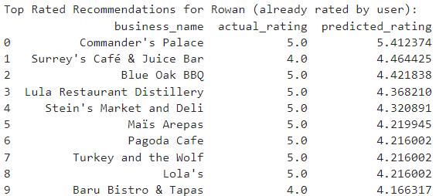
Deployment
Using the best performing model to make recommendations for a given user

Slide 23

Conclusions & Future Work
Overall, the best performing CF model was the User-Based with adjusted cosine similarity, which achieved an RMSE of 0.927
The best performing content-based model was the stacked regressor, which achieved an RMSE of 1.02
In the future, we may look to combine these 2 methods to create a hybrid recommender system.

Slide 24

Q&A

