Slide 1

Prof.V.B.Shah Institute of Management & R.V.Patel College of Commerce (Eng.Med.) & V.L.Shah College of Commerce (Guj.Med.) & Sutex Bank College of Computer Applications & Science, Amroli
(Accredited ‘B’ (CGPA 2.55) by NAAC Dec.-2009)
VEER NARMAD SOUTH GUJARAT UNIVERSITY, SURAT
Minor-PROJECT REPORT
FOR THE DEGREE OF
Bachelor of computer application
(B.C.A 6TH SEMESTER) YEAR: 2025-26
SUBMITTED BY :
412 – Bhalala Jenish Shaileshbhai
433 – Sakariya Pruthviraj Sureshbhai
470 – Patoliya Raj Ratibhai
GUIDED BY :
Mr. Ashish solankiamani.
Techify

Slide 2
Techify (e-commerce platform)

Slide 3
agenda
Project Overview
Project Profile
System Flow Diagram
Data Flow Diagram
ER Diagram
Database Design
Database Design
References

Slide 4
Project Overview
Techify is a modern, responsive full-stack e-commerce platform designed to provide a seamless online shopping experience for technology products and electronics.
It serves everyday consumers and tech enthusiasts seeking a reliable, secure, and user-friendly storefront to discover, save, and purchase products.
The platform emphasizes an intuitive user interface, efficient product management, secure cart and checkout processes, and responsive design.
Techify consists of two primary access levels:
Admin Panel
II. User Panel

Slide 5
admin panel
Requires login with an administrator account.
Admin can add, view, update, and delete products from the catalog.
Admin can view, manage, and delete registered user accounts.
Admin can view user orders and update their order status (Processing, Shipped, Delivered).
Admin can read and manage customer inquiries and messages submitted via the Contact Us form.

Slide 6
User panel
Requires login with a user account (guests may be able to browse).
Users can view and update their profile, including their shipping address.
Users can browse, search, and filter products by category and brand.
Users can add products to an active shopping cart or save them to a wishlist for later.
Users can proceed to checkout, place orders securely, and view their past order history.
Users can send inquiries, complaints, or suggestions to the admin using the Contact Us form.

Slide 7
Project profile
Techify
Project Title | Techify
Fontend | HTML , CSS, Anguler, Tailwind css
Backend | Node Js, Express Js
Database | MongoDB
Platform | Vs Code, Mongo DB Compass, Stitch, Git Hub
Documantaion Tools | MS Word, Figma
Guide Name | Mr. Ashish Solanki

Slide 8
System flow diagram
Admin System Flow Diagram
User System Flow Diagram

Slide 9
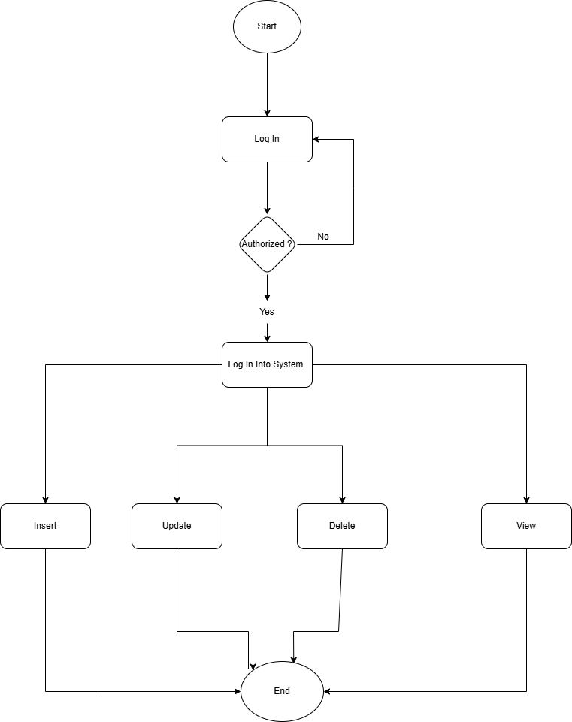
Admin system flow diagram

Slide 10
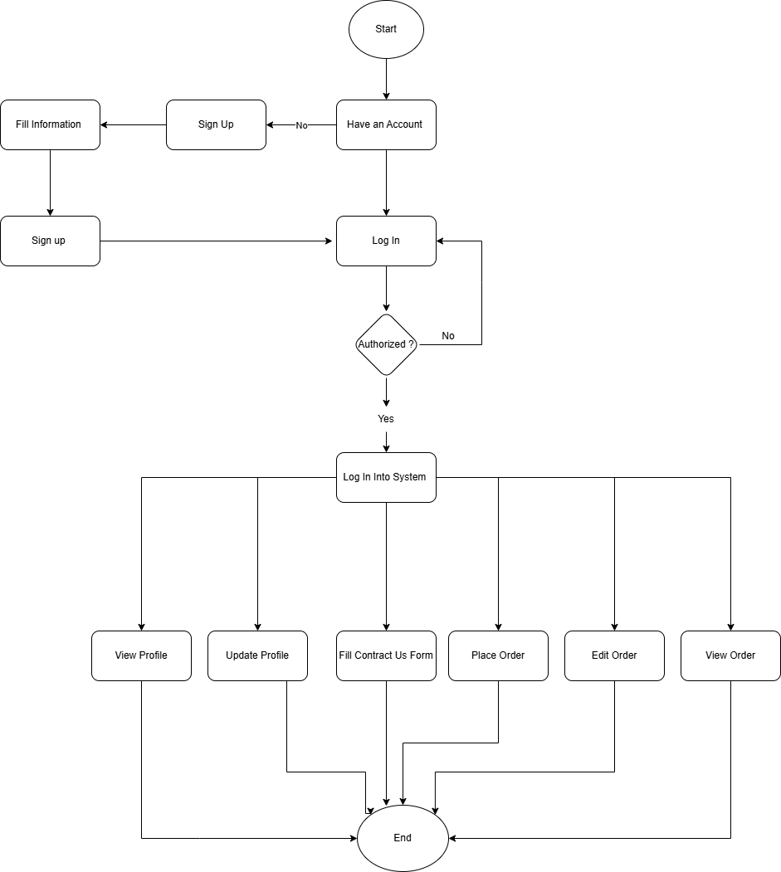
user system flow diagram

Slide 11
Data flow diagram
0 level Diagram
1 level Admin Diagram
1 level User Diagram

Slide 12
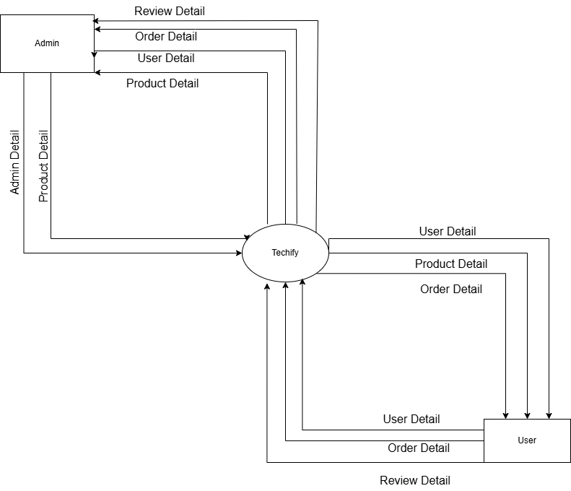
0 level diagram

Slide 13
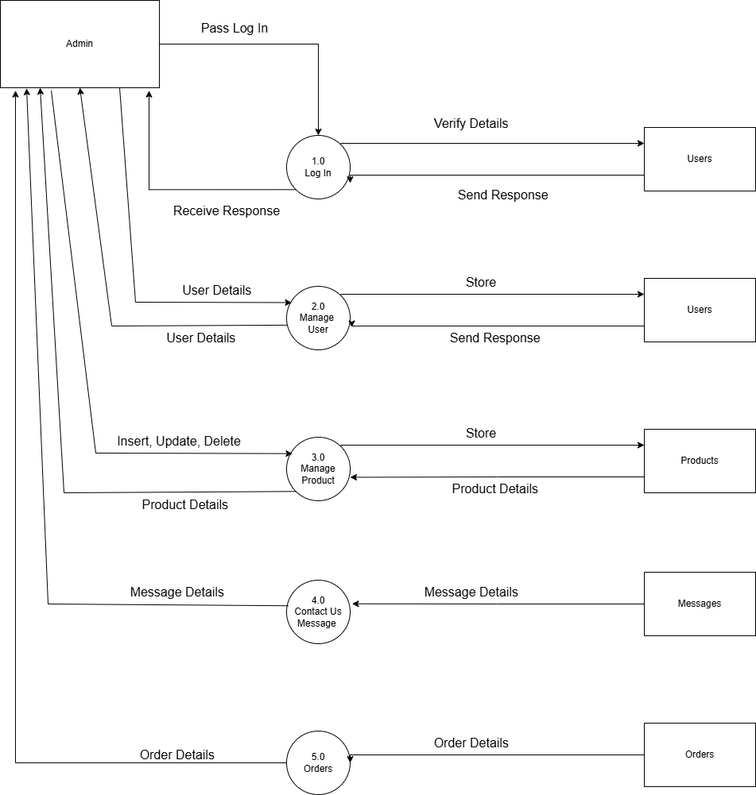
1 level admin diagram

Slide 14
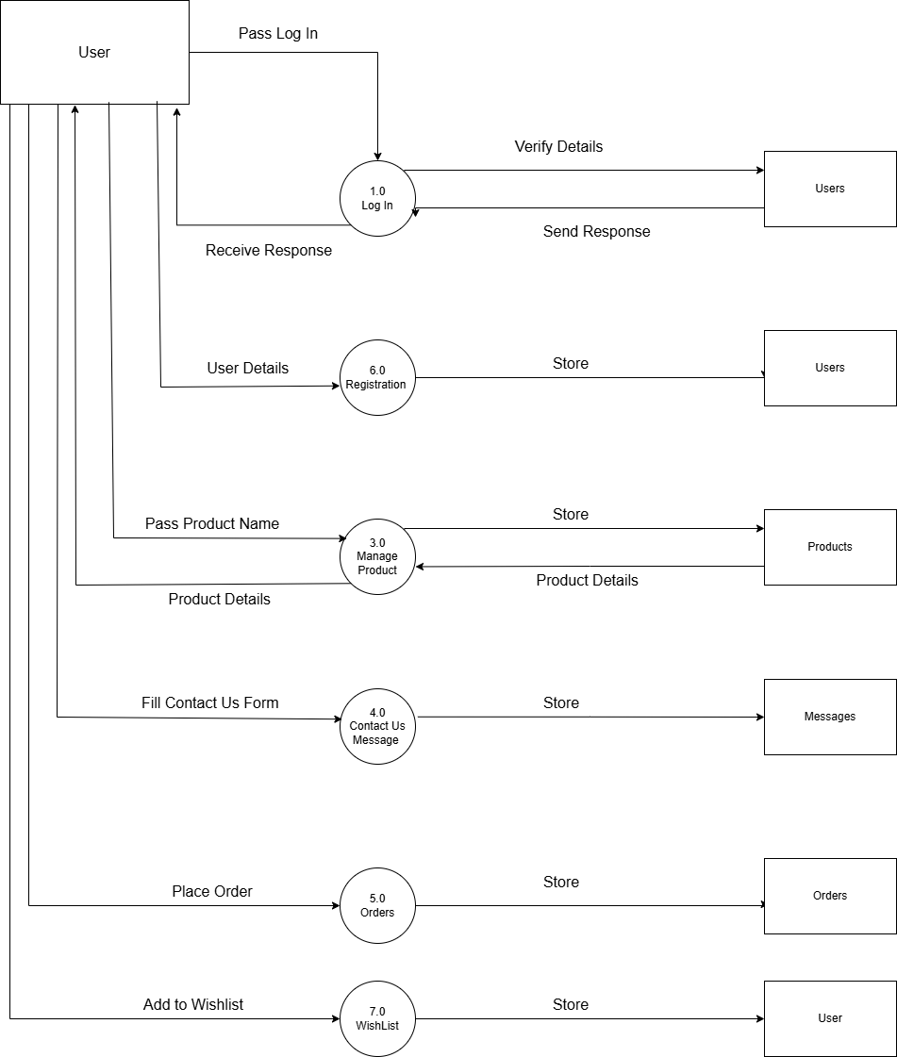
1 level user diagram

Slide 15
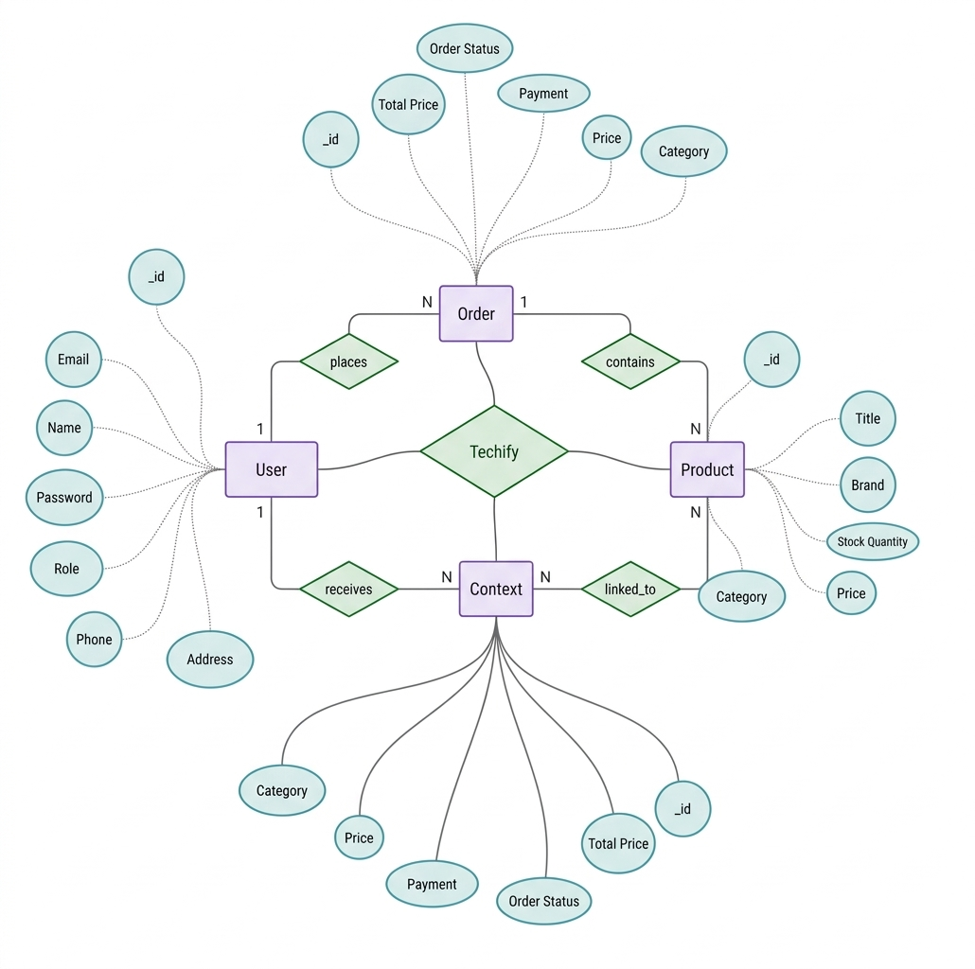
ER diagram

Slide 16
Database design
User Collection
Product Collection
Order Collection
Message Collection

Slide 17
User collection
Field | Type | Description
name | String | User full name
email | String | Unique login email
password | String | Encrypted password
role | Enum | user/admin access role
cart | Array | Embedded items with productId and quantity
wishlist | Array<ObjectId> | Saved product references

Slide 18
Product collection
Field | Type | Description
title | String | Product title
description | String | Detailed product information
category | String | Product category
brand | String | Brand name
price | Number | Base price
discountPercentage | Number | Discount value in %
finalPrice | Virtual | Computed discounted price
stockQuantity | Number | Current stock

Slide 19
order collection
Field | Type | Description
userId | ObjectId | Reference to User
orderItems | Array | Snapshot of purchased products
shippingAddress | Object | Delivery details
paymentMethod | String | Selected payment mode
totalPrice | Number | Final payable amount
orderStatus | Enum | Processing/Shipped/Delivered

Slide 20
message collection
Field | Type | Description
name | String | Sender name
email | String | Sender email
subject | String | Query subject
message | String | Query body
status | Enum | unread/read/replied

Slide 21
References
Angular Documentation - https://angular.dev
Node.js Documentation - https://nodejs.org/en/docs
Express Documentation - https://expressjs.com
MongoDB Documentation - https://www.mongodb.com/docs
Mongoose Documentation - https://mongoosejs.com/docs
Tailwind CSS Documentation - https://tailwindcss.com/docs
TypeScript Documentation - https://www.typescriptlang.org/docs
GitHub - https://github.com

Slide 22
Thank you

