Slide 1


Slide 2

SCIENTIFIC CALCULATOR
~ Multi Calculations

Slide 3
📘 Submitted By :
Jenish Gohel (92300527156)
Ravi Sav (92300527257)
📍 Internal Guide:
Prof. Tejas Chauhan Faculty of Computer Applications.
🏫 Institution Address:
Marwadi University, Rajkot - Morbi Road, At & PO: Gauridad, Rajkot

Slide 4
INTRODUCTION
In today’s digital world, calculators have evolved from simple arithmetic tools to powerful applications capable of handling complex computations. To meet this growing demand, we have developed an Android-based Scientific Calculator Application that provides accurate results, an intuitive interface, and multiple calculation utilities in a single app.
The application is designed to serve students, professionals, and general users by offering different types of calculators under one platform. The key calculation modules included in this application are:
Basic Calculator
Performs basic arithmetic operations such as addition, subtraction, multiplication, and division.
Scientific Calculator
Supports advanced mathematical operations such as trigonometric functions (sin, cos, tan), logarithmic functions (log, ln), square root, power functions, and degree/radian mode.
Age Calculator
Calculates the exact age of a user based on the provided date of birth.
Loan Calculator
Calculates total interest and total payable loan amount based on principal amount, rate of interest, and time period.
The application is developed using Java and XML in Android Studio, following standard Android UI and coding practices. It features a navigation drawer, calculation history, offline functionality, and a clean, modern user interface. The app has been successfully deployed on the Google Play Store and is currently being used by real users.
This project demonstrates the practical application of Android development concepts and delivers a reliable, real-world mobile solution.

Slide 5
PLAY STORE DEPLOYMENT DETAILS
The developed calculator application has been successfully published on the Google Play Store, making it publicly accessible to users worldwide. This deployment confirms that the application meets Google’s quality, performance, and security standards.
Key Play Store Details:
Application Name: Scientific Calculator
Platform: Android (Google Play Store)
Release Status: Published & Live
Availability: Public (Anyone can download)
Distribution Type: Free Application
Play Store Link: https://play.google.com/store/apps/details?id=com.jg.scientificcalculator
Highlights:
The application is officially uploaded and approved by Google Play.
It is available for real users and has active downloads.
All calculator features work offline, ensuring reliability.
Regular updates and improvements can be pushed through the Play Store.
This deployment transforms the project from an academic application into a real-world production-level Android app.

Slide 6
OBJECTIVES OF THE PROJECT
The main objectives of developing the Scientific Calculator Android Application are as follows:
To design and develop a user-friendly calculator application with a clean and intuitive interface.
To provide basic arithmetic calculations such as addition, subtraction, multiplication, and division.
To support advanced scientific operations including trigonometric, logarithmic, exponential, and power functions.
To include multiple calculators such as:
Basic & Scientific Calculator
Age Calculator
Loan Calculator
To store and manage calculation history for quick reuse of previous results.
To ensure accurate and fast calculations with support for multiple operands.
To develop an application that works offline without internet dependency.
To implement a modern Android UI using Material Design principles.
To deploy the application on the Google Play Store for real-world usage.

Slide 7
TECHNOLOGIES USED
The following technologies and tools were used in the development of the Scientific Calculator Android Application:
Programming Language :
Java used for implementing application logic, calculations, and event handling.
Android SDK :
Provides core APIs for building Android applications.
Android Studio :
Official IDE used for coding, debugging, testing, and deployment.
XML :
Used for designing user interface layouts and defining UI components.
SQLite Database :
Used to store and manage calculation history locally on the device.
Material Design Components :
Used for creating a modern, responsive, and visually appealing UI.
Navigation Drawer :
Implemented to provide smooth navigation between multiple calculators.
Google Play Console :
Used for publishing, managing, and updating the application on the Play Store.

Slide 8
KEY FEATURES
Multi-Calculator Application
Includes Basic Calculator, Scientific Calculator, Age Calculator, and Loan Calculator in a single app.
Basic Arithmetic Operations
Supports addition, subtraction, multiplication, and division.
Advanced Scientific Operations
Trigonometric functions: sin, cos, tan
Logarithmic functions: log, ln
Power, square, cube, and square root calculations.
Degree & Radian Mode
Allows users to switch between DEG and RAD modes for trigonometric calculations.
Calculation History
Automatically saves calculations and allows users to reuse previous results.
User-Friendly Interface
Clean, modern UI with Material Design components.
Navigation Drawer Support
Easy navigation between different calculators using a side menu.
Offline Functionality
Works completely offline without internet connection.
High Accuracy & Fast Performance
Provides precise results with instant response time.
Play Store Published Application
Successfully uploaded on Google Play Store and available for public download.

Slide 9
MODULES IN CALCULATOR
1. Scientific Calculator Module
Advanced mathematical and trigonometric functions
Supports long expressions and multiple operands
2. Age Calculator Module
Calculates age in years, months, and days
Simple and user-friendly input design
3. Loan Calculator Module
Calculates:
Principal Amount
Total Interest
Total Payable Amount
Displays results in an attractive CardView layout
4. History Module
Stores previous calculations
Allows users to reuse past results
5. Navigation Drawer Module
Easy navigation between different calculator modules
Includes About Us section

Slide 10
TECHNICAL DESCRIPTION
1). Hardware Requirements ( User Side ) :
Device Type : Android Smartphone
Processor : Any standard mobile processor
RAM : Minimum 2 GB
Internal Storage : Minimum 20 MB free space
System Type : 64-bit
Input Method : Touch Screen
Display : Any standard smartphone display
2). Software Requirements ( User Side ) :
Operating System : Android OS
Minimum Android Version : Android 6.0 (Marshmallow) or above
Application Type : Mobile Application
Installation Source : Google Play Store
Internet Requirement : Required only for download
Working Mode : Offline
3) Application Environment :
Platform : Android
Category : Utility Application
User Interface : Touch-based graphical interface
Database : SQLite (internal, invisible to user)
4) Compatibility :
Supported Devices : Android smartphones and tablets
Supported Screen Sizes : All standard Android screen sizes
Supported Orientation : Portrait Mode

Slide 11
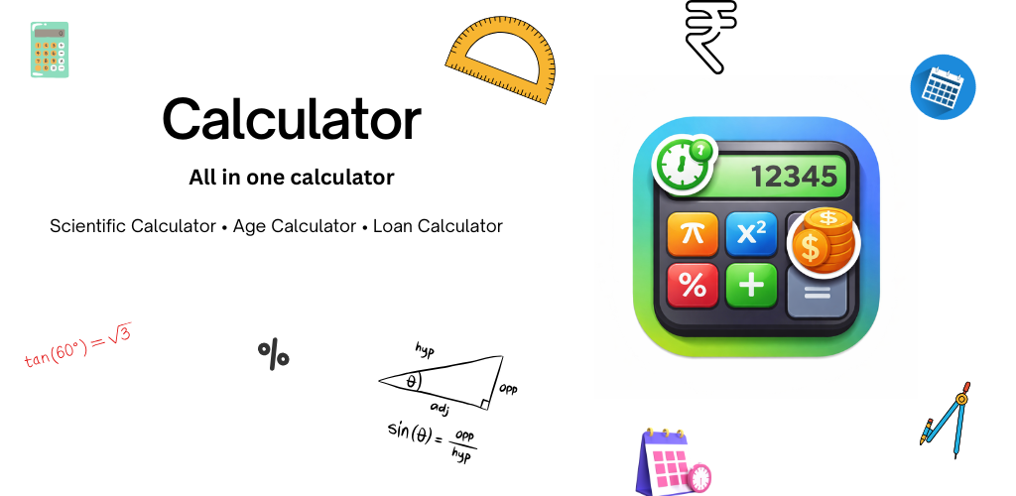
APP FEATURE SCREEN DESIGN

Slide 12
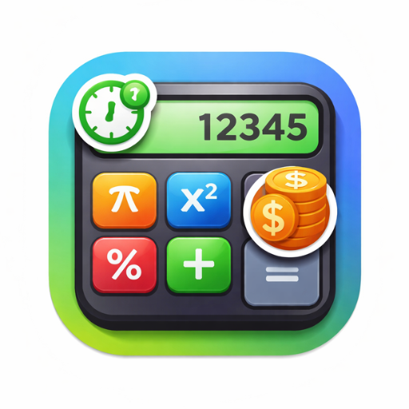
APP LOGO PICTURE

Slide 13
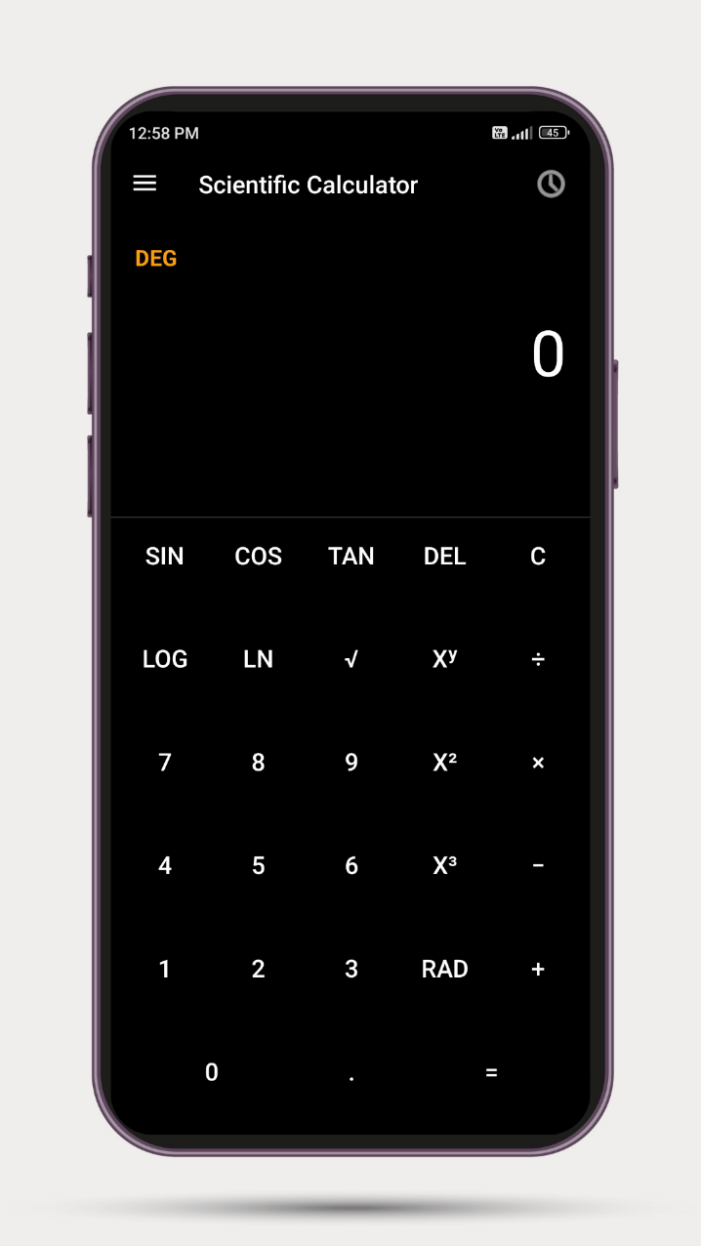
1. SCIENTIFIC CALCULATOR SCREEN
This screen is main screen that comes when you start application and its actual screen for Basic and Scientific Calculations

Slide 14
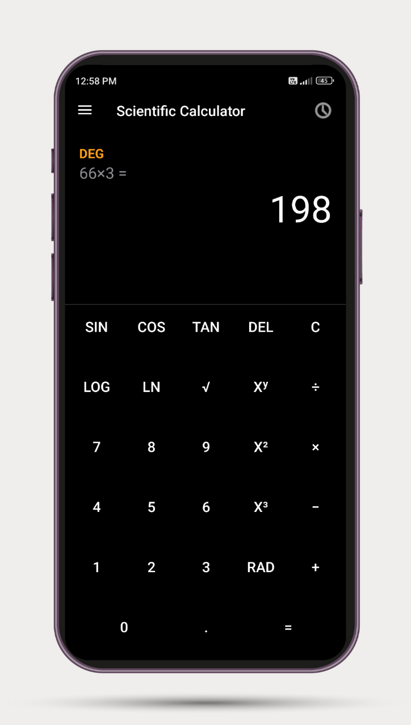
2. CALCULATION SCREEN
This screen is main screen it self where all calculations are possible basic to scientific

Slide 15
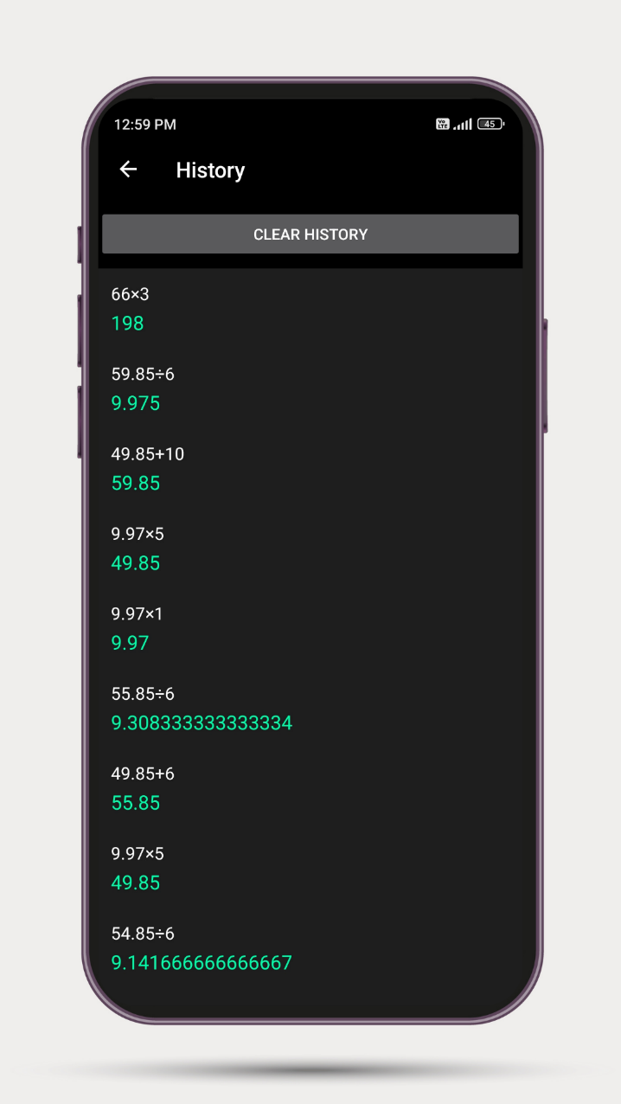
3. HISTORY SCREEN
This screen shows all basic to scientific calculations history with its expression and user can also reuse that expression by clicking on that.

Slide 16
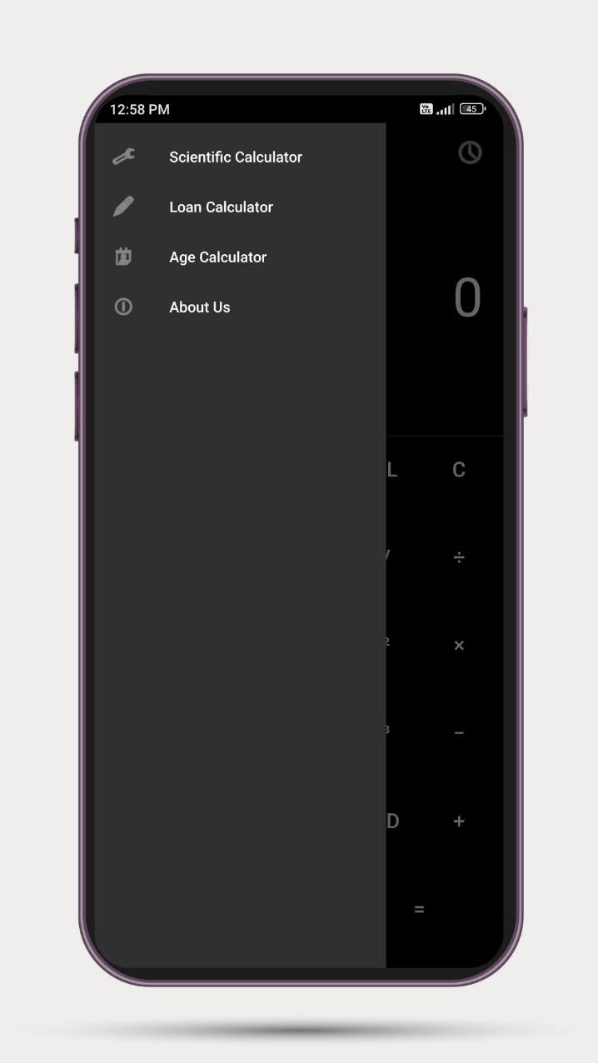
4. DRWAER MENU
This is drawer menu of our app that contains 4 options as :
Scientific Calculator
Loan Calculator
Age Calculator
About Us

Slide 17
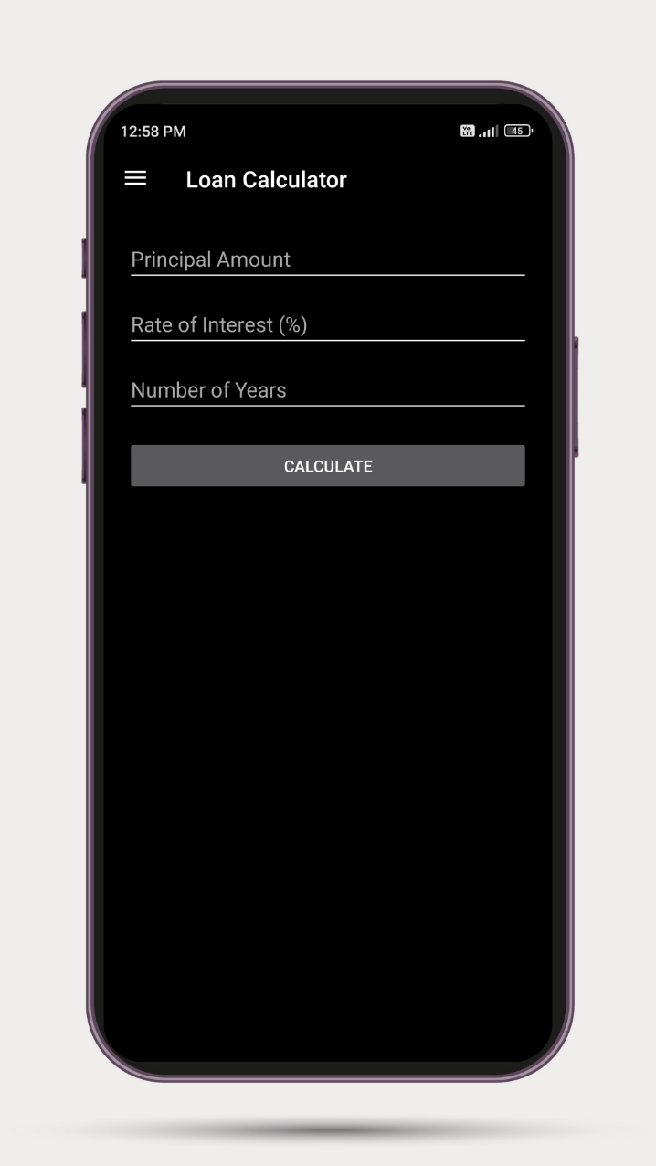
5. LOAN CALCULATOR SCREEN
This screen is Loan Calculator initial screen with 3 input fields for Amount , Rate of Interest and Number of Years with final CALCULATE Button for final result

Slide 18
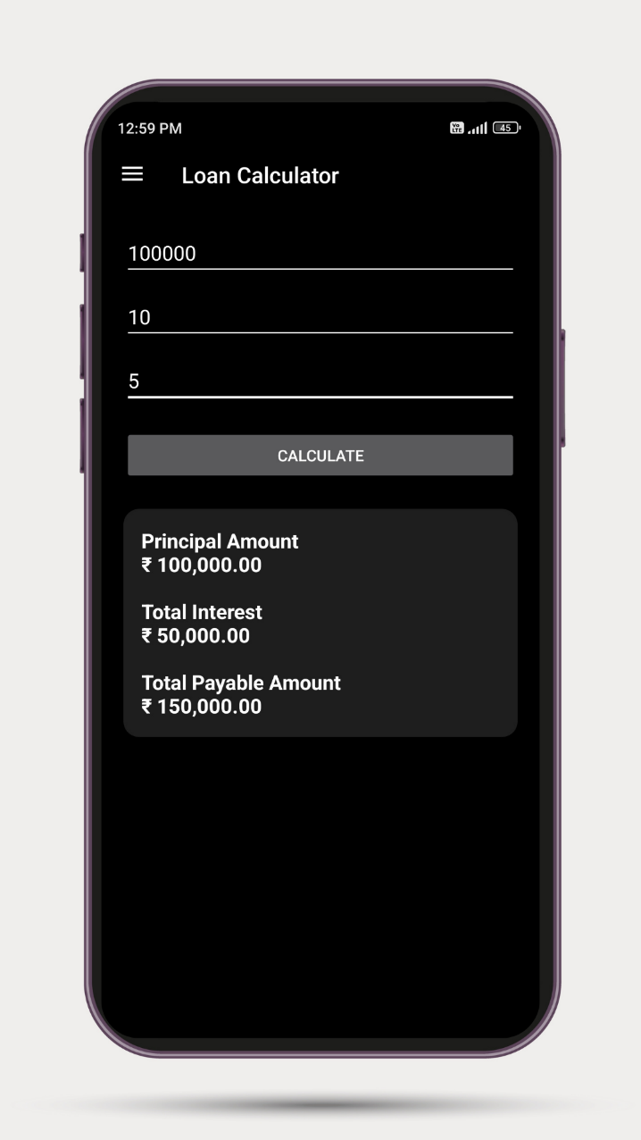
6. LOAN CALCULATION
This screen shows Loan calculation with its given inputs and for that inputs its corresponding outputs

Slide 19
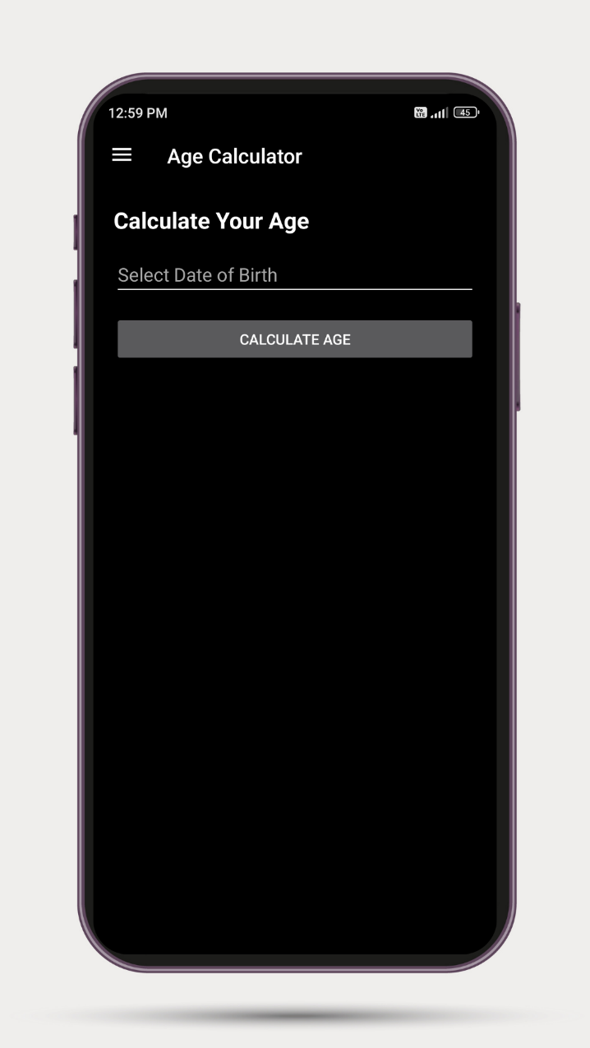
7. AGE CALCULATOR
This screen is Age Calculators initial screen with input field for entering Date if Birth and one CALCULATE AGE button to calculate and display result.

Slide 20
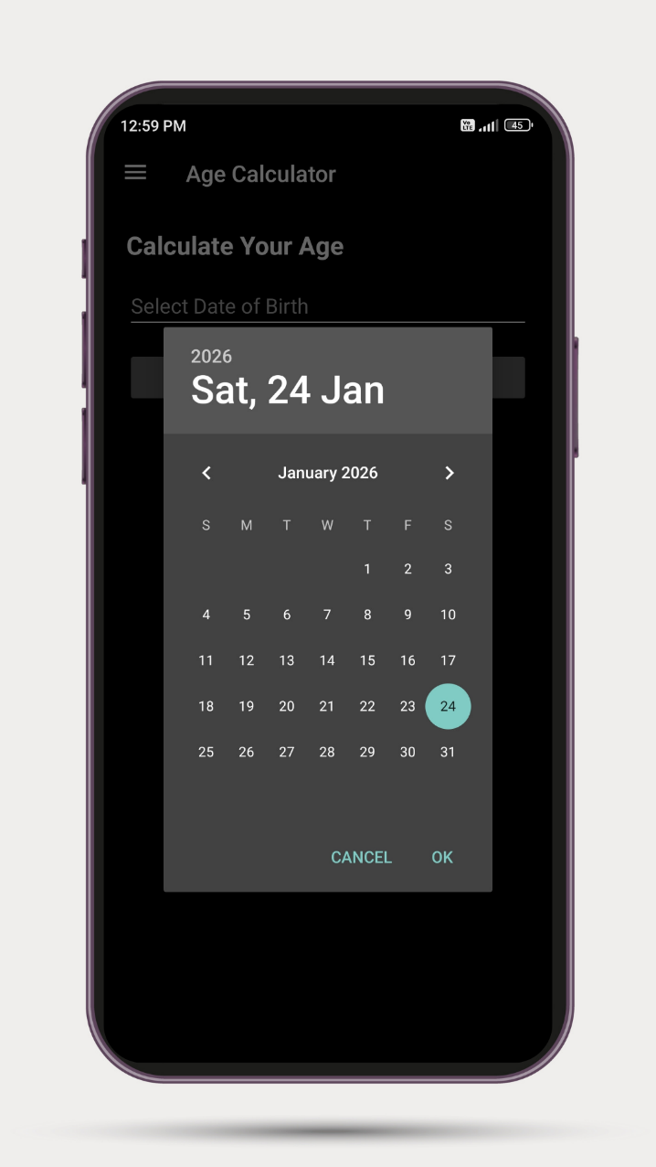
8. DATE OF BIRTH ENTERING
This screen shows how Date of Birth user can select for calculate His / Her Age.

Slide 21
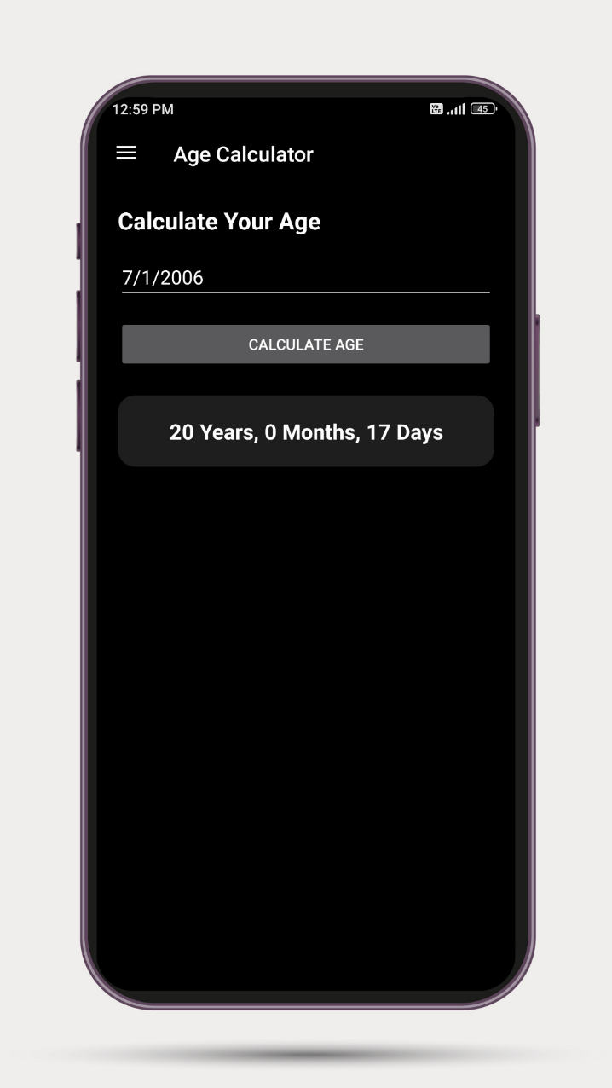
9. AGE CALCULATION
This screen displays result of user after entering Date of Birth with its Correct Age till today.

Slide 22
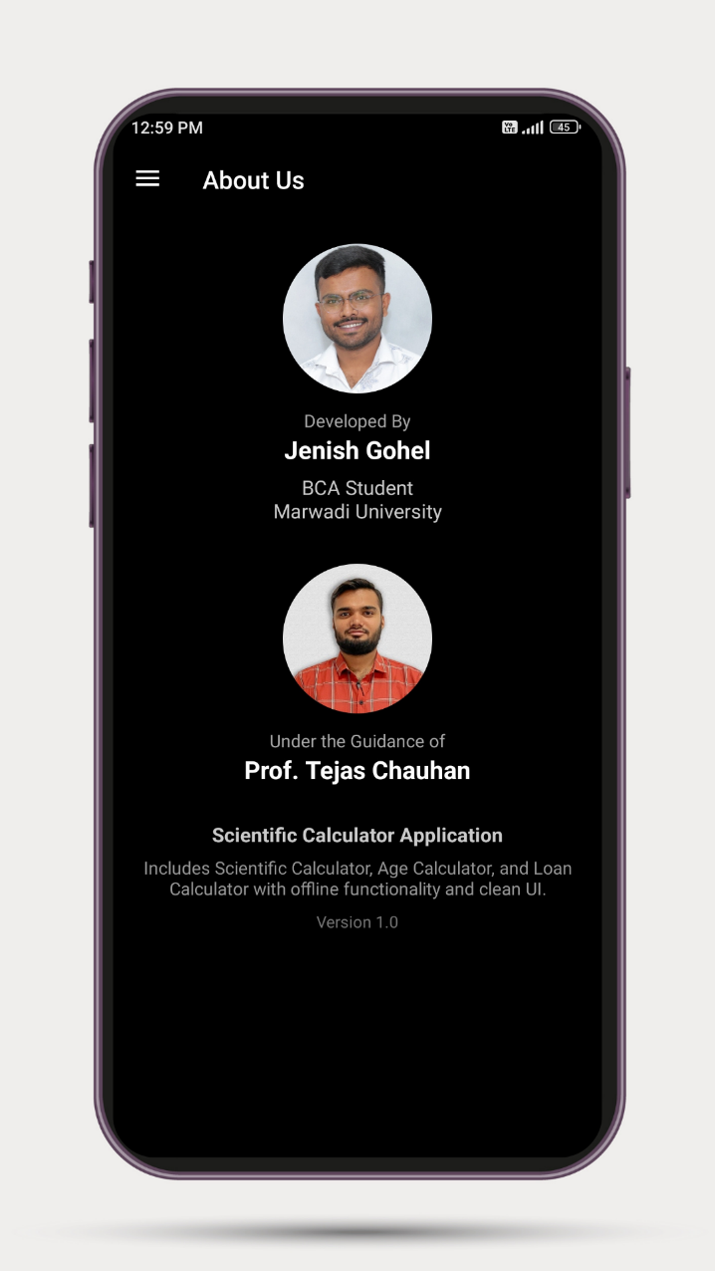
10. ABOUT US SCREEN
This is about us screen that shows Developer Information along with its Internal Guide Information and Short Application Introduction with Version

Slide 23
DATABASE DESIGN
The Calculator application uses a local database to store calculation history. The database is implemented using SQLite, which is lightweight, fast, and suitable for mobile applications.
Database Type :
Database : SQLite
Storage Location : Internal storage of the Android device
Mode : Offline
Access : Application-only (not visible to users)
Purpose of Database :
To store calculation history
To allow users to view previous calculations
To enable reuse of past results
To improve user convenience and efficiency
Advantages of SQLite in This Project :
No internet connection required
Fast data access
Low storage consumption
Secure and device-local storage

Slide 24
DATABASE DESIGN
Database Structure :
The application contains one main table for storing history records.
Table Name : history
Field Name | Data Type | Description
id | INTEGER | Unique record ID (Primary Key)
expression | TEXT | Calculation entered by the user
result | TEXT | Final computed result
timestamp | TEXT | Date and time of calculation
Primary Key :
id (Auto-incremented)
Data Flow :
User performs a calculation
Expression and result are generated
Data is stored in SQLite database
User can view history anytime from History screen

Slide 25
LEARNING DURING PROJECT
During the development of the Calculator application, we gained practical knowledge and hands-on experience in various technical and non-technical areas.
1. Android Application Development
Learned to design Android applications using Java
Understood the use of Activities, Layouts, and UI components
Implemented multiple screens using Intent navigation
2. User Interface (UI) Design
Designed responsive layouts using XML
Learned to manage screen alignment, scrolling, and overlapping issues
Improved user experience with Material Design components
3. Mathematical Logic Implementation
Implemented logic for:
Basic arithmetic calculations
Scientific operations (sin, cos, log, power, etc.)
Loan and age calculations
Handled edge cases like invalid inputs and operator errors
4. Database Handling
Learned to use SQLite database in Android
Stored and retrieved calculation history
Implemented CRUD operations using a database helper class

Slide 26
LEARNING DURING PROJECT
5. Debugging and Problem Solving
Fixed runtime errors and logical bugs
Resolved issues such as:
Auto-scroll behavior
Scientific notation formatting
Navigation drawer problems
Improved accuracy and stability of the application
6. Navigation & App Flow
Implemented Navigation Drawer
Learned smooth switching between multiple calculator modules
Maintained consistent UI across different screens
7. App Deployment Knowledge
Learned steps to:
Generate signed APK / AAB
Upload application to Google Play Store
Manage app versions and updates
8. Teamwork & Project Management
Improved planning and time management skills
Learned to document code and features clearly
Gained confidence in explaining technical concepts during presentations
Overall Learning Outcome
This project enhanced our technical skills, logical thinking, and problem-solving ability, and gave us real-world experience in developing and publishing a complete Android application.

Slide 27
BIBLIOGRAPHY
Online References :
[1] Android Developers, Official Android Developer Documentation. [Online]. Available: https://developer.android.com/ [Accessed: Sept. 10, 2026].
[2] Oracle Corporation, Java SE Documentation. [Online]. Available: https://docs.oracle.com/javase/ [Accessed: Sept. 10, 2026].
[3] Google Developers, Material Design Guidelines. [Online]. Available: https://material.io/design [Accessed: Sept. 10, 2026].
[4] SQLite Consortium, SQLite Official Documentation. [Online]. Available: https://www.sqlite.org/docs.html [Accessed: Sept. 10, 2026].
[5] W3Schools, Java and Android Programming Tutorials. [Online]. Available: https://www.w3schools.com/ [Accessed: Sept. 10, 2026].
[6] YouTube, Educational Android Development Tutorials. [Online]. Available: https://www.youtube.com/ [Accessed: Sept. 10, 2026].
[7] Stack Overflow, Community-Based Troubleshooting Platform for Android Developers. [Online]. Available: https://stackoverflow.com/ [Accessed: Sept. 10, 2026].
[8] Google Play Console, Android App Publishing Guidelines. [Online]. Available: https://play.google.com/console/ [Accessed: Sept. 10, 2026].

Slide 28
BIBLIOGRAPHY
Offline References :
[9] Study materials and lecture notes provided by the Faculty of Computer Applications, Marwadi University, India.
[10] Practical learning and hands-on experience gained during Android application development laboratory sessions.
[11] Continuous guidance, reviews, and technical suggestions provided by the project guide and faculty members during project development.
[12] Concepts and principles learned from Mobile Application Development, Java Programming, and Software Engineering subjects as part of the academic curriculum.
.

Slide 29
CONCLUSION
The Scientific Calculator Android Application successfully delivers a modern, accurate, and user-friendly mobile calculator designed using Android Studio with Java and XML. By integrating multiple calculator modules into a single application and enhancing it with a clean UI and smooth navigation, the system provides an efficient digital solution for everyday and advanced mathematical calculations.
Key Outcomes:
Successfully developed a Scientific Calculator Android application
Implemented basic arithmetic operations such as addition, subtraction, multiplication, and division
Integrated advanced scientific functions including trigonometric, logarithmic, power, and root operations
Developed an Age Calculator module for accurate age computation
Implemented a Loan Calculator module to calculate interest and total payable amount
Integrated calculation history using SQLite database for result tracking
Implemented Degree and Radian mode switching for scientific calculations
Designed a responsive, clean, and user-friendly interface
Enabled offline functionality without internet dependency
Successfully published and deployed the application on Google Play Store
Overall, the Scientific Calculator project meets its objectives by offering a reliable, feature-rich, and scalable mobile application. The project provides practical exposure to Android application development, UI/UX design, Java programming, XML layouts, database integration, and real-world app deployment, making it highly valuable for academic learning and future enhancements.

Slide 30


