Slide 1

Land Fraud: India's Hidden Crisis
A forensic verification platform to digitize, detect, and prove land ownership in Tamil Nadu — built for the era of digital governance.

Slide 2
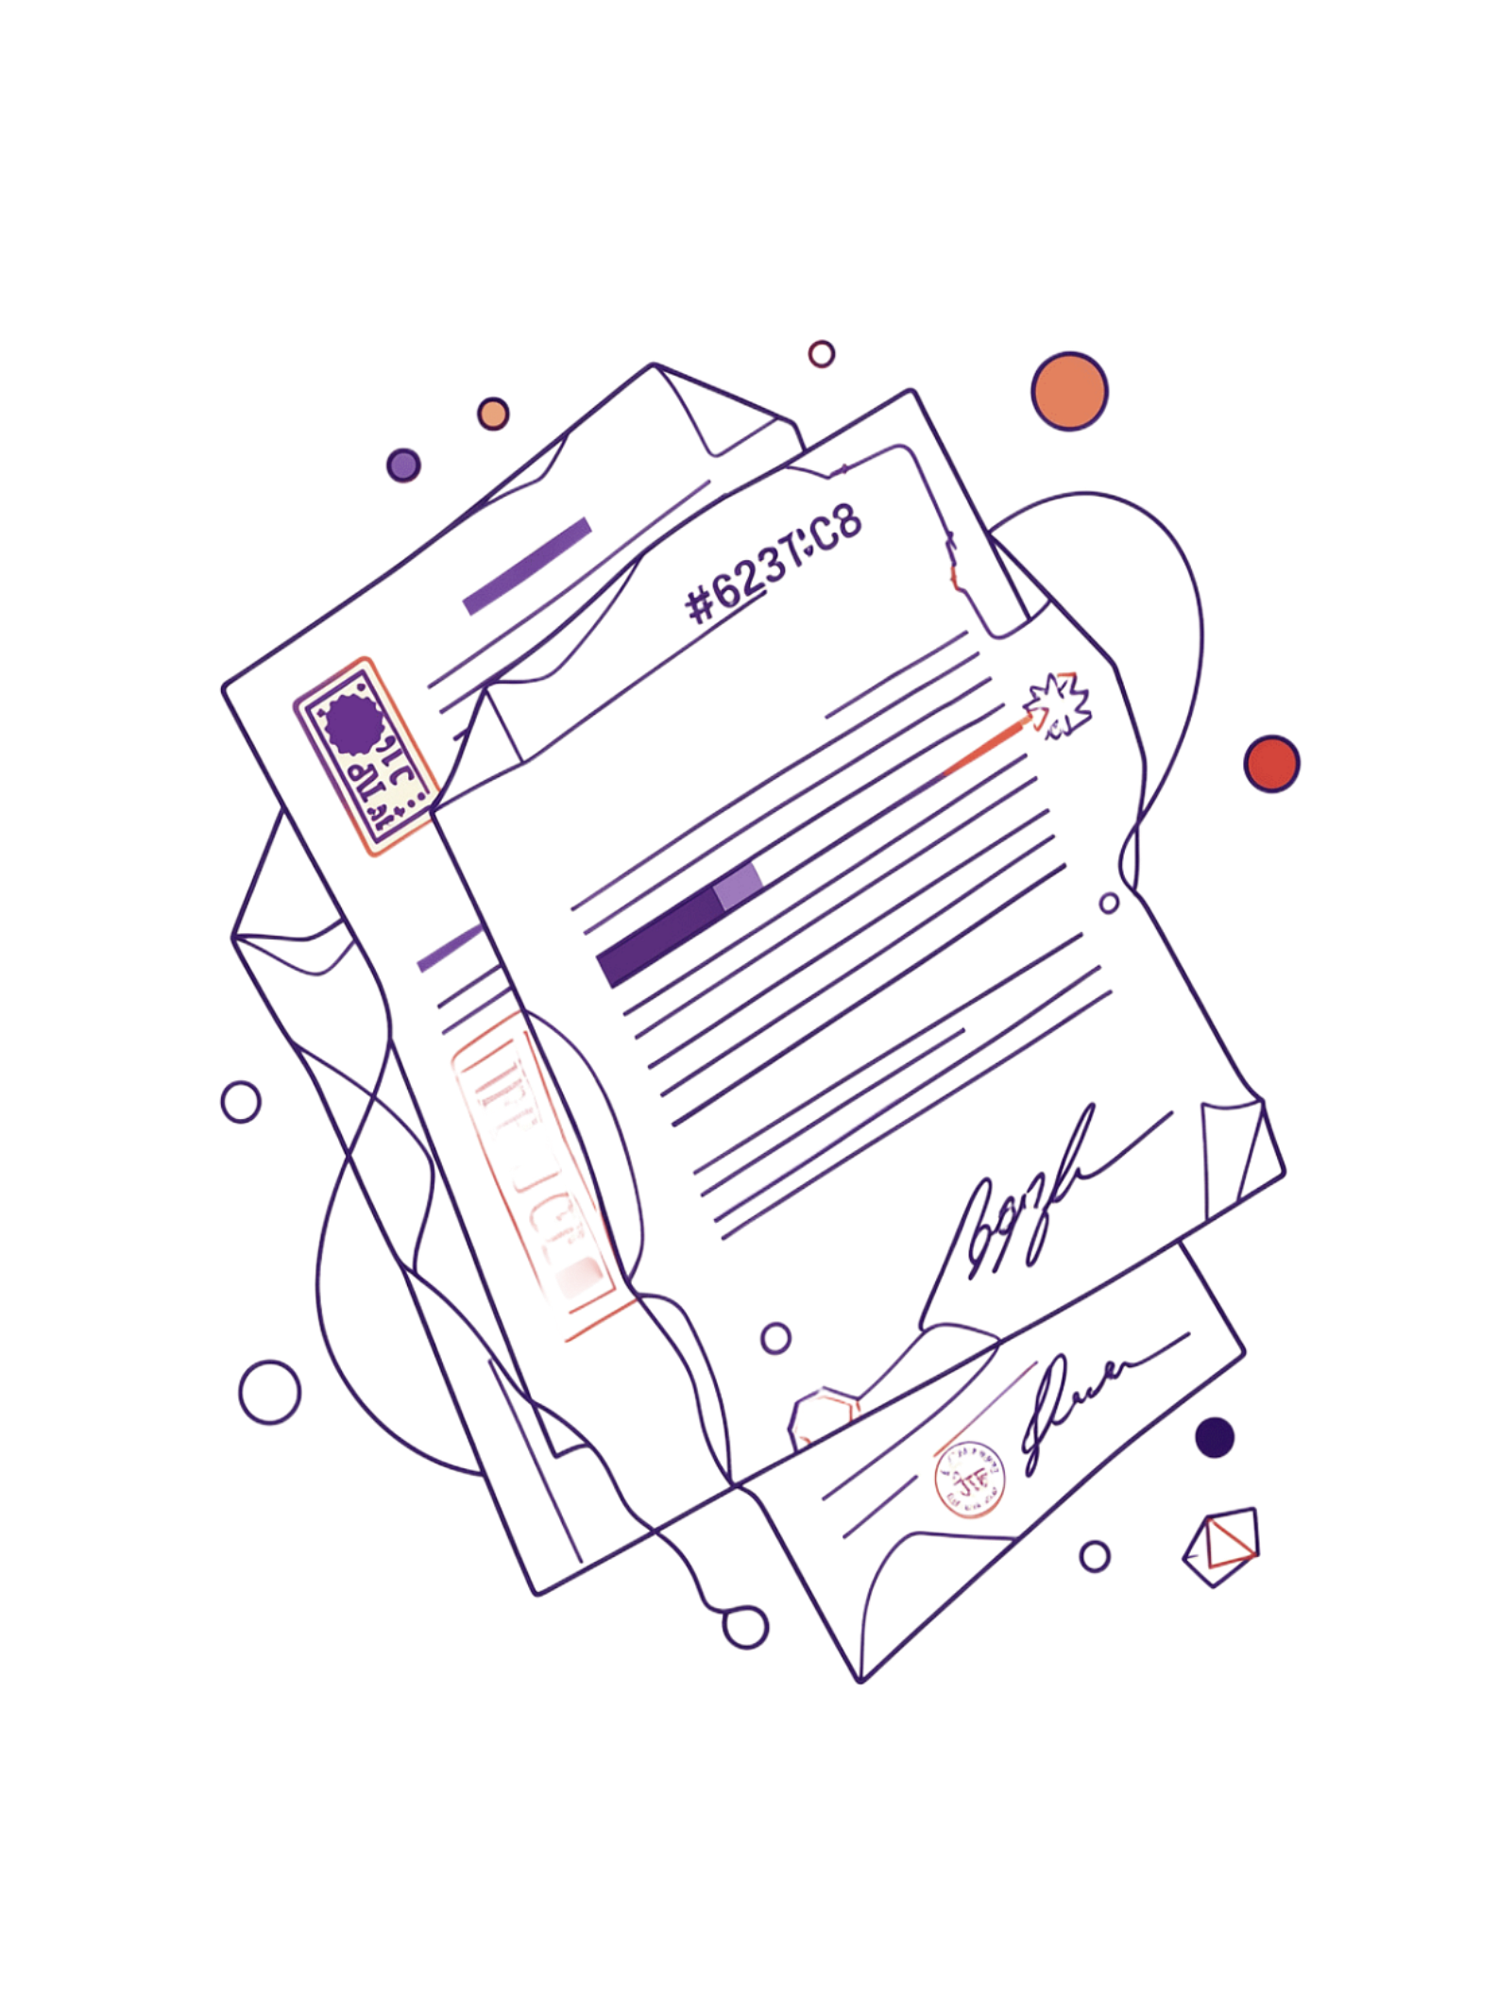

The Problem: Forged Deeds, Disputed Ownership
₹2.5 Lakh Crore
In disputed land claims across India — one of the largest categories of civil litigation in the country.
15–45 Days
Manual verification time per property. Citizens must visit offices, wait in queues, and hope records haven't been tampered with.
Handwritten Registers
Legacy records are vulnerable to ink alteration, page substitution, and deliberate forgery — with no digital audit trail.
No Self-Service
Citizens have no way to verify ownership without physically visiting revenue offices — a systemic gap exploited by fraudsters.

Slide 3

FOCUS REGION
Why Tamil Nadu?
8.6M registered properties — 40% with ownership disputes in urban areas
Existing Bhoomi/Bhulekh systems lack forensic verification capabilities
High-value real estate market makes fraud extremely lucrative
Strong digital infrastructure readiness — ideal for phased deployment

Slide 4
The Solution: Digitize, Verify, Prove
📄 Scan & Extract
🔬 Forensic Analysis
Historical land registers scanned and processed — structured data output with confidence scores per field.
Detects tampering, overlapping claims, and conflicting survey boundaries automatically.
🔗 Immutable Audit Trail
🌐 Public API
Every verification event is chained — tamper-evident, time-stamped, legally defensible.
Integrates directly with Bhoomi, DILRMP, and Bhulekh — no rip-and-replace required.

Slide 5

CHAPTER
The Pipeline
From scanned paper to verified spatial record — step by step.

Slide 6
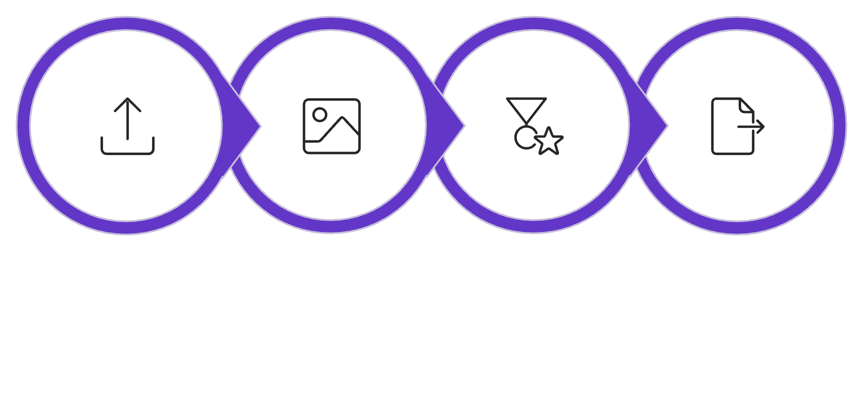

From Paper to Data: 7-Step Flow
What Comes Out
Each processed page yields a structured JSON record containing:
Owner name (in Tamil and transliterated)
Survey number with format validation
Area in hectares with unit normalization
Boundaries parsed as spatial references
Date of registration with confidence score
Upload
Preprocess
OCR
Extract JSON
Every field carries a confidence score — fields below 85% are automatically flagged for human review.

Slide 7



Validation & Human Review
Format Validate
Review Queue
Store & Index
Survey number patterns checked, cross-field consistency enforced, duplicate survey IDs flagged instantly.
Fields below 85% confidence are routed to a human reviewer dashboard — prioritized by dispute risk score.
Verified records written to PostgreSQL + PostGIS — enabling sub-second spatial queries and full audit logs.

Slide 8
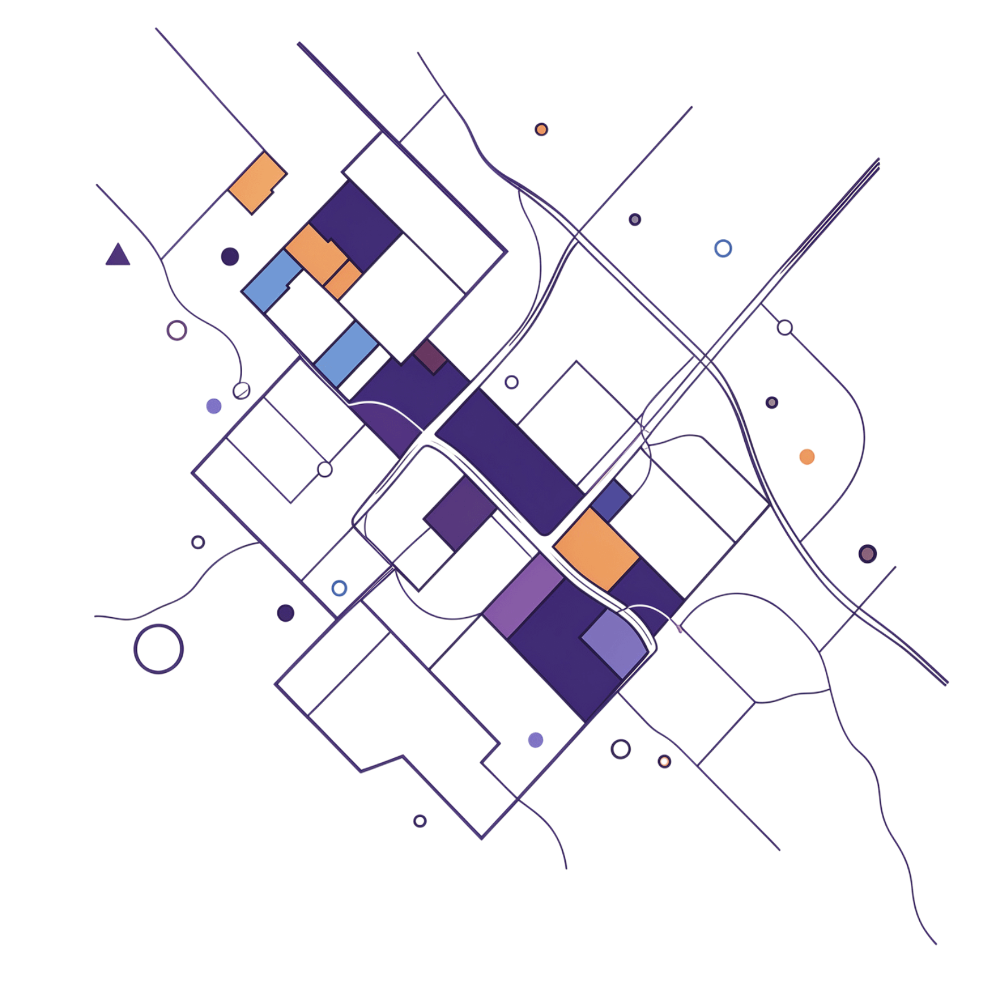
MAP & VISUALIZE
See Every Claim. Flag Every Conflict.
Verified records are rendered as GeoJSON polygons on a Leaflet/MapLibre interactive map — giving authorities and citizens a real-time spatial view of land ownership.
Overlap Detection
Citizen Portal
Conflicting boundary claims highlighted in real-time — no manual cross-referencing required.
Public-facing interface shows verified ownership with tamper evidence — accessible from any browser.

Slide 9

CHAPTER
Live Demo
Watch the pipeline in action — from scanned register page to verified spatial record in under 2 minutes.

Slide 10




Demo: Scan to Verified Record (2 min)
Upload
OCR Extraction
A scanned Tamil Nadu register page is dropped into the portal — raw image, no preprocessing required from the user.
Watch in real-time as owner name, survey number, and area are extracted — confidence scores appear field by field.
Review Flagging
Verify & Map
Low-confidence fields light up in red — the reviewer sees exactly which values need a human decision before saving.
Reviewer confirms → record is saved → the parcel polygon appears live on the geospatial map with a verified badge.

