Slide 1
The Maze
DFS and BFS Approach
Jenish patel | 19549

Slide 2
Index
Introduction
Algorithm
Code
Conclusion

Slide 3
About Project
This Project is about to solve the maze problem using two approaches:
DFS: depth-first search
BFS: breadth-first search
First I’ll Elaborate the both approaches using simple example which includes the graphs and trees as well as stack and then we’ll look around the python code

Slide 4
Problem

Slide 5
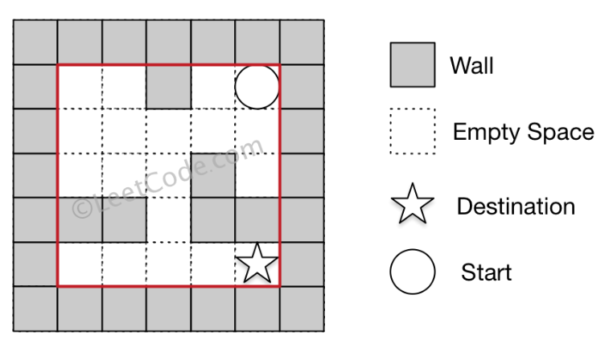
Problem
There is a ball in a maze with empty spaces and walls. The ball can go through empty spaces by rolling up, down, left or right, but it won't stop rolling until hitting a wall. When the ball stops, it could choose the next direction.
Given the ball's start position, the destination and the maze, determine whether the ball could stop at the destination.
The maze is represented by a binary 2D array. 1 means the wall and 0 means the empty space. You may assume that the borders of the maze are all walls. The start and destination coordinates are represented by row and column indexes.

Slide 6
Algorithm

Slide 7
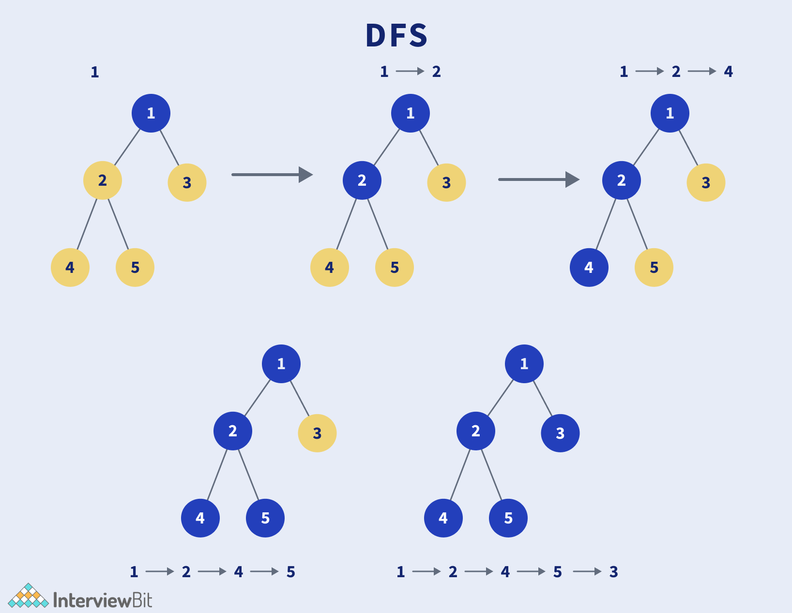
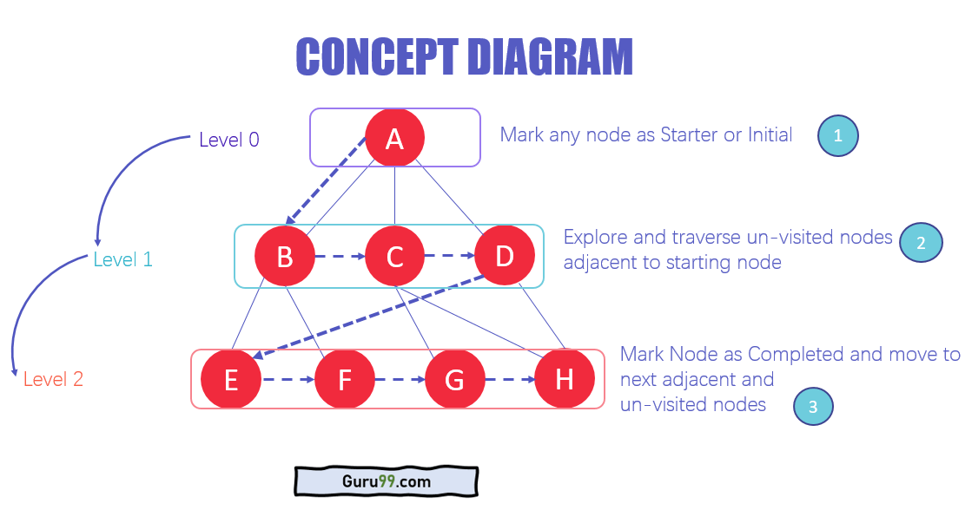
DFS
BFS
algorithm for searching all the vertices of a graph or tree data structure. DFS visiting all the nodes of a graph.
unlike trees, graphs may contain cycles, so we may come to the same node again

Slide 8
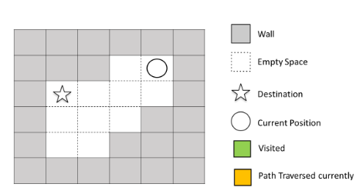
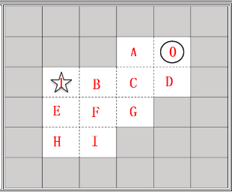
Let’s try to understand the concept
Fill the gap with letters and assign ‘0’ as a starting point and ‘1’ as a ending point

Slide 9
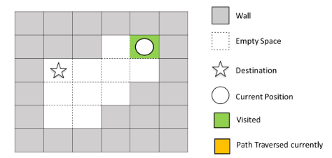

Initially the node visited ‘0’ which means the starting node

Slide 10
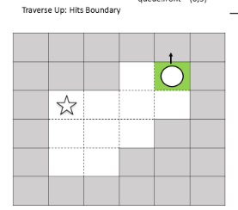
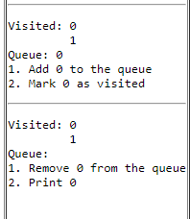
Ball starts moving by going up

Slide 11
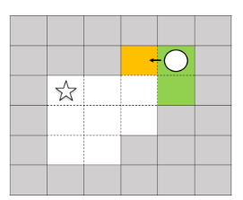
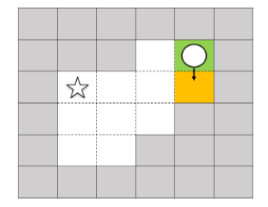
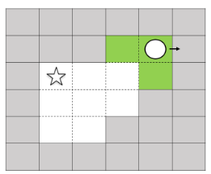
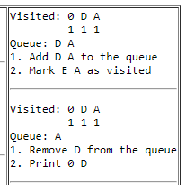
Going down visited D hits the wall change the direction
Going left visited A, hits the wall change the direction
Going Right hits the wall change the direction
The ball can go through the empty spaces by rolling up, down, left, right, but it won't stop rolling until hitting a wall. When the ball stops, it could choose the next direction.

Slide 12
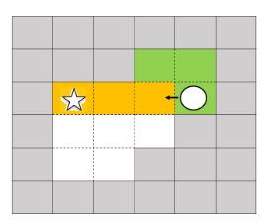
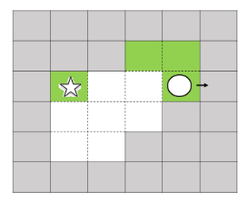
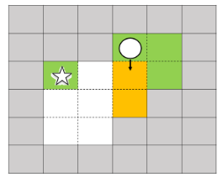
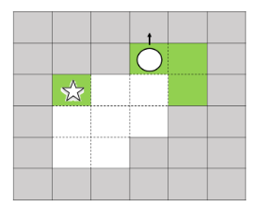
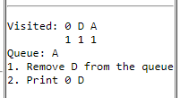
Going up visit 0, left,right visit A, going up, change the direction
Going Right visited ‘1’, hits the wall
Going down visited D,hits the wall change the direction
Going down visited G
Stack

Slide 13
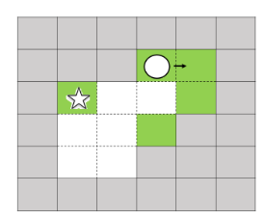
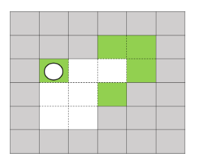
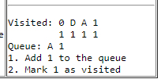
Going up visited A and hits the wall, going right hits the wall, going left hits the wall, going down hits the wall
And finally reached the destination with all path covered

Slide 14
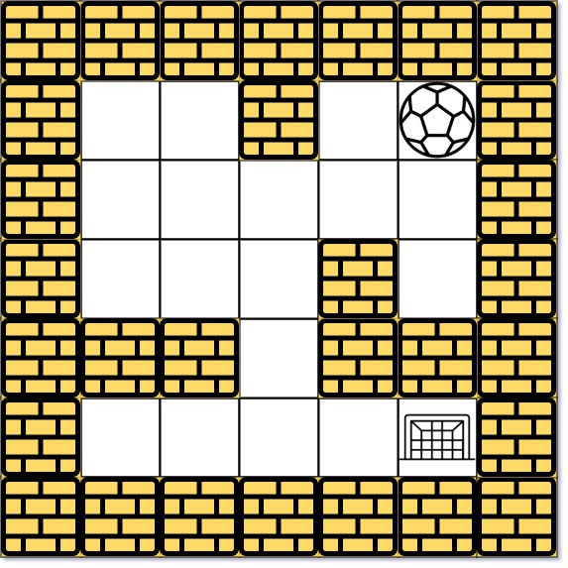
Now Let’s focus on Our Problem
The ball can go through the empty spaces by rolling right, left, up, down, but it won't stop rolling until hitting a wall. When the ball stops, it could choose the next direction.

Slide 15
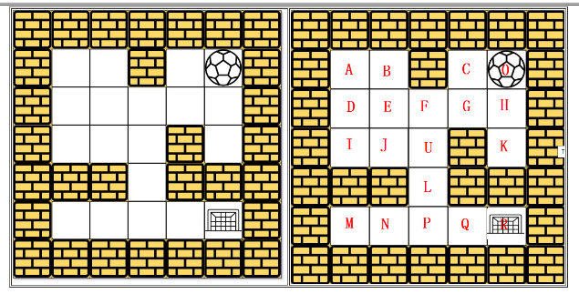
Fill the gaps using alphabets
It helps to solve the problem
Let’s convert into graph

Slide 16
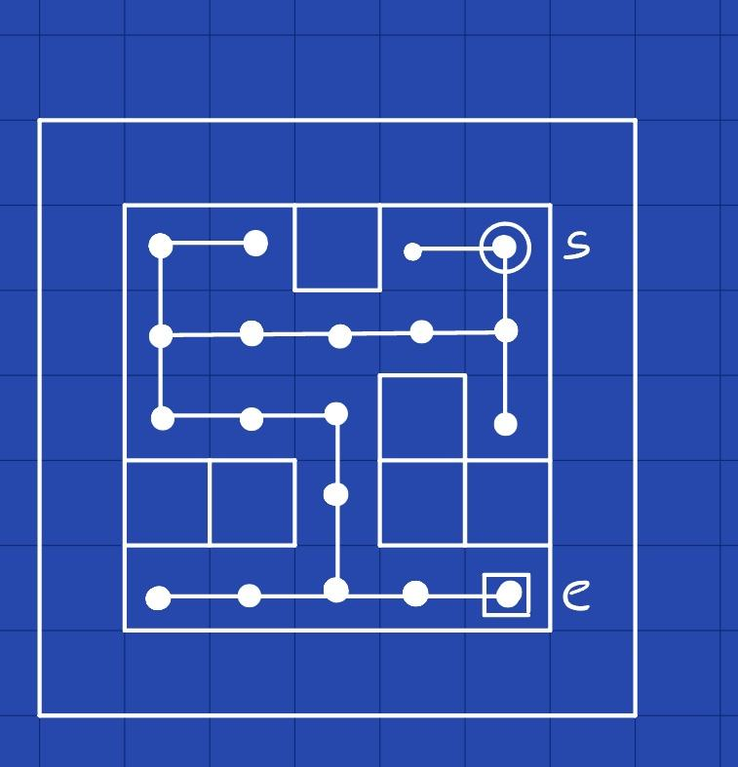
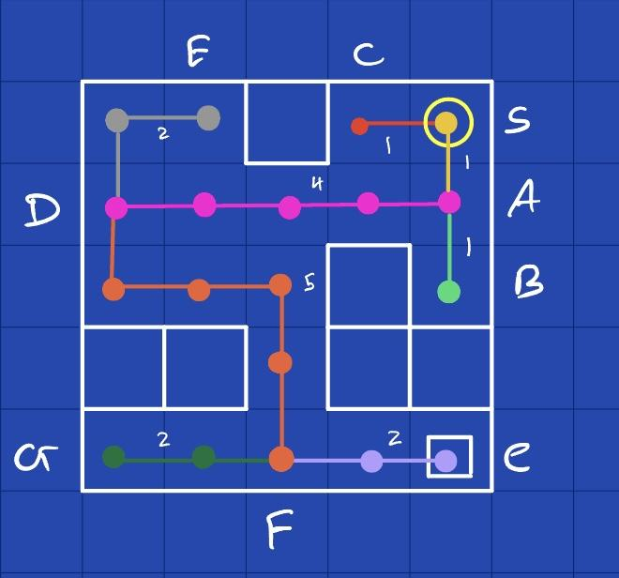
Let’s convert this graph into tree

Slide 17
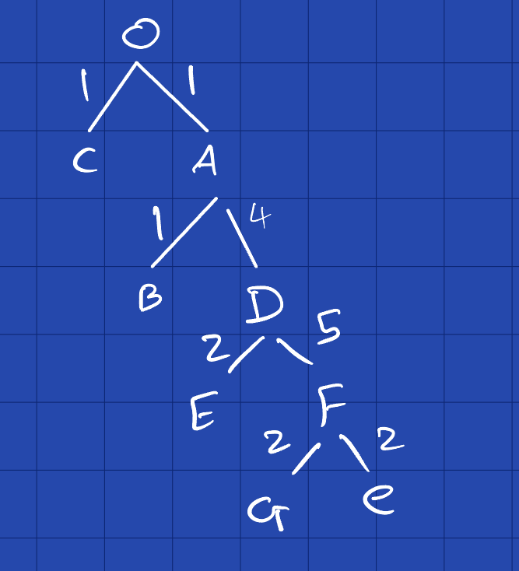
Tree
Let’s Convert the Tree into Stack

Slide 18
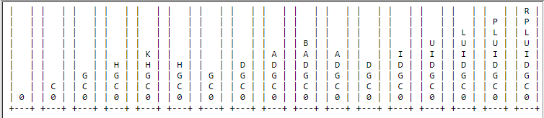
Stack

Slide 19
Code
- Python 3
- Google Collab

Slide 20
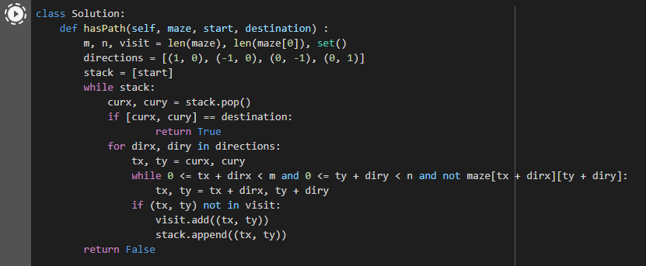

DFS
Code:
https://colab.research.google.com/drive/1-WBHtAhIBCX41oINLSd7wTeCrgM2P7q_?usp=sharing

Slide 21
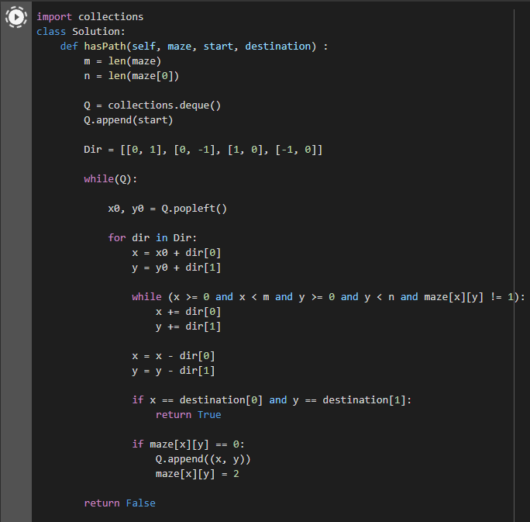

BFS
Code:
https://colab.research.google.com/drive/1Cxt_25xxWM33Hu3GdMGhQaQZxNAqdkTI?usp=sharing

Slide 22
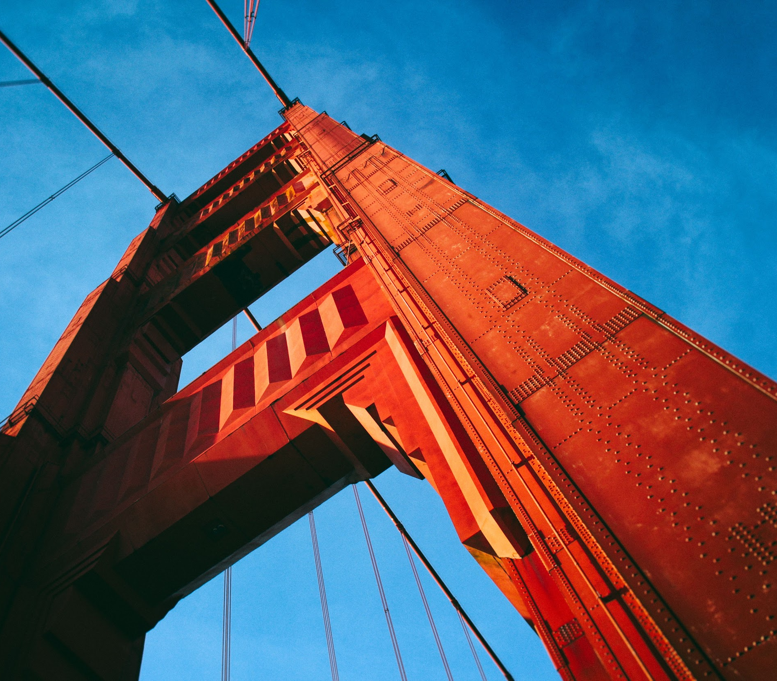
Thank you
Jenish Patel
19659
BSCS
SF Bay University
www.github.com/Jenishbh

