Slide 1
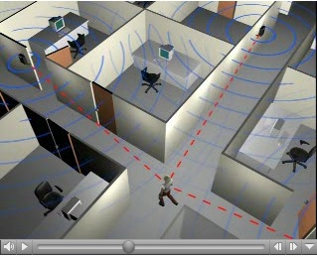
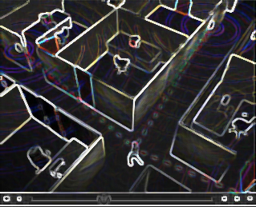
Radio Tomographic Imaging (RTI):
Using WiFi for Indoor Imaging and Sensing
GROUP-3
GROUP-1
Model based machine learning for improved results
Incorporate model information into the Neural Network to achieve higher resolution results
Increase the robustness of the achieved results by reducing noise and false detections
Reconstruction Algorithm and testing with simulation data
Design and implement the RTI model
Classical Machine learning for inverse problem
Simulation and experimental results
GROUP-2
Hardware implementation, measurement setup and Data collection
Configuring wireless network made up of ESP32 sensors
Collect experimental data under various conditions
Experimental data
Experimental data

Slide 2
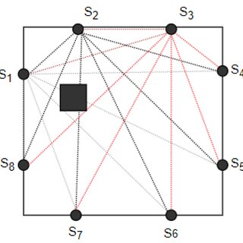
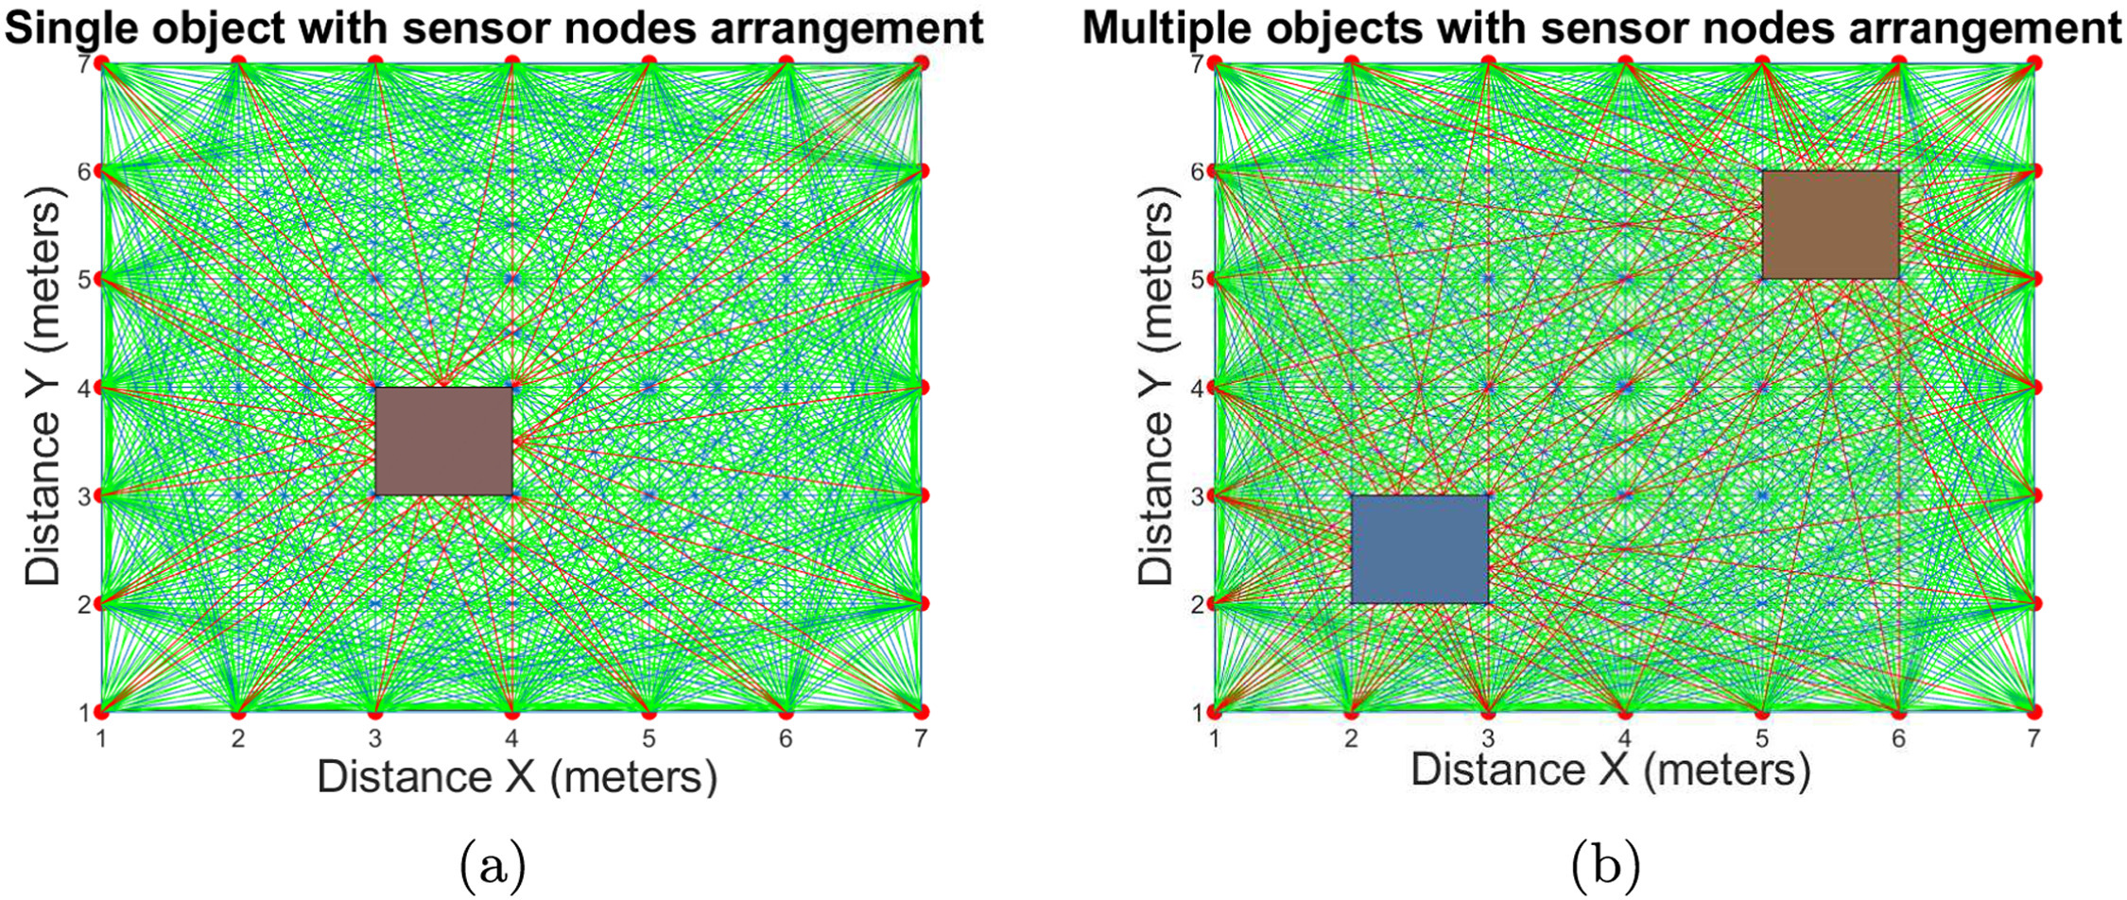
B Tech Project
END-Term Review
Prof Amartansh Dubey
Radio Tomographic Imaging (RTI):
Utilizing Wi-Fi for Indoor Imaging and Sensing
Group 1: Developing and Implementing Image Reconstruction Algorithms
27th November 2025
By-
Sambhab Dalai – 2022EE11721
Priti Kumari Meena – 2022EE11185

Slide 3
What is Radio Tomographic Imaging (RTI)?
BTP-RF IMAGING AND SENSING
Key Advantages
An imaging technology that maps signal attenuation caused by physical objects within a wireless network.
It's "device-free," meaning objects being imaged don't need to carry any electronic device.
Not Limited to Localization: Captures Shape, Size, and Attenuation
Imagine it as a large-scale CT scanner or MRI but instead of x-rays, we are using RF signals
Works through through-the-wall and obstructions: RTI utilizes radio signals that can pass through walls, trees, and smoke, unlike camera systems.
Functions in darkness: The system operates on radio waves, allowing it to work effectively in complete darkness, where cameras fail.
Preserves privacy: RTI provides a person's location and movement but cannot be used for identification, addressing privacy concerns.
The technology can be used for various applications.
  Emergency response: Locate survivors in fire, smoke, or collapsed buildings.
  Security and defense: Detect intruders or track offenders without devices.
  Smart buildings: Monitor occupancy for energy optimization and automated control.
“Device free” : No electronic device is needed on the person being imaged. This makes it useful for applications like security breaches, rescue operations, and tracking offenders where the subjects may not be carrying an electronic device.
How RTI Works?
Multiple node pairs create numerous transmission paths through the monitored area
Objects moving into wireless network areas cause shadowing losses on radio links
Signal strength changes indicate object presence and location
Linear model processes RSS measurements to generate attenuation images.
Source : Reference

Slide 4
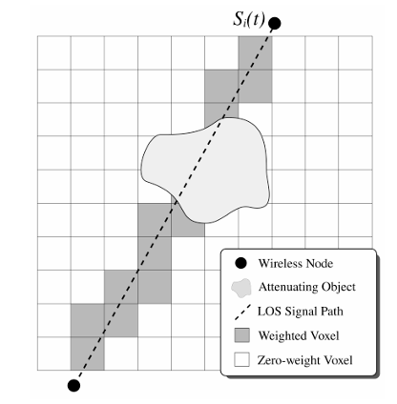
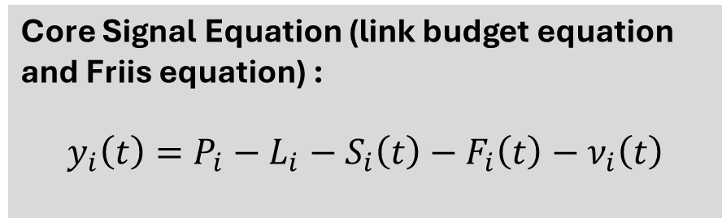
BTP-RF IMAGING AND SENSING
Mathematical Foundation: Linear RTI Model
Core Signal Equation (link budget equation and Friis equation) :
$$y_{i}\left(t\right)=P_{i}−L_{i}−S_{i}\left(t\right)−F_{i}\left(t\right)−ν_{i}\left(t\right)$$
Any pair of nodes is counted as a link, whether or not communication actually occurs between them. The signal strength y_i(t) of a particular link i at time t is dependent on:
Signal Components
P_i: Transmitted power in decibels
L_i: Static losses in decibels due to distance, antenna patterns, device inconsistencies
S_i(t): Shadowing loss in decibels due to objects that attenuate the signal
F_i(t): Fading loss in decibels that occurs from constructive and destructive interference of narrow band signals in multipath environments
ν_i(t): Measurement noise
An illustration of a single link in an RTI network that travels in a direct LOS path. The signal is shadowed by objects as it crosses the area of the network in a particular path. The darkened voxels represent the image areas that have a nonzero weighting for this particular link.
Source : Reference

Slide 5
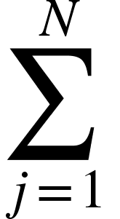
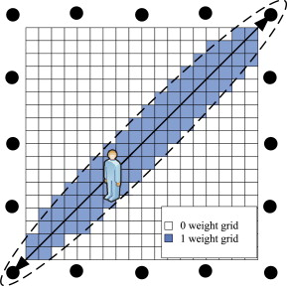
BTP-RF IMAGING AND SENSING
Shadowing loss is the weighted sum of attenuation occurring in each voxel j:
Si​(t)=​ wij ​xj​(t)
xj​(t): Attenuation in voxel j
wij​: Weighting of voxel j for link i (zero if the link doesn't "cross" the voxel)
FINAL RESULTS
Matrix Formulation
Δy=WΔx+n
Δy: RSS measurement changes
W: Weighting matrix (M × N)
Δx: Attenuation image to estimate
n: Noise vector
y taking the difference in RSS between two times (ta and tb ), all static losses (Pi , Li ) are removed:
△yi = yi (tb)−yi (ta)
The difference in RSS is related to the change in attenuation (△xj ) and a grouped noise term (ni ):
△yi = wij △xj +ni
ni groups the fading and measurement noise :
ni =Fi (tb )−Fi (ta )+νi (tb )−νi (ta)
Source : Reference

Slide 6
BTP-RF IMAGING AND SENSING
IMAGE RECONSTRUCTION
The Linear RTI Model and its Limitations
The Model: We model the change in received signal strength, △y, as a linear function of the change in attenuation in each voxel, △x:
y=Wx+n
  y : Vector of RSS changes for all M links.
  W : The weighting matrix (M×N) that links each voxel to each link.
    M = (K² – K) / 2 : If K is the number of nodes in the RTI network
    N = Number of Pixels of the Image vector
  x : The attenuation image vector (N×1) to be estimated.
  n : The noise vector, including multipath fading and measurement noise.
Why a Simple Inverse Fails: The Ill-Posed Inverse Problem
  A direct inverse solution, x=W ⁻¹ y,
The Problem: Small amounts of noise in the measurements (n) get significantly amplified during inversion, leading to a corrupted image.
Source : Reference

Slide 7
BTP-RF IMAGING AND SENSING
IMAGE RECONSTRUCTION
The Linear RTI Model and its Limitations
The Model: We model the change in received signal strength, △y, as a linear function of the change in attenuation in each voxel, △x:
y=Wx+n
  y : Vector of RSS changes for all M links.
  W : The weighting matrix (M×N) that links each voxel to each link.
    M = (K² – K) / 2 : If K is the number of nodes in the RTI network
    N = Number of Pixels of the Image vector
  x : The attenuation image vector (N×1) to be estimated.
  n : The noise vector, including multipath fading and measurement noise.
Why a Simple Inverse Fails: The Ill-Posed Inverse Problem
  A direct inverse solution, x=W ⁻¹ y,
  It is impossible because W is not a square matrix.
The Problem: Small amounts of noise in the measurements (n) get significantly amplified during inversion, leading to a corrupted image.
Source : Reference

Slide 8
IMAGE RECONSTRUCTION
The Linear RTI Model and its Limitations
The Model: We model the change in received signal strength, △y, as a linear function of the change in attenuation in each voxel, △x:
y=Wx+n
  y : Vector of RSS changes for all M links.
  W : The weighting matrix (M×N) that links each voxel to each link.
    M = (K² – K) / 2 : If K is the number of nodes in the RTI network
    N = Number of Pixels of the Image vector
  x : The attenuation image vector (N×1) to be estimated.
  n : The noise vector, including multipath fading and measurement noise.
Why a Simple Inverse Fails: The Ill-Posed Inverse Problem
  A direct inverse solution, x=W ⁻¹ y,
  It is impossible because W is not a square matrix.
  The least-squares solution xLS​=(W ^{T} W)⁻¹W^{T}y
The Problem: Small amounts of noise in the measurements (n) get significantly amplified during inversion, leading to a corrupted image.
Source : Reference

Slide 9
BTP-RF IMAGING AND SENSING
IMAGE RECONSTRUCTION
The Linear RTI Model and its Limitations
The Model: We model the change in received signal strength, △y, as a linear function of the change in attenuation in each voxel, △x:
y=Wx+n
  y : Vector of RSS changes for all M links.
  W : The weighting matrix (M×N) that links each voxel to each link.
    M = (K² – K) / 2 : If K is the number of nodes in the RTI network
    N = Number of Pixels of the Image vector
  x : The attenuation image vector (N×1) to be estimated.
  n : The noise vector, including multipath fading and measurement noise.
Why a Simple Inverse Fails: The Ill-Posed Inverse Problem
  A direct inverse solution, x=W ⁻¹ y,
  It is impossible because W is not a square matrix.
  The least-squares solution xLS​=(W ^{T} W)⁻¹W^{T}y
  This is numerically unstable because W is not full-rank.(Let’s understand this more deeply !)
The Problem: Small amounts of noise in the measurements (n) get significantly amplified during inversion, leading to a corrupted image.
Source : Reference

Slide 10
BTP-RF IMAGING AND SENSING
IMAGE RECONSTRUCTION
Why Regularization is Important ? (The Problem)
Singular Matrix Inversion: The least-squares solution is solution xLS​=(W ^{T} W)⁻¹W^{T}y. However, the matrix W is typically not full-rank because many voxels are estimated from relatively few links.
Unbounded Solution: When W is decomposed using Singular Value Decomposition (SVD), the presence of zero or near-zero singular values in W means that inverting them (as required for the least-squares solution) leads to unbounded results for the corresponding image components, rendering the image unusable.
  Un-crossed Voxels: If a pixel (voxel) is not crossed by any wireless link, its entire column in the W matrix will be all zeros. This means the column vector is linearly dependent on other columns, making the rank of W less than N. If a pixel isn't crossed, every possible attenuation value for that pixel would yield the same measurement data, making inversion impossible for that pixel.
  Highly Correlated Paths: Multiple links may pass through nearly the same set of voxels, making their rows in W nearly identical (highly correlated). This leads to near-zero singular values.
Therefore, W is typically rank-deficient: rank (W) < N.
In summary, regularization is essential to stabilize the inversion and suppress the noise amplification, turning the unstable least-squares solution into a stable estimate.
Source : Reference

Slide 11
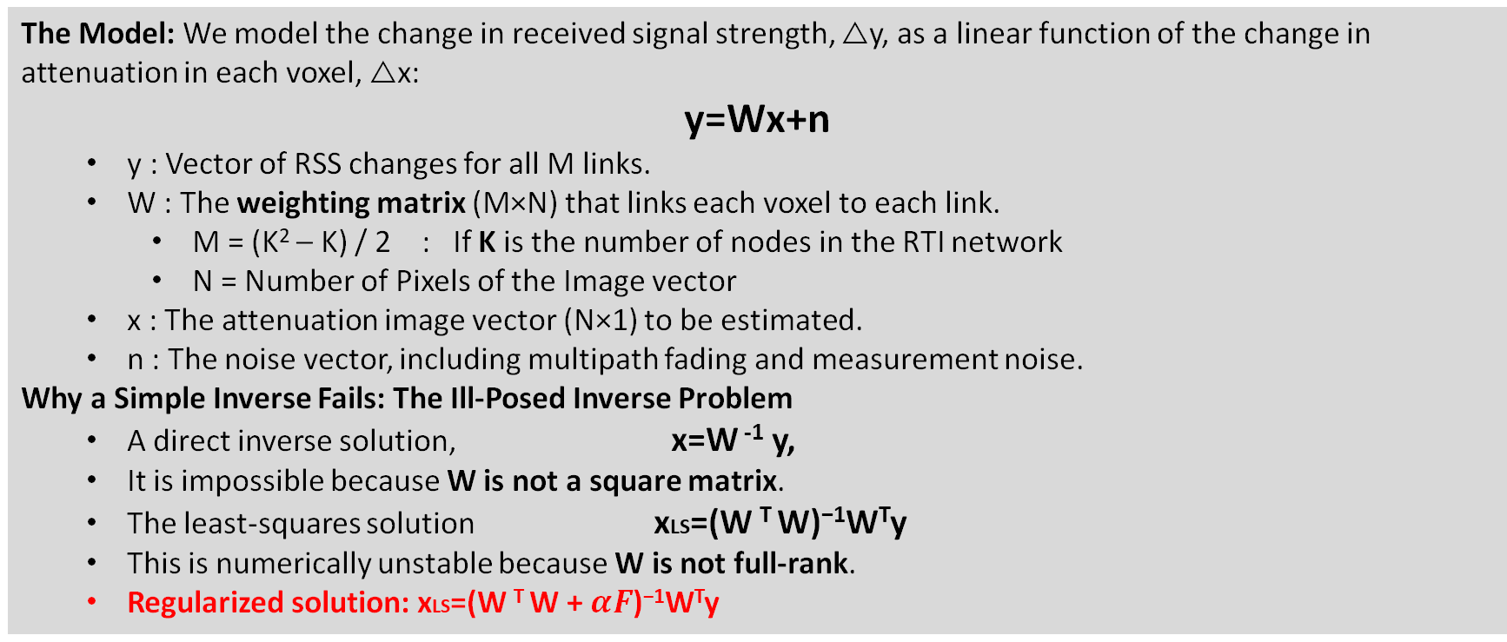
BTP-RF IMAGING AND SENSING
IMAGE RECONSTRUCTION
The Linear RTI Model and its Limitations
The Model: We model the change in received signal strength, △y, as a linear function of the change in attenuation in each voxel, △x:
y=Wx+n
  y : Vector of RSS changes for all M links.
  W : The weighting matrix (M×N) that links each voxel to each link.
    M = (K² – K) / 2 : If K is the number of nodes in the RTI network
    N = Number of Pixels of the Image vector
  x : The attenuation image vector (N×1) to be estimated.
  n : The noise vector, including multipath fading and measurement noise.
Why a Simple Inverse Fails: The Ill-Posed Inverse Problem
  A direct inverse solution, x=W ⁻¹ y,
  It is impossible because W is not a square matrix.
  The least-squares solution xLS​=(W ^{T} W)⁻¹W^{T}y
  This is numerically unstable because W is not full-rank.
  Regularized solution: xLS​=(W ^{T} W + $αF$)⁻¹W^{T}y
The Problem: Small amounts of noise in the measurements (n) get significantly amplified during inversion, leading to a corrupted image.
Source : Reference

Slide 12
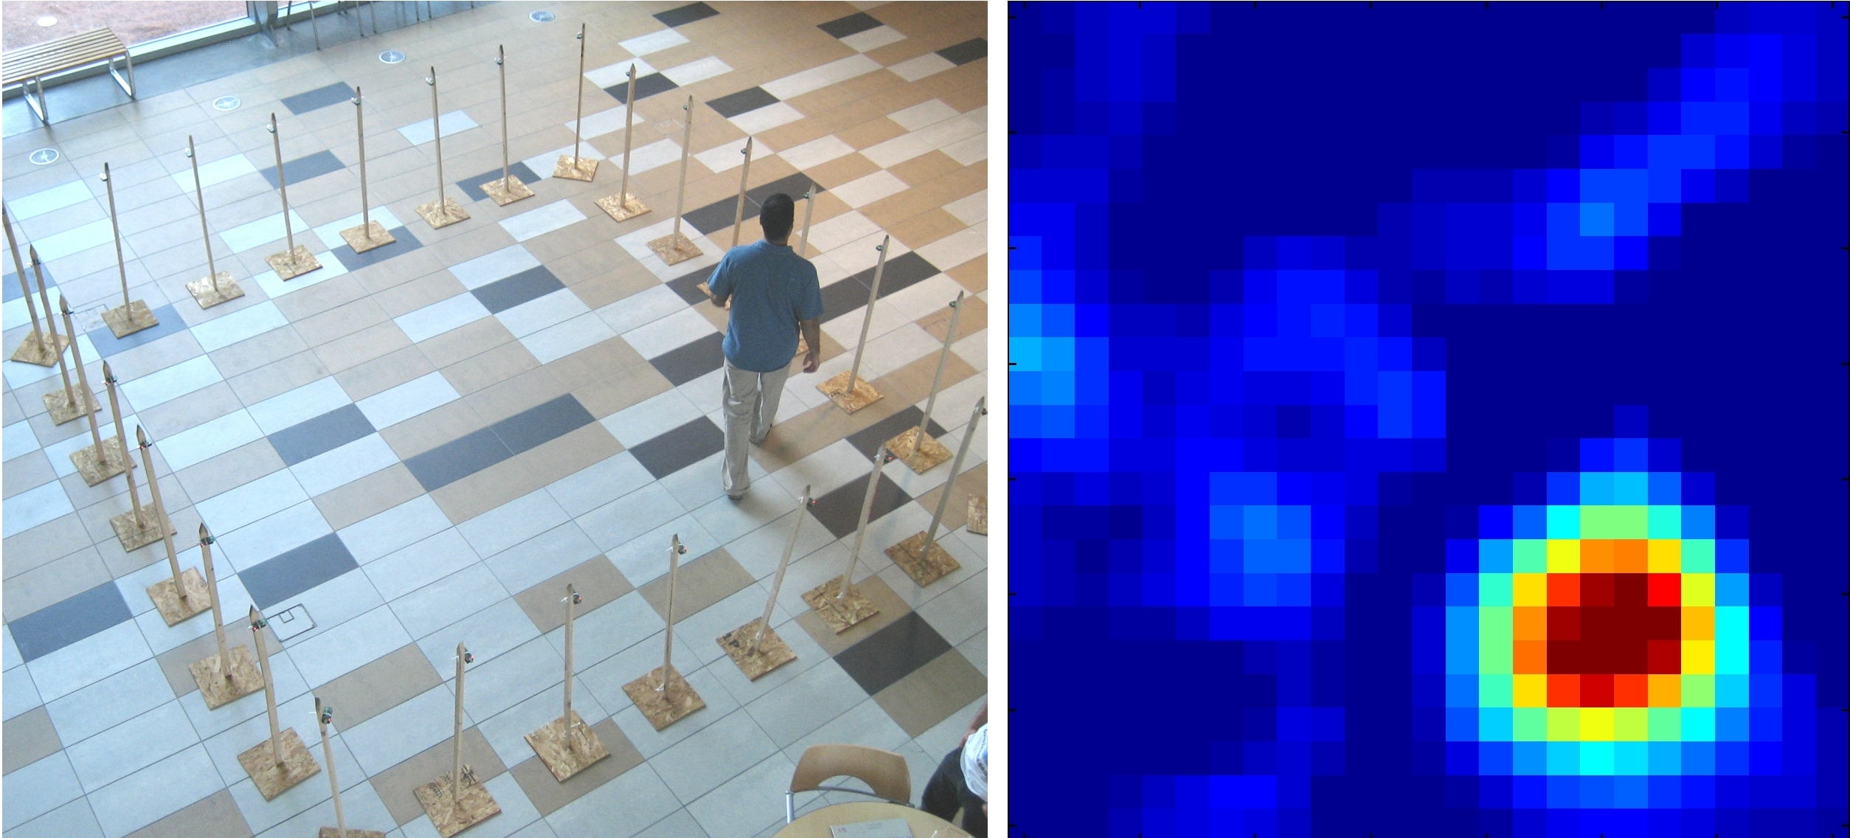
The preliminary results should look like :
Goal is to first achieve localization and imaging results with low resolution, then improve the results using machine learning. We also aim to reduce the required number of WiFi sensors.
REFERENCE: J. Wilson and N. Patwari, "Radio Tomographic Imaging with Wireless Networks," in IEEE Transactions on Mobile Computing, vol. 9, no. 5, pp. 621-632, May 2010, doi: 10.1109/TMC.2009.174.

Slide 13

Regularization in RTI
Solving the Ill-Posed Inverse Problem: y = Wx
Implementation and Comparison of Ridge and TV Norms for Stable Trajectory Tracking

Slide 14


BTP-RF IMAGING AND SENSING
REGULARIZATION
The Inverse Problem: Why Regularization is Mandatory
The Challenge: Ill-Posed System
System: y = Wx + n (RTI Linear Model).
The Solution: Tikhonov Form
•
We introduce a prior belief R(x), to find a stable, unique solution:
•
Underdetermined: We solve for N=3600 pixels using only M=380 link measurements. Infinite solutions exist.
•
Ill-Conditioned: The sensitivity matrix W'W is nearly singular. Small measurement noise (n) is massively amplified (by factors like 1/λ), destroying the image.
Min ||Wx - y||₂² + α · R(x)
Data Fidelity (Least-Squares Fit) + Regularization Penalty (Solution Structure)
Why we can't just invert it:
Small noise in y gets divided by near-zero eigenvalues (λ ≈ 0).
The choice of R(x) dictates the final reconstructed image properties (smooth vs. sharp)
Output = Noise / 0.000001 = Explosion
Source : Reference

Slide 15


BTP-RF IMAGING AND SENSING
REGULARIZATION
Ridge Regression (L2): The Logic of Smoothness
We add a penalty to the squared magnitude of pixels: ||x||²
Step 1: The Cost Function J(x) = ||Wx - y||² + α||x||²
How "Squares" Create "Smoothness"
Step 2: Expand Terms ||x||² is actually x^{T}x.
J(x) = (Wx - y)² + α(x^{T}x)
Imagine we need to assign 10 units of energy.
Option A: Spike | Option B: Smooth Hill
Put 10 in 1 pixel | Put 1 in 10 pixels
Cost: 10² = 100 | Cost: 1² × 10 = 10
Step 3: Take Gradient (= 0) Derivative of x^{T}x is 2Ix.
2W^{T}Wx - 2W^{T}y + 2αIx = 0
Step 4: Solve for x → Group the x terms:
(W^{T}W+ αI)x = W^{T}y
x = (W^{T}W + αI)⁻¹ W^{T}y
The Result
The math hates spikes because x² makes large numbers expensive.
It prefers to spread energy out evenly
Spreading = Blurring
Code Implementation (Closed-Form Solution)
% Pre-computation (W ^{T} W + αI)
% Solve the linear system A_ridge * x = W ^{T}y
% Non-iterative, fast, stable solution
Source : Reference

Slide 16
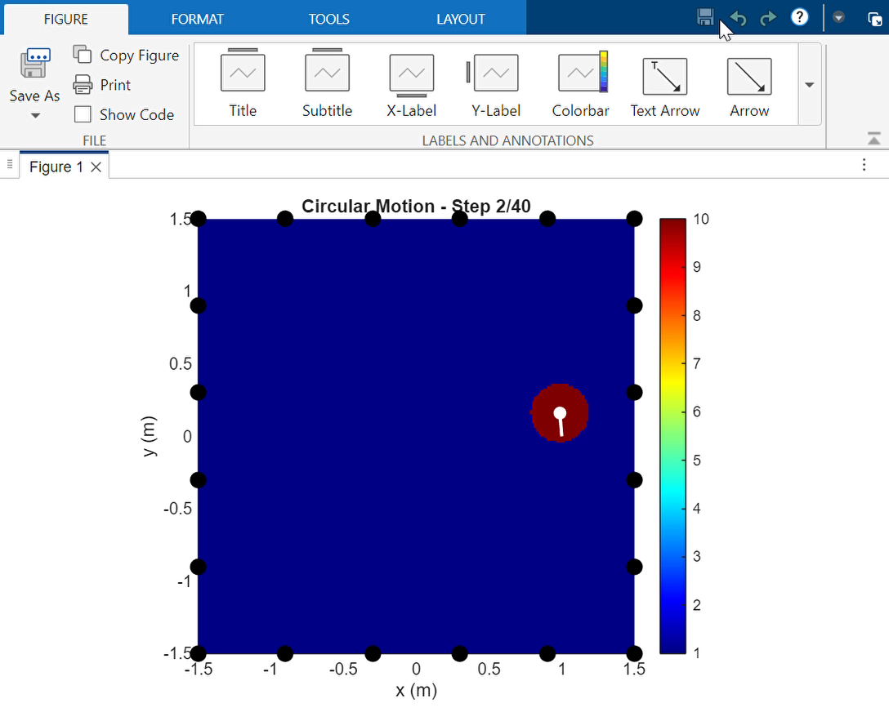
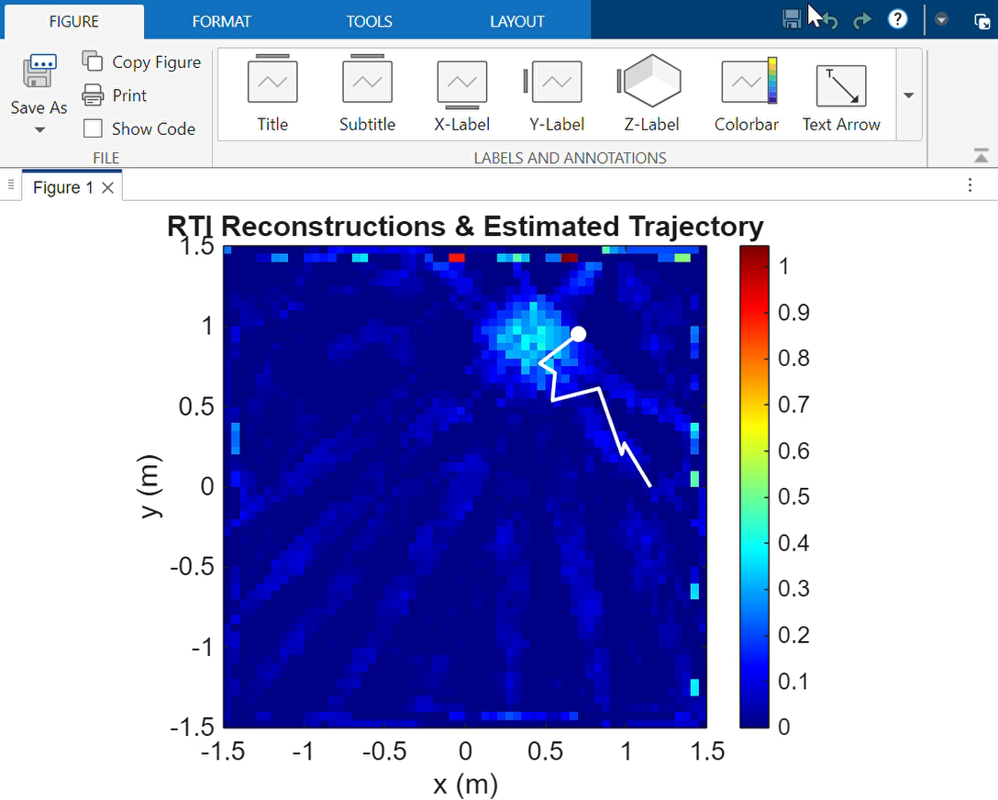
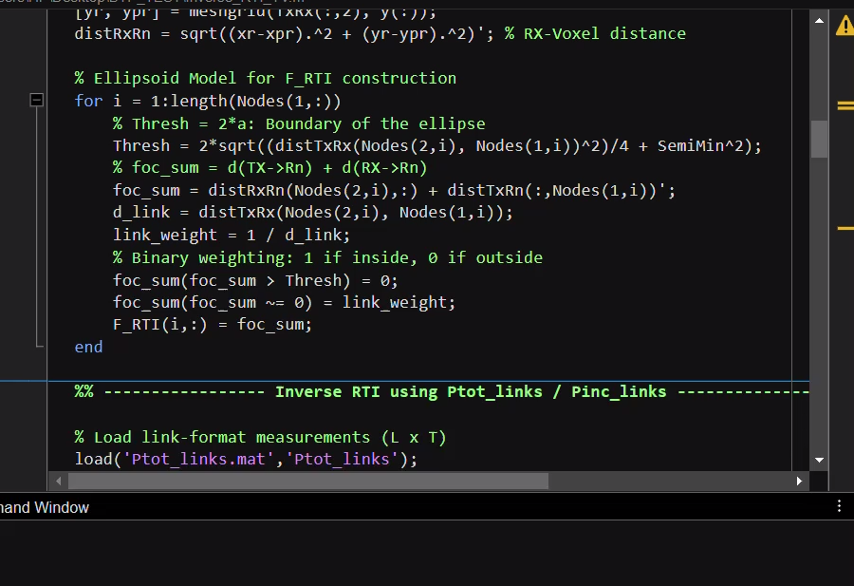
BTP-RF IMAGING AND SENSING
FINAL RESULTS
REGULARIZATION – RIDGE
Assigned Weight as 1
Assigned Weight as 1/d
Where d is distance between the transmitter and receiver
Source : Reference

Slide 17
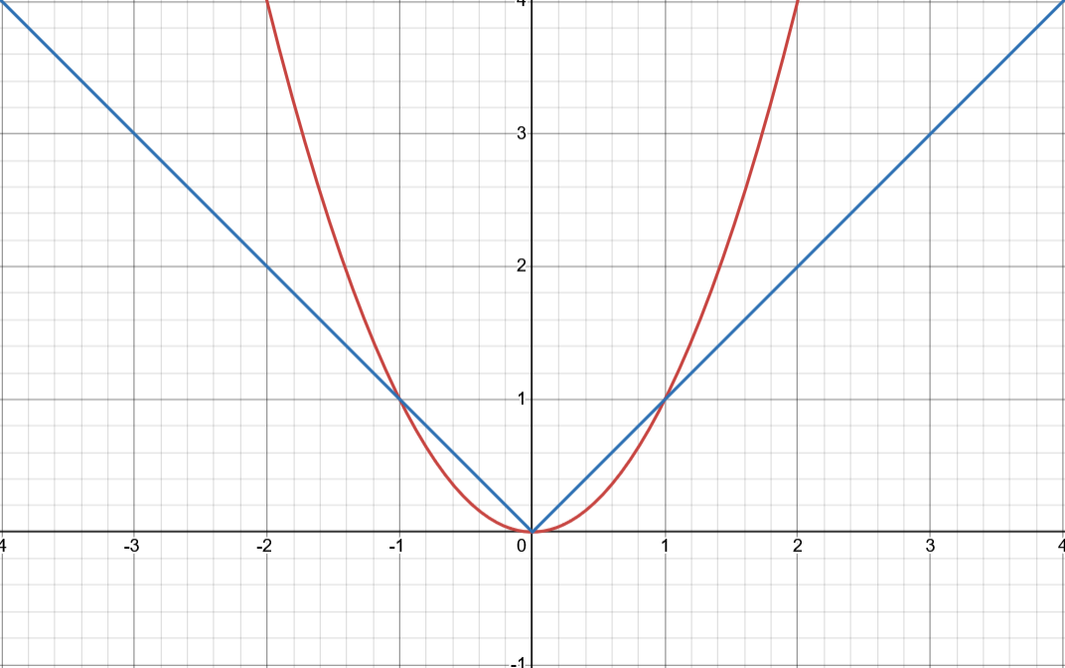
BTP-RF IMAGING AND SENSING
GRAPH EXPLAINATION
Zone 1: The "Vanishing" Zone (Signal Magnitude x<1)
This zone represents the low-amplitude signals, which is often where background noise resides in your reconstructed image.
L2 Penalty (x2 - Ridge)
Cost Behavior: The slope of the x2 curve is very shallow near zero. When x is small the penalty cost is significantly smaller than the L1​ cost.
Result (Weak Penalization): The cost function barely penalizes the small noise components. Consequently, the noise values are shrunk but never forced exactly to zero. This is why Ridge solutions often have a noisy, non-zero background baseline.
L1 Penalty (∣x∣ - TV/Lasso)
Cost Behavior: The slope of the ∣x∣ curve is steep and constant near zero. When x is small , the penalty cost is relatively large compared to the L2 cost.
Result (Sparsity Promotion): The L1 penalty aggressively punishes even small, non-zero values. The optimizer finds that the cheapest way to satisfy the penalty is to set the noise values exactly to zero. This ability to force coefficients to zero is called Sparsity.
Zone 2: The "Explosive" Zone (Signal Magnitude x>1)
This zone represents the high-amplitude signals, such as the core of your object's attenuation blob.
L2 Penalty (x2 - Ridge)
Cost Behavior: The cost grows quadratically . The penalty cost rapidly outweighs the data fitting cost.
Result (Edge Crushing): The algorithm violently suppresses large values. It cannot tolerate sharp, high-intensity edges and is forced to crush and spread the energy to minimize the squared cost. This is the source of the blurring in Ridge solutions.
L1 Penalty (∣x∣ - TV/Lasso)
Cost Behavior: The cost grows linearly (10×α). While high, the cost increase is manageable.
Result (Acceptance of Large Values): The L1 penalty does not disproportionately punish large values. Therefore, it is willing to tolerate the high pixel values needed to reconstruct sharp, clear edges as long as those edges are sparse (which is the premise of TV regularization).
Source : Reference

Slide 18

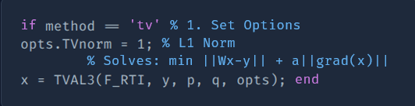
BTP-RF IMAGING AND SENSING
REGULARIZATION
TV Regression : Preserving Edges
Why we switched to TV
Step 1: The Cost Function
Ridge creates blurry blobs. Real objects have hard edges.
TV penalizes the Gradient (∇x), which is the change between pixels.
TV Solution Process: Iteration
Non-Differentiable: The L1 norm prevents direct solution.
Iterative Optimization: The solver refines the image (x) over thousands of steps to minimize the total cost, until it converges.
Comparison of transitioning from 0 to 10 using L1 Norm of Gradient (|Change|).
Option A: Smooth Ramp | Option B: Sharp Edge
0 → 2 → 4 → 6 → 8 → 10 | 0 → 0 → 0 → 0 → 10 → 10
Cost: |2| + |2| + |2| + |2| + |2| Total = 10 | Cost: |0| + |0| + |0| + |10| + |0| Total = 10
Code Implementation (Closed-Form Solution)
RESULT: Since the cost is the same, the solver chooses Option B because L1 norms promote Sparsity (zeros). Option B has 4 zeros; Option A has none.
CONCLUSION: The math forces the image to be flat everywhere and jump all at once. That is an edge. Promotes sparsity in the gradient domain, resulting in large, flat regions and sharp, clean boundaries. Ideal for imaging distinct, blocky objects.
% 1. Define Solver Options
% 2. Call specialized iterative solver (e.g., TVAL3)
% Finds optimal x over many steps
% 3. Vectorization and Constraint
Source : Reference

Slide 19
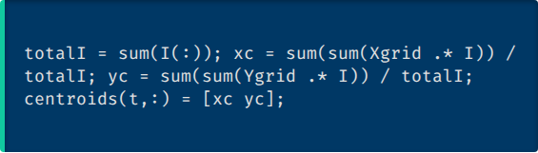

BTP-RF IMAGING AND SENSING
FINAL TRAJECTORY
Centroid Extraction: From Image to Trajectory Point
Trajectory Construction
The entire tracking process involves:
Load all time-series data (P_{tot}, P_{inc})
Loop T times (for each frame)
Solve the regularized inverse problem for O_{img}
Extract the centroid (x_c, y_c)
Animate the sequence of centroids to display the path
Step 2: Weighted Centroid Calculation
We apply the Center of Mass formula, where the pixel intensity (I) acts as the weight for its coordinate (X_{grid}, Y_{grid}).
Step 1: Thresholding for Object Isolation
% Weighted Average Formula (Center of Mass)
max
% Threshold
sum
% Isolate pixels above 35% of the peak intensity
The result (x_c, y_c) is the estimated location of the object for that frame.
Source : Reference

Slide 20
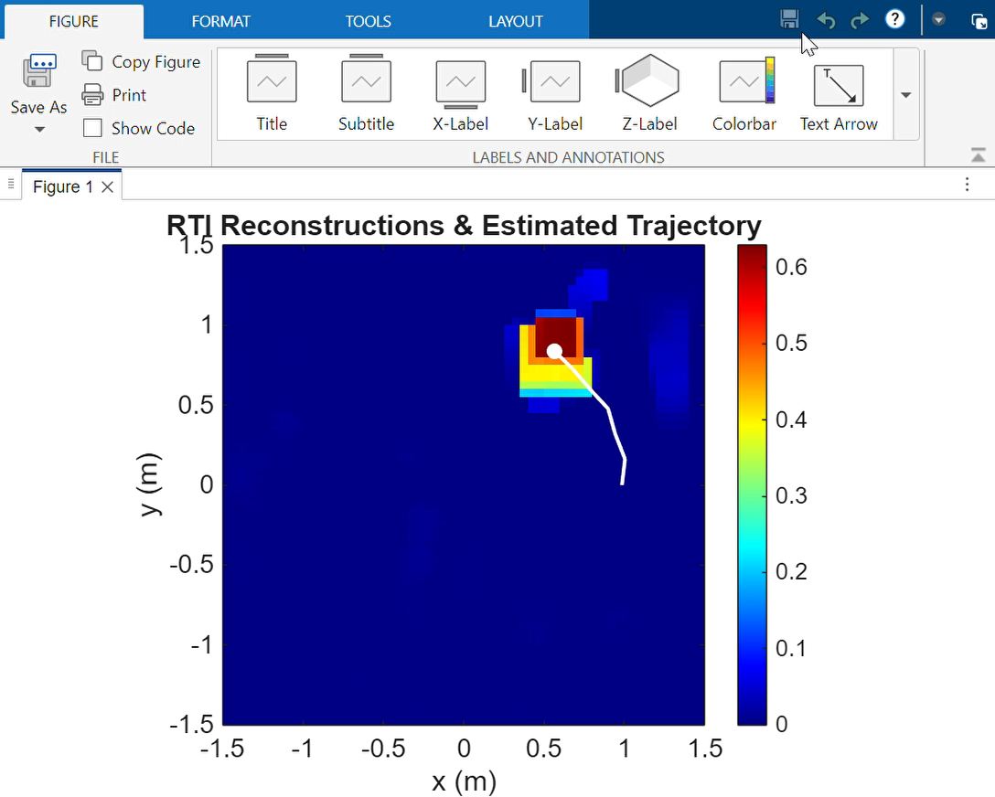
BTP-RF IMAGING AND SENSING
FINAL RESULTS
REGULARIZATION – TV
Source : Reference

Slide 21
BTP-RF IMAGING AND SENSING
THANK YOU

