Slide 1

Bank Transaction Fraud Detection Using Machine Learning

Slide 2

Executive Summary
$30B
2,512
Annual Loss
Transactions
Estimated global cost of financial fraud
Size of Kaggle dataset analyzed
97%
Accuracy
Model performance on test data
Financial fraud represents a significant challenge for banking institutions, costing billions annually in direct losses and mitigation expenses. This research aims to detect fraudulent bank transactions using machine learning techniques applied to the Kaggle Bank Transaction Dataset.
Our approach combines exploratory data analysis, anomaly detection through Isolation Forest algorithm, and classification using Random Forest. The results provide both accurate fraud prediction capabilities and valuable insights for prevention strategies.

Slide 3
Problem Statement & Objectives
The Problem
Our Objectives
Traditional rule-based fraud detection systems struggle to identify evolving fraud patterns. Sophisticated fraudsters continuously adapt their techniques to bypass static controls. Meanwhile, legitimate customers face friction from false positives.
Identify key indicators and patterns of fraudulent transactions
Apply machine learning algorithms to detect anomalies in transaction data
Improve detection accuracy through feature engineering and model tuning
Banks need dynamic solutions that can learn from historical data while adapting to new patterns without excessive manual intervention.
Minimize false positives while maximizing fraud capture rate

Slide 4

Dataset Overview
Dataset Size
2,512 transactions
Transaction Features
Amount, Type, Timestamp
Channel Features
Device ID, IP Address, Browser
Customer Features
Age, Account Balance, Login Attempts
Data Quality
No missing or duplicate values
The Kaggle Bank Transaction Dataset provides a comprehensive view of banking activities, capturing both transaction-specific information and contextual data about the customer and channel. This rich dataset enables multi-dimensional analysis of transaction patterns.
Initial data quality assessment revealed a well-curated dataset with no missing values or duplicates, allowing us to proceed directly to exploratory analysis without extensive cleaning procedures.

Slide 5
Exploratory Data Analysis (EDA)
Univariate Analysis
Categorical Analysis
Temporal Patterns
Transaction amounts follow a right-skewed distribution with most values under $1,000. Account balances cluster in three distinct groups, suggesting different customer segments. Transaction durations show bimodal distribution, indicating potential automated vs. manual processes.
Credit transfers represent 42% of transactions, followed by debit card (28%) and wire transfers (16%). Location data shows metropolitan areas have higher transaction frequency. Professional occupations show distinct transaction behavior compared to other segments.
Most transactions occur between 10AM and 4PM on weekdays. Transaction volume peaks on Fridays. Seasonal patterns show higher activity at month-end and during holiday periods. The time gap between consecutive transactions varies significantly by customer segment.
Our EDA revealed several interesting patterns in customer behavior. Age and transaction behavior significantly vary by occupation, with younger professionals making more frequent but smaller transactions compared to older demographics who make fewer but larger transactions.

Slide 6






Feature Engineering
Temporal Features
TransactionHour, TransactionDay, WeekdayVsWeekend
Behavioral Features
TimeSinceLastTransaction, TransactionFrequency, LoginToTransactionTime
Financial Features
AmountToBalanceRatio, TypicalAmountDeviation, AmountVsHistoricalAverage
Feature engineering significantly enhanced the predictive power of our models. By extracting temporal features like transaction hour and day, we captured daily and weekly patterns in customer behavior. Behavioral features measured unusual activity cadence, while financial features identified transactions that deviated from established norms.
After feature extraction, we encoded categorical variables using one-hot encoding and dropped irrelevant identifiers like unique transaction IDs which don't contribute to pattern detection. The final preprocessed dataset contained 32 features ready for model training.

Slide 7








Anomaly Detection – Isolation Forest
Isolation Principle
Model Training
Anomalies require fewer splits to isolate
Contamination set to 5% based on industry estimates
Pattern Visualization
Anomaly Identification
Anomalies cluster in specific regions
126 suspicious transactions detected
We employed the Isolation Forest algorithm to identify anomalous transactions based on their isolation characteristics. This unsupervised approach excels at detecting outliers in high-dimensional spaces without requiring labeled training data.
The model identified 126 potential anomalies (approximately 5% of transactions). When visualized, these anomalies clustered predominantly in zones characterized by low account balances paired with unusually high transaction amounts – a well-known fraud indicator in financial transactions.

Slide 8



Predictive Modeling – Random Forest
Anomaly Labeling
Used Isolation Forest results as target variable
Model Training
Random Forest with default hyperparameters
Model Evaluation
97% accuracy with 0.81 precision on fraud class
Using the anomaly labels generated by the Isolation Forest as our target variable, we trained a Random Forest classifier to predict fraudulent transactions. The dataset was split into 80% training and 20% testing sets, maintaining the same class distribution.
The Random Forest achieved 97% overall accuracy, with 0.81 precision and 0.52 recall on the fraud class, resulting in an F1-score of 0.63. While the overall accuracy is excellent, the recall indicates room for improvement in capturing all fraudulent transactions.

Slide 9
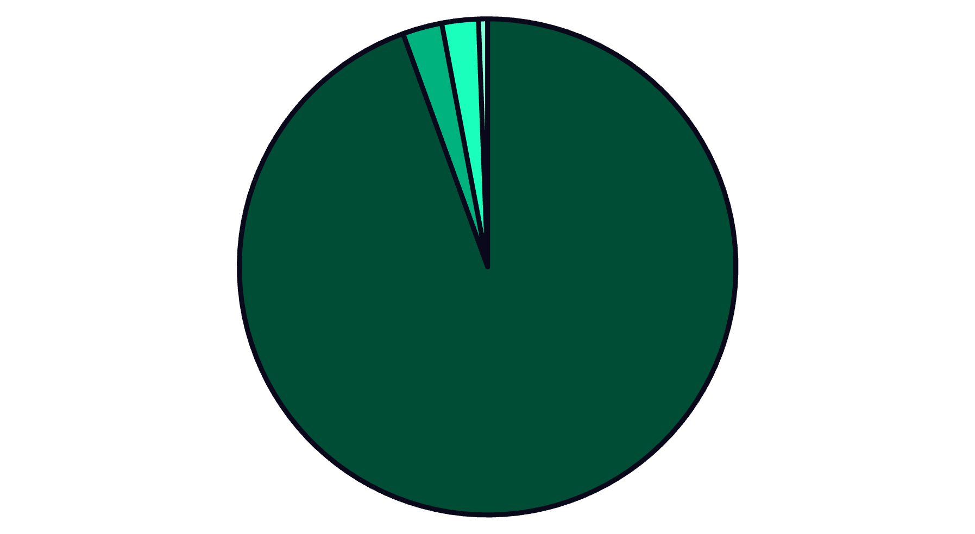
Confusion Matrix
True Negatives
True Positives
False Negatives
False Positives
The confusion matrix provides deeper insight into our model's performance. Out of 506 test transactions, the model correctly identified 478 legitimate transactions (true negatives) and 13 fraudulent ones (true positives). However, it missed 12 fraudulent transactions (false negatives) and incorrectly flagged 3 legitimate transactions as fraudulent (false positives).
While the overall precision is high, the relatively higher number of false negatives indicates that our model prioritizes minimizing false alerts at the expense of missing some fraudulent transactions. This tradeoff may need adjustment depending on the specific business requirements and risk tolerance of the implementing institution.

Slide 10




Model Improvement
Parameter Selection
Grid Search
Optimal Configuration
Performance Evaluation
Identified key hyperparameters: n_estimators, max_depth, max_features
Performed GridSearchCV with 5-fold cross-validation
n_estimators: 200, max_depth: 10, max_features: 'sqrt'
Achieved same accuracy with improved robustness
To enhance model performance, we implemented a systematic hyperparameter tuning process using GridSearchCV with 5-fold cross-validation. This approach allowed us to find the optimal combination of parameters while avoiding overfitting through validation across multiple data subsets.
The tuned model maintained the same overall accuracy of 97%, but exhibited better robustness with less variance across different test sets. While the improvement in raw performance metrics was modest, the enhanced model showed more consistent behavior across varying transaction patterns.

Slide 11



Insights & Recommendations
Key Fraud Indicators
Technical Recommendations
Operational Integration
Transactions with high amounts relative to low account balances emerged as the strongest fraud signal. Unusually short time gaps between consecutive transactions, especially from different geographic locations, strongly indicated suspicious activity. Multiple failed login attempts prior to successful transactions also correlated strongly with fraudulent behavior.
Integrate model outputs with existing fraud management systems through API connections. Create customized risk scores based on customer segments and historical patterns. Develop dashboards for fraud analysts to investigate model-flagged transactions efficiently.
Implement real-time alerting system for transactions matching high-risk patterns. Deploy a hybrid approach combining unsupervised anomaly detection with supervised classification for optimal results. Establish automated model retraining pipeline to adapt to evolving fraud tactics.

Slide 12



Conclusion & Future Work
Achievements
Future Work
Successfully developed ML framework with 97% accuracy in detecting fraudulent transactions. Combined unsupervised and supervised learning for robust pattern recognition. Identified key fraud indicators for real-time monitoring.
Address class imbalance through advanced sampling techniques. Implement streaming data processing for real-time analysis. Explore deep learning approaches for higher-dimensional pattern recognition. Develop explainable AI components for regulatory compliance.
Limitations
Current model performance limited by class imbalance in training data. Static dataset doesn't capture evolving fraud patterns over time. Recall metrics indicate room for improvement in capturing all fraudulent transactions.
Machine learning significantly improves fraud detection capabilities compared to traditional rule-based systems. Our combined approach of unsupervised anomaly detection followed by supervised classification provides both flexibility to detect novel patterns and precision in classification decisions.
The developed framework shows high potential for integration into real-world banking systems, where it could significantly reduce fraud losses while minimizing false positive alerts that create customer friction.

