Slide 1
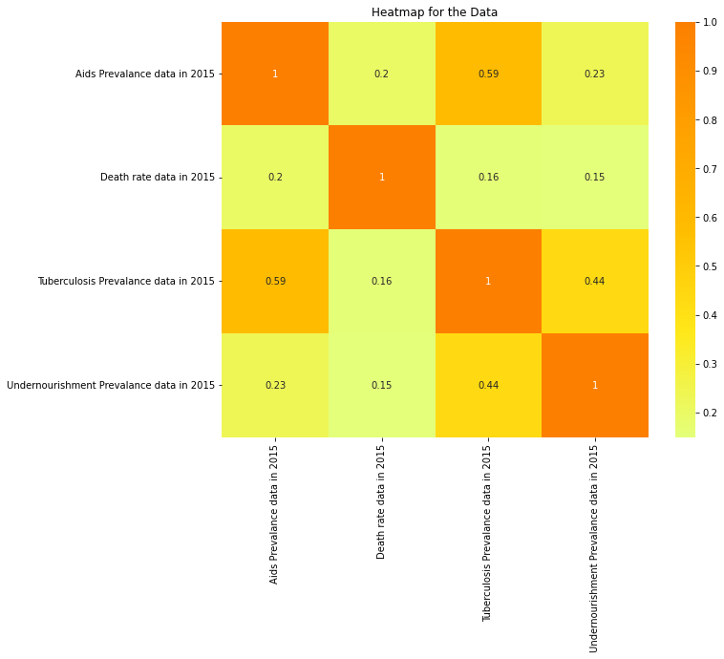
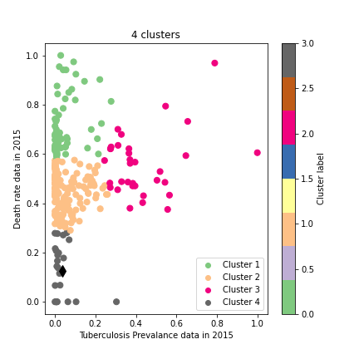
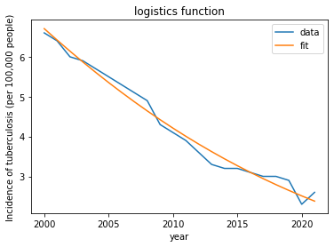
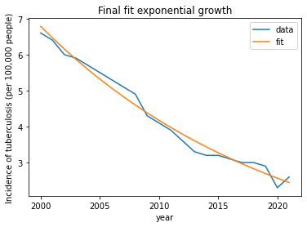
Analysis on death rate per 1,000 people in the general population
Introduction
The investigation that follows looks at the death rate in 2015 related to the prevalence of HIV/AIDS, tuberculosis, and malnutrition.
Death rate analysis is the number of deaths in a population over a specific period of time.
This analysis is often used to track trends in mortality and identify patterns that may be related to certain causes of death.
The most commonly used measure in death rate analysis is the crude death rate, which is the number of deaths per 1,000 people in a population.
Death rate analysis can be used to identify health disparities and inform public health policy.
It can also be used to identify potential health risk factors and monitor the effectiveness of interventions.
The heatmap shown above illustrates the relationship between death rates and the incidence of AIDS, tuberculosis, and malnutrition.
Undernourishment has the lowest correlation because the color of the cell shows the intensity of the association, with deeper colors indicating a higher correlation and lighter colors indicating a lesser correlation
This data from the World Bank shows connected clusters for numerous nations, which suggests that the death rate from tuberculosis prevalence in 2015 was higher.
Each cluster contains similar observations based on the chosen feature.
As we can analyze for a span of 5 years the incidence of tuberculosis has decreased rapidly for countries like UK and US. It has been plotted and fitted using exponential data to make it more accurate
A fit graph is used to show the incidence of tuberculosis over time, and the curve would be used to model the relationship between the number of cases and the time period. The fit could be linear, polynomial, or some other type of mathematical function depending on the data.
For example, if tuberculosis incidence decreases over time, the curve would be a downward-facing parabola.
Conclusion:
This decrease in incidence can be attributed to various factors such as the implementation of effective public health measures, improved living conditions, and the introduction of new and effective drugs for the treatment of tuberculosis. These measures have helped to control the spread of the disease and to reduce the number of cases. But as the predictions suggest it may slightly increase and become a main factor in the death rate

