Slide 1
Normalization

Slide 2
What is Normalization?
Normalization is a database design technique which organizes tables in a manner that reduces redundancy and dependency of data.
It divides larger tables to smaller tables and links them using relationships.

Slide 3
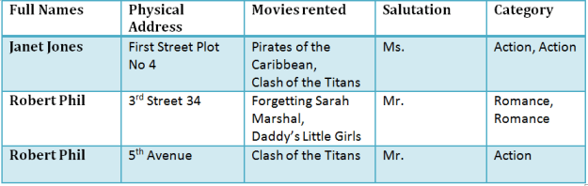
Database Normalization Examples

Slide 4
Database Normal Forms
1NF (First Normal Form) Rules
Each table cell should contain a single value.
Each record needs to be unique.

Slide 5
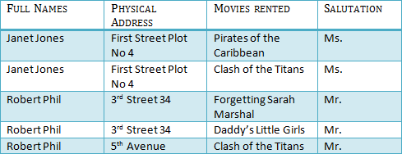
1 NF Example

Slide 6
What is a KEY?
A KEY is a value used to identify a record in a table uniquely. A KEY could be a single column or combination of multiple columns.
Primary Key: A primary is a single column value used to identify a database record uniquely.
Composite Key: A composite key is a primary key composed of multiple columns used to identify a record uniquely

Slide 7


2NF (Second Normal Form) Rules
Rule 1- Be in 1NF
Rule 2- Single Column Primary Key

Slide 8
Database - Foreign Key
In Table 2, Membership_ID is the Foreign Key

Slide 9
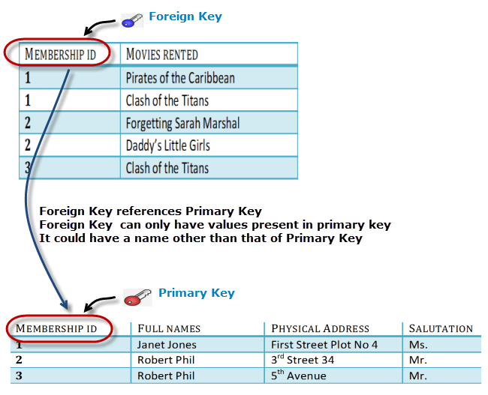

Slide 10
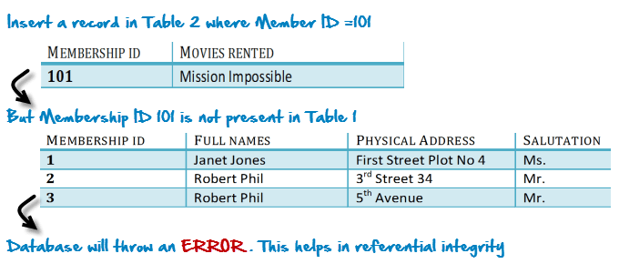
Why do you need a foreign key?

Slide 11
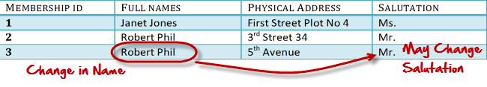
What are transitive functional dependencies?
A transitive functional dependency is when changing a non-key column, might cause any of the other non-key columns to change

Slide 12
3NF (Third Normal Form) Rules
Rule 1- Be in 2NF
Rule 2- Has no transitive functional dependencies
To move our 2NF table into 3NF, we again need to again divide our table.

Slide 13

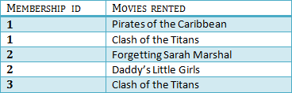

3NF

Slide 14
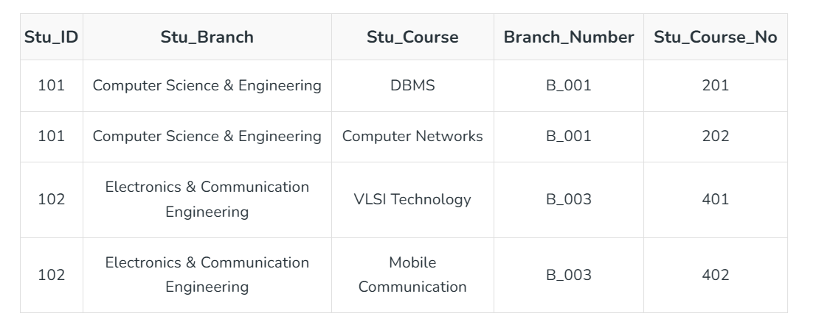
Boyce-Codd Normal Form (BCNF)
Even when a database is in 3rd Normal Form, still there would be anomalies resulted if it has more than one Candidate Key.
Stu_ID −> Stu_Branch Stu_Course −> {Branch_Number, Stu_Course_No}

Slide 15
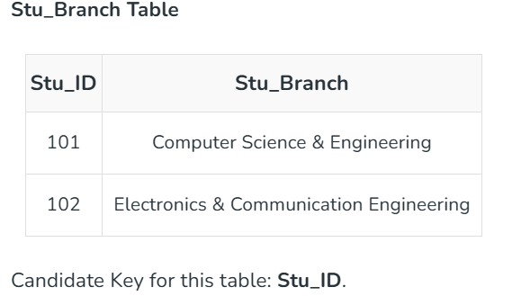
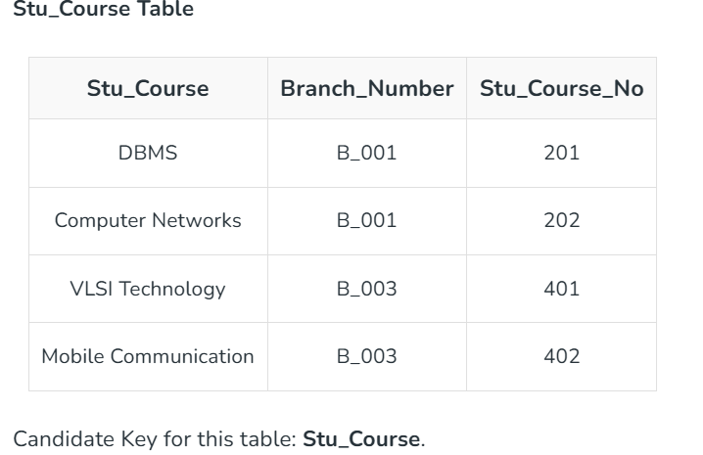
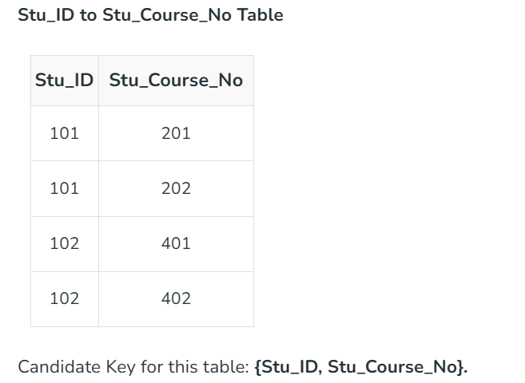

Slide 16
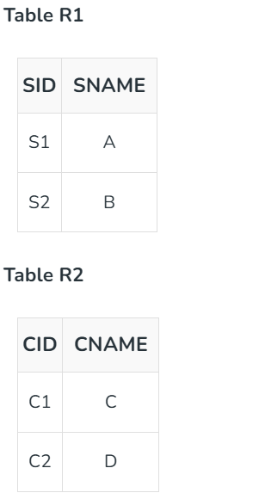
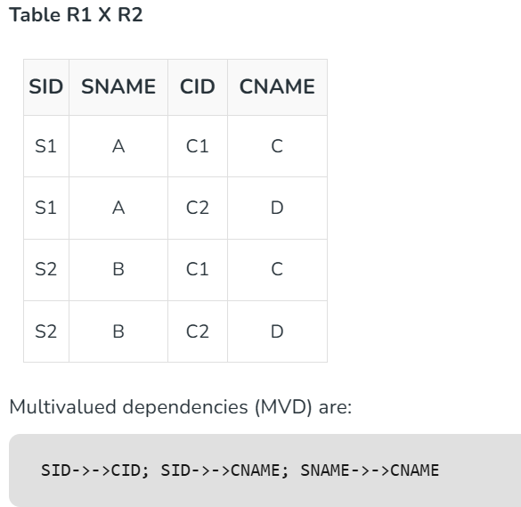
4NF (Fourth Normal Form) Rules
If no database table instance contains two or more, independent and multivalued data describing the relevant entity, then it is in 4th Normal Form

Slide 17
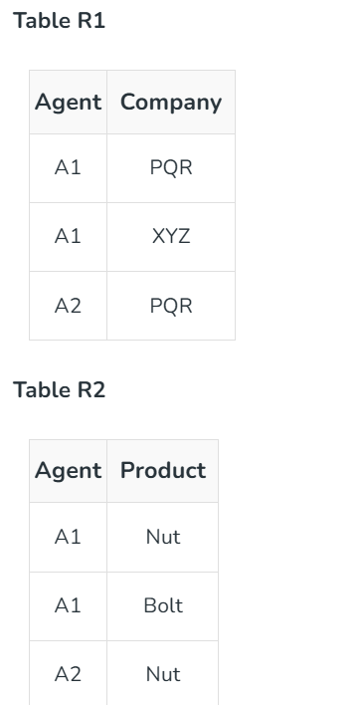
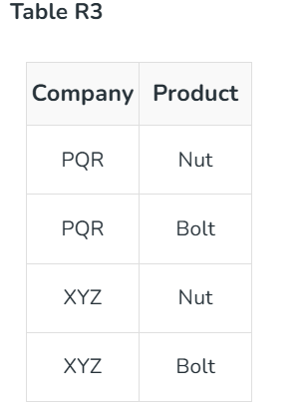
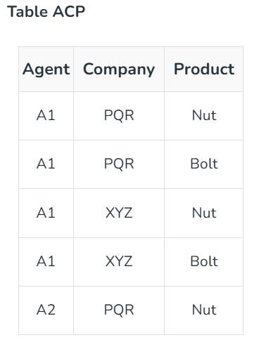
5NF (Fifth Normal Form) Rules
A table is in 5th Normal Form only if it is in 4NF and it cannot be decomposed into any number of smaller tables without loss of data.

