Slide 1
HW9
陳宜莉 109356049@nccu.edu.tw
林苡晴 110356019@nccu.edu.tw

Slide 2
Keyword
A keyword is a tuple of [String name, Integer count]
For example:
{
name: “Fang”,
count: 3
}
A key word should output in format [name,count] :
[Fang,3]

Slide 3
Requirements
Maintain a keyword list, and implement the LCS algorithm
For the list structure, you can
Use java.util.ArrayList
Or develop it by yourself

Slide 4
I/O Example: add
Input:
Token1 : a constant “add”
Token2 : keyword name k
Token3: keyword count c
EX: add Fang 3
To do: Insert a keyword [k,c] to the list

Slide 5
I/O Example: find
Input:
Token1 : a constant “find”
EX: find
To do: Find and output the most similar keyword by using the LCS algorithm
Output:
If heap is empty, simply output a line of “InvalidOperation”:
InvalidOperation
If it is legal to peek:
NTU: [NCCU, 2]

Slide 6
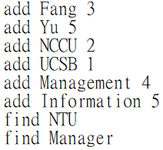
Input file
You need to read the sequence of operations from a txt file
The format is firm
Raise an exception if the input does not match the format

Slide 7

Output

