Slide 1
HW2
陳宜莉 109356049@nccu.edu.tw
林苡晴 110356019@nccu.edu.tw

Slide 2
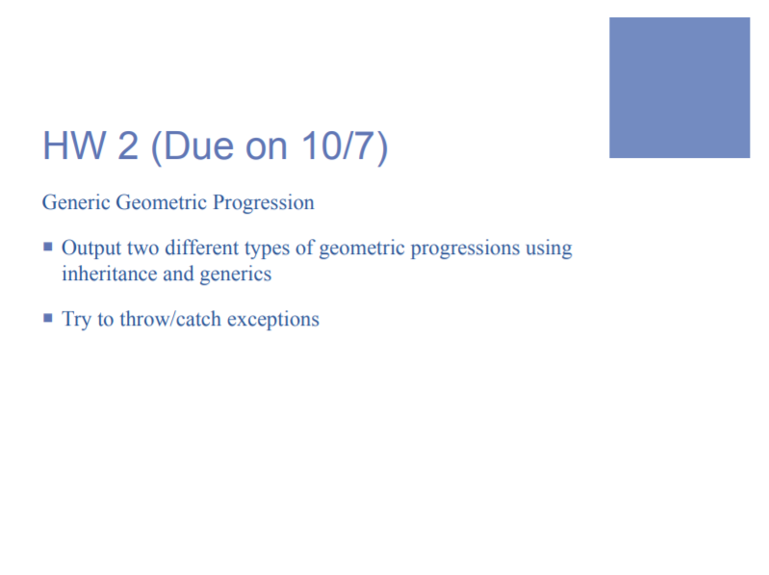

Slide 3
INPUT
There are four token for inputs:
Token 1 ➔Population 或 Capital(type):
0 = Population
1 = Capital
Token 2 ➔number of people or initial capital = geometric sequence First term
Token 3 ➔rate = geometric sequence common ratio
Token 4 ➔how many years (number of generation)

Slide 4
EXAMPLE- Population
input ➔
output ➔

Slide 5
EXAMPLE - Capital
input ➔
output ➔

Slide 6
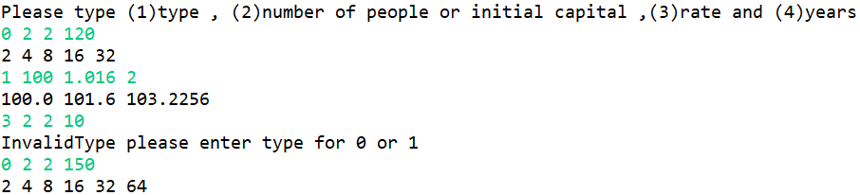
Lab class notice
Remember ,It’s not just one input data (one line). you need to constantly stuffed in many input data to the program. Please use the ‘for loop’ to receive many input data and run the program.
Notes:
It’s not just a one input data (one line), it needs to constantly stuffed in many input data. Please use the ‘for loop’ to receive many input data and run the program.

Slide 7
Special rules of Homework
uProject Name: HW{#number of homework} , ex: HW1
uThe class name where the main function of the code is located must be Main
uRemind uppercase and lowercase
uWhen the code is compressed and uploaded, please compress the project folder (ex. HW1)
into .zip
uUnless otherwise specified by TA, homeworks that cannot be compiled and executed won’t
be accepted.

Slide 8
Special rules of Homework
uReject the homework of plagiarism and tampering
uFirst time: Zero point for that homework.
uSecond time: Zero point for the entire semester homeworks.
uThe list of plagiarism and tampering will announce at the end of the semester.

