Slide 1
作業4說明
陳宜莉 109356049@nccu.edu.tw
林苡晴 110356019@nccu.edu.tw

Slide 2
Keyword
A keyword is a tuple of [String name, Integer count, Double weight]
For example:
{
name: “Fang”,
count: 3,
Weight: 5.5
}
A key word should output in format [name,count,weight] :
[Fang,3,5.5]

Slide 3
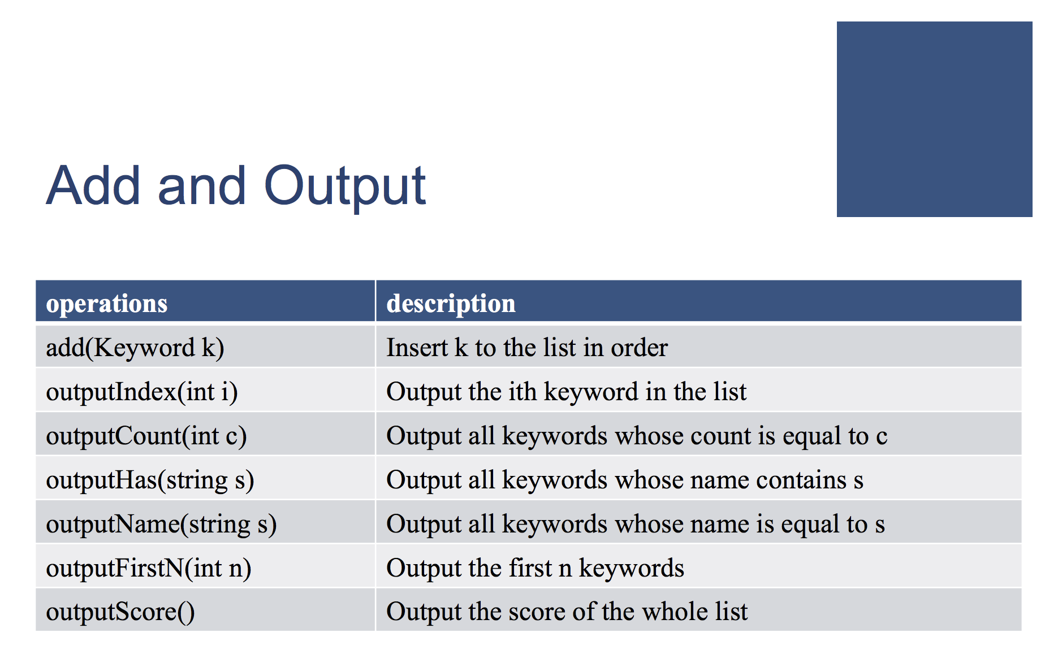

Slide 4
I/O Example: Add
Input:
Token1 : a constant “add”
Token2 : keyword name k
Token3: keyword count c
Token4: keyword weight w
EX: add Fang 3 0.5
To do: Insert a keyword [k,c,w] to the list in order

Slide 5
I/O Example: outputIndex
Input:
Token1 : a constant “outputIndex”
Token2 : an index i in our keyword list
EX: outputIndex 3
To do: Output the i th keyword in the list
Output:
If i is out of bound, simply output a line of “InvalidOperation”:
InvalidOperation
If i is legal:
[NCCU,4,9.9]

Slide 6
I/O Example: outputCount
Input:
Token1 : a constant “outputCount”
Token2 : an integer c
EX: outputCount 4
To do: Output all keywords whose count is equal to c in order
Output:
If there is no keyword whose count is equal to c, simply output a line of constant “NotFound”:
NotFound
If there’s any (split them in one space):
[OK,4,2.2] [MIS,4,3.3] [NCCU,4,9.9]

Slide 7
I/O Example: outputHas
Input:
Token1 : a constant “outputHas”
Token2 : a pattern string s
EX: outputHas ang
To do: Output all keywords whose name contains s
Output:
If there is no keyword whose name contains s, simply output a line of constant “NotFound”:
NotFound
If there’s any (split them in one space):
[Stanger,4,2.2] [Rang,4,3.3] [Fang,4,9.9]

Slide 8
I/O Example: outputName
Input:
Token1 : a constant “outputName”
Token2 : a string s
EX: outputName Fang
To do: Output all keywords whose name is equal to s
Output:
If there is no keyword whose name is equal to s, simply output a line of constant “NotFound”:
NotFound
If there’s any (split them in one space):
[Fang,4,9.9]

Slide 9
I/O Example: outputFirstN
Input:
Token1 : a constant “outputFirstN”
Token2 : an signed integer N
EX: outputFirstN 3
To do: Output the first N Keywords, if N <= size of list
Output:
If N > size of keyword list, simply output a line of constant “InvalidOperation”:
InvalidOperation
If N is legal (split them in one space):
[Stanger,4,2.2] [Rang,4,3.3] [Fang,4,9.9]

Slide 10
I/O Example: outputScore
Input:
Token1 : a constant “outputScore”
EX: outputScore
To do: Output the score of the whole list
Σ(count*weight)
Output:
Simply output a line of score
EX: 108.5

Slide 11
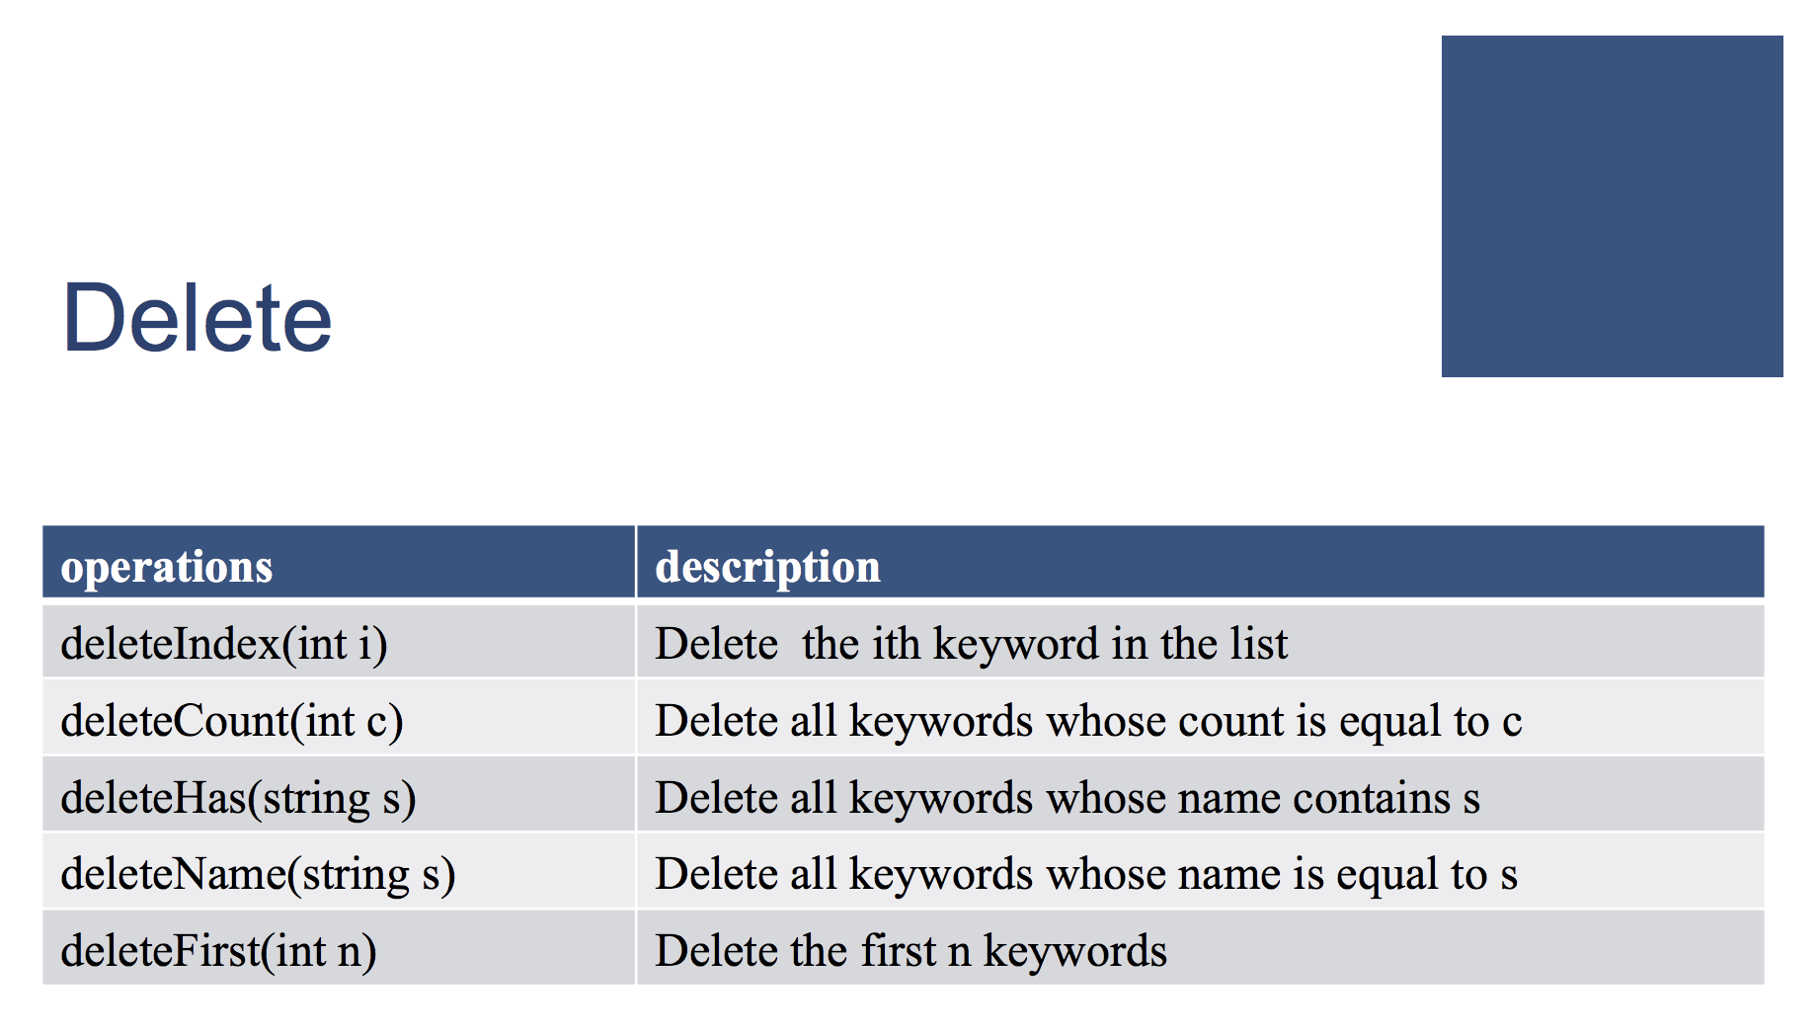

Slide 12
I/O Example: deleteIndex
Input:
Token1 : a constant “deleteIndex”
Token2 : an index i in our keyword list
EX: deleteIndex 3
To do: Delete the ith keyword in the list

Slide 13
I/O Example: deleteCount
Input:
Token1 : a constant “deleteCount”
Token2 : an integer c
EX: deleteCount 4
To do: Delete all keywords whose count is equal to c

Slide 14
I/O Example: deleteHas
Input:
Token1 : a constant “deleteHas”
Token2 : a pattern string s
EX: deleteHas ang
To do: Delete all keywords whose name contains s

Slide 15
I/O Example: deleteName
Input:
Token1 : a constant “deleteName”
Token2 : a string s
EX: deleteName Fang
To do: Delete all keywords whose name is equal to s

Slide 16
I/O Example: deleteFirstN
Input:
Token1 : a constant “deleteFirstN”
Token2 : an signed integer N
EX: deleteName Fang
To do: Delete the first N Keywords, if N <= size of list

Slide 17
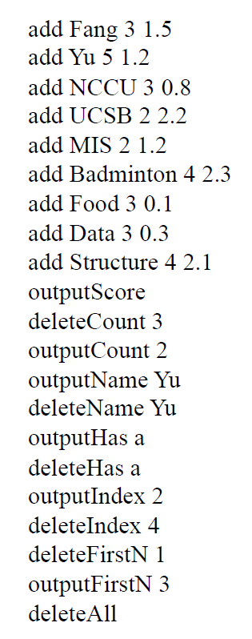
Input file
You need to read the sequence of operations from a txt file
The format is firm
Raise an exception if the input does not match the format

Slide 18
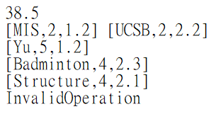
Output

