Slide 1
AI for wearable ECG prototype (ResNet + SE model) Tech 07 class project Related to a virtual poster presentation at SciPy 2025 https://www.scipy2025.scipy.org/
Jennifer E Yoon: mail@JenniferYoon.com
github: https://github.com/JennEYoon/ECG-transform

Slide 2
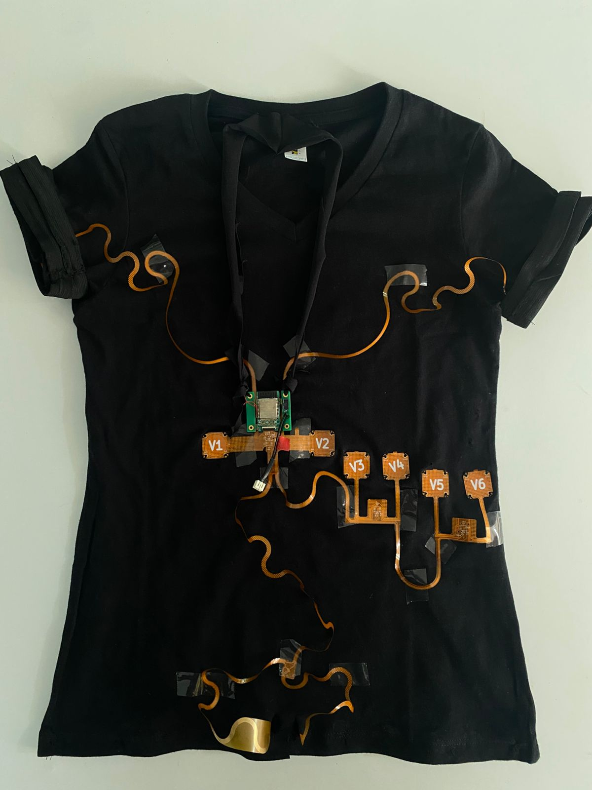
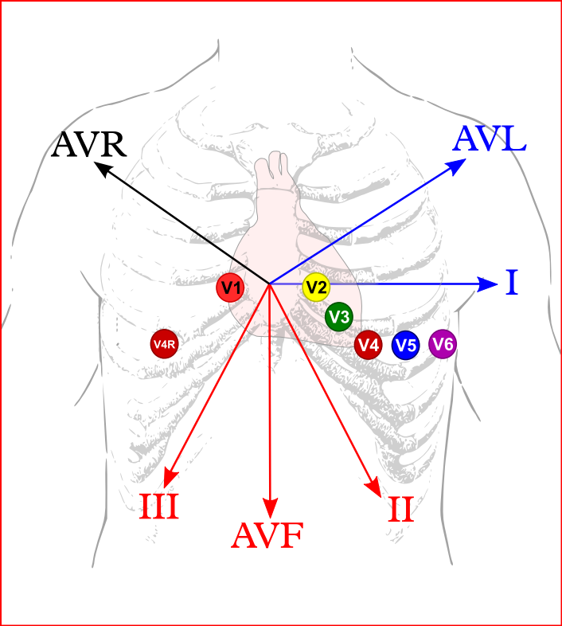
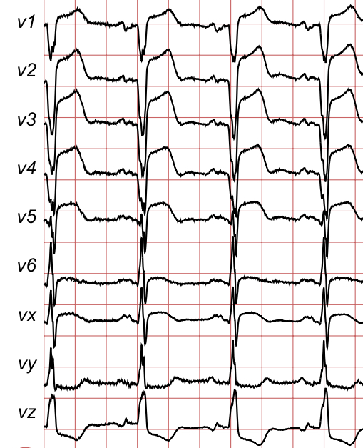
Areteus ECG prototype (Areteus.us)
ECG 12-signal device, on t-shirt
Electrodes placement diagram Source: ECGpedia.org
Sample ECG plot

Slide 3
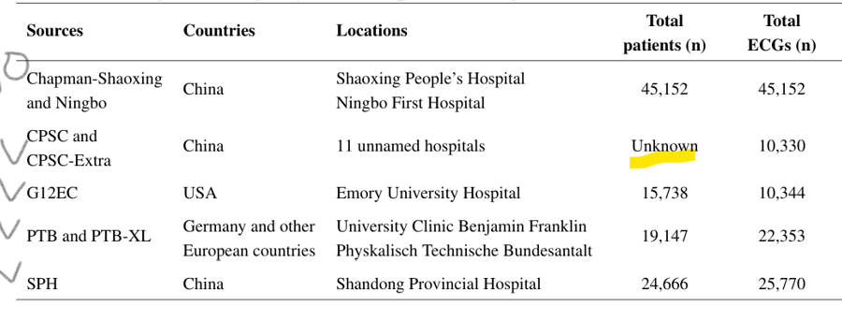
ECG Datasets
ECG datasets used for 47 years (<2018)
New 12-signal datasets (2018-2021)
MIT-BIH
Hospital recording on 2 channels, 47 patients, 30 minute recording time. Old recordings and machines, 1975-79.
Patients were moving around. Some non-readable signals were hand corrected by doctors & may have biases.
PTB original
Hospital recording on 15 channels, 294 patients, 10 second recording time, using newer machines, 1990-1997.
Good quality data, but too small patient number to run complex models or output more than a few diagnostic classes
Large patient numbers, about 100,000 total
High Quality 12-signal (latest hospital ECG machines)
Multiple hospitals, multiple countries (China, USA, Germany, Europe)
Efforts to standardize diagnostic class labels
Developed with recent deep learning models in mind (ResNet, SENetworks, Transformers, RNN)
Datasets Used

Slide 4
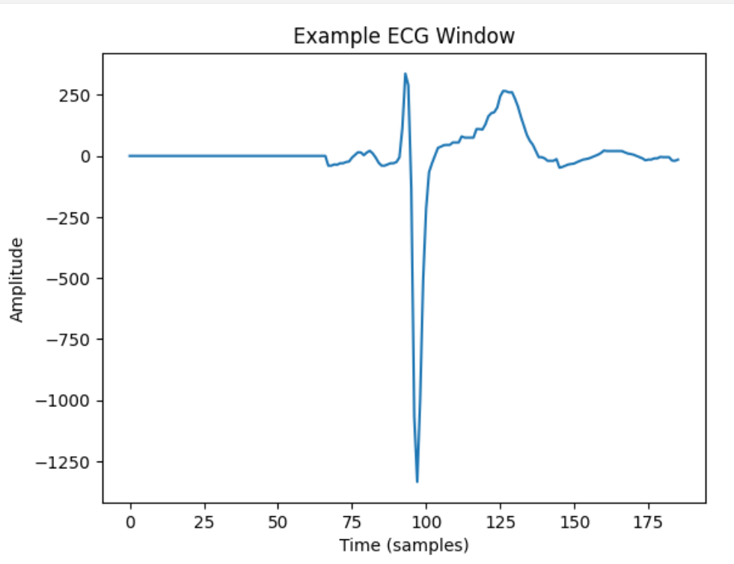
Data Processing From new, large 12-signal datasets (2018-2021 collections) PTB-XL dataset was selected with about 22,000 patients, 10 second recording length. From this, 1,000 patients were selected for a test run.
ECG signals data processing
Image, peak centering, zero padding
Peak center, split into 1.5 sec. windows, zero pad left & right.
Baseline meander fix to zero
Filters usually applied but not performed since may have information value:
Peak to peak distance standardizing
Peak amplitude standardizing
Removing negative values (squaring)
random split, overlapping split (less accuracy, image models also center object)
much longer time windows (not relevant for deep learning, better suited for time-series)
no relationship, feed each one of 12 signals independently (not as accurate for some conditions)

Slide 5
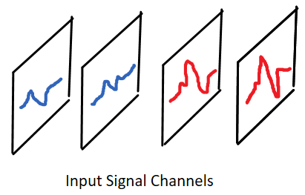
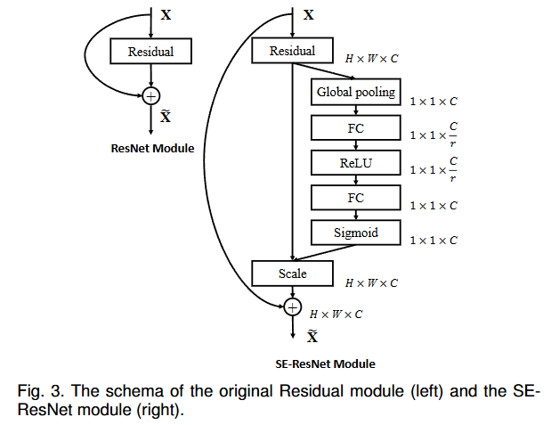
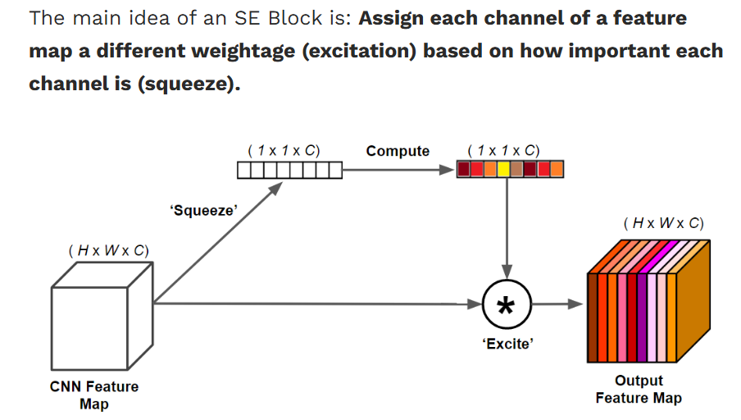
ResNet (Residual Network) + SE (Squeeze and Excite)
SE Block Diagram from TY Yang

Slide 6
Results & Future Steps: What I hope to show
COMPLETED WORK
CNN, Random Forest, old MIT-BIH, PTB data:
Accuracy, F1 score: earlier models
* MIT-BIH (2-signals, small sample)
* PTB original (12-signals, small sample)
Areteus device inference:
- proof of concept, using one person, healthy heart data, 30 recordings taken over 2 days.
Translate binary/hex into usable numpy format
ResNet+ SE, PTB-XL 12-signal data:
Accuracy, F1 score
Binary classification
4-6 class classification
24 class classification
Comparison of PTB-XL with SPH data
Future Steps:
Areteus device: to gather many more patient data, and from large number of abnormal diagnostic classes.
Areteus device: to test for model accuracy when user moves or when user did not attach all 12-nodes at right locations.
Areteus device: how to adapt the device to different body sizes? Initially medium t-shirt size is available, but small and large sizes are planned. Will need to test device accuracy on users with varying body sizes.
AI models: Transformer + RNN model is also a good candidate. Uses 2-stage training to makes full use of 12-signal dataset.
FUTURE WORK

Slide 7
AI for wearable ECG prototype (ResNet + SE model)
We’re looking for volunteers to contribute abnormal heart beats data.
We’re planning a kick-starter funding, Areteus ECG (https://areteus.us/)
Jennifer E Yoon mail@JenniferYoon.com
https://github.com/JennEYoon/ECG-transform/tree/main/Tech07-project
Deep Residual Networks, c. 2015: https://arxiv.org/abs/1512.03385
Yannic Kilcher: https://www.youtube.com/watch?v=GWt6Fu05voI
Squeeze-and-Excitation (SE) Networks, c. 2017: https://arxiv.org/abs/1709.01507 Soroush Mehraban: https://youtu.be/3b7kMvrPZX8?si=g0JY09P5dIPMXwRj

