Slide 1
AI for wearable ECG prototype (ResNet + SE model) Tech 07 class project Related to a virtual poster presentation at SciPy 2025 https://www.scipy2025.scipy.org/
Jennifer E Yoon: mail@JenniferYoon.com
github: https://github.com/JennEYoon/ECG-transform

Slide 2
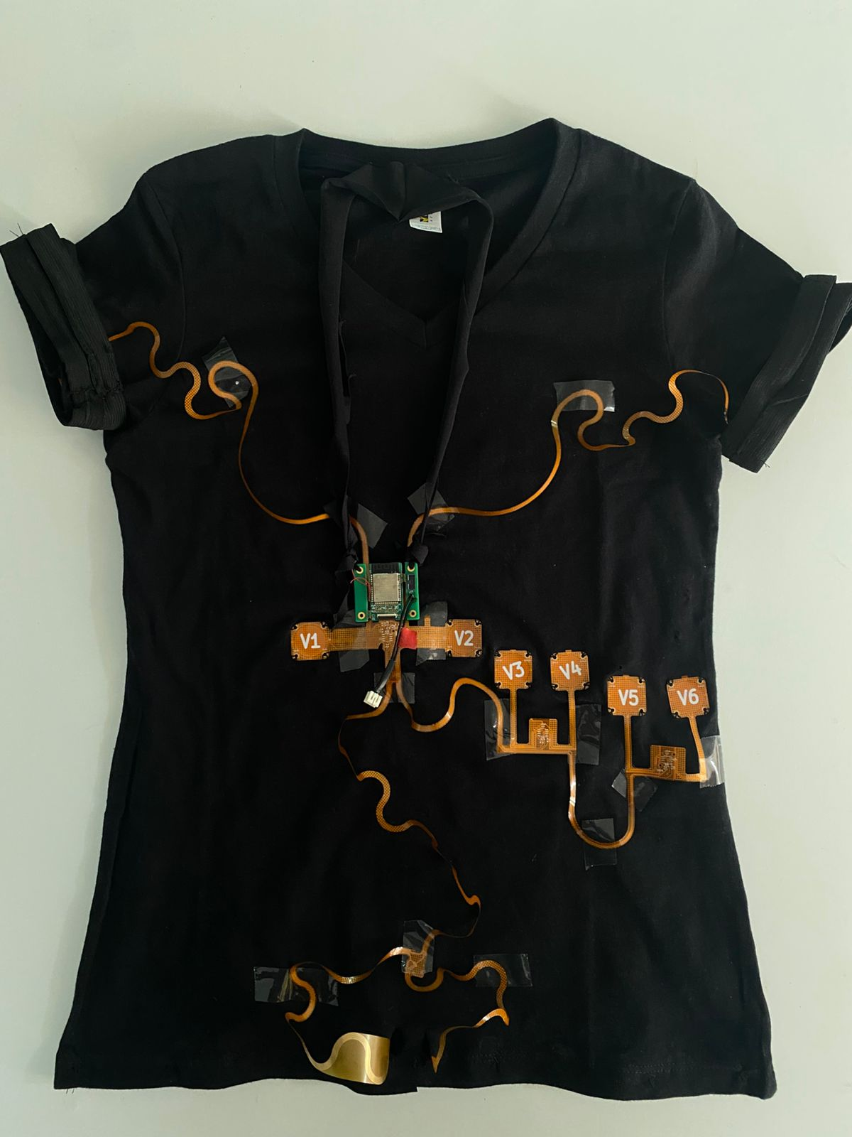
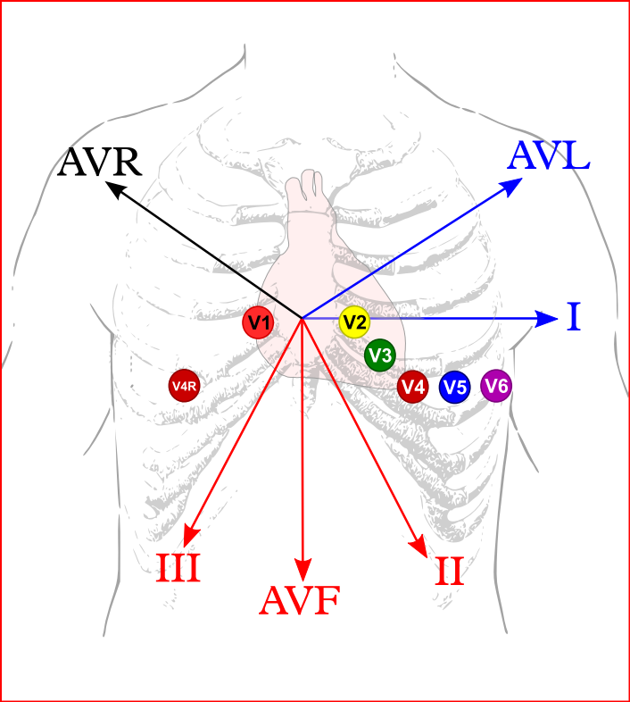
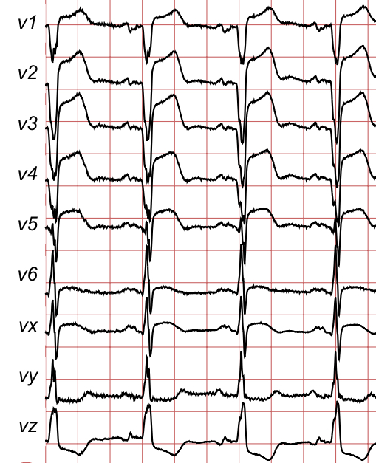
Areteus ECG prototype (Areteus.us.com)
ECG 12-signal device, on t-shirt
Electrodes placement diagram Source: ECGpedia.org
Sample ECG plot

Slide 3
New ECG 12-signal datasets for AI (to do)
ECG datasets for 50 years (<2017)
New 12-signal datasets (2018-2021)
MIT-BIH
PTB original
Large patient numbers
High Quality 12-signal (latest hospital ECG machines)
Multiple hospitals, multiple countries
Efforts to standardize diagnostic class labels
Developed with recent deep learning models in mind (ResNet, SENetworks, Transformers, RNN)

Slide 4
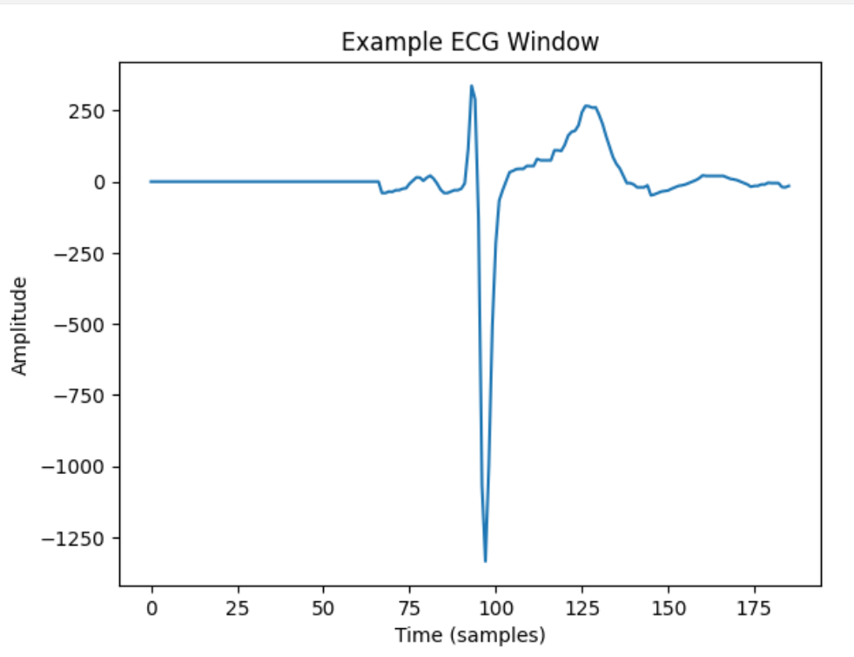
Data Processing (to do) From new, large 12-signal datasets (2018-2021 collections) PTB-XL dataset was selected with about 22,000 patients, 10 second recording length. From this, 1,000 patients were selected for a test run.
ECG signals data processing
Image, peak centering, zero padding
Peak center, split into 1.5 sec. windows, zero pad left & right.
Baseline meander fix to zero
Filters not applied:
Peak to peak distance standardizing
Peak amplitude standardizing
Removing negative values (squaring)
random split, overlapping split
much longer time windows
no relationship, feed each one of 12 signals independently

Slide 5
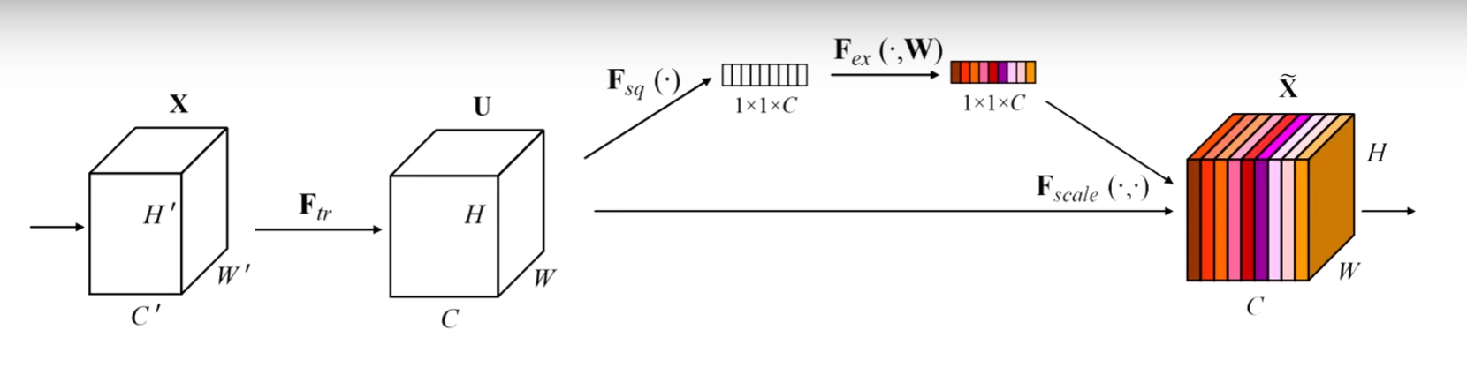
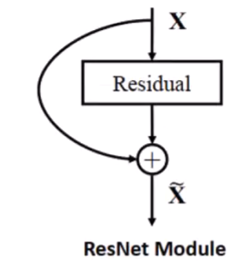
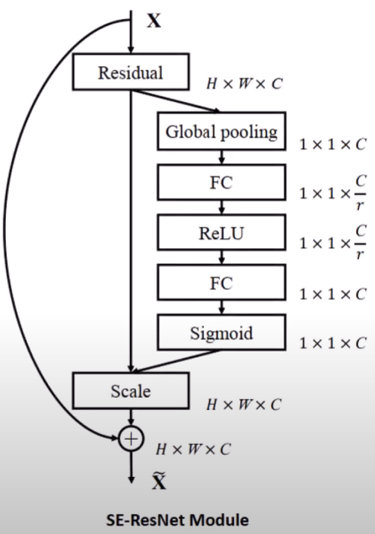
ResNet (Residual Network) + SE (Squeeze and Excite)
draw sheets, signals, 12-channels

Slide 6
Results: What I hope to show (to do)
ResNet+ SE, PTB-XL 12-signal data:
Accuracy, F1 score
Binary classification
4-6 class classification
24 class classification
Comparison of PTB-XL with SPH data
CNN, Random Forest, old MIT-BIH, PTB data:
Accuracy, F1 score: earlier models
* MIT-BIH (2-signals, small sample)
* PTB original (12-signals, small sample)
Areteus device inference:
- proof of concept, using one person, healthy heart data, 30 recordings taken over 2 days.
Translate binary/hex into usable numpy format
Future Steps:
Areteus device – need to gather many more patient data, and from large number of abnormal diagnostic classes.
Areteus device - testing for accuracy when user moves, when user did not attach all 12-nodes at right locations.
Areteus device – how to adapt the device to body sizes. Initially medium t-shirt size is available, but small and extra-large sizes planned. Will need to test device accuracy on users with varying body sizes.
Transformer + RNN model, also a good candidate. 2-stage training, makes full use of 12-signal dataset. Future work

Slide 7
AI for wearable ECG prototype (ResNet + SE model)
Tech 07 class project
Jennifer E Yoon mail@JenniferYoon.com
https://github.com/JennEYoon/ECG-transform/tree/main/Tech07-project
Deep Residual Networks, c. 2015: https://arxiv.org/abs/1512.03385
Yannic Kilcher: https://www.youtube.com/watch?v=GWt6Fu05voI
Squeeze-and-Excitation (SE) Networks, c. 2017: https://arxiv.org/abs/1709.01507 Soroush Mehraban: https://youtu.be/3b7kMvrPZX8?si=g0JY09P5dIPMXwRj

