Slide 1
AI for wearable ECG prototype (ResNet + SE model) Tech 07 class project Related to a virtual poster presentation at SciPy 2025 https://www.scipy2025.scipy.org/
Jennifer E Yoon, mail@JenniferYoon.com
github: https://github.com/JennEYoon/ECG-transform

Slide 2
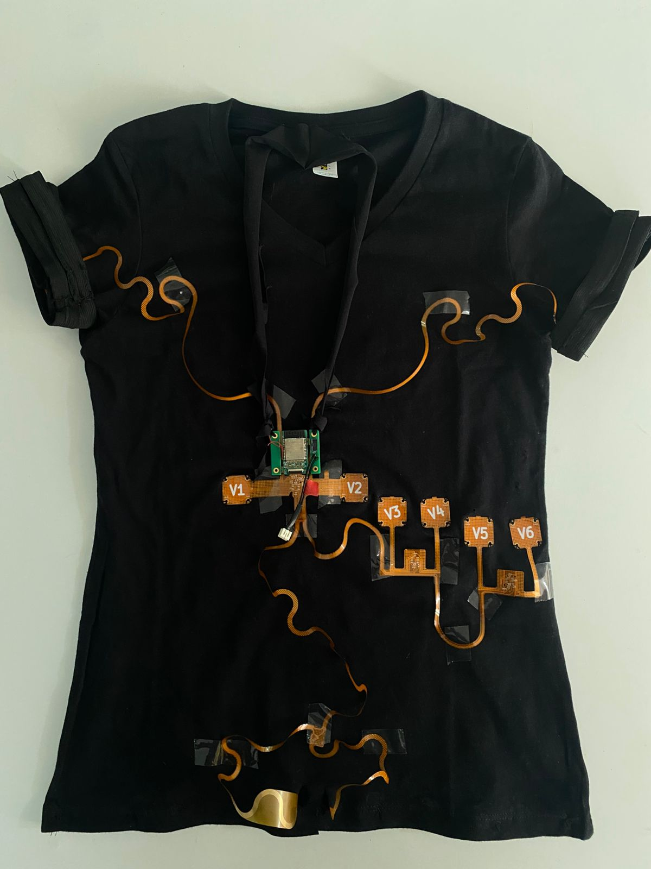
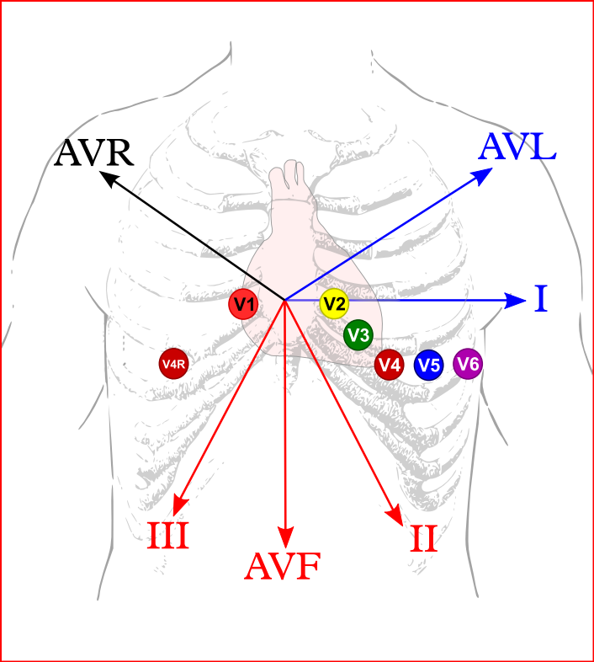
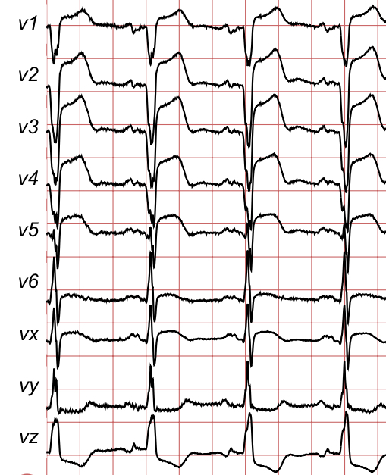
Areteus ECG prototype (Areteus.us.com)
ECG 12-signal device, on t-shirt
Electrodes placement diagram Source: ECGpedia.org
Sample ECG plot

Slide 3
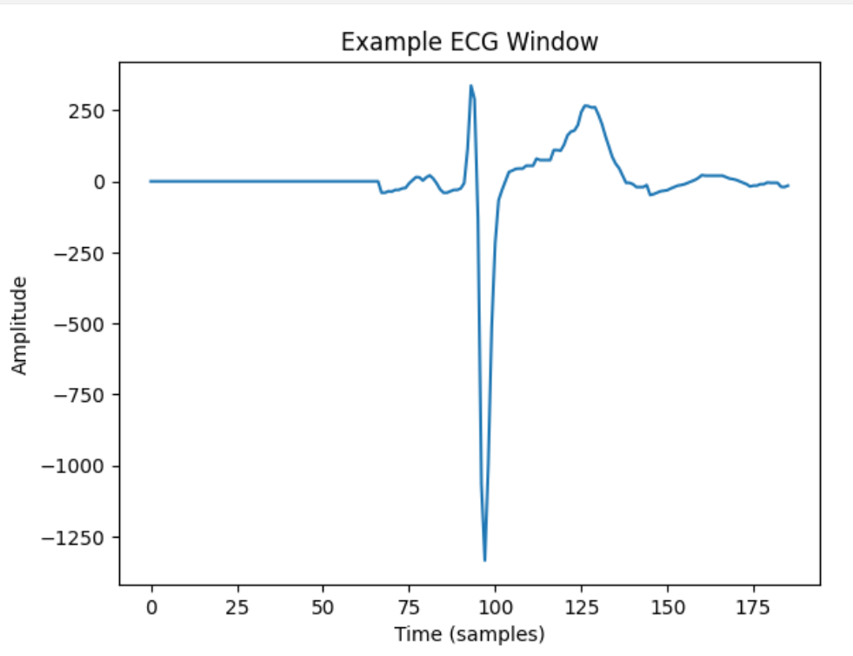
Data Processing (to do) From new, large 12-signal datasets (2018-2021 collections) PTB-XL dataset was selected with about 22,000 patients, 10 second recording length. From this, 1,000 patients were selected for a test run.
ECG signals data processing
Image, peak centering, zero padding
Peak center, split into 1.5 sec. windows, zero pad left & right.
Baseline meander fix to zero
Filters not applied:
Peak to peak distance standardizing
Peak amplitude standardizing
Removing negative values (squaring)
random split, overlapping split
much longer time windows
no relationship, feed each one of 12 signals independently

Slide 4
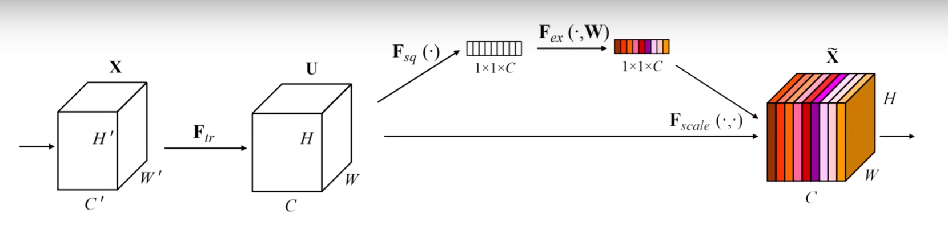
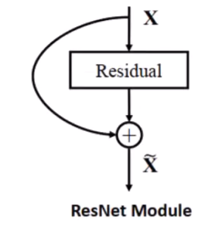
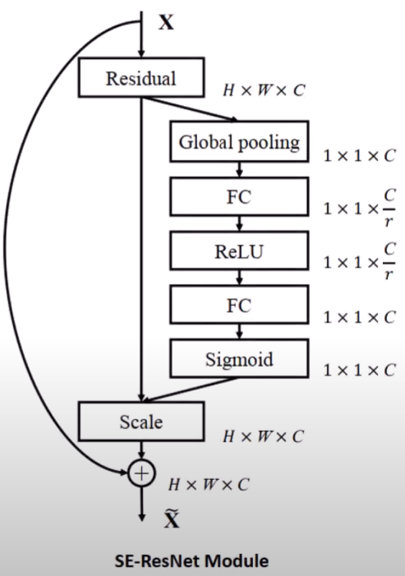
ResNet (Residual Network) + SE (Squeeze and Excite)
draw sheets, signals, 12-channels

Slide 5
Results (to do) and Future Steps
Results:
Accuracy, F1 score
Binary classification
4-6 class classification
Areteus device inference - proof of concept.
Translate binary/hex into usable numpy format
Future Steps:
Need to test what happens when person moves, if user does not attach notes at right positions.
Transformer + RNN model, also a good candidate. 2-stage training, makes full use of 12-signal dataset. Future work

Slide 6
AI for wearable ECG prototype (ResNet + SE model)
Tech 07 class project
Jennifer E Yoon mail@JenniferYoon.com
github: https://github.com/JennEYoon/ECG-transform
Deep Residual Networks, c. 2015: https://arxiv.org/abs/1512.03385
Yannic Kilcher:https://www.youtube.com/watch?v=GWt6Fu05voI
Squeeze-and-Excitation (SE) Networks, c. 2017: https://arxiv.org/abs/1709.01507 Soroush Mehraban: https://youtu.be/3b7kMvrPZX8?si=g0JY09P5dIPMXwRj

