Slide 1
Random Forest
A Visual Explanation
by Jennifer Yoon
Presented to DSML Meetup, on June 8, 2021
Heavily based on “Random Forest Explained” blog
https://towardsdatascience.com/random-forest-explained-7eae084f3ebe

Slide 2
Random Forest is a combination of Decision Trees.
One of the main drawbacks of Decision Trees is that they are very prone to over-fitting: they do well on training data, but are not so flexible for making predictions on unseen samples.

Slide 3
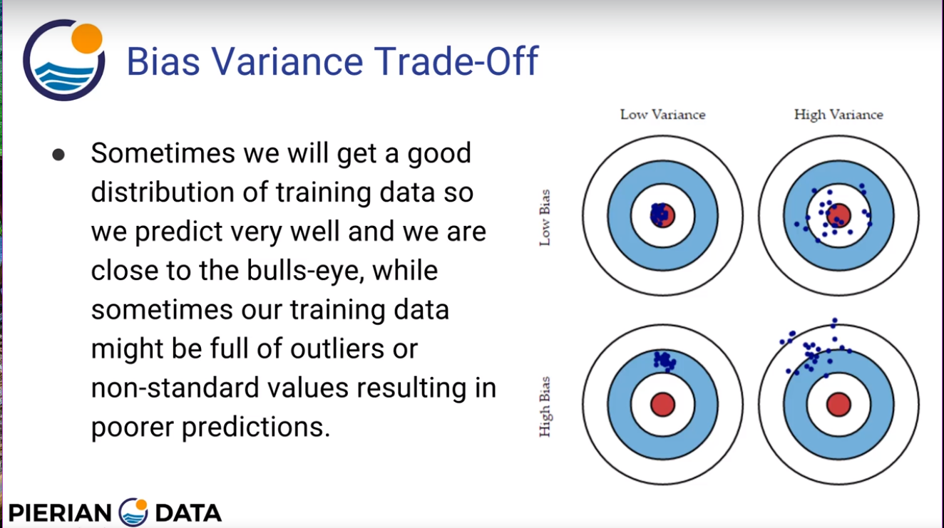

Slide 4
We use random sampling to overcome over fitting.
1. Randomly select partial rows (data sample)
2. Randomly select partial columns (features)
3. Combine and average to get better predictions
(This statistical concept occurs over and over in ML)

Slide 5
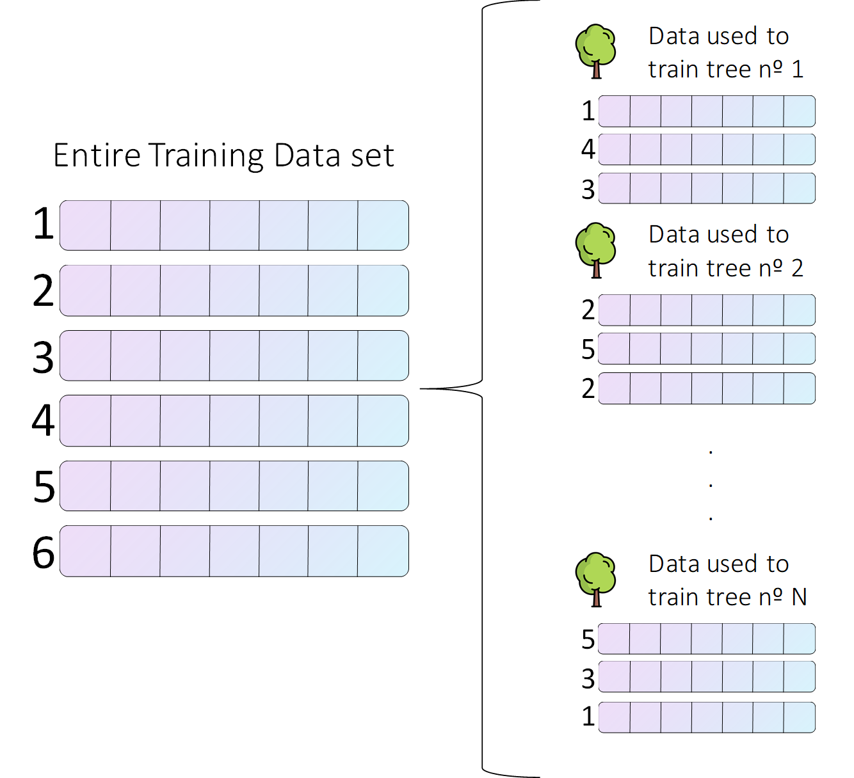
Randomly Select Partial Rows (data points)

Slide 6
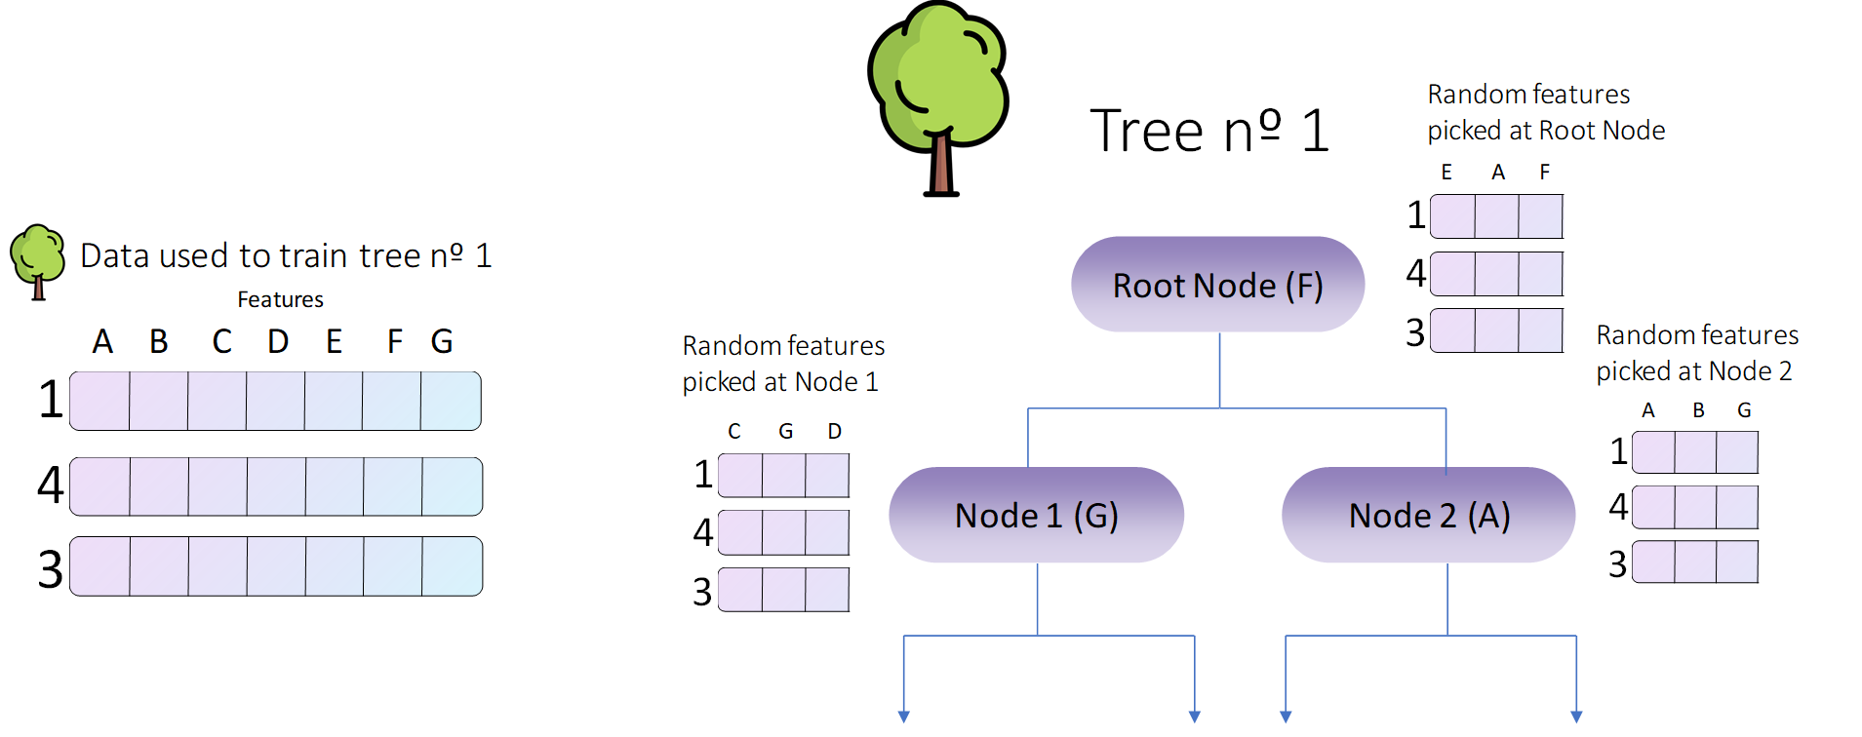
Randomly Select Partial Columns (features)

Slide 7
In conclusion, the whole process goes as follows:
1. Create a bootstrapped data set for each tree.
- Randomly select partial rows (data items)
2. Create a decision tree using its corresponding data set, but at each node use a random sub sample of variables or features to split on.
- Randomly select partial columns (features)
3. Repeat these steps hundreds of times to build a massive forest with a wide variety of trees. This variety is what makes a Random Forest way better than a single decision tree.
- Each tree has high variance but low bias (centered)
- Many overlapping tree variances average to a better predictor

Slide 8
Once we have built our forest, we are ready to use it to make our predictions.
1. Categorical Model – discrete levels predictor
2. Regression Model – continuous levels predictor

Slide 9
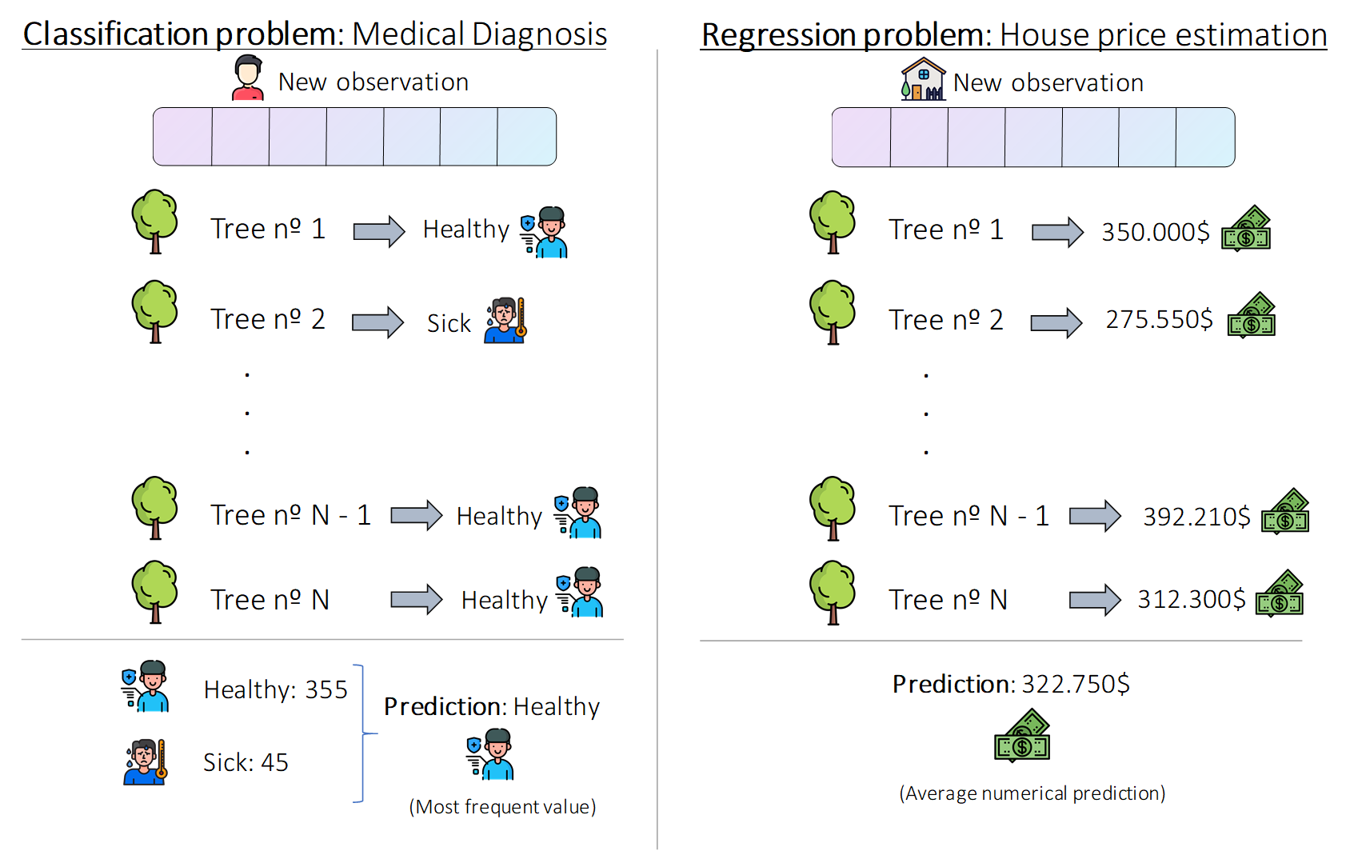

Slide 10
Overlapping Tree Variances Diagram
Note: Centers (means) of each circle falls inside the edges (variances, tolerances) of other circles. If the circles were widely separated, i.e., they did not overlap, the random forest model will produce an unusable result. This is unlikely with most data, but worth noting.

Slide 11

Reference: Random Forest Explained, https://towardsdatascience.com/random-forest-explained-7eae084f3ebe
Reference: Pierian Data, Udemy
Notes:
co

