Slide 1
SME Qualification Assessments

Slide 2
In the competitive hiring process, hiring managers often receive certificates of eligibles that may lack qualified applicants to select.
Notes:
USDS was invited in to work on improving an aspect of federal hiring given our expertise bringing in highly technical experts at OMB in the USDS pipeline. We focused on competitive, delegated examining hiring, because we saw that as a primary pain point that lead to the growth of so many alternative flexibilities. If we could improve that base problem, maybe we could use delegated examining certificates more often.

Slide 3
PROBLEM // PRIMARY FOCUS
Improve quality first.
Increase speed second.
Notes:
For a long time the federal government has pushed time to hire as the critical metric to improve hiring outcomes. This effort instead focused on first improving the quality of hires and once we have an assessment strategy that works, speeding up the process. Quality first; speed second.

Slide 4


PROBLEM // TODAY’S PROCESS
How an applicant is deemed qualified today
Cut & paste
Complete a self-assessment questionnaire
Keywords into a “federal resume”
“I’m an expert!”

Slide 5
We need more rigor before we consider an applicant qualified.
Resume
Exam
Preference
Certificate
Notes:
The way to improve quality of hires within the competitive service is to verify that an applicant is qualified before calling them qualified. Rather than jumping from someone appearing qualified on paper to then applying preference and category ratings, we can re-introduce an examination step to assess the required competencies before considering any applicant really qualified. This is currently allowed within all laws and regulations. This does not change the application of veterans preference or how applicants are ranked into categories. All this changes is the variable of when an applicant is considered qualified through a pass/fail examination. OPM reached this conclusion in 2015 when USA Hire assessments (a 1-3 hour computer test) were introduced as a new kind of civil service examination with cut scores. The SME-QA process introduces interviews with subject matter experts as an alternative to keep barrier to entry low for highly sought after technical talent.

Slide 6
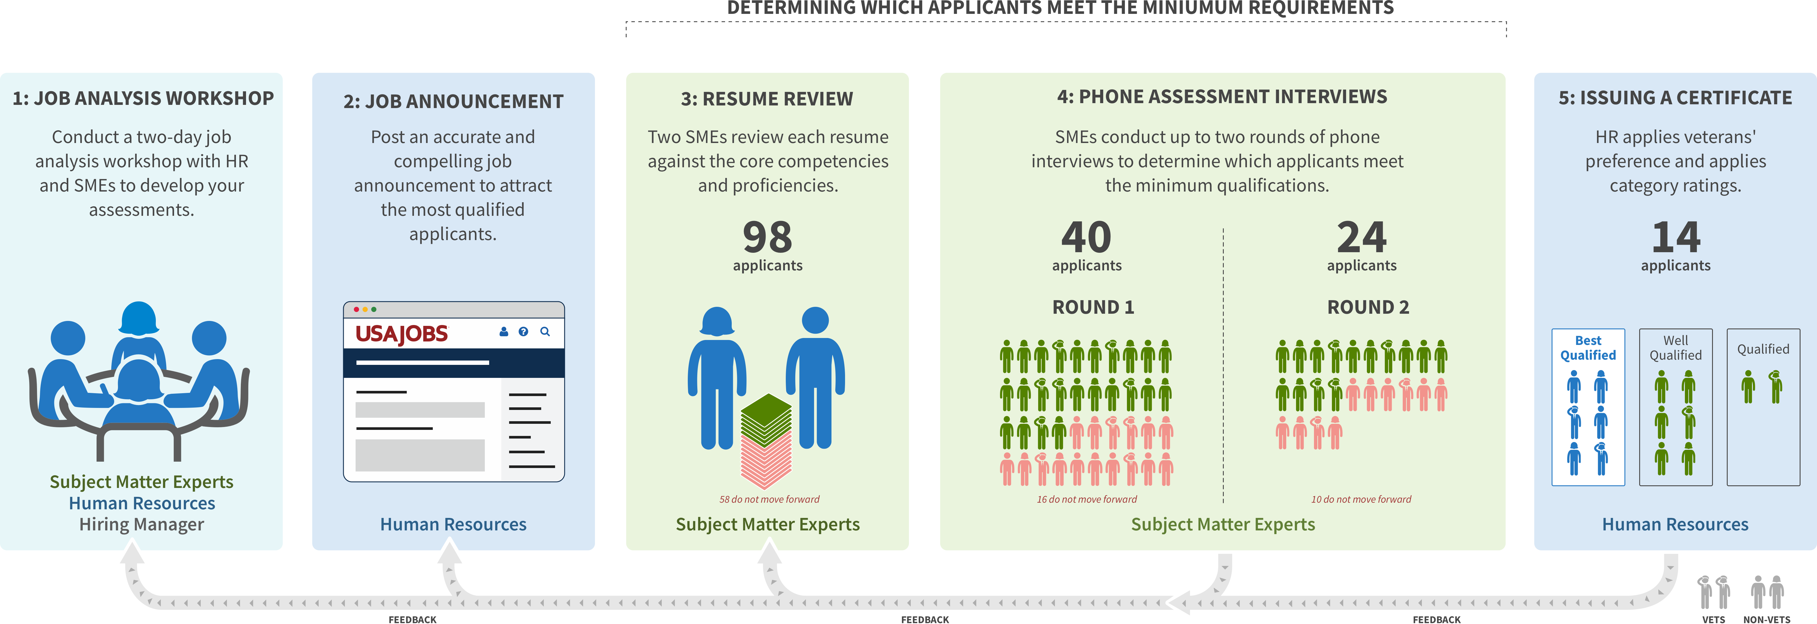
PILOT // WHAT WE TESTED
These numbers are for illustration purposes only.
Notes:
Shorter presentations (10-15 min)
During the job analysis workshop, SMEs work with HR to establish the specialized experience required for the position, which are presented as technical competencies. In practice, these technical competencies become the minimum qualification bar for the position.HR trains SMEs to assess all applicants against that bar during resume review and phone interviews. HR is responsible for the certificate, but according to the assessment strategy, they lean on SMEs’ deep technical expertise to assess applicants before they’re considered qualified. The hiring manager can be confident that any applicant, including the minimally qualified, will succeed in the role from day one.
Because SME-QA is time-intensive for SMEs, we reduced their participation burden by limiting the number of resume pages they review, including only one SME per structured phone interview, and minimizing the length of justification for every cut. In addition, applicants who do not receive a passing score in the first interview do not proceed to the second interview.
SME-QA applies to delegated examining, and veterans’ preference and category ratings still apply. However, applicants aren’t considered qualified until after they pass both interview assessments with SMEs. After the assessments are complete, HR adjudicates preference for the first time to all applicants who passed the assessment phase.
Longer presentations (1 hour)
During the job analysis workshop, SMEs work with HR to establish the specialized experience required for the position, which are presented as technical competencies. In practice, these technical competencies become the minimum qualification bar for the position. HR trains SMEs to assess all applicants against that bar during resume review and phone interviews. HR is responsible for the certificate, but according to the assessment strategy, they lean on SMEs’ deep technical expertise to assess applicants before they’re considered qualified. The hiring manager can be confident that any applicant, including the minimally qualified, will succeed in the role from day one.
Job Analysis: SMEs and hiring managers work with HR to:
Set specialized experience in the form of technical qualification criteria that will in practice become part of the minimum qualifications
Write structured interview questions to assess applicants against the defined competencies and proficiency levels
Finalize the assessment strategy
Job Announcement: Bridges a standard PD with an accurate announcement.
Represents the actual job being hired for
Is not cut and pasted from the position description
Contains only critical information with links to other items
Closes at midnight the day it hits 100 applicants so SMEs aren’t overwhelmed by too many applicants.
No occupational questionnaire to assess applicants qualifications. We don’t care how an applicant rates themselves; technical SMEs assess applicants.
Resume Review: HR only checks for eligibility requirements, SMEs check for the technical competency requirements. There are no quotas for how many applicants can move forward.
SMEs determined how many pages of each resume they would review during job analysis and documented in JOA (reduces time burden on SMEs, levels the playing field for private sector applicants).
SMEs compare resumes against the required competencies and write 1-4 sentences about why they are moving an applicant forward or cutting them.
HR reviews the justifications to make sure cuts were based on retraceable technical reasons (not to second guess SME’s technical judgement).
Applicants who pass resume review are not automatically qualified. Instead, they earn entry into a passing score examination, which is two rounds of structured interviews.
Interviews: Before beginning interviews, HR conducts a required 2-hour training with SMEs to practice the structured interview script.
Given the heavy time burden for participating SMEs, SME-QA uses one SME per phone interview. SMEs transcribe the applicants’ responses to the best of their ability.
HR reviews the SMEs’ analysis of the applicants’ qualifications to make sure they were only based on the required competencies and proficiency levels from job analysis.
To be considered qualified with a passing score, applicants must pass two interviews, each with a different SME, measuring the breadth of and then depth of knowledge in the required competencies.
Applicants who don’t pass the first interview can’t achieve an overall passing score, so they don’t move on to the second interview.
Certificate: For the first time, HR adjudicates veterans’ preference claims and then applies normal veterans’ preference rules, followed by category ratings.
For applicants who not only meet but exceed the qualifications, HR uses that info to put applicants into categories.
Any disabled veteran who is minimally qualified will float to the top of the best qualified list. Hiring managers must consider them before any other applicant.
For example:
100 people applied
HR removed 2 because they didn’t submit resumes, so SMEs reviewed 98 resumes.
SMEs interviewed 40 applicants in the first round.
Of those, SMEs interviewed 24 applicants in the second round.
Of those, SMEs considered 14 applicants qualified. Those applicants met the minimum qualifications for the job and received a passing score on both interviews.

Slide 7
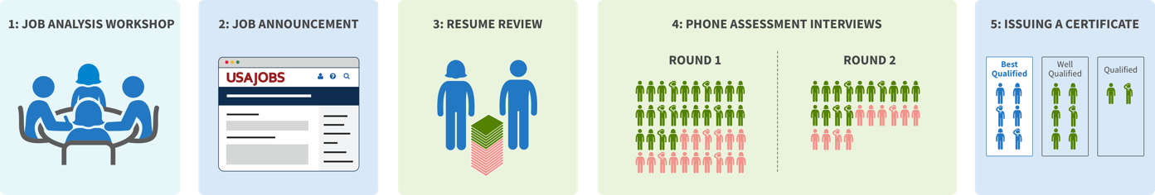
PILOT // RESULTS
8
SMEs
2
HR
165
applied
94
First Interview
51
Second Interview
36
Qualified (5 veterans)
+
HHS
8
SMEs
+
2
HR
DOI
224
applied
67
First Interview
37
Second Interview
25
Qualified (4 veterans)
Notes:
Here are the results from each pilot. We successfully narrowed the applicant funnel down in each stage. At HHS, 36, or 22% of the applicant pool was found qualified. At DOI, 25, or 11% of the applicant pool were found qualified. In baseline data from each agency, typically many more applicants are found qualified and fewer are selected. In this process, the hiring mangers were given a much shorter list of qualified applicants but more applicants were selected. In the pilots, there were multiple certificates created due to multiple locations and/or sub-roles listed in the job announcements. Some of the certificates were comprised completely of qualified veterans. When the hiring managers looked at the resumes, their reaction was, “these veterans are really qualified!” After the agencies made offers to the veterans, they received additional certificates with the names of the qualified non-veterans to select from.

Slide 8
PILOT // IMPACT
“This is the best way to find and hire a qualified veteran. We can’t wait to bring them on.”
HHS PILOT
DOI PILOT
22%
11%
Of applicants were found qualified, 7 were selected
Of applicants were found qualified, 13 were selected
- DOI Selecting Official
Notes:
At HHS they have already selected 6 applicants and 4 more will be selected soon. At DOI, they had 7 vacancies and already made 11 selections, more than expected. Both agencies are now sharing the certificates with other hiring managers at the agencies to see if they can hire all qualified applicants.

Slide 9
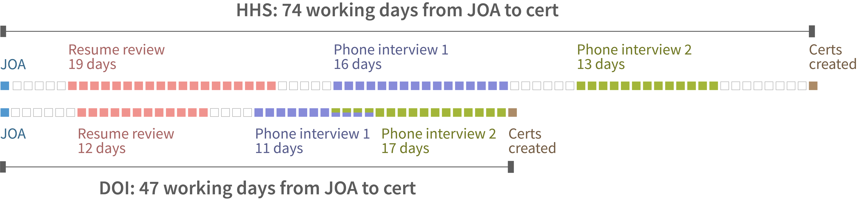
Second Iteration took 27 fewer working days
PILOT // TIME TO HIRE

Slide 10
PILOT // JOB ANALYSIS WORKSHOP
Output:
Set an accurate bar to assess applicants
Finalize assessment strategy
Define 4-5 core competencies for this role based on job tasks and their proficiency levels
Write two sets of structured interview questions
Notes:
The next step for SMEs is a job analysis workshop to establish the bar for what it means to be qualified for this role. From the pilots of this process, the SMEs said they wish they spent an extra half day after the 2 day workshop to further refine their interview questions.The hiring managers said this was the most valuable part of the process since without establishing the appropriate requirements up front, how could have have expected the right list of applicants at the end?

Slide 11
PILOT // JOB ANALYSIS WORKSHOP: Set an accurate minimum qualification bar
2210 IT Specialist Required Competencies
OPM Qual Standards | HHS Job Analysis | DOI Job Analysis
Attention to Detail Oral Communication Problem Solving Customer Service | IT Practices Technical Communication Analytical Ability Stakeholder Engagement Managing Without Authority | Technical Operations Security and Policy Communication and Collaboration Customer Service and Support
Notes:
OPM puts out qualification standards per job series but it’s up to the agency to create specialized experience, which becomes part of the min quals.
In this process, the specialized experience was all in the form of competencies and proficiency levels.
Through job analysis, we identified these requirements necessary for the position and put them in the job announcement under qualifications.
Agencies must analyze their own positions and finding out their own competencies and those should be used for their assessments.
You can also see there was a lot of commonalities between the OPM and the ones from HHS and DOI. The Qual standards lets you use IT related experience to demonstrate that they have the requirements so you can see that reflected here.
You should not be cutting and pasting the qual standards- you need to do the work of the job analysis per OPM guidelines you must conduct job analysis. It’s never sufficient to cut and paste.

Slide 12
PILOT // Time Commitment
Subject Matter Experts
2 days: Job Analysis Workshop
5 hours: Resume review training (3 hours) and Interview training (2 hours)
8 hours: Resume Review over 1 week
Up to 40 hours (over 3 weeks): Interviews with applicants*
*assumes 100-200 applicants/8 SMEs conducting 2 rounds of 1 on 1 interviews
Hiring Manager/Selecting Official
2 days: Job Analysis Workshop
10 hours: Once the Certificate is issued, commit to any additional interviews and selections within two weeks
Notes:
Here is breakdown of the time commitment required by SMEs in the process, and the time required by selecting officials.

Slide 13
Thank you!

