Slide 1
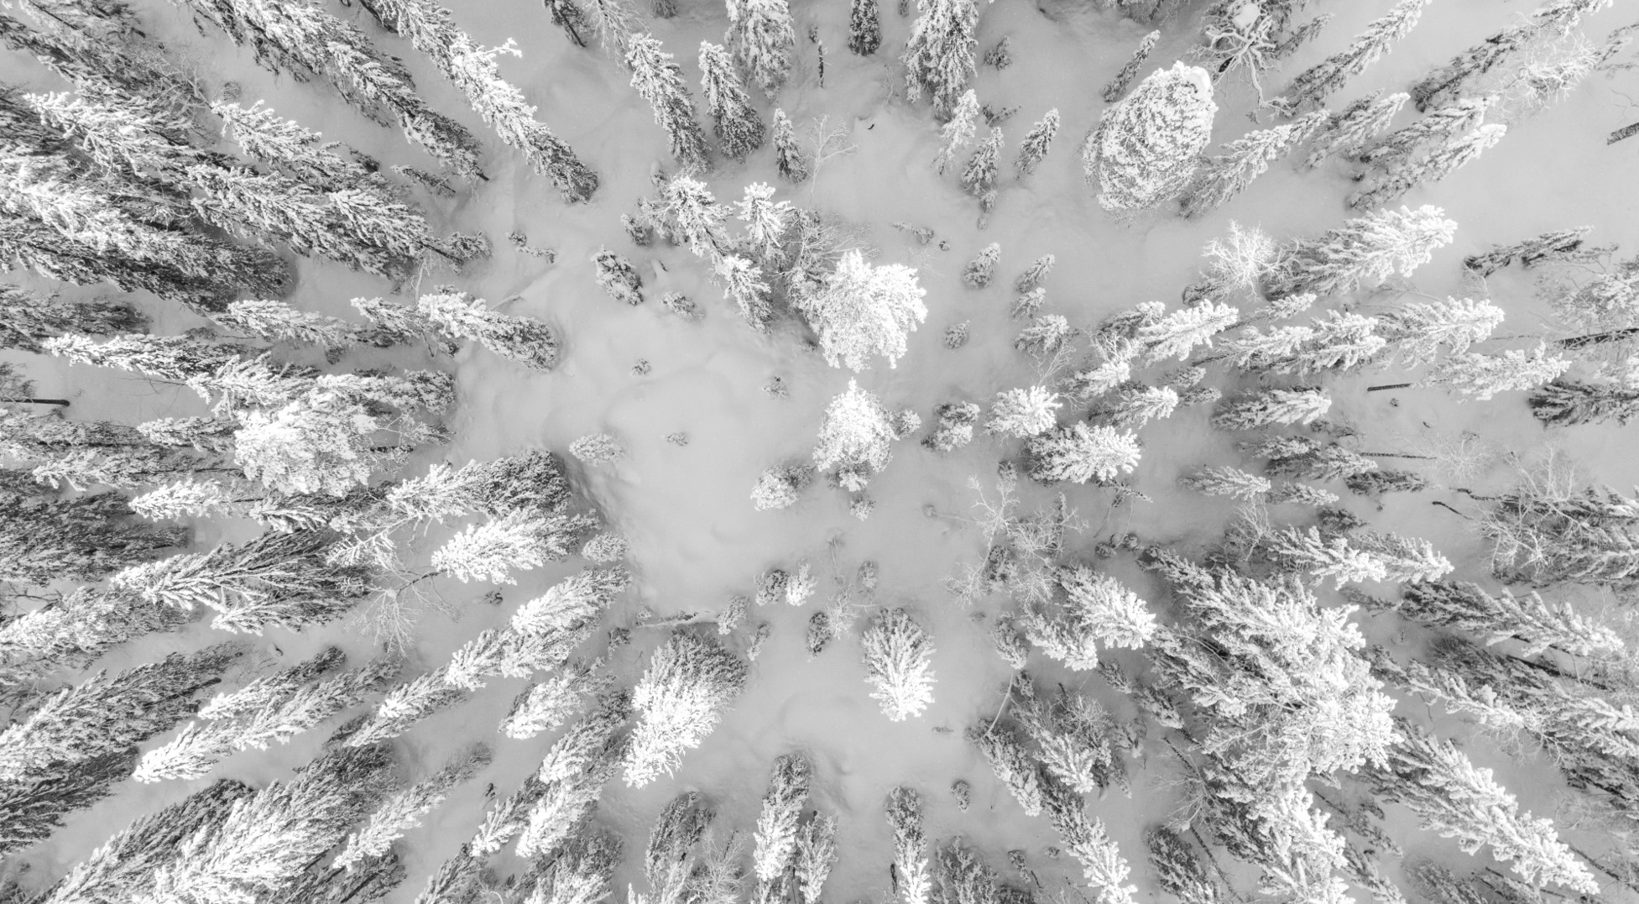
Data-driven Resort Pricing Project
Right-sizing our revenue and facilities

Slide 2
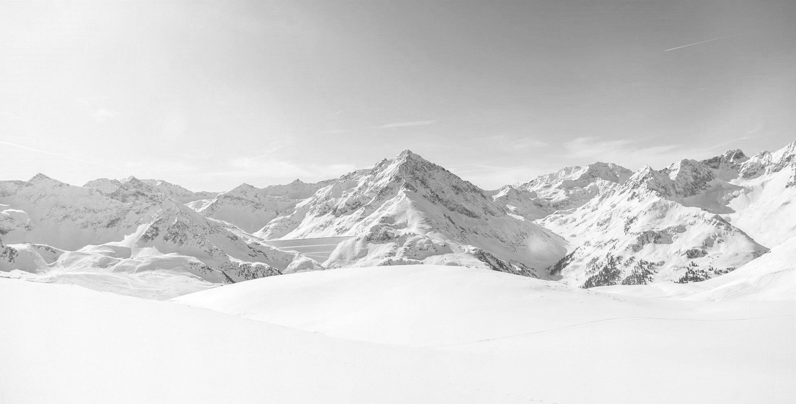
Right Now on the Big Mountain
Where are we starting from?

Slide 3
Big Mountain Today
.
What we’ve got
What could we do?
Spectacular views of Glacier National Park and Flathead National Forest.
350,000 yearly visitors buying average 5 tickets.
105 trails, 11 lifts, 2 T-bars, and 1 magic carpet.
Recently added a new chairlift.
3.3 mile longest run.
Base elevation 4,464 ft, summit 6,817 ft: vertical drop of 2,353 ft.
All for an $81.00 daily lift ticket!
Big Mountain needs to ensure it is successfully capitalizing on its unique combination of facilities and amenities.
We could benefit from evaluating our ticket prices according to our place in the market by features.
We would like to know if it’s feasible to raise ticket prices by 10% for the upcoming season.
Considering other changes to facilities, what are the recommendations of this new pricing model?

Slide 4
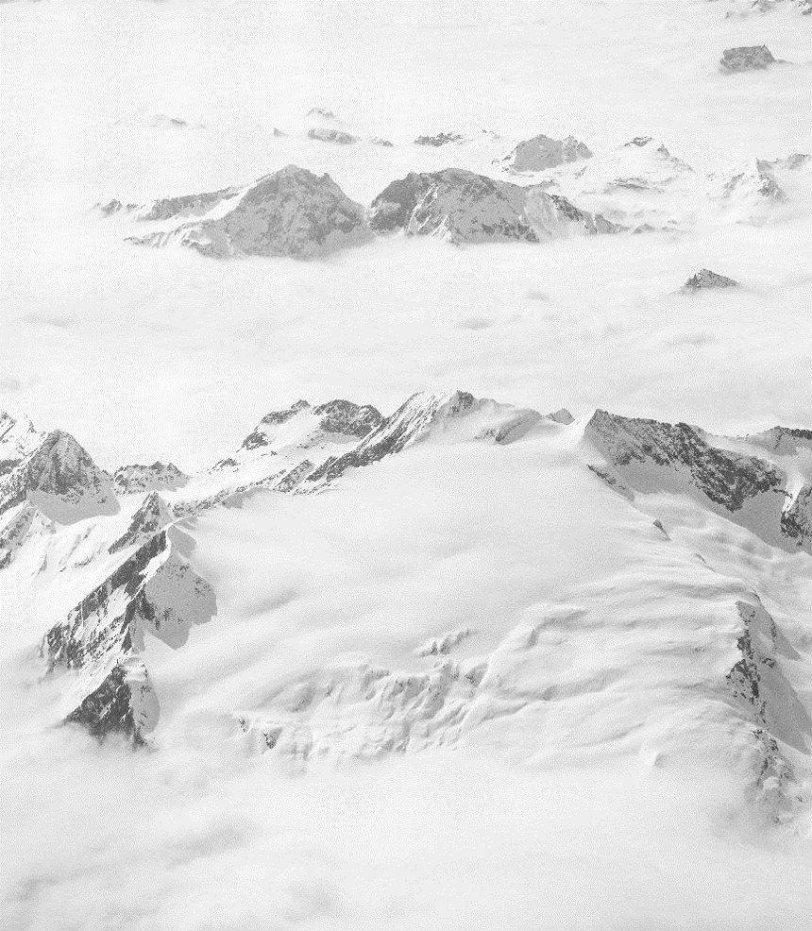
Getting the Data
Resort-specific data:
summit height, vertical drop
numbers and types of chairlifts
number of runs
skiable acreage
snowmaking coverage
night skiing
and, crucially, ticket prices
for 277 resorts in our market.
Supplemented with statewide data:
State population and physical area
Summary statistics of resorts per state, total skiable acres per state, and others
Big thanks to Alesha Eisen, Database Manager, for providing our original data!
How do resort features relate to ticket prices?

Slide 5
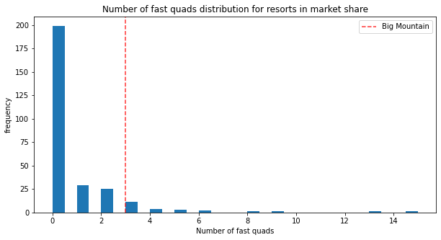
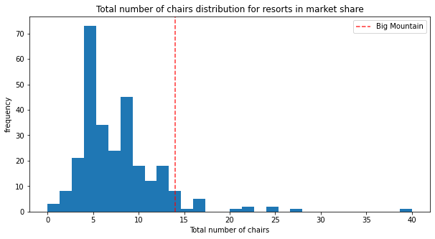
So where are we?
Our place in the top 5 key features related to ticket prices:
High on chairs and fast Quads!

Slide 6
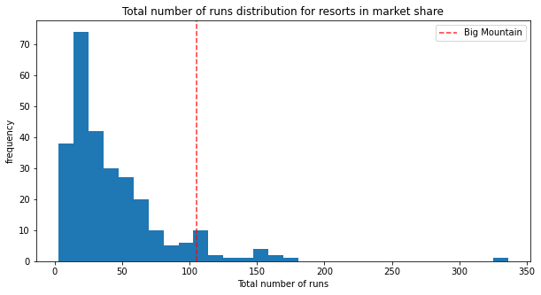
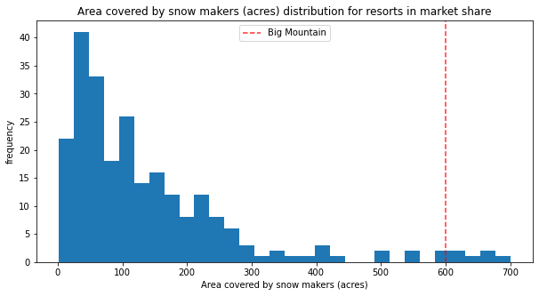
So where are we? (2)
Our place in the top 5 key features related to ticket prices:
High on runs and very high on snowmaking!

Slide 7

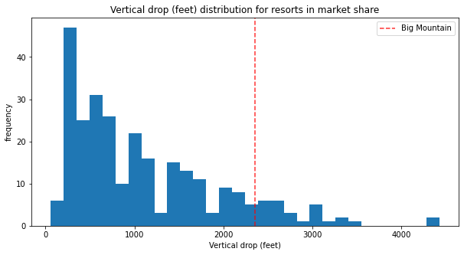
So where are we? (3)
Our place in the top 5 key features related to ticket prices:
High on vertical drop!

Slide 8
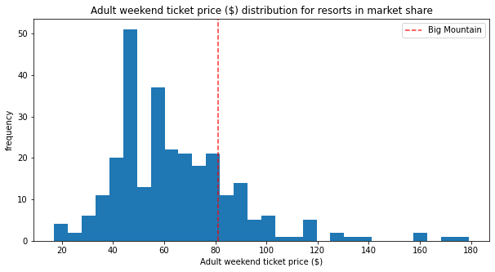
What about our ticket price?
Medium high. Could it be higher?

Slide 9
The Model Says…
.
Yes!
Could we do better?
Our model predicted that with our existing set of amenities our ticket price could be
$95.87
with a mean absolute error of $10.39, and therefore a range from $85-105.
Our desired 10% increase would be $89.10, easily within this range.
Considering other changes to facilities, what are the recommendations of this new pricing model?
Scenario 1: close up to 10 of the least-used runs
Scenario 2: add a low run to increase our vertical drop by 150 feet. Includes adding a chairlift to return skiers to the base.
Scenario 3: same low run and chairlift, additionally supported by 2 acres of snowmaking.
Scenario 4: increase longest run by 0.2 miles, adding 4 acres of snowmaking support

Slide 10
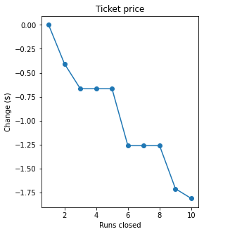
Scenario 1: close up to 10 of the least-used runs
.
Will we save costs to cover lost revenue?
Our model predicted that closing runs beyond 1 will drive down prices, often significantly.
We did not consider operating costs in our modeling.
We also did not model the possible closure of lifts serving the closed runs, but the importance of lift numbers to the model in general suggests that reducing lifts would also drive prices down.

Slide 11

Scenario 2 & 3: Adding a low run
.
Recommended!
Our model predicted that adding a low run with chairlift would increase individual ticket prices by $1.99
With 350,000 visitors buying 5 tickets each, this would result in $3,474,638 additional revenue
Assuming the new chairlift operating costs are similar to our most recently installed new lift, at $1,540,000, increased revenue would easily cover this cost.
Increasing snowmaking coverage by only 2 acres did not measurably affect the price and would not be recommended.

Slide 12
Scenario 4: Increase longest run
Not recommended.
Increases to longest run and snowmaking in this scenario are minimal and have zero predicted effect on price.

Slide 13





Thank You
Jenna Flanagan
+1 23 987 6554
jennaf@bigmountain.com
www.bigmountain.com

