Slide 1




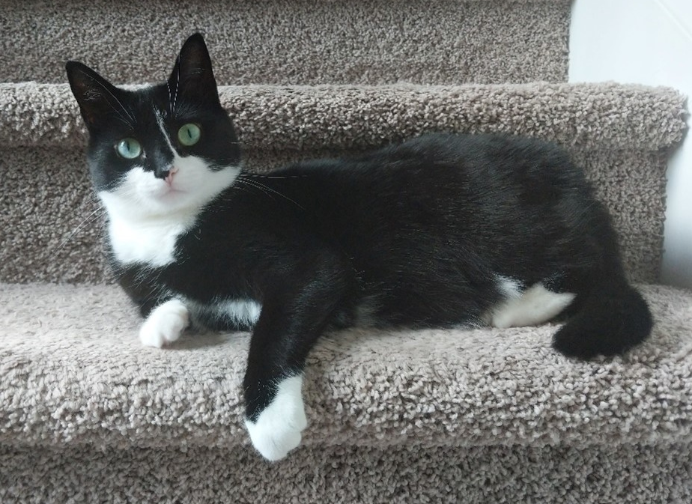
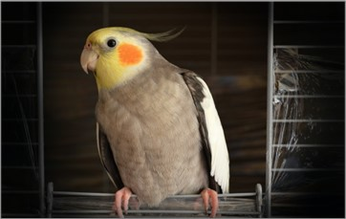

Home Dogs Cats Birds Pexperts
Welcome!
Pets are nature's gift to humanity. It has been scientifically proven that opening our homes and hearts to a pet increases our longevity and improves our overall quality of life as well as the lives of our pets. At Pet Paradigm Professionals, our mission is to offer resources to help you care for your furry, scaly, feathery, and slimy loved ones. Our pet experts—or “Pexperts”—have been working with pet owners and professionals alike for the past twelve years. They offer one-on-one consultations with current and prospective pet owners as well as group presentations designed for veterinary, pet shelter, and pet breeding professionals.
Looking for basic pet care advice for the most common type of pets? Need additional help determining which type of pet is right for you and your family? We will work with you and provide tailored evidence-based pet care to ensure lifelong health and wellness of your new companion.
We are also happy to help you navigate the adoption process! We will guide you through each step in the process from determining which type of pet is best suited for your family and home environment, to completing the necessary paperwork, to bringing your new loved one home. Please fill out our contact form to request a consultation. We will contact you within 48 hours to schedule a consultation. All fields are required.
Looking for your new best friend? The following organizations can help you find and adopt the perfect companion:
- General Adoption Resources:
https://home-home.org/
- ASPCA: https://www.aspca.org/
- Fish Rescue: https://www.sterlingshelter.org/humane-society/koi-fish-rescue/
- Snake Rescue: https://savethesnakes.org/snakerescuecall/
- Bird Rescue: https://ftlob.rescuegroups.org/
About Us Contact Us
@JennaGordon Enterprises

Slide 2


Home Dogs Cats Birds Pexperts
Dogs
The domestic dog is an extremely social animal and offers a diverse variety of choices as there are well over 300 breeds recognized by the World Canine Organization. Adopting a dog offers mutual benefits between dog and owner. Many studies cite the social benefits of having a companion as well as the reduced feelings of loneliness from adopting a dog. Studies even show medical indicators such as reduced blood pressure and improved lipid profiles. If you have a dog, it is important to make sure that you care for your dog; be mindful of what you feed your dog and provide enough opportunities for exercise. In this page, you will find more information about how to care for your pets throughout the various stages of their lives.
Diet & Exercise
Throughout dogs’ lifespans, they should generally be fed fewer meals as they mature. Puppies should be nursed the first two months, then introduced to three meals per day when they are about three to six months years old. Their food intake should be reduced to two meals per day when they are six months to one year old and finally reduced to one meal after they reach one year old. And a dog’s typical body mass is composed of somewhere between 60 and 70 percent water. The ASPCA says just a 10 percent decrease in body water can cause illness, and a 15 percent loss can cause death, so make sure you keep your pooch hydrated!
Much like humans, dogs need to have a healthy level of activity to keep their organs healthy, as well as sun and fresh air. The minimum recommended time for exercise varies greatly with breed and size differences, but generally a range of 30–120 minutes of exercise is recommended per day.
Grooming & Handling
Keeping your furry family member clean is important to its health. So be sure to brush frequently to reduce the amount of shedding and prevent matted and tangled fur that can prove to be extremely difficult to remove. Check for insects such as ticks and fleas, especially after visiting heavily wooded areas. Rinse all of the soap out, as any residual soap can result in a rash. No matter the size of your dog, you need to be cautious as you carry your canine. If you have a small dog, then cradle the pup with one hand under the chest and the forearm supporting the back half. If it is a large dog, reach under the belly with both your arms perpendicular to the dog, and use each arm to support the chest and rear as you lift.
Vaccinations & Medications
You should always consult with your veterinarian, but there is a core set of vaccines that are typically recommended. Vaccines that reduce the exposure risk to things such as hepatitis, rabies, and parvovirus. Others may be determined by your vet depending on the environment in which the dog resides. Some of these include Bordetella bronchiseptica, Borrelia burgdorferi, and Leptospira bacteria.
About Us Contact Us
@JennaGordon Enterprises

Slide 3


Home Dogs Cats Birds Pexperts
Cats
Cats were first domesticated around 7500 BCE in the western Asia region and are currently the second most popular domestic pet in the United States. While there are over 60 unique documented cat breeds, care and diet can differ between breeds. However, some diets and practices are generally recommended for the well-being of your fluffy family member regardless of breed.
Zero to Four Weeks
It is important the queen (a term commonly used for a female cat that is either pregnant or nursing) directly nurse her young if possible. Monitor your kitten’s growth closely to make sure its growth rate is progressing steadily. If any kitten is not growing at a sufficient rate, a caretaker might need to feed the kitten directly either with a bottle or a feeding tube. Some reasons why kittens might not gain weight appropriately include the following:
too many other siblings are competing for mom's milk
gastrointestinal disease
environmental conditions such as extreme heat or cold, or unsanitary conditions
Four Weeks to One Year
Kittens can start being introduced to soft wet kitten food typically around three to four weeks after birth. According to the ASPCA, kittens at this age should eat half to one cup of dry kitten food or six to nine ounces of wet kitten food per day. If your kitten has difficulties eating hard food, a small amount of water can be added to soften the food. Cat food that is optimized for kittens provides the additional nutrients that are needed for growth, energy, and wellness. Depending on the breed, your cat may have different dietary requirements. You should always consult with your veterinarian for recommendations.
One Year to Seven Years
This age is when kittens reach the cat stage and do not need as many nutrients. At this age, their level of activity decreases, and so does their metabolism. It is not recommended to leave food out for the cats all day. Instead, provide food a couple times a day so they eat meals rather than snacking throughout the day. This practice reduces the risk of obesity and other weight-related feline ailments.
Seven Years and More
Much like many living organisms, the body begins to deteriorate and experience a lot of changes. Cats at this age should eat less fats and calories and more quality proteins. This means when you are purchasing packaged foods for your cat, look for food that states a particular protein (such as "salmon") and not just a category (such as fish). This usually means they are byproducts, or combinations, of lesser quality proteins.
About Us Contact Us
@JennaGordon Enterprises

Slide 4
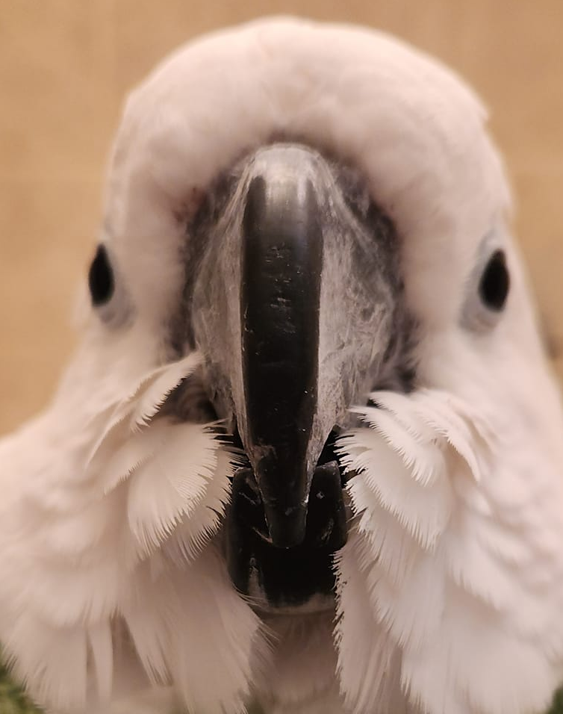
Home Dogs Cats Birds Pexperts
Birds
Birds are very intriguing creatures as they can range from birds as small as a Cuban bee hummingbird (about two inches long and a little over 1/20 of an ounce) to as large as an ostrich. While most birds fly, there are some that don’t.
Birds are amazing and each breed is unique in its own way, particularly when it comes to their relational needs and well-being. Unfortunately, birds can experience sadness and depression just like humans. A number of root causes may be responsible for your bird's depression such as an illness (either physical or mental), losing its companion, or increasingly becoming bored. Some signs to help identify if your bird is experiencing depression may include the following:
- reduced appetite
- becoming increasingly irritable
- aggressive behavior
- songs have a different, more solemn tone
Be sure to tell your veterinarian if you see signs of any of these symptoms. Just like many illnesses, identifying and treating the symptoms earlier may drastically increase the lifespan of your birdie.
About Us Contact Us
@JennaGordon Enterprises

Slide 5
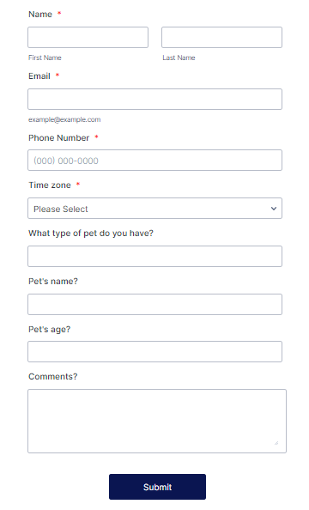
Home Dogs Cats Birds Pexperts
Contact the Pexperts!
Consult with the pet experts, or “pexperts!” Get your own, on-on-one consultation with an expert on your specific type of pet! Our “pexperts” are highly-trained in their fields and will be happy to talk to you about any concerns you have about your pet.
Please complete the form to the right and a “pexpert” will contact you within 48 hours.
About Us Contact Us
@JennaGordon Enterprises

Slide 6
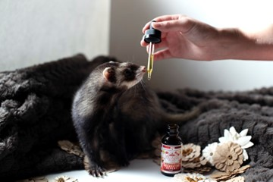
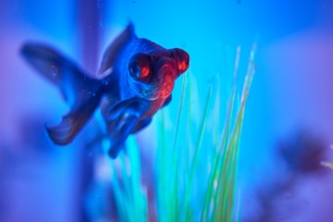


Home Dogs Cats Birds Pexperts
About Us
Business Name: Paradigm Pet Professionals
Slogan: Evidence-based pet care advice for every pet lover
Brand Values: Paradigm Pet Professionals has 12 years’ experience working with pet owners, certifications in pet health and nutrition, and customer recognition for outstanding support
Services: virtual consultations and presentations, one-on-one consultations concerning individual pets, group presentations regarding general pet care (can be tailored to the needs of the group)
About Us Contact Us
@JennaGordon Enterprises

Slide 7

Home Dogs Cats Birds Pexperts
Contact Us
Phone:
555-555-5555
We’re available 9am – 6pm Eastern, Monday – Friday
Email:
PPP@notanemail.com
Mailing address:
Paradigm Pet Professionals
P.O. Box 555
Anywhere, NJ 55555
Social Media:
Facebook: http://www.facebook.com/paradigmpetprofessionals
Instagram: http://www.Instagram.com/therealparadigmpetpros
X/Twitter: http://www.twitter.com/PPP-NJ
Discord: http://www.discordapp.com/users/PPP-NJ
Want “pexpert” advice?
Click here to contact the experts!
About Us Contact Us
@JennaGordon Enterprises

