Slide 1
League of Legends Prediction
By Jenner Felton

Slide 2
Overview
Project Goals
Data Acquisition
Network Configuration
Results
Future Goals

Slide 3
Project Goals and League Overview
League of Legends is an online game which is usually played in a 5v5 game mode.
There are over 100 different champions which can be played in each match.
I want to create a neural network that can predict the victor of these games using basic player statistics and champion statistics.

Slide 4
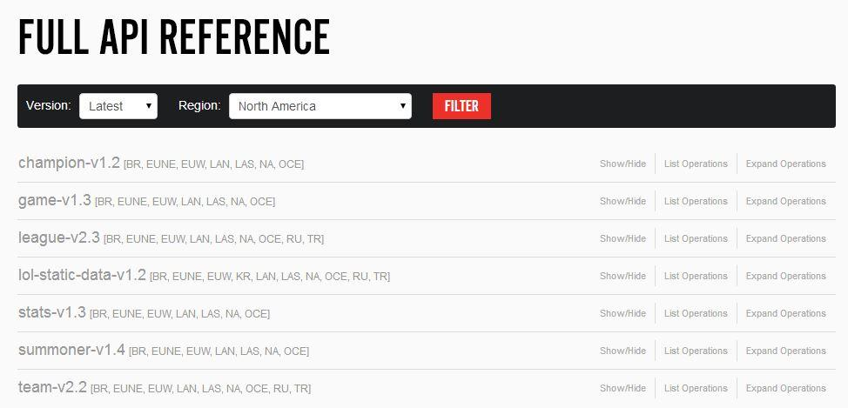
Data Acquisition
I used the Riot API to grab player statistics and used an excel spreadsheet to grab champion statistics.

Slide 5
More Data Acquisition
Data Used:
Player win rates with the champion being played for each player.
Champion win rates overall for each champion being played.
Sum of the above two categories - two for each team.

Slide 6
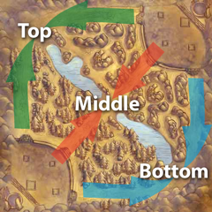
More Data Acquisition
Preliminary results were not a good as I had hoped: ~70% prediction rate
To maximize the meaning of my input values, I sorted the first 20 inputs based on the lane they are usually played in.

Slide 7
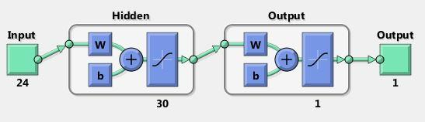
Network Configuration
24 inputs
1 hidden layer with 30 nodes
1 output

Slide 8
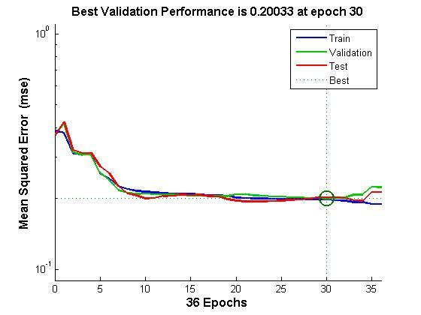
Results
After sorting the data and using the previously shown network, I was able to get a roughly 80% correct prediction rate.

Slide 9
Conclusions
We get correct classification with 4 out of 5 games.
The statistics of each player clearly matter quite a bit (even with the randomness involved in the game).
Players are probably pretty happy with a 80 percent prediction rate.

Slide 10
Future Work
Make a working website that allows players to predict the outcome of their current game.
Access to current games through outside API
Create a backpropagation network using javascript
Create multiple networks that are tailored to the different game modes.

