Slide 1
League of Legends Game Outcome Prediction
Jenner Felton

Slide 2

Introduction
League of Legends is the number one most played game today.
As of January 2014, over 67 million people play League of Legends per month, 27 million per day, and over 7.5 million concurrently during peak hours.
These people would be curious to see the odds of victory before the game starts.
There is plenty of data available to train a neural net on.
This project aims to create a completely objective, statistics based system for predicting the outcome of League games.

Slide 3
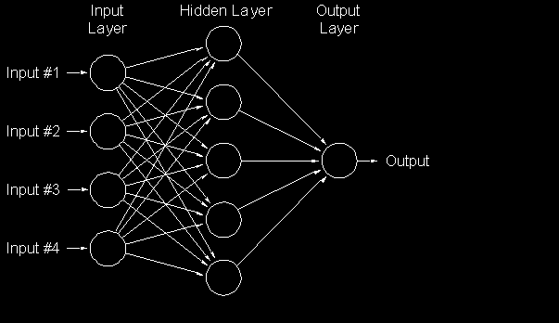
Method
Back-propagation multi-layer perceptron
Supervised learning

Slide 4
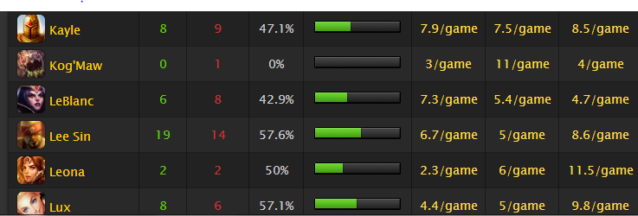
Statistics Used
Player Stats
Win/Loss
Win/Loss with this Champ
KDA
League Division
Champion Stats
Blue/Purple Side

Slide 5

Game Modes
If the neural net cannot quite capture the randomness of League games, this same technique will be applied to different game modes.

