Slide 1

Hunt n’ gather an eclectic online store
ADVANCED CUSTOMER SEGMENTATION
K-MEANS ALGORITHM

Slide 2
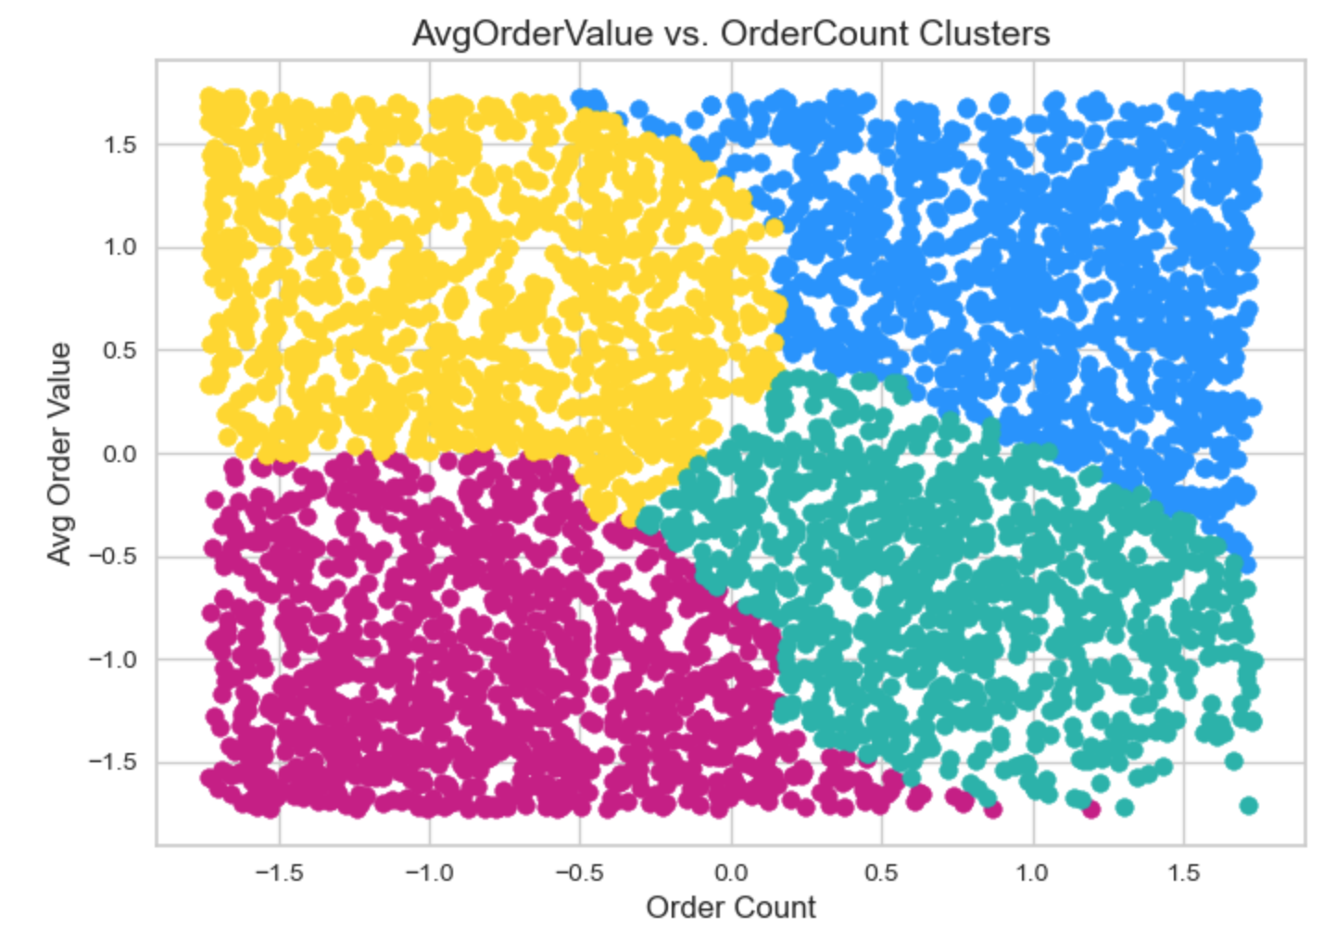
Business situation
The marketing department has established which customers fall into these classic marketing segments:
Highest Value Customer:
Highest Avg Order Value / Highest Order Count
High Value Customer:
High Avg Order Value / Lower Order Count
Lower Value Customer:
Lower Avg Order Value / Lower Order Count
Lowest Value Customer:
Lowest Avg Order / Lowest Order Count

Slide 3
What’s missing?
We always want to move customers to the magic quadrant.
What’s missing is identifying specific buying behaviors that can be incorporated into a clustering algorithm
This provides a more nuanced picture of the segmentation from which specific marketing interventions can be ideated
Notes:
these customers then must be labeled so the appropriate interventions are sent in accordance with identified behaviors.

Slide 4

objectives
Determine buying behaviors to be uncovered through exploratory data analysis
AND
Determine what new segments emerge via k-Means clustering?

Slide 5
Process
EDA
CLUSTERING
Notes:
Determine viability of features via EDA
What traits could be shared between clusters?
Could attributes be exclusive to some clusters?
How does this help us?
What happens in higher dimensions?

Slide 6
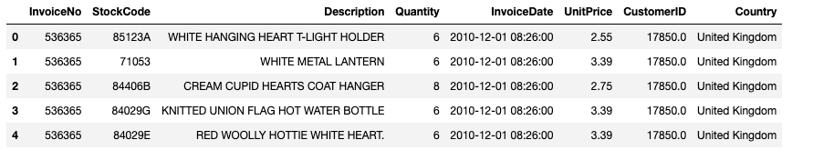
Available data
Raw Data
Rows
541,909 Invoice Line Items
8 Potential Features:
Invoice No
Stock Code
Product Description
Customer ID
Country
Quantity Ordered
Invoice Date / Time
Unit Price
Unique Values
25,900
4,070
4,223
4,372
38 Countries / 91% transactions come from UK
Range: 1 – 80,995
2010 & 2011, Months 1-12
NA

Slide 7
Workflow to first focus on business buyer
Buying Behaviors to explore
 | Buying Behavior (2010 - 2011) | Feature(s) to Engineer
WHO Business vs Retail Customer | Business and Retail Buying Segments? Understand what these segments look like with emphasis on the business buying segment. Initial data indicated qty purchase range of a single item from 1 – 80,995 | Separate Business Buyers from Retail Shoppers - Business Buyers > x items per given stock code - Retail Shoppers < x items per given stock code
HOW MANY ITEMS Quantity by item / per invoice | Is there a low, mid, high quantity business buyers? Understanding how they cluster amongst other features can give us more understanding | Business Buyer Features based on Quantity They Order Look at distributions of order quantity to determine break points Low, Mid, High features
HOW MUCH Are they spending | What observations can be made about spend of the new segments? Which segments, and corresponding behaviors, need to most be moved? | Spend features based on Standard deviation criteria - remove outliers Total average spend not including outliers
WHAT ITEMS Type of Product Purchased | Do certain types of products tend to be bought within low, mid, high, quantity purchasers? If so, what can we hypothesize about these people and other items they may want? | How to do this - Use stock code to get to this - Use an NLP tactic to understand type of product.
WHEN Cadence of purchasing | Uncover purchase motivators based on when they buy What specific months do business customers tend to purchase? What specific months do retail customers tend to purchase? | Groupby business customer and month Groupby retail customer and month Get # of unique months
WHERE Country Purchased | How do UK customers behave and segment? Focus on understanding UK customers first, they make up 91% rows of data | [Country] == United Kingdom

Slide 8



Why use a clustering algorithm?
Leverage advanced math and computational power
Process more potential purchasing behaviors
Includes all customers, not just a small sample
Strategies are implemented on the exact customer
Utilize k-Means algorithm as starting point
Explore other algorithms (Hierarchal, etc) as next phase of work

