Slide 1
Employee Data Analysis using Excel
STUDENT NAME: S.Jennie
REGISTER NO:122204090/asunm1659122204090
DEPARTMENT:B.com (corporate secretaryship)
COLLEGE:Shri krishnaswamy College for women

Slide 2
PROJECT TITLE
Employee Gender Analysis using Excel

Slide 3


AGENDA
Problem Statement
Project Overview
End Users
Our Solution and Proposition
Dataset Description
Modelling Approach
Results and Discussion
Conclusion
3/21/2024 Annual Review

Slide 4

PROBLEM STATEMENT
The organization faces a potential imbalance in gender representation across various departments and levels, which could impact fairness in promotions, compensation, and overall workplace equity. The lack of detailed analysis on gender distribution and related disparities hinders our ability to address and rectify these issues. To ensure a fair and equitable work environment, it is crucial to analyze gender-related data comprehensively and identify any underlying patterns or discrepancies that need to be addressed

Slide 5

PROJECT OVERVIEW
An employee gender analysis project aims to assess the gender distribution within a company to identify disparities and trends. The key components include:
Objective: Evaluate gender representation across various departments and levels to understand diversity and inclusion.
Scope: Analyze current gender ratios, compare them against industry benchmarks, and examine pay equity and career progression.
Deliverables: Reports on gender distribution, pay gaps, and recommendations for improving gender equality.

Slide 6

WHO ARE THE END USERS?
The end users for employee gender analysis typically include:
Human Resources (HR) Departments: To inform recruitment, retention, and promotion strategies, ensuring gender diversity and equity.
Leadership and Executives: To make informed decisions about organizational policies and culture, and to set diversity goals.
Diversity and Inclusion (D&I) Teams: To track progress on diversity initiatives and implement strategies for improving gender balance.

Slide 7

OUR SOLUTION AND ITS VALUE PROPOSITION
Solution: Employee Gender Analysis Platform
Overview: An advanced analytics platform designed to provide comprehensive insights into gender diversity and equity within an organization. The platform collects, processes, and visualizes gender-related data to support decision-making and drive strategic initiatives.
Key Features:
Data Collection and Integration: Seamlessly integrates with existing HR systems to collect and consolidate employee demographic data.
Advanced Analytics: Utilizes statistical models and AI to analyze gender distribution, pay gaps, promotion rates, and retention trends.
Customizable Dashboards: Provides real-time visualizations and reports tailored to different user needs (HR, leadership, D&I teams).

Slide 8
Dataset Description
Gender
City
Sum of joining
Sum of age

Slide 9
THE “WOW IN OUR SOLUTION
•Performance=IFS(Z9>=7.°VERY LOW°.Z9>=4.°HIGH".Z9>4."MED". TRUE."HIGH°)

Slide 10
MODELLING
1. Data Collection
Employee Demographics: Gather data on the gender of all employees. Ensure that the data collection process is compliant with privacy laws and organizational policies.
2. Data Analysis
Descriptive Statistics: Calculate the percentage of each gender across the organization and within different departments, job roles, and levels.
Example:Total employees: 60% female, 40% male
In Management: 40% female, 60% male
3. Identifying Patterns and Trends
Representation: Identify areas with significant gender imbalance.
Progression: Analyze whether there is gender disparity in promotions or progression opportunities.
10

Slide 11
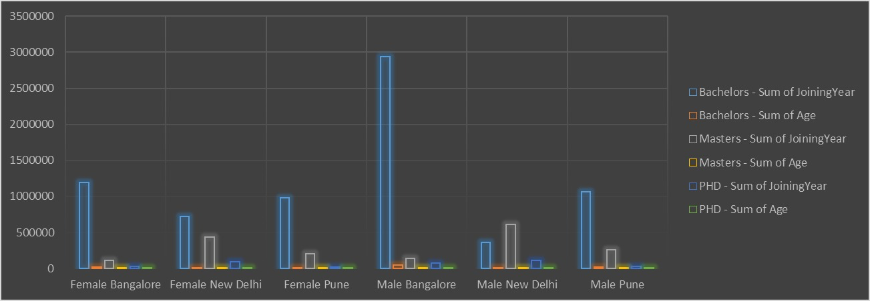
RESULTS
11

Slide 12
conclusion
The gender analysis of our workforce has provided valuable insights into the current state of gender diversity within our organization. The data reveals [insert key findings, such as the proportion of male to female employees, gender distribution across departments, or leadership roles].
Moving forward, it is essential to address these disparities by implementing targeted initiatives, such as [mention strategies, e.g., mentorship programs, inclusive hiring practices, or gender-sensitive workplace policies]. By fostering a more balanced and inclusive work environment, we can enhance employee satisfaction, drive innovation, and ensure that our organization reflects the diversity of the communities we serve.
With a committed approach, we can achieve a more equitable and productive workplace for all employees.

