Slide 1
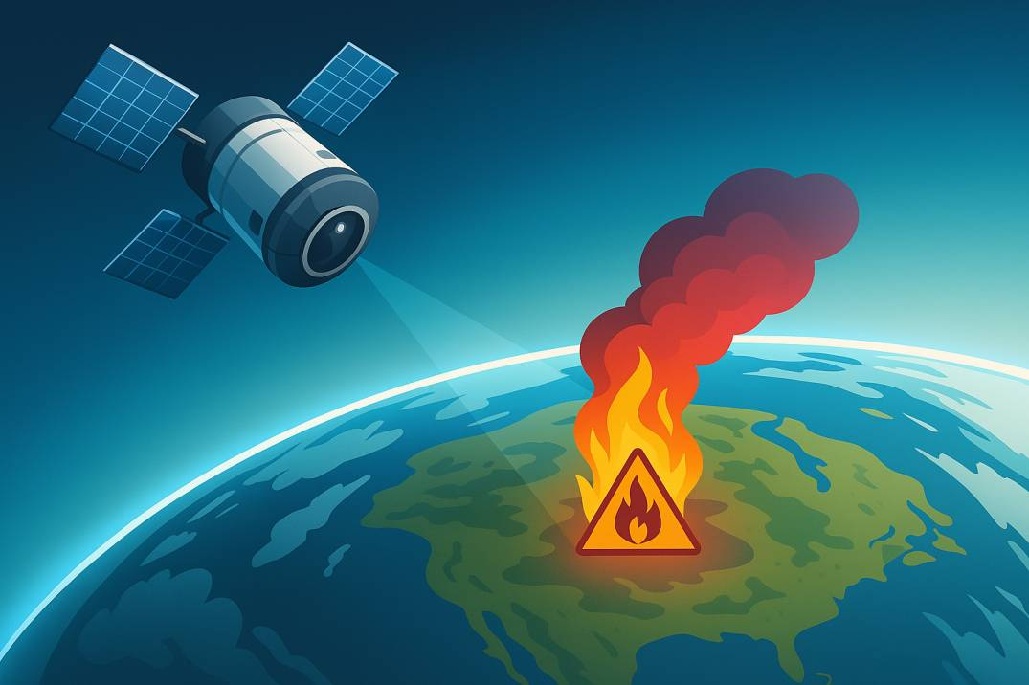
Landfills Fire & Air Quality Monitor
Team Orque
Jennifer Dybman & Sampieru Simeoni
Challenge: From Earth data to action — Cloud computing with EO Data for Predicting Cleaner, Safer Skies
Background image AI-generated

Slide 2
The Problem
Landfill fires degrade air quality and threaten communities
Fast and reliable situational awareness is needed so that actions can be taken in time

Slide 3
Our Solution
Detect fires (NASA FIRMS) near landfill coordinates
Trigger satellite (TEMPO) + ground (OpenAQ / PurpleAir) data ingestion
Compute a current “fused” AQI + forecast 72 hours
Alert notification to users
Keep words minimal • Emphasize flow • Show visuals next

Slide 4
Workflow Overview
Pipeline 1: FIRMS Fire Check
Pipeline 2: TEMPO (Harmony)
YES = TRIGGER →
Pipeline 3: OpenAQ / PurpleAir
Pipeline 4: AQI (Sat / Ground / Fused)
Pipelines 5–6: Meteo + 72h Forecast
Fire gate: Pipelines 2–6 run only when a fire is detected in P1

Slide 5
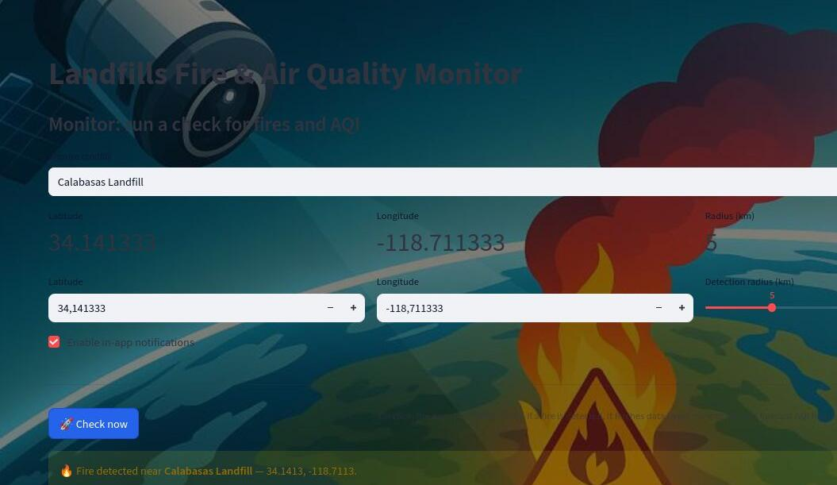
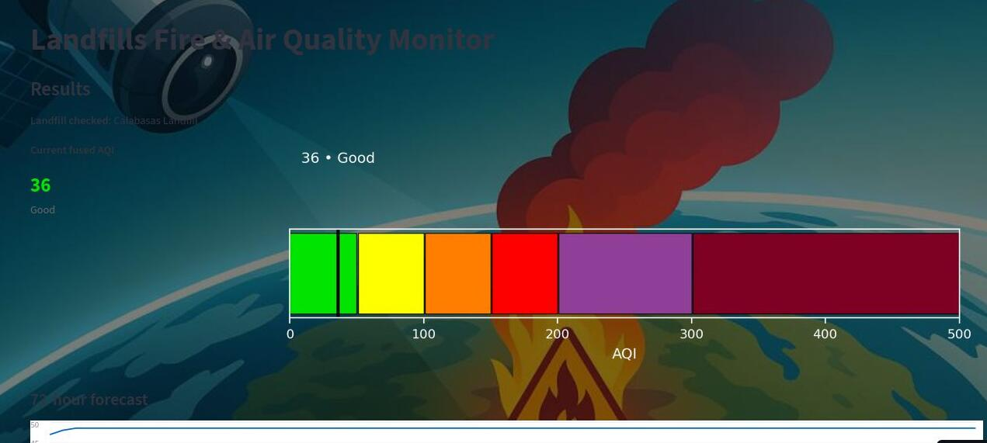
User Experience
HOME App name & purpose
MONITOR • Choose landfill or enter coords • FIRMS check
RESULTS • Fire? AQI now + 72h
+ alert • No fire? Clean message
Replace these with Streamlit screenshots later.

Slide 6
Open Data & Space Tech
NASA FIRMS — Active fire detections (open)
Cloud-Native Integration
• Harmony subsetting on-demand • REST APIs for ground & weather • Streamlit for rapid UI & sharing
NASA TEMPO via Harmony
OpenAQ v3 - (API)
Languages & Libraries
• Python (main language) • HarmonyPy (for satellite data) • LightGBM (forecasting model)
• requests, pandas, numpy, matplotlib etc.
PurpleAir — PM2.5 community sensors (API)
OpenWeatherMap — Current weather (API)
US EPA (AQI reference scale)

Slide 7
Impact & Next Steps
Impact
Timely alerts for sensitive sites (e.g., landfills) leading to increased population safety
Next
Increase the number of sites
Improve data pipelines
Robust notifications

