Slide 1
Disc Golf Pro Tour Player Ranking Classification
By: Jennifer Smiley

Slide 2
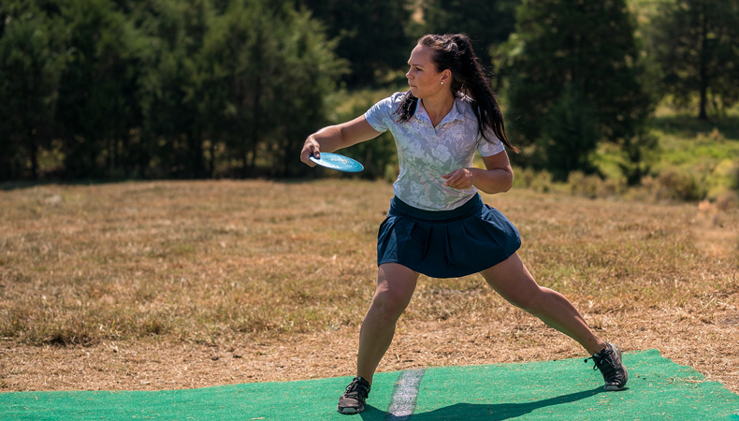
What is Disc Golf?
Throw discs or Frisbees down a fairway until you get within putting distance. Then one must throw a disc into the basket.
A players’ score for that hole is determined by how many throws it took for the disc to come to rest in the basket.
Most Holes are anywhere from 200 – 1000 feet with a par 3-5 being normal.
Determined by the number of throws it takes a 1000 rated player to get there and then two putts.

Slide 3
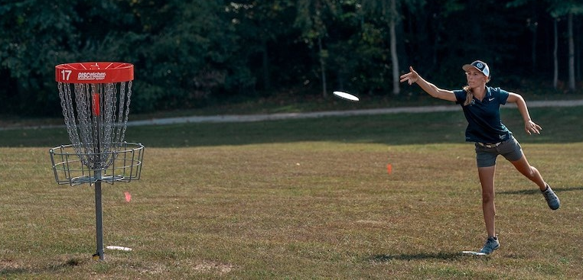

Slide 4
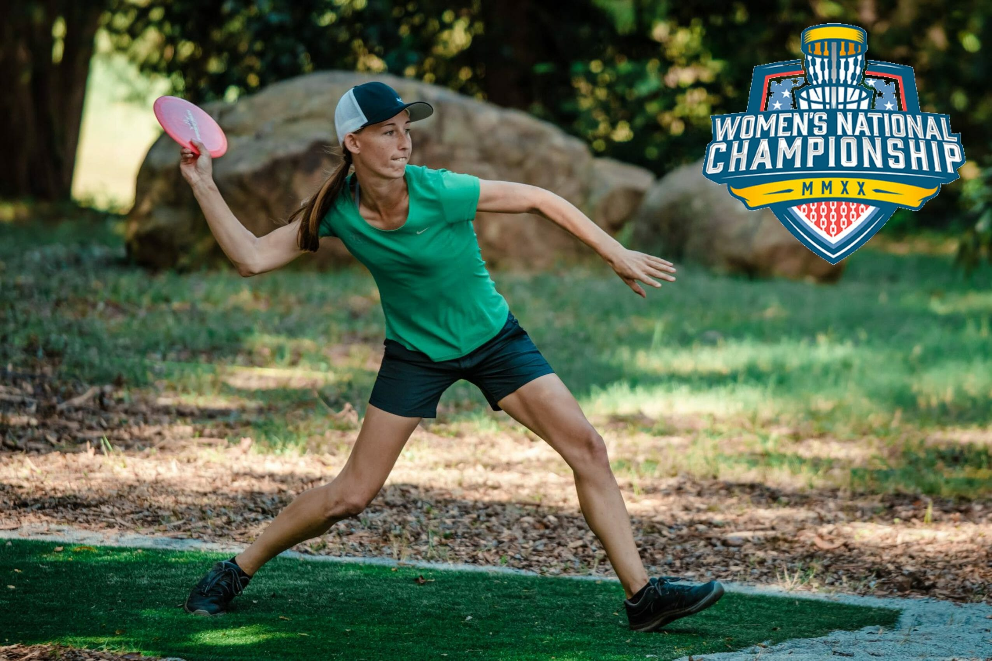

Slide 5
Goal
Scrape the data from Udisc.com
Find the most useful categories to use in the analysis
Create a k-nn classifier that finds the nearest point and classifies new data
New data points used from players who were unable to compete in the 2020 Pro Tour series due to COVID travel bans or other reasons using their 2021 stats
Kristin Tattar (Estonia), Ella Hansen (US), Maria Oliva (US), Juliana Korver (US), Raven Klein (US), Nicole Bradley (US), Renae Farr (US), Keiti Tätte (Estonia, did not play in US in 2021), Anniken Steen (Norway, Did not play in US in 2021)

Slide 6
Statistics Gathered:
Percentage of Aces
A ‘hole-in-one’. Throwing the disc into the basket from the tee box in one throw
Percentage of Eagles
When a player completes a hole two under par, when a par is above 3
% of Birdies
When a player completes a hole one under par.
% of Pars
The expected number of throws it will take to get in the basket from the tee pad. Usually, the number of throws to get down to the basket and then two putts.
% of Bogeys
When a player completes a hole one over par
Double Bogeys
When a player completes a hole two over par.
% 3+ Bogeys
When a player completes a hole 3 or more over par
Fairway Hits
When the drive lands on the fairway with a clear shot to the basket.

Slide 7
Statistics Gathered:
Parked
Landing with a tap in for birdie, within 11ft/3.3m of the basket. Also counts as hitting C1 & C2 in Regulation.
Circle 1 in Regulation
Reaching Circle 1 (33ft/10m) with two shots remaining for par (and a chance at birdie). Also counts as hitting C2 in Regulation.
Circle 2 in Regulation
Reaching Circle 2 with two shots remaining for par (and a chance at birdie).
Scramble
Throwing OB or off the fairway and still saving par or better.
C1 Putts
Percentage of putts made from inside the traditional 10m/33ft circle from the basket.
C2 Putts
Percentage of putts made from between 10-20m/33-66ft.
Number of Tournaments
The number of Pro Tour Tournaments the player competed in during the 2020 season.

Slide 8
Analysis to determine the statistics to be used
2 Methods:
Logistic Regression to determine feature importance
Not as good because the data is not categorical
Principal Component Analysis (PCA) Looking at the first PCA because it will explain over 60% of the variance in the data
Works better than Logistic Regression

Slide 9
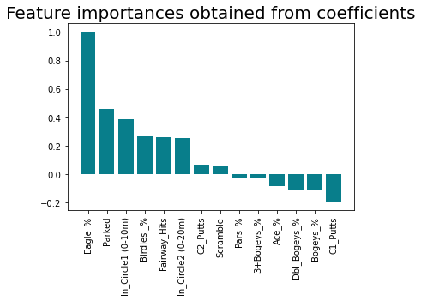
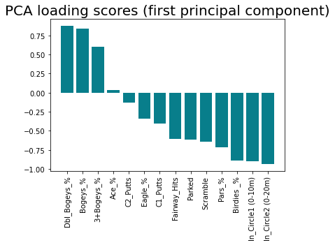
Logistic Regression VS. PCA

Slide 10
Variables
LR Variables
Eagles
Parked
In Circle 1
Birdies
Fairway Hits
In Circle 2
C2 Putts
Scramble
PCA Variables
Double Bogeys
Bogeys
Triple or more Bogeys
Ace
Variables Needed
Number of Tournaments

Slide 11
Data used to determine which variables to use in the algorithm
Paige Pierce,
Highest rated women in the world,
Best FPO US Player
PDGA Ranking of 1 based on the 2020 Pro Tour
Kristin Tattar
Estonian
Best European Player
Currently Ranked Number 1 in the world according to Udisc
Was not able to come to America in 2020 to participate
Using the scores she acquired in the 2021 Pro Tour

Slide 12
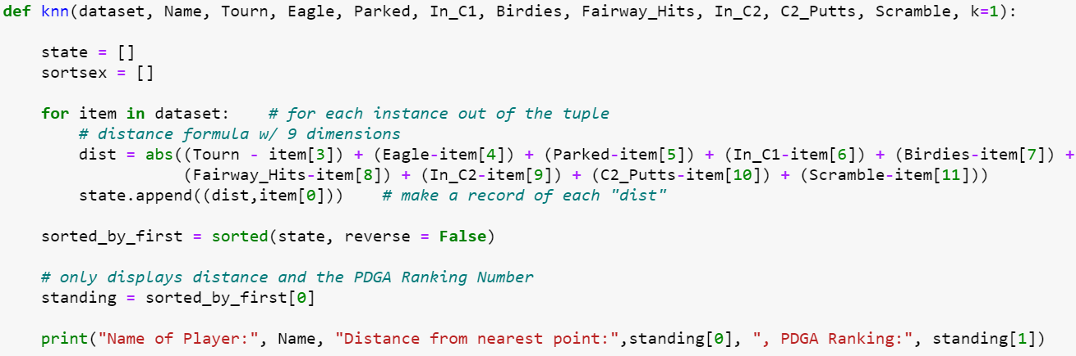
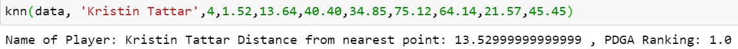
Logistic Regressions Important Coefficients

Slide 13
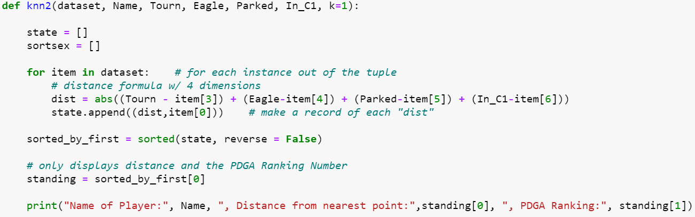
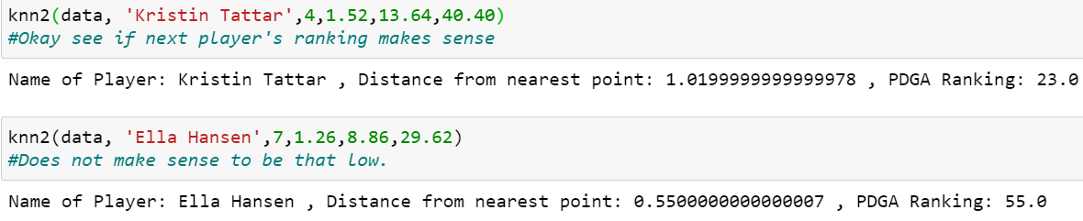
Top 3 Logistic Regression Coefficients

Slide 14
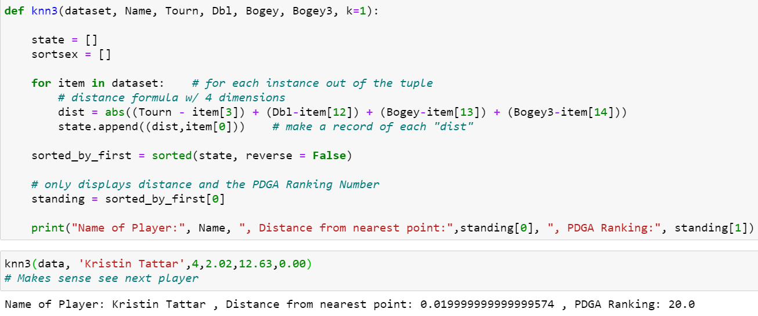
Top 3 PCA Coefficients
2021 Ranking: 21

Slide 15
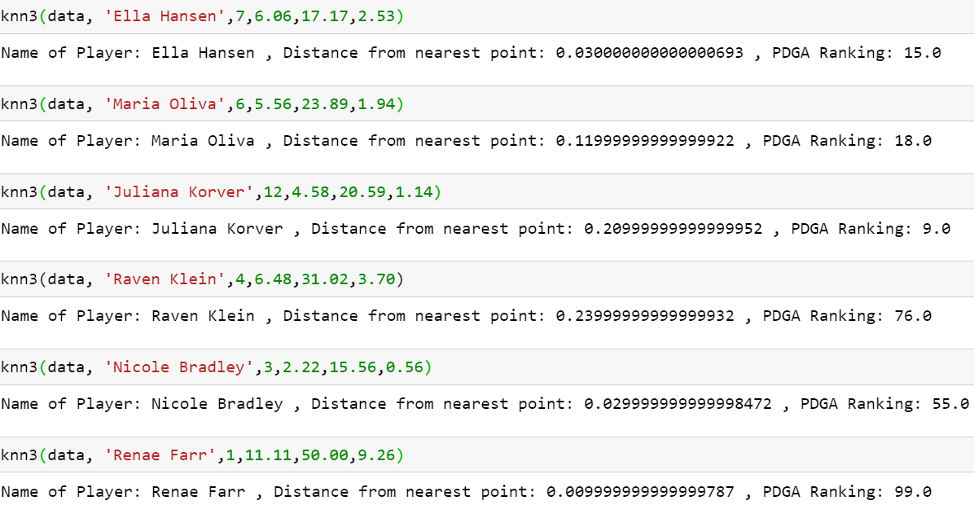
Other Test Players for PCA Coefficients

Slide 16
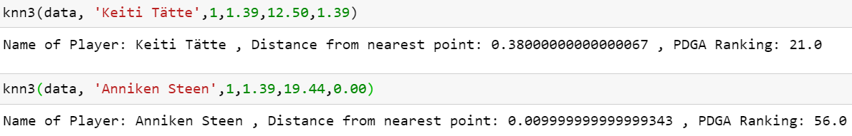
Other Test Players for PCA Coefficients

Slide 17
Conclusions and Next Steps
1st Principal Component from PCA gave the best results showing the likely ranking a player would have taken last year, had they been able to compete in the United States Pro Tour.
Difficult to decide on the variables due to over or under fitting
Possible other combinations could be made to make the model predict the rankings better
Could be used to show how they might do in the next year if they improve on one or two statistics

Slide 18
Citations
https://udisclive.com/standings?d=FPO&y=2020
https://udisclive.com/standings?d=FPO&y=2021
https://udisclive.com/about

