Slide 2
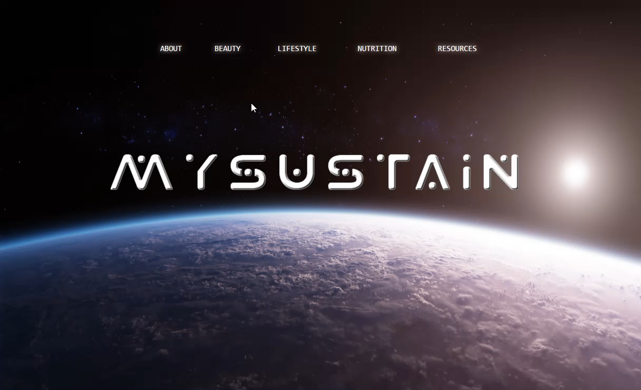
MySustain – Environmental Website
About – Principles
Beauty – Cosmetics, Hair, Skincare, Hygiene
Lifestyle – Energy, Waste, Clothing, Pollution
Nutrition – Vitamins, GMOs, Sustainability, Organic
Resources – Useful Links

Slide 3
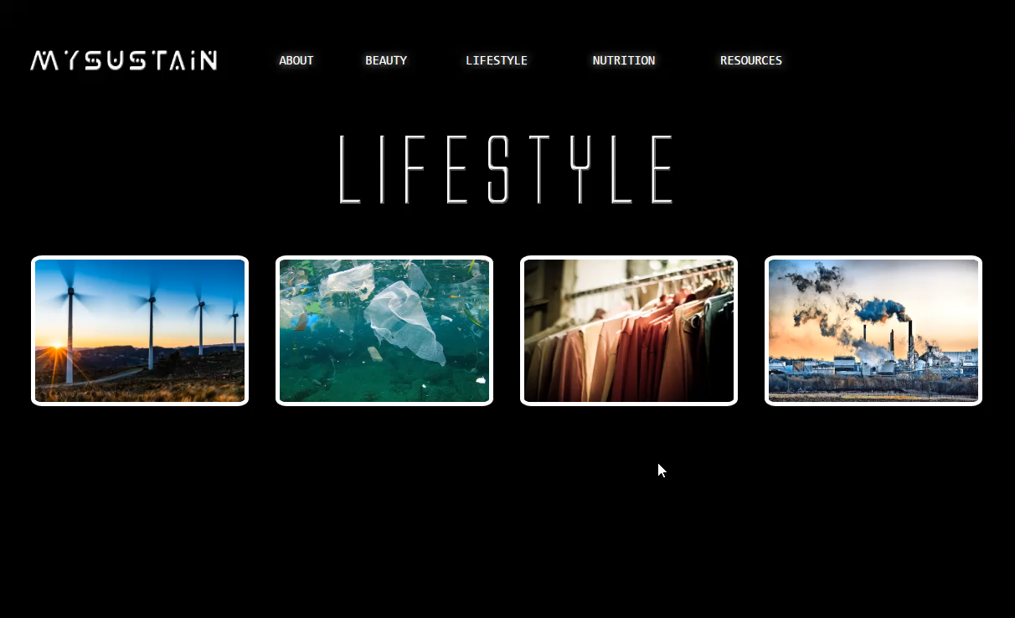
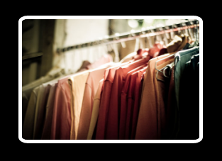
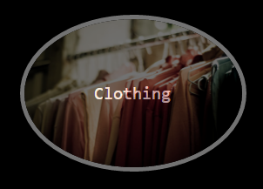

Slide 4
Goals for the Future
Posts
Transitions
Domain
JavaScript
Palm Oil
Animal Testing
Leather / Fur / Down
Sustainable vs. Commercial
Fragrance
Silicones / Sulfates
Fluoride
Nitrates / Phosphates
Formaldehyde / EDTA / Glycol
BPA
Fracking
Renewable Energy
Hybrid / Electric
"Biodegradability"
Recycling
Water and Energy Usage
Plastics and Styrofoam
Disposable vs. Reusable
Overfishing and Bycatch

