Slide 1
Social media and it’s affect on our privacy on the web and our productivity
Jennifer HAnn

Slide 2
Introduction
What is social media?
Platform where a person can interact with other members who are using the same platform
What can you use social media for?
Communicate
Idea sharing
Opinion sharing
Information sharing

Slide 3

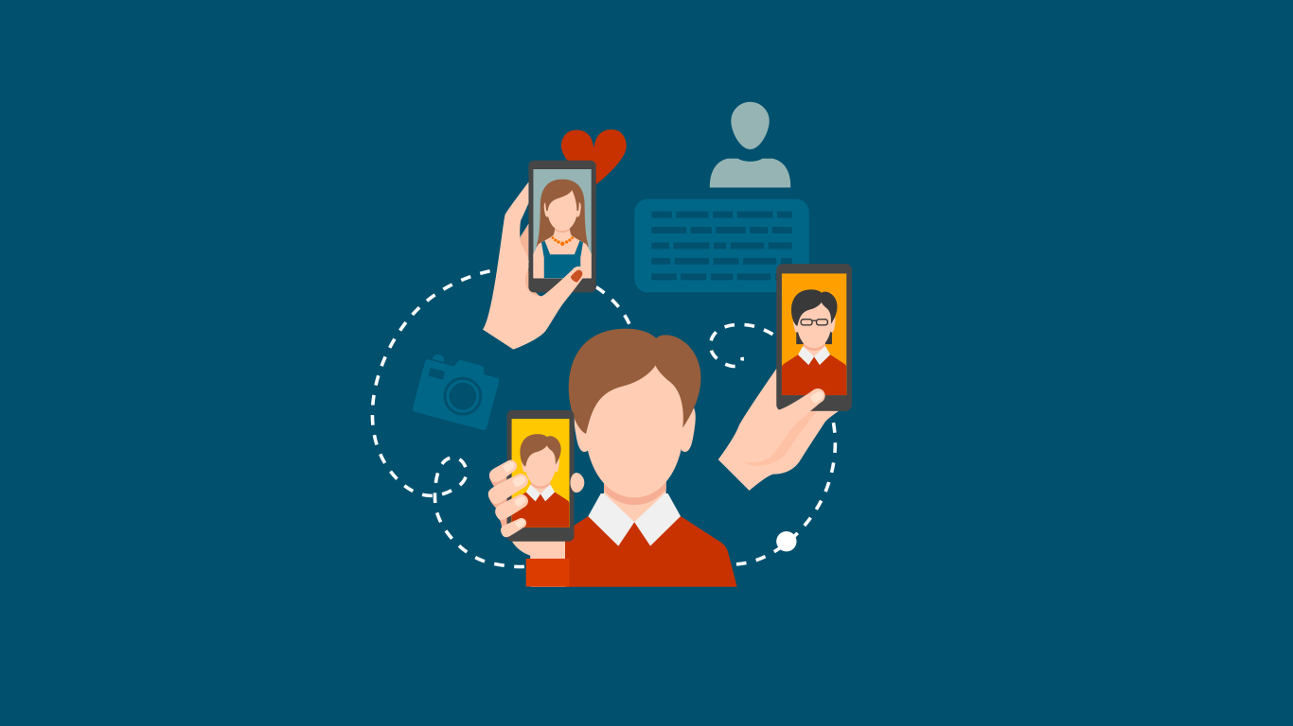
Privacy
Simply not uploading a picture or an information is not enough to hide an event
Having friends who are active on social media can be risky to our privacy
It is easy to save and send information on the web
The consequence of our privacy being expose cannot be reverted

Slide 4
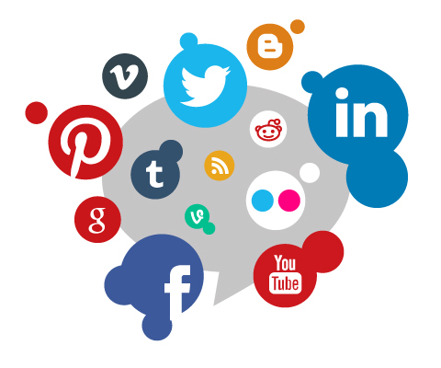
productivity
Helps with teamwork
Sharing ideas
Collaborate
Problem solving
A platform for learning
Improving the employees skills

Slide 5
Summery
Privacy on social media is no longer safe because once it’s on the web, the person can’t do anything about it
Social media can improve the productivity of a work place if use properly

Slide 6
Thank you for your attention

