Slide 1
Experiment

Slide 2
Experiment – Network architecture
GeoNet
Rigid
DepthNet (pixel level)
PoseNet
Non-rigid
ResFlowNet (pixel level)

Slide 3
Experiment – Network architecture
GeoNet
Rigid
DepthNet (pixel level)
PoseNet
Non-rigid
ResFlowNet (pixel level)
Notes:
The input to ResFlowNet consists of batches of tensors concated
in channel dimension, including the image pair Is and It,
the rigid flow f
rig
t→s , the synthesized view
̃
I
rig
s
and its er-
ror map compared with original frame It

Slide 4
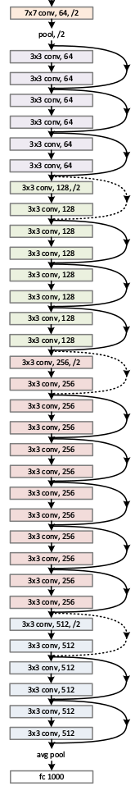
Experiment – Network architecture
Backbone: Unsupervised monocular depth estimation with left-right consistency(CVPR 2017)
Encoder
ResNet50
Decoder
deconvolution layers
enlarge spatial feature to full scale as input
Skip connection (residual block) between encoder and decoder part

Slide 5
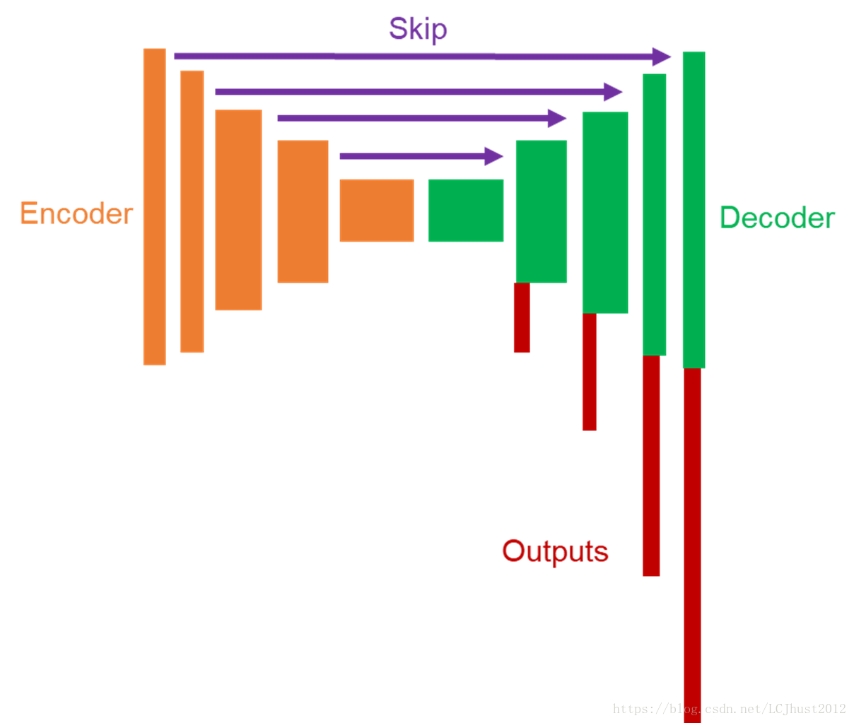
Experiment – Network architecture
Backbone: Unsupervised monocular depth estimation with left-right consistency(CVPR 2017)
Encoder
ResNet50
Decoder
deconvolution layers
enlarge spatial feature to full scale as input
Skip connection (residual block) between encoder and decoder part
Notes:
To preserve both global high-level and local detailed information, we
use skip connections between encoder and decoder parts
at different corresponding resolutions.

Slide 6
Experiment – Network architecture
GeoNet
Rigid
DepthNet (pixel level)
PoseNet
6DoF camera poses
Euler angles and translational vectors
Non-rigid
ResFlowNet (pixel level)

Slide 7
Experiment – Network architecture
Backbone: Unsupervised learning of depth and ego-motion from video (CVPR 2017)
8 Convolution layers
Global average pooling layer
Batch normalization and ReLus between all convolution layers (except prediction layers)

Slide 8
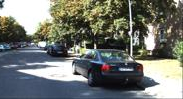
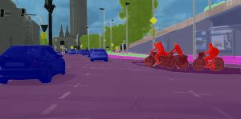
Experiment - Training Details
Training/test on KITTI
TensorFlow
TitanXP GPU
First train DepthNet and PoseNet, then fixing their weights, train ResFlowNet thereafter
Resize image resolution to 128 x 416
Perform random resizing, cropping, color augmentation to prevent overfitting
Adam optimizer
Learning rate: 0.0002, Mini batch size: 4
Converge for first stage: 30epochs, second stage: 200 epochs

Slide 9
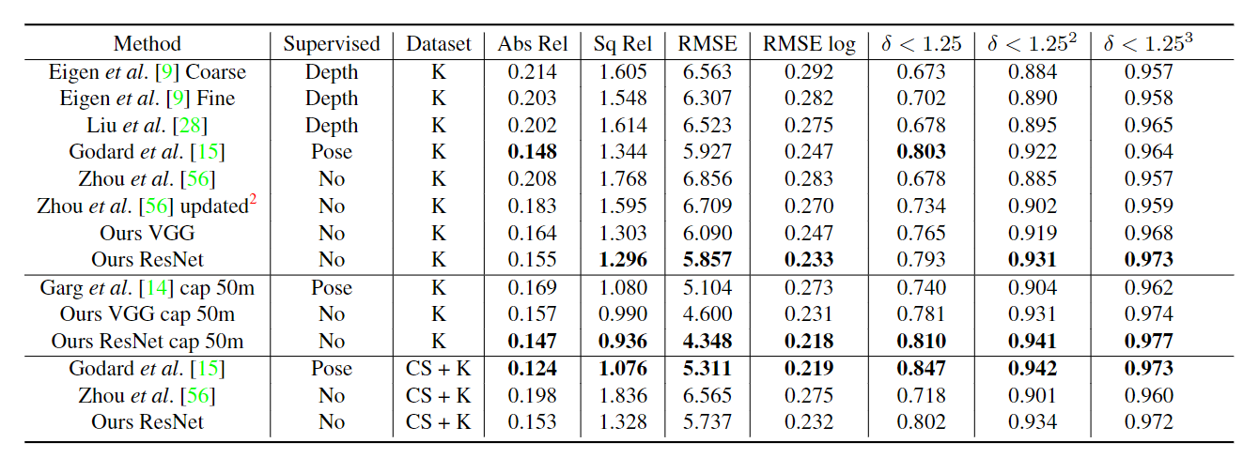
Experiment – Monocular Depth Estimation
K: KITTI dataset, CS: Cityscapes dataset
Notes:
Ours VGG” trained only on KITTI shares the same network architecture with “Zhou et al. [56]
without BN”, which reveals the effectiveness of our loss
functions.
While the difference between “Ours VGG” and
“Ours ResNet” validates the gains achieved by different net-
work architectures.
Our method significantly outperforms
both supervised methods [9, 28] and previously unsuper-
vised work [14, 56].

Slide 10
Experiment – Monocular Depth Estimation
K: KITTI dataset, CS: Cityscapes dataset
Notes:
Ours VGG” trained only on KITTI shares the same network architecture with “Zhou et al. [56]
without BN”, which reveals the effectiveness of our loss
functions.
While the difference between “Ours VGG” and
“Ours ResNet” validates the gains achieved by different net-
work architectures.
Our method significantly outperforms
both supervised methods [9, 28] and previously unsuper-
vised work [14, 56].
在同時train在K跟CS的時候表現較不好
We believe this is due to the profound distinctions between training data characteristics,i.e. rectified
stereo image pairs and monocular video sequences.

Slide 11
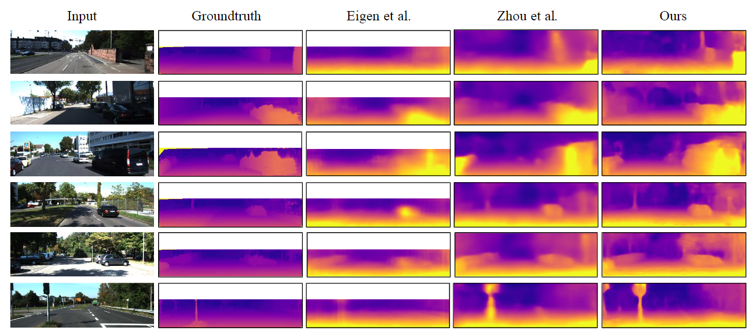
Experiment – Monocular Depth Estimation
KITTI

Slide 12
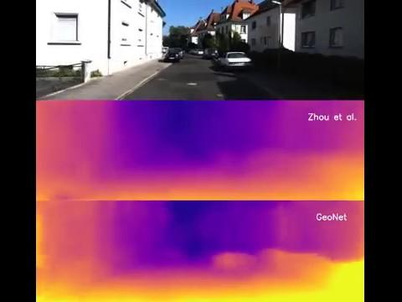
Depth on KITTI

Slide 13

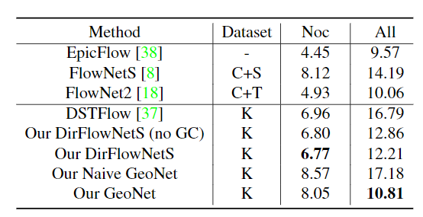


Experiment - Optical Flow Estimation
KITTI stereo/flow split
Testing: 200 images from official training data
Compare our Residual Flow Learning with Direct Flow Learning
FlowNetS $→$ Our DirFlowNetS(No GC)
GC = with Geometric Consistency
Noc = Non-occluded regions
Notes:
however, the direct unsupervised flow network DirFlowNetS performs better in
non-occluded regions than GeoNet, which seems unreason-
able.

Slide 14
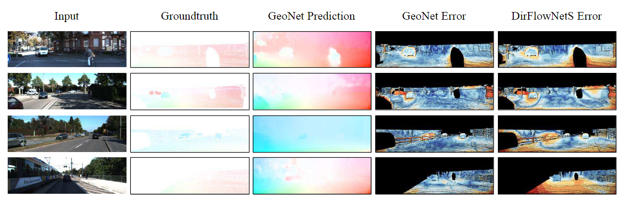
Experiment - Optical Flow Estimation

Slide 15
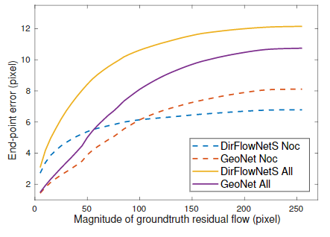
Experiment - Optical Flow Estimation
In total regions (All), GeoNet consistently outperforms direct flow regression;
But in non-occluded regions (Noc), the advantage of GeoNet is restricted to the neighborhood of rigid flow.
Replacing the Warping Loss with supervised one (DirFlowNetS) in GeoNet solved this problem.
Future work: avoid the gradient locality of warping loss
Use unsupervised method DirFlowNetS as groundtruth to modify predict of Geonet.
EPE(Endopoint error)
Notes:
wever, the direct unsupervised flow network DirFlowNetS performs better in
non-occluded regions than GeoNet, which seems unreason-
able.
. Experimentally, we
find that GeoNet is extremely good at rectifying small er-
rors from rigid flow.
, the predicted residual flow
tends to prematurely converge to a certain range, which is in
consistency with the observations of [15]. It is because the
gradients of warping based loss are derived by local pixel
intensity differences, which would be amplified in a more
complicated cascaded architecture,i.e. the GeoNet.

Slide 16
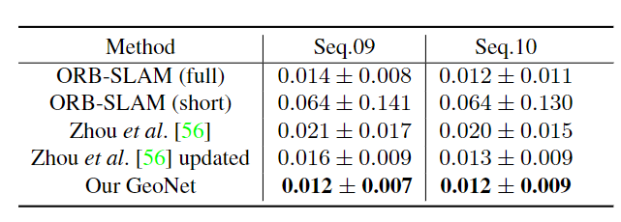
Experiment - Camera Pose Estimation
KITTI visual odometry split
Input length of sequence: 5 frames
ORB-SLAM(short): 5 frames as input, ORB-SLAM(full): entire sequence as input
Absolute trajectory error (ATE):the ATE first aligns the two trajectories and then evaluates directly the absolute pose differences.
Notes:
Note
that even though our GeoNet only utlizes limited informa-
tion within a rather short sequence, it still achieves better
result than “ORB-SLAM(full)
Fi-
nally, we analyse the failure cases and find the network
sometimes gets confused about the reference system when
large dynamic objects appear nearby in front of the camera,
which commonly exist in direct visual SLAM [10].

Slide 17
Conclusion
1.Handle non-rigid cases.
2.An Unsupervised method achieved SOTA.
3.However, non-occluded regions problem should find a practical solution.

