Slide 1
Benchmarking machine learning performances with compositional data
Project Structure and Notes
Jennifer Neumaier

Slide 2
Goals
Data-driven
Good interpretability
Performance Machine Learning models
Guideline

Slide 3


Projektstrukturplan I
*Good pipeling exists with mikropml
Stand: 31.03.22
Benchmarking
Project management
Literature Review
Work Block 2
Work Block 3
Collect Sources/Literature
Establish Pipeline
*
Writing Master Thesis
Goals
Strategy
Define Dataset
Data Transformation
Presentation/ Defense
Requirements
Write Review
Comparison ML models
Paper
Quality Management
Presentation
GitHub

Slide 4
Projektstrukturplan II
Stand: 31.03.22

Slide 5
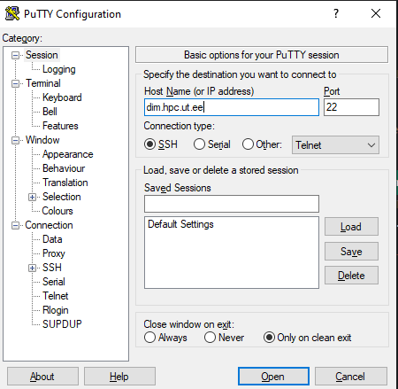
HPC
https://linuxize.com/post/how-to-use-linux-screen/
VPN:
https://wiki.ut.ee/pages/viewpage.action?pageId=17105590
MAin command for running codes in server: R --slave --vanilla --args arg1 arg2 < script_name.R &
"top" - to look at the server load "q" to exit
14:00 Uhr
Use "logout" to exit the session

Slide 6
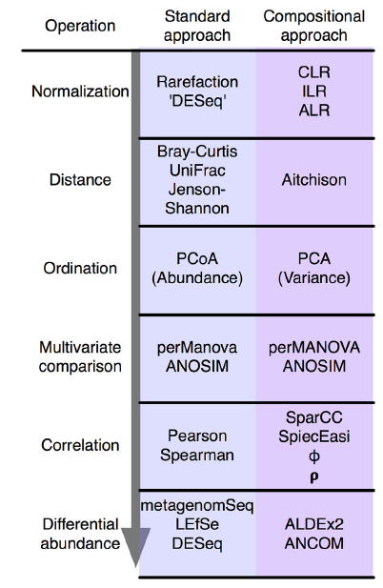
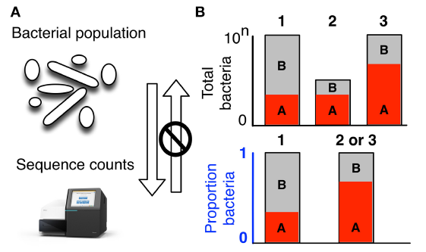
Compositional Data
What is it/consequences/current solutions

Slide 7
Log-Ratio Transformations
Stand: 22.01.22
Which ones exist
Characteristics
What are they doing?
Q: do they improve machine learning performances?

Slide 8
Machine Learning Approaches
Which ones do we use
How do they work?

Slide 9
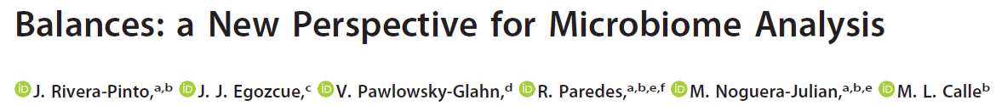
selbal
Stand: 22.01.22
First thoughts:
Imputes itself -> no control over it
Cannot handle negative values -> cannot feed it transformed values (or not without adding an extra scaling step)
Classes need to be converted to binary
Takes a long time to process -> a lot longer than glmnet (exact time measurement?)

Slide 10
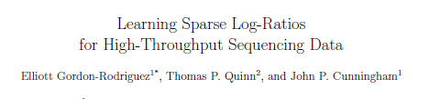
CoDaCoRe
Stand: 22.01.22
First thoughts:
Example showed imputation by +1
Logratio type is ILR or SLR (balances or amalgamation) -> comparison questionable?

Slide 11
Pipeline
Data sets
Large/small
High/low corr.
Continuous/discrete
Pre-Processing
Zero-Imputation (pseudocount/mbImpute)
Filtering (10%/50%)
Microbiome-native methods
Log-Ratio Transformations
Use of mikropml advantageous -> uses repeated CV
Performance
selbal
CoDaCoRe
TSS
CLR
ALR (random), ALR (optimal), ALR (top 10)
10-fold stratified nested cross-validation
Machine Learning models
ElasticNet (ENET
XGBoost (XGB)
Linear Discriminant Analysis (LDA)
Use of mikropml advantageous -> only has glmnet and xgboost -> for now sticking to those

Slide 12
Pipeline
Transformation
TSS(), ALR_optimal(), ALR_worst(), ALR_random(), CLR()
Data split
Test set
Initial data split for consistency in all models
Dataset
CV + models
K-folds = 5, CV = 10
(selbal)
codacore
glmnet
xgboost
Model accuracy
Repeat 10x to observe statistical fluctuations

Slide 13
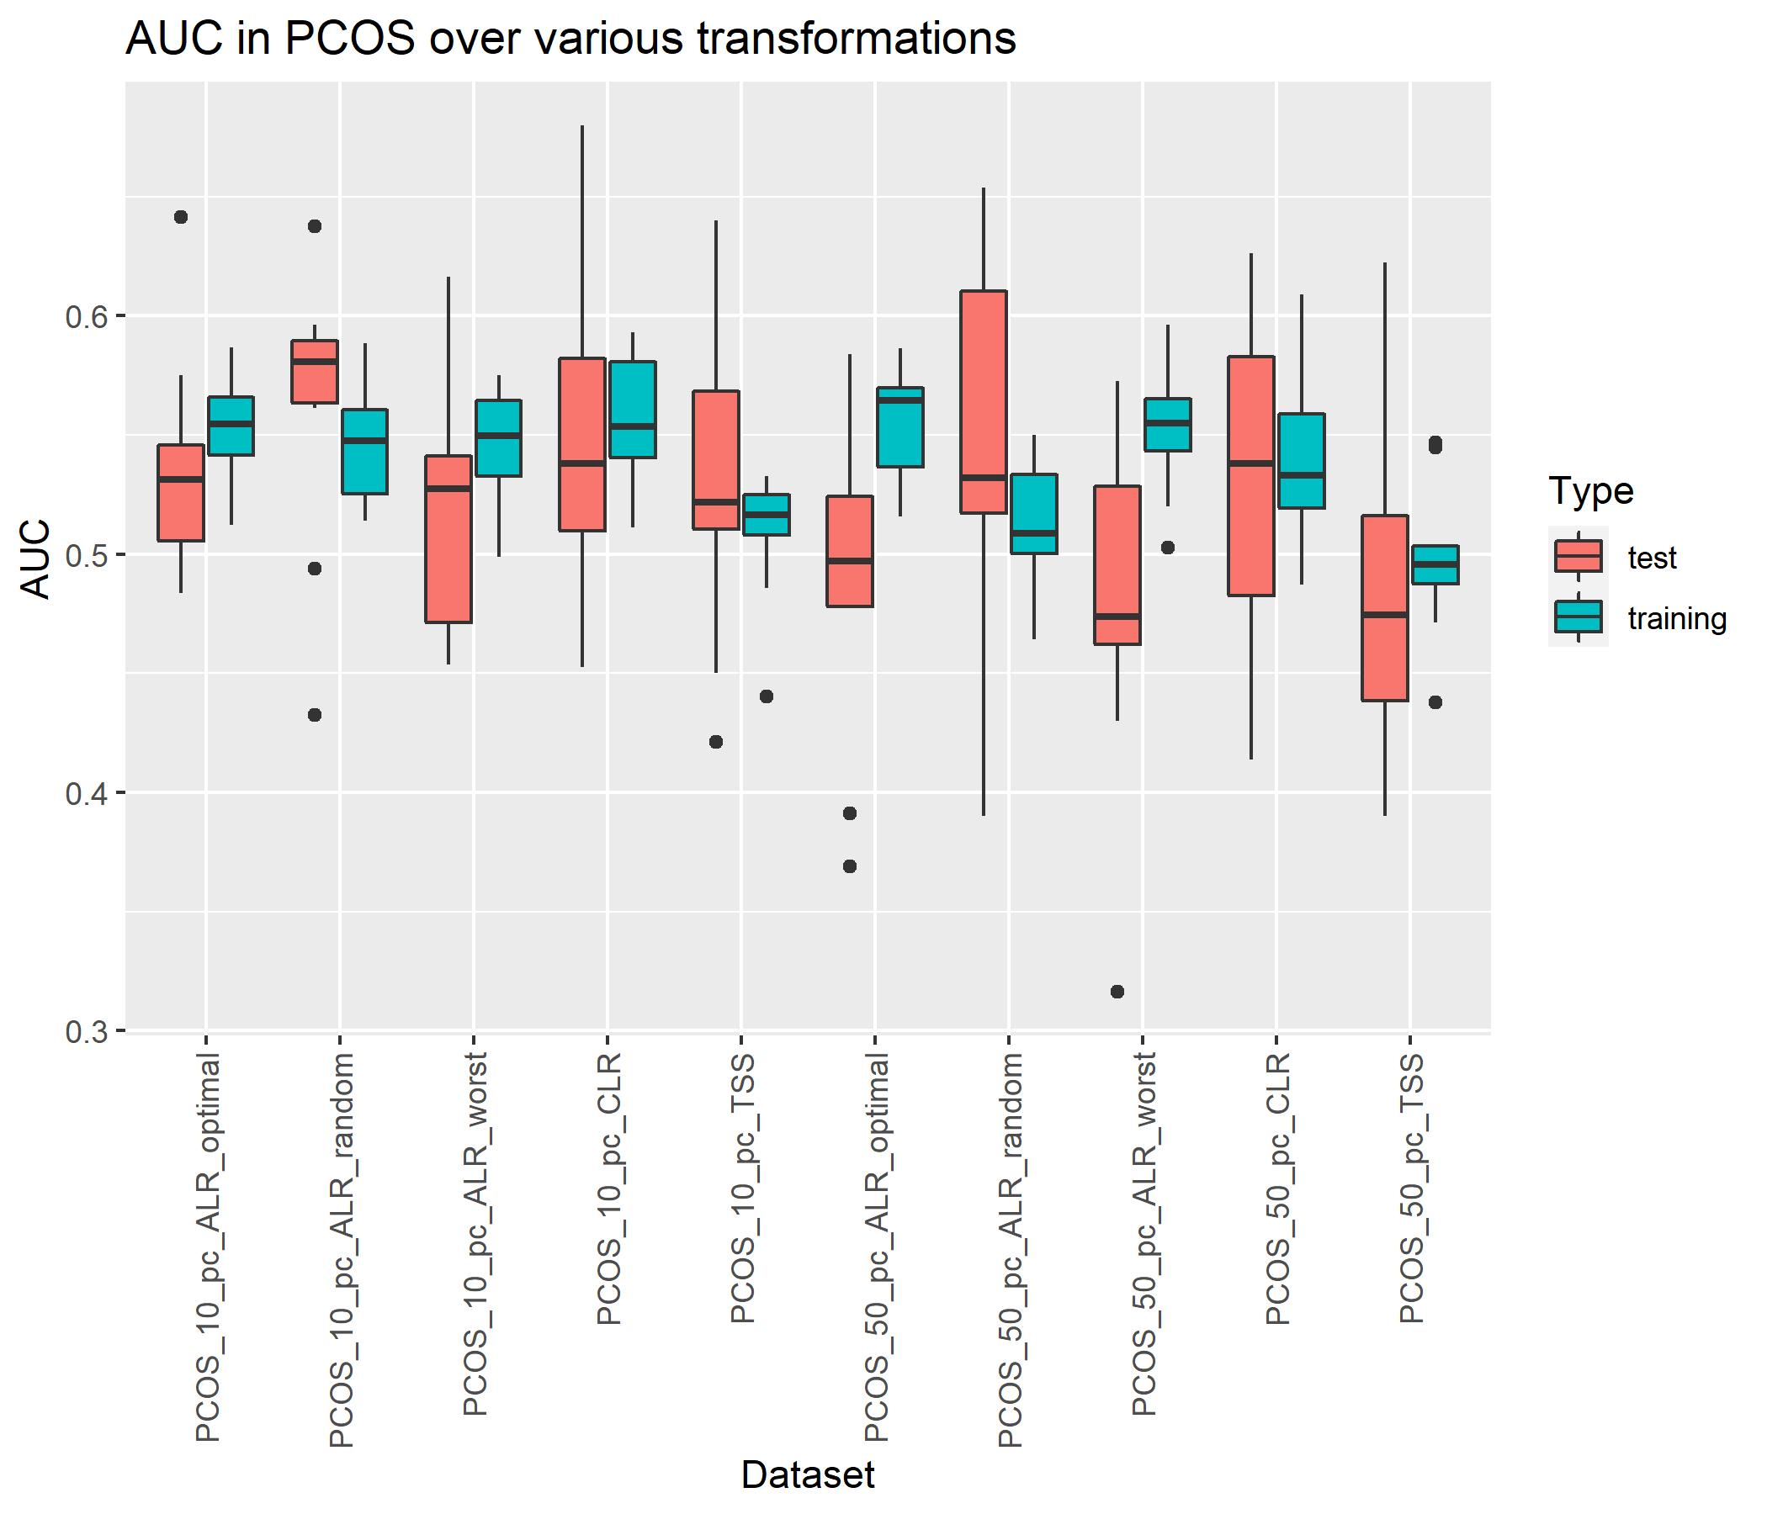
PCOS
K-folds: 5
CV_times: 10
Different training/test set every iteration

Slide 14
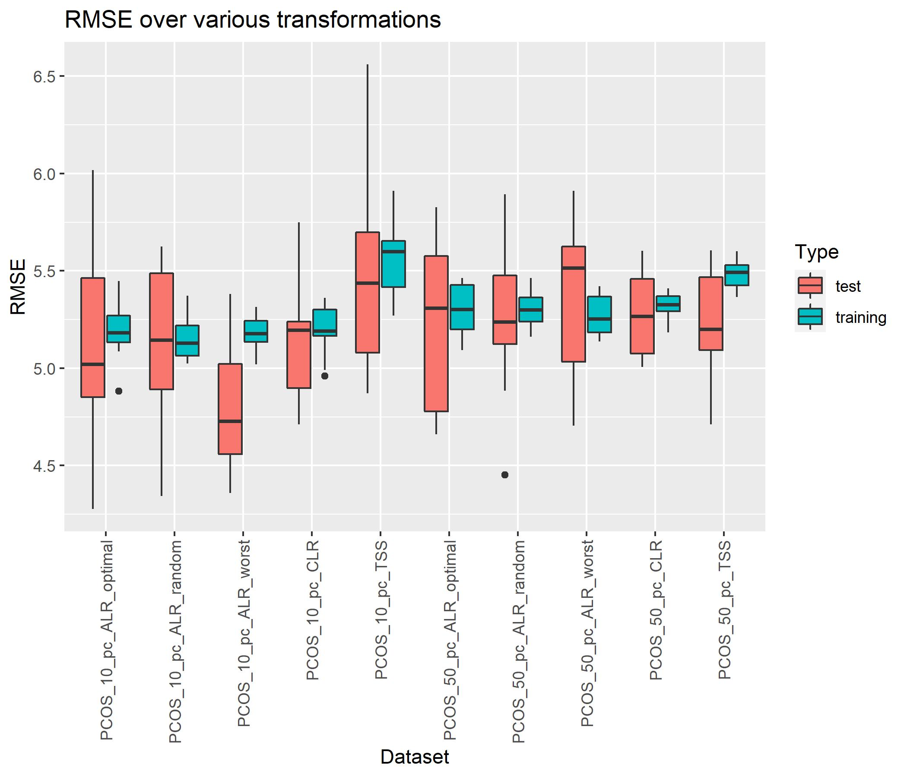
PCOS
K-folds: 5
CV_times: 10
Different training/test set every iteration

Slide 15
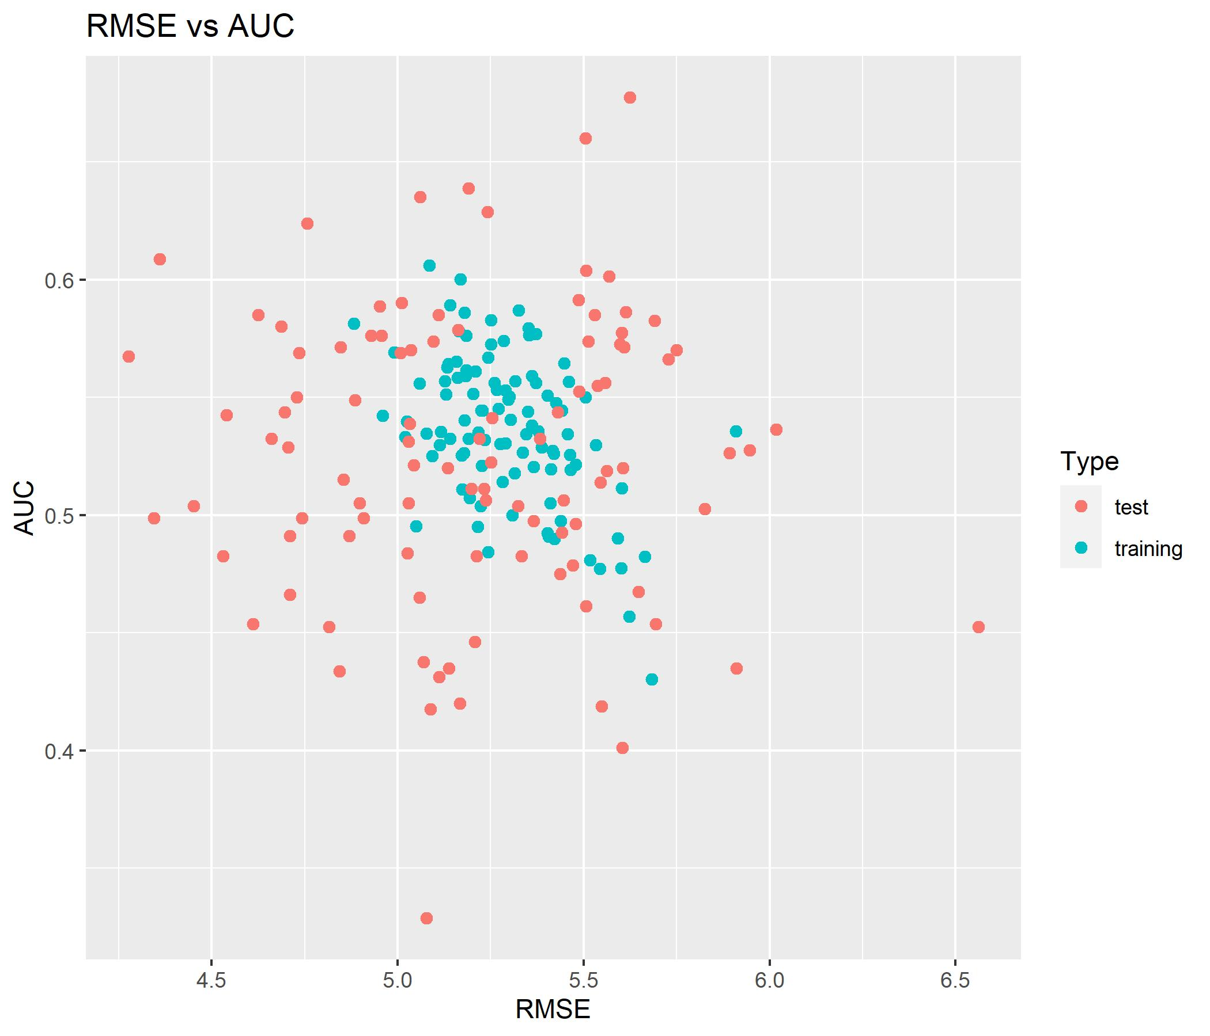
PCOS

Slide 16
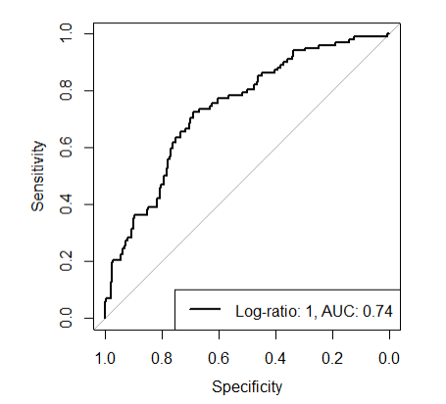
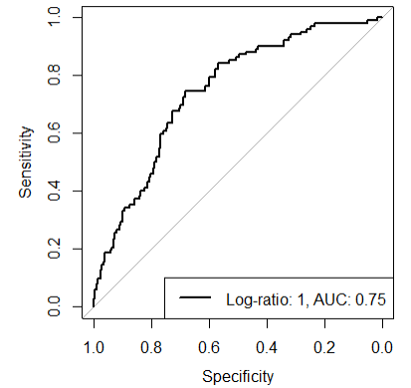
PCOS
Different training/test set every iteration
10% abundance filter
50% abundance filter
Codacore: 393 524 555 580 643 683 773
Codacore: 10 50 57 89 112
FINDALR: 10 14 52 64 509
FINDALR: 10 14 16 40 44

Slide 17
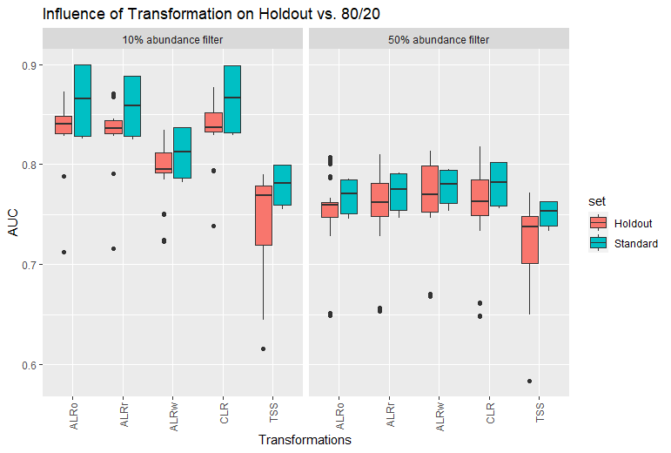
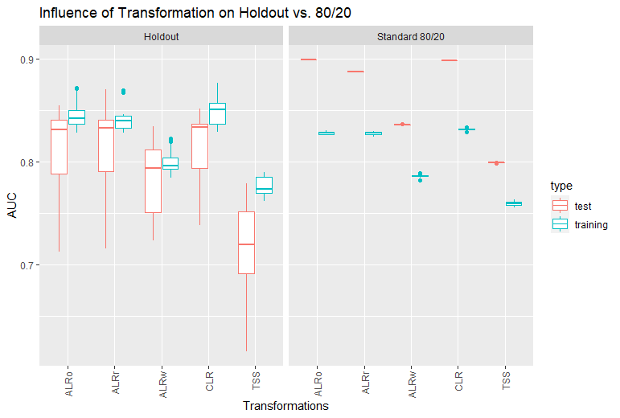
Holdout vs 80/20
Data: D:\Master\Master Biologie\Sommersemester 2022\Master thesis\Github\out\CRC_holdout
My evidence to use standard 80/20 for all further models
A
B
Notes:
A: all countries were holdout set once and for this graph all performances were taken together under „holdout“ and separates into abundance filters
B: since 10% abundance filters clearly shows better performances, only this data was taken and the performances per transformation separated into test and training performances.

Slide 18
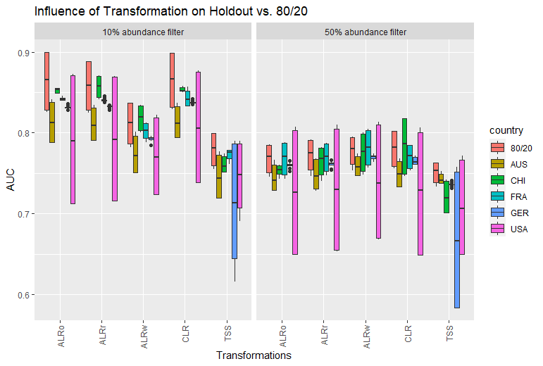
Holdout vs 80/20
Data: D:\Master\Master Biologie\Sommersemester 2022\Master thesis\Github\out\CRC_holdout
My evidence to use standard 80/20 for all further models
Take only 10% and split into train and test set!
Notes:
Here, again the split between 10% abundance and 50% abundance but all holdout performances plus standard 80/20 viewed directly. NB! Test and training performances are plotted together again -> distance of boxplots gives hint about the discrepancy between test and training performances per holdout set vs 80/20.

Slide 19
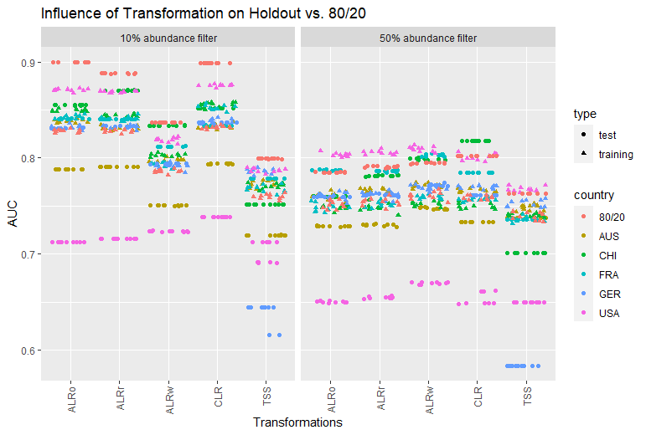
Holdout vs 80/20
Overloaded version
(in supplementary?)
Data: D:\Master\Master Biologie\Sommersemester 2022\Master thesis\Github\out\CRC_holdout
Notes:
That’s the same graph as on slide 18, but the boxplots removed so one is able to differentiate between test and training set per transformation.

Slide 20
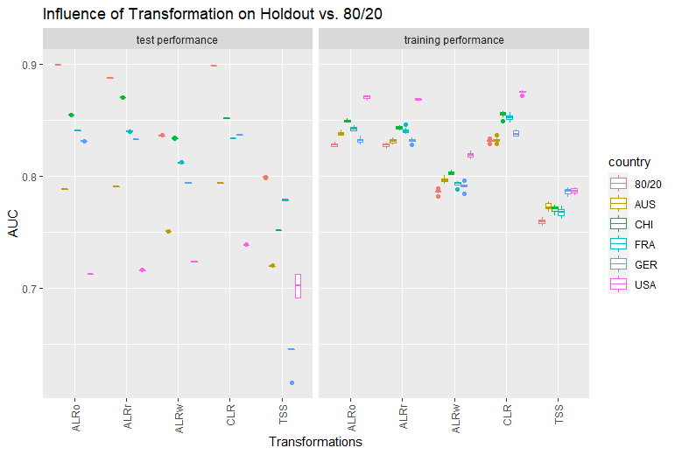
Holdout vs 80/20
Data: D:\Master\Master Biologie\Sommersemester 2022\Master thesis\Github\out\CRC_holdout
10% abundance

Slide 21
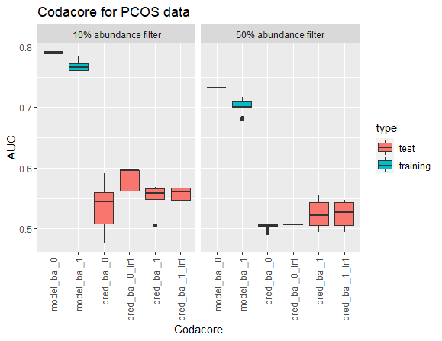
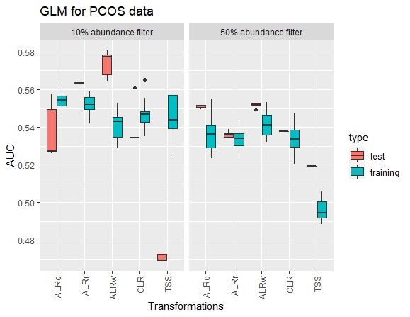
PCOS classification
Data: D:\Master\Master Biologie\Sommersemester 2022\Master thesis\Github\out\PCOS
A
B

Slide 22
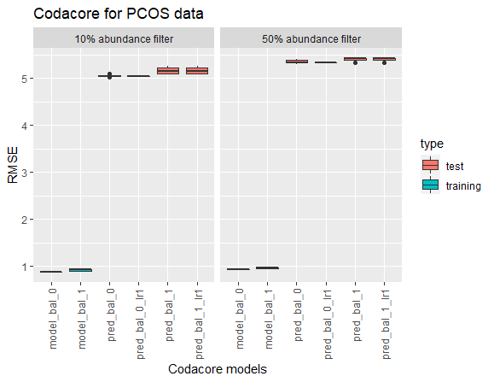
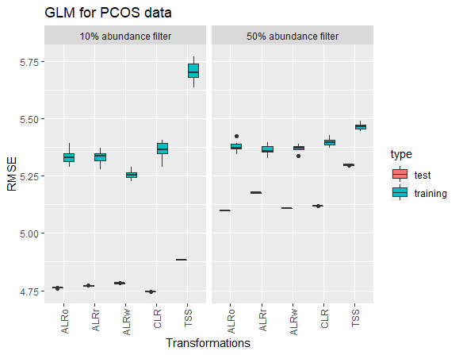
PCOS regression
Data: D:\Master\Master Biologie\Sommersemester 2022\Master thesis\Github\out\PCOS
A
B

Slide 23
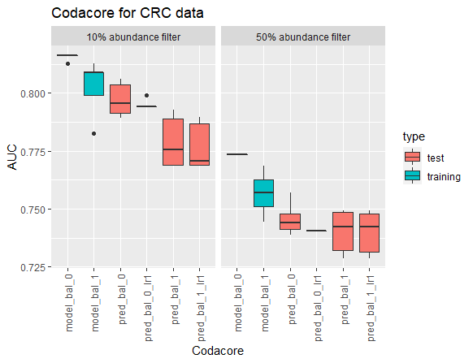
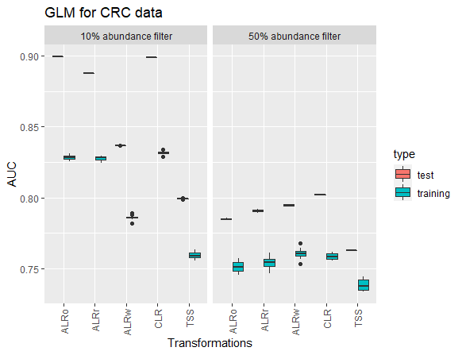
CRC classification
Data: D:\Master\Master Biologie\Sommersemester 2022\Master thesis\Github\out\CRC
A
B

Slide 24
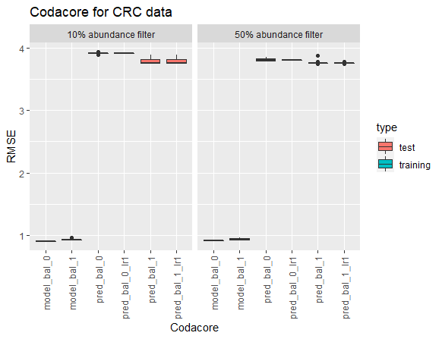
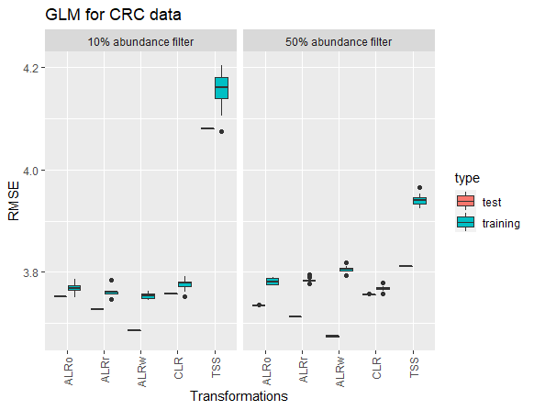
CRC regression
Data: D:\Master\Master Biologie\Sommersemester 2022\Master thesis\Github\out\CRC
A
B

Slide 25
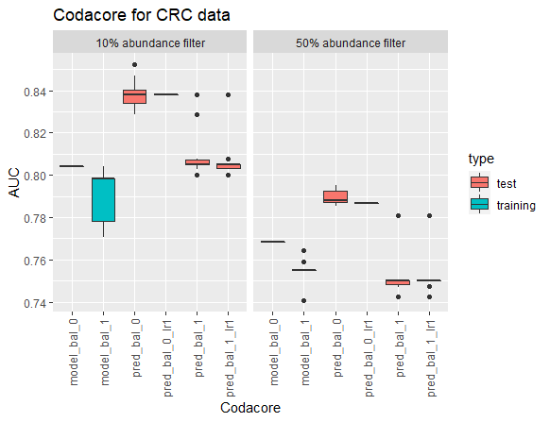
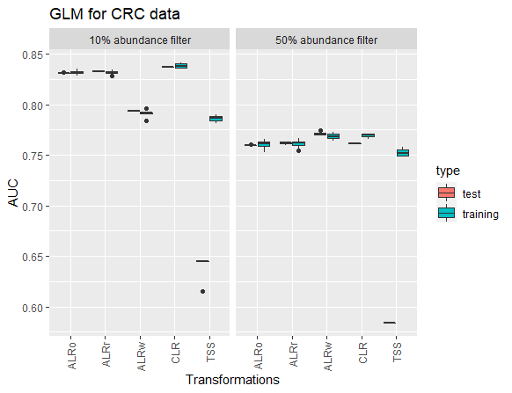
CRC classification
Data: D:\Master\Master Biologie\Sommersemester 2022\Master thesis\Github\out\CRC_holdout

Slide 26
CRC classification
Predicted on AUS holdout set!

Slide 27
CRC classification
Do all holdouts and combine?

Slide 28
IDEA
Data: D:\Master\Master Biologie\Sommersemester 2022\Master thesis\Github\out\leaky_nonleaky
Direct comparison if transformations are a big influence on leaky data
Take CRC data set as it has clear correlations and gives nice control over test set via country codes
Compare glmnet models with transformation separate on test/train set and on full data set
Test first with two countries and TSS/CLR/ALR
Main interest in ALR
Note: possibility that different denominator is chosen for test set and train set -> code needs to adjust for that -> especially later in PCOS? -> both denominators should be discarded from data set!

Slide 29
Concept
Include also imputation once
Non-leaky
leaky
Data set
Data set
Only 10% abundance filtering used
Merging with metadata
Transformations on whole data set
Splitting data
Merging with metadata
Transformation separately on test and train set
Splitting data
Modeling
Modeling

Slide 30
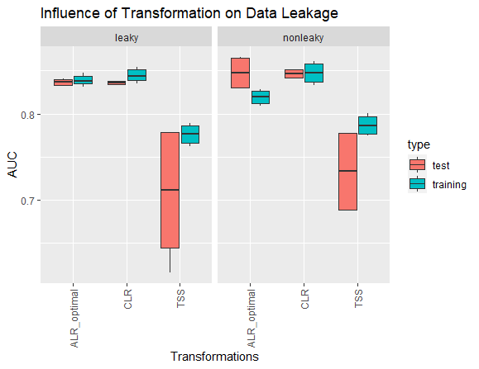
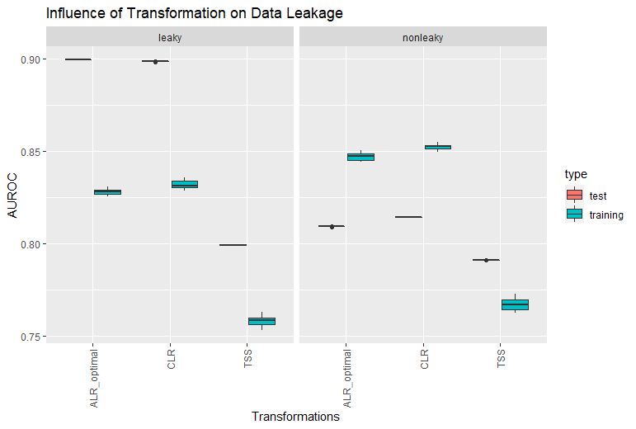
CRC
Predicted once on GER and once on FRA and then combined
Predicted once on standard 80/20

Slide 31
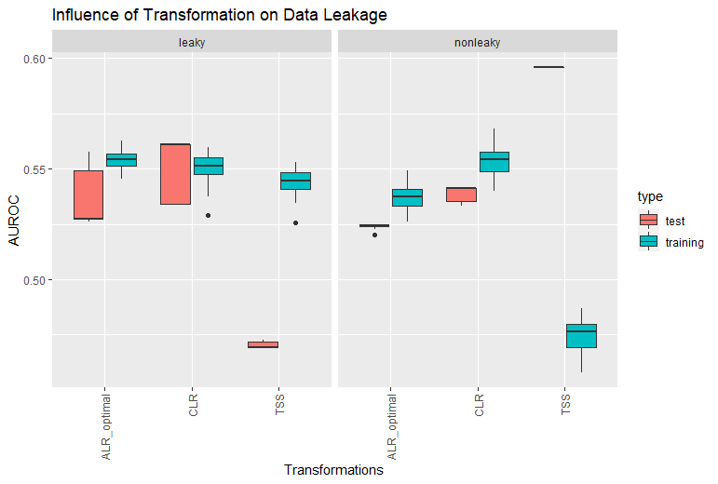
PCOS

Slide 32
Concept
Non-leaky
leaky
Data set
Data set
Merging with metadata
Imputation on whole data set
Only 10% abundance filtering used
Splitting data
Transformations on whole data set
Imputation separately on test and train set
Merging with metadata
Transformation separately on test and train set
Splitting data
Modeling
Modeling

Slide 33
CRC

Slide 34
PCOS

Slide 35
Pre-Processing
Imputation:
mbImpute needs phylogenetic tree -> ignored for now
EstMB dataset: pseudocount inserts decimal values between 0 and 1
Solution for now: all these values were rounded up to 1
Possibly in a later run keep decimal values, because some papers suggest sensitivity to pseudocount in machine learning models
Problems and Notes
CRC:
128 rows removed due to NA in BMI
DE saved separately as holdout
All tests were done with country sets: USA, China, Austria, France
PCOS:
6 rows removed in abundance table because they were not included in metadata
EstMB:
21 rows removed in metadata due to NA
21 patients cut out of abundance table due to metadata

Slide 36
Transformations
Problems and Notes
CLR/ALR:
What to do with LR.wt?
What to do with part.names and part.wt?
Column names ALR?
EstMB:
Needs a lot of time for ALR -> solved in HPC?

Slide 37
Hierarchy dimensionality reduction
Problems and Notes
PCA:
Microbiome Preprocessing Machine Learning Pipeline (2021)
Proposes to use PCA as hierarchy reduction
Families can be clustered and genus is not necessary

Slide 38
mikropml
Testing out mikropml as it already has a function run_ml() that incorporates nested cross-validation for several standard supervised machine learning models:
Logistic/multiclass/linear regression ("glmnet")
Random forest ("rf")
Decision tree ("rpart2")
Support vector machine with a radial basis kernel ("svmRadial")
xgboost ("xgbTree")
Test it here for linear regression and xgboost.
Function run_ml has several parameters:
dataset,
method,
outcome_colname = NULL, (standardized the first column)
hyperparameters = NULL,
find_feature_importance = FALSE, (`TRUE` is recommended if you would like to identify features important for predicting your outcome, but it is resource-intensive.
calculate_performance = TRUE,
kfold = 5, (standard at 5)
cv_times = 100, (standard at 100)
cross_val = NULL, (cross_val a custom cross-validation scheme from `caret::trainControl()` (default: `NULL`, uses `kfold` cross validation repeated `cv_times`). `kfold` and `cv_times` are ignored if the user provides a custom cross-validation scheme.)
training_frac = 0.8, (standard at 0.8)
perf_metric_function = NULL,
perf_metric_name = NULL,
groups = NULL,
group_partitions = NULL,
corr_thresh = 1,
ntree = 1000, (For random forest, how many trees to use (default: `1000`). Caret doesn't allow this hyperparameter to be tuned)
seed = NA (set seed for reproducibility)

Slide 39
Data set
Compare what Thomas P. Quinn uses (13 datasets) and take out from estonian biobank
prediction/classification tasks
One with continuous and one with discrete variables
one with high correlation and one with low to microbiomes
one small and one large data set
EstMB, colorectal cancer, PCOS
CRC data set preparation and models:
https://github.com/zellerlab/crc_meta/blob/master/src/prepare_data.R

Slide 40
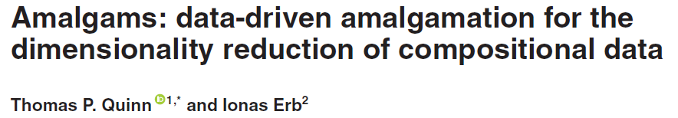
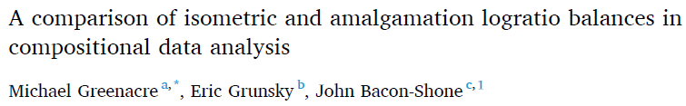
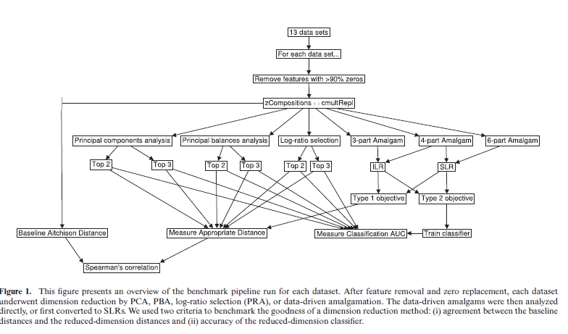
Amalgams

Slide 41
Problems
Microbial features are not independent
Some microbial features are found in correlation!

Slide 42
Notes 30.01. meeting
Review paper ML for microbiome paper
COST action paper
Confidentiality form, sign, scan and send to Elin
Meeting Oliver Friday, 4th February
Literature Review: ~10-20 pages, include Figures and Tables, equations for major transformations, write for biologists

Slide 43
Notes: 01.04. meeting
Pipeline:
Test models and codacore on the same training&test split (and set seed)
Take out training and test split from run_ml?
K_folds and CV_folds don‘t have to be the same for every data set
Time comparison?
CRC:
Keep one country cohorts for extra validation
BMI as outcome_column for continuous
GROUP for classification

Slide 44
Literature
https://www.youtube.com/watch?v=j1IbfQrT2Cs (12.01.2022)
https://www.youtube.com/watch?v=fQPCeV4MUe4 (12.01.2022)

Slide 45

Project holder
Elin Org ()
Supervisor
Oliver Asmets ()
Supervisor Kiel
Tal Dagan ()
Bioinformatics
Lucas Moitinho-Silva (l.silva@ikmb.uni-kiel.de)

