Slide 1
Benchmarking machine learning performances with compositional data
Project Structure and Notes
Jennifer Neumaier

Slide 2
Goals
Data-driven
Good interpretability
Performance Machine Learning models
Guideline

Slide 3

Projektstrukturplan I
Stand: 22.01.22
Benchmarking
Project management
Literature Review
Work Block 2
Work Block 3
Goals
Collect Sources/Literature
Establish Pipeline
Writing Master Thesis
Strategy
Define Dataset
Data Transformation
Presentation/ Defense
Requirements
Write Review
Comparison ML models
Paper
Quality Management
Presentation
GitHub

Slide 4
Projektstrukturplan II
Stand: 14.02.22

Slide 5
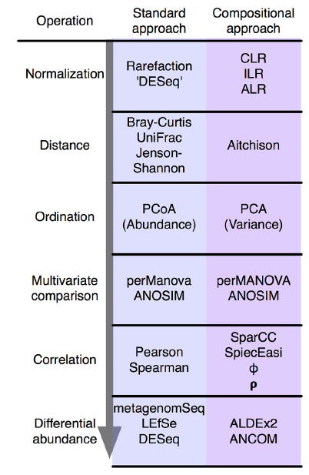
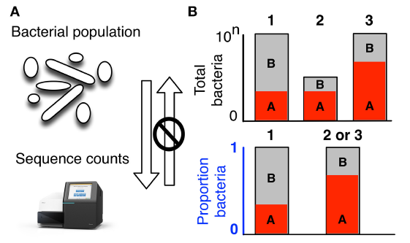
Compositional Data
What is it/consequences/current solutions

Slide 6
Log-Ratio Transformations
Stand: 22.01.22
Which ones exist
Characteristics
What are they doing?
Q: do they improve machine learning performances?

Slide 7
Machine Learning Approaches
Which ones do we use
How do they work?

Slide 8
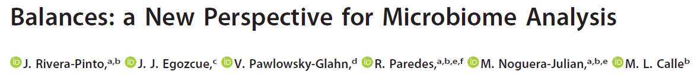
selbal
Stand: 22.01.22

Slide 9
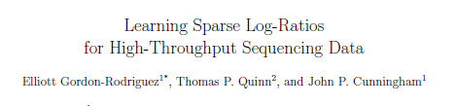
CoDaCoRe
Stand: 22.01.22

Slide 10
Pipeline
Data sets
Large/small
High/low corr.
Continuous/discrete
Pre-Processing
Zero-Imputation (pseudocount/mbImpute)
Filtering (10%/50%)
Microbiome-native methods
Log-Ratio Transformations
Performance
selbal
CoDaCoRe
TSS
CLR
ALR (random), ALR (optimal), ALR (top 10)
10-fold stratified nested cross-validation
Machine Learning models
ElasticNet (ENET
XGBoost (XGB)
Linear Discriminant Analysis (LDA)

Slide 11
Data set
Compare what Thomas P. Quinn uses (13 datasets) and take out from estonian biobank
prediction/classification tasks
One with continuous and one with discrete variables
one with high correlation and one with low to microbiomes
one small and one large data set
EstMB, colorectal cancer, PCOS
CRC data set preparation and models:
https://github.com/zellerlab/crc_meta/blob/master/src/prepare_data.R

Slide 12
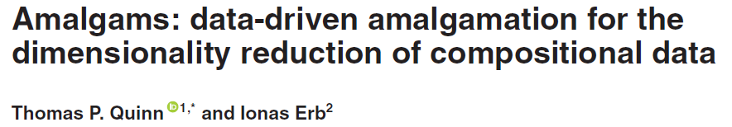
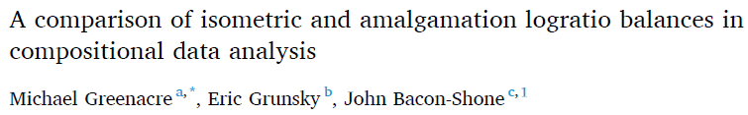
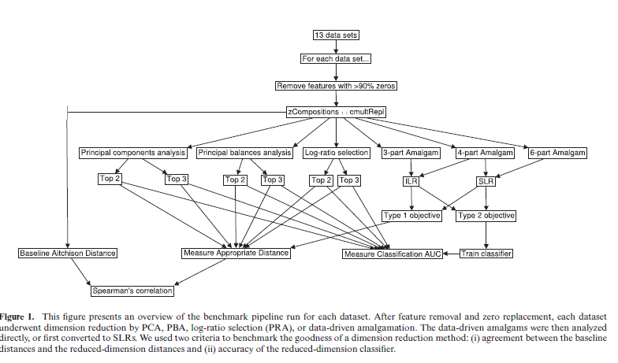
Amalgams

Slide 13
Problems
Understanding simplex space
Understanding the characteristics of log-ratios

Slide 14
Notes 30.01. meeting
Review paper ML for microbiome paper
COST action paper
Confidentiality form, sign, scan and send to Elin
Meeting Oliver Friday, 4th February
Literature Review: ~10-20 pages, include Figures and Tables, equations for major transformations, write for biologists

Slide 15
Literature
https://www.youtube.com/watch?v=j1IbfQrT2Cs (12.01.2022)
https://www.youtube.com/watch?v=fQPCeV4MUe4 (12.01.2022)

Slide 16

Project holder
Elin Org ()
Supervisor
Oliver Asmets ()
Supervisor Kiel
Tal Dagan ()
Bioinformatics
Lucas Moitinho-Silva (l.silva@ikmb.uni-kiel.de)

