Slide 1
Benchmarking machine learning performances with compositional data
Project Structure and Notes
Jennifer Neumaier

Slide 2
Goals
Data-driven
Good interpretability
Performance Machine Learning models
Guideline
Research Questions:
How well do perform machine learning models with log-ratio transformation?
Do they work better than microbiome-specific algorithms like e.g., codacore?
What consequences arise when using log-ratio transformation for machine learning models (e.g., data leakage)?

Slide 3


Projektstrukturplan I
*Good pipeling exists with mikropml
Stand: 31.03.22
Benchmarking
Project management
Literature Review
Work Block 2
Work Block 3
Collect Sources/Literature
Establish Pipeline
*
Writing Master Thesis
Goals
Strategy
Define Dataset
Data Transformation
Presentation/ Defense
Requirements
Write Review
Comparison ML models
Paper
Quality Management
Presentation
GitHub

Slide 4
Projektstrukturplan II
Stand: 31.03.22

Slide 5
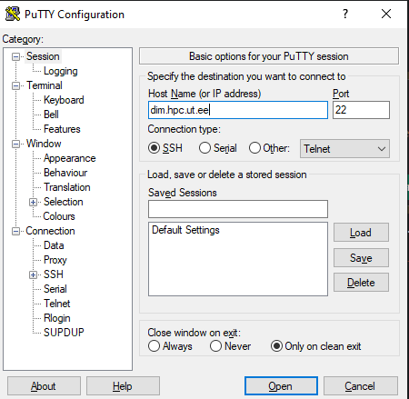
HPC
https://linuxize.com/post/how-to-use-linux-screen/
VPN:
https://wiki.ut.ee/pages/viewpage.action?pageId=17105590
MAin command for running codes in server: R --slave --vanilla --args arg1 arg2 < script_name.R &
"top" - to look at the server load "q" to exit
14:00 Uhr
Use "logout" to exit the session

Slide 6
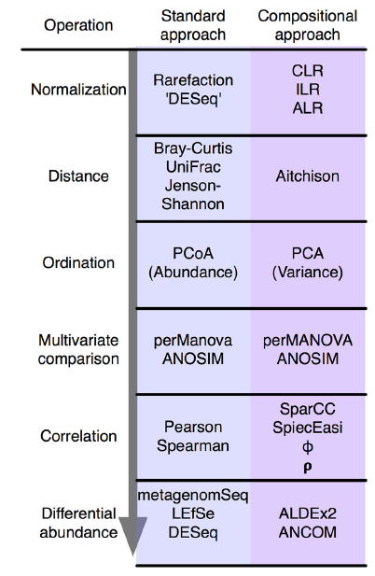
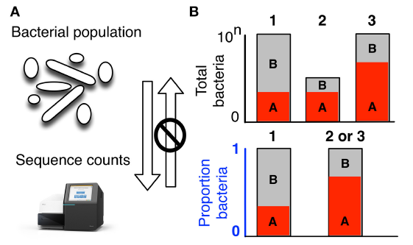
Compositional Data
What is it/consequences/current solutions

Slide 7
Log-Ratio Transformations
Stand: 22.01.22
Which ones exist
Characteristics
What are they doing?
Q: do they improve machine learning performances?

Slide 8
Machine Learning Approaches
Which ones do we use
How do they work?

Slide 9
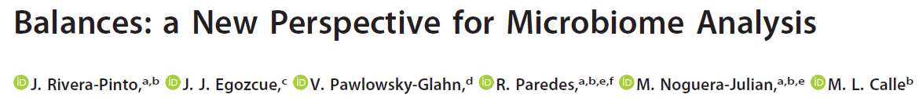
selbal
Stand: 22.01.22
First thoughts:
Imputes itself -> no control over it
Cannot handle negative values -> cannot feed it transformed values (or not without adding an extra scaling step)
Classes need to be converted to binary
Takes a long time to process -> a lot longer than glmnet (exact time measurement?)

Slide 10
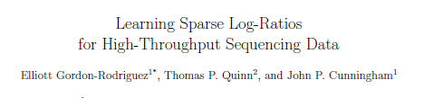
CoDaCoRe
Stand: 22.01.22
First thoughts:
Example showed imputation by +1
Logratio type is ILR or SLR (balances or amalgamation) -> comparison questionable?

Slide 11
Pipeline
Data sets
Large/small
High/low corr.
Continuous/discrete
Pre-Processing
Zero-Imputation (pseudocount/mbImpute)
Filtering (10%/50%)
Microbiome-native methods
Log-Ratio Transformations
Use of mikropml advantageous -> uses repeated CV
Performance
selbal
CoDaCoRe
TSS
CLR
ALR (random), ALR (optimal), ALR (top 10)
10-fold stratified nested cross-validation
Machine Learning models
ElasticNet (ENET
XGBoost (XGB)
Linear Discriminant Analysis (LDA)
Use of mikropml advantageous -> only has glmnet and xgboost -> for now sticking to those

Slide 12
Pipeline
Transformation
TSS(), ALR_optimal(), ALR_worst(), ALR_random(), CLR()
Data split
Test set
Initial data split for consistency in all models
Dataset
CV + models
K-folds = 5, CV = 10
(selbal)
codacore
glmnet
xgboost
Model accuracy
Repeat 10x to observe statistical fluctuations

Slide 13
Pipeline
Dataset
Pre-Processing
Imputation
Transformation
Models
TSS
CRC
10% filtering
GLMNET
CLR
PCOS
50% filtering
pseudocount
optimal ALR
svmRadial
EstMB
90% filtering
random ALR
CoDaCoRe
worst ALR

Slide 14
Pipeline

Slide 15
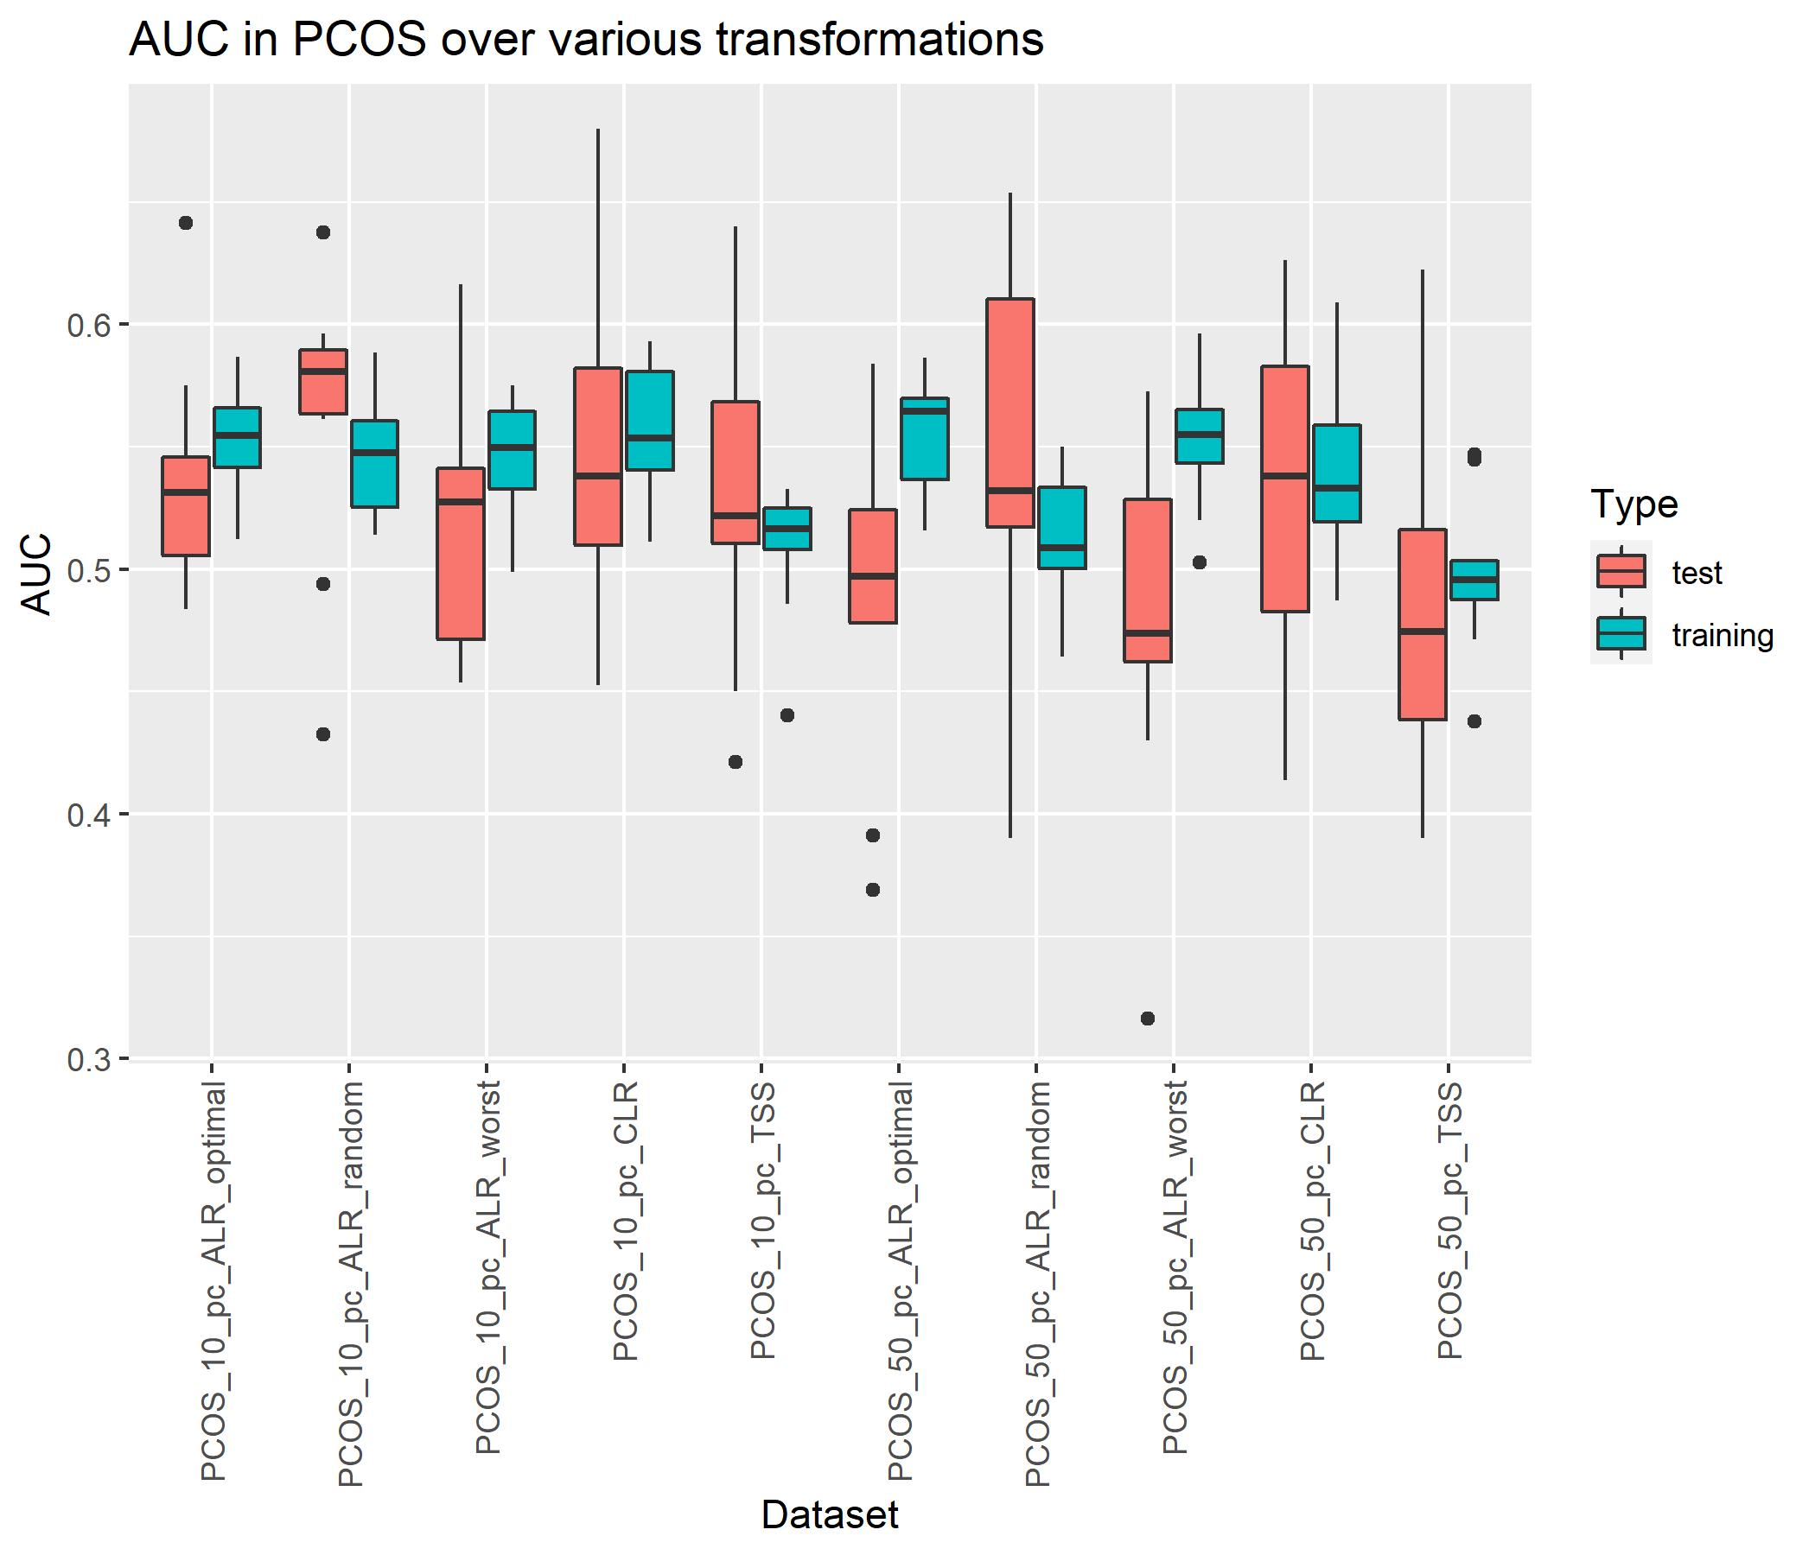
PCOS
K-folds: 5
CV_times: 10
Different training/test set every iteration

Slide 16
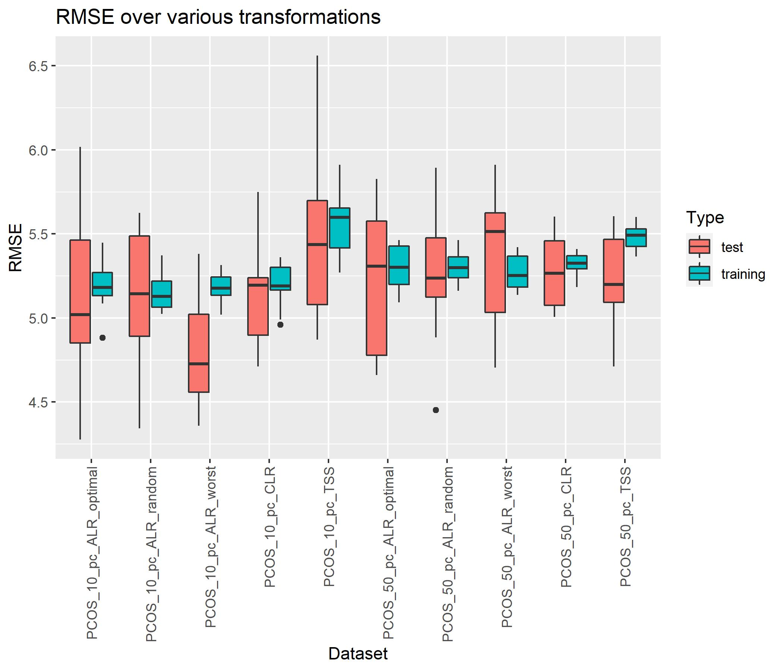
PCOS
K-folds: 5
CV_times: 10
Different training/test set every iteration

Slide 17
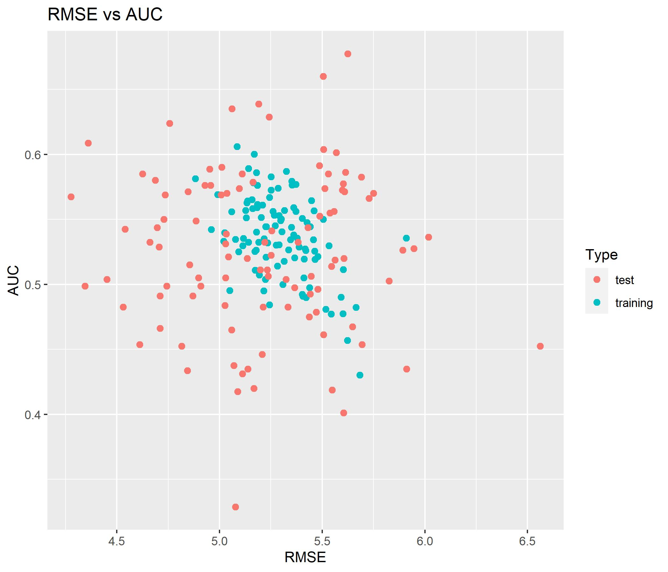
PCOS

Slide 18
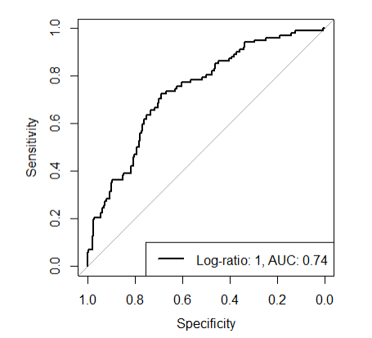
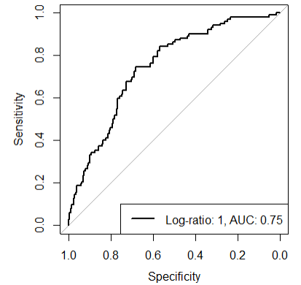
PCOS
Different training/test set every iteration
10% abundance filter
50% abundance filter
Codacore: 393 524 555 580 643 683 773
Codacore: 10 50 57 89 112
FINDALR: 10 14 52 64 509
FINDALR: 10 14 16 40 44

Slide 19
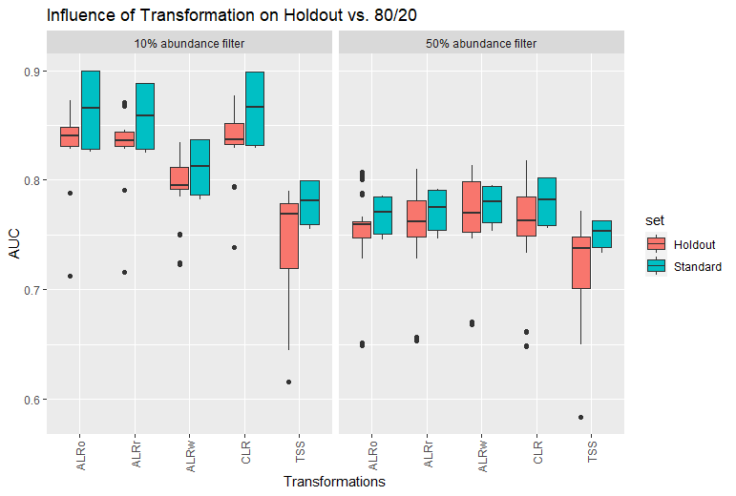
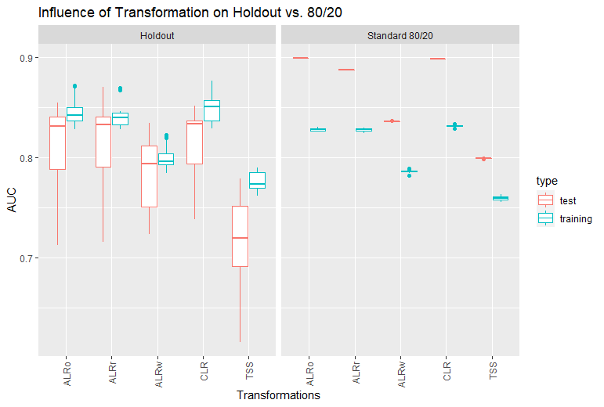
Holdout vs 80/20
Data: D:\Master\Master Biologie\Sommersemester 2022\Master thesis\Github\out\CRC_holdout
My evidence to use standard 80/20 for all further models
A
B
Notes:
A: all countries were holdout set once and for this graph all performances were taken together under „holdout“ and separates into abundance filters
B: since 10% abundance filters clearly shows better performances, only this data was taken and the performances per transformation separated into test and training performances.

Slide 20
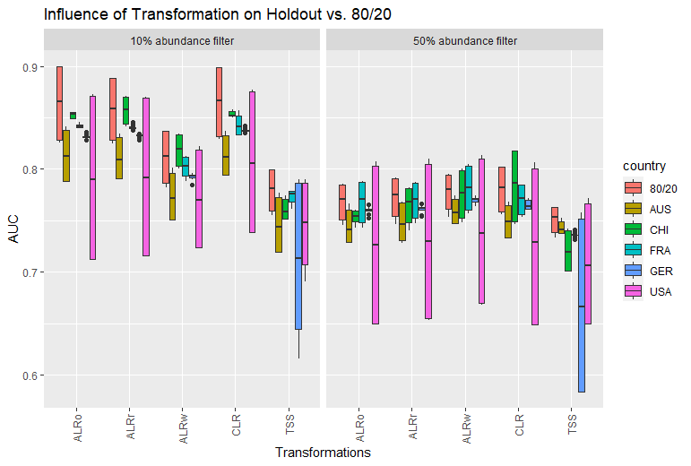
Holdout vs 80/20
Data: D:\Master\Master Biologie\Sommersemester 2022\Master thesis\Github\out\CRC_holdout
My evidence to use standard 80/20 for all further models
Take only 10% and split into train and test set!
Notes:
Here, again the split between 10% abundance and 50% abundance but all holdout performances plus standard 80/20 viewed directly. NB! Test and training performances are plotted together again -> distance of boxplots gives hint about the discrepancy between test and training performances per holdout set vs 80/20.

Slide 21
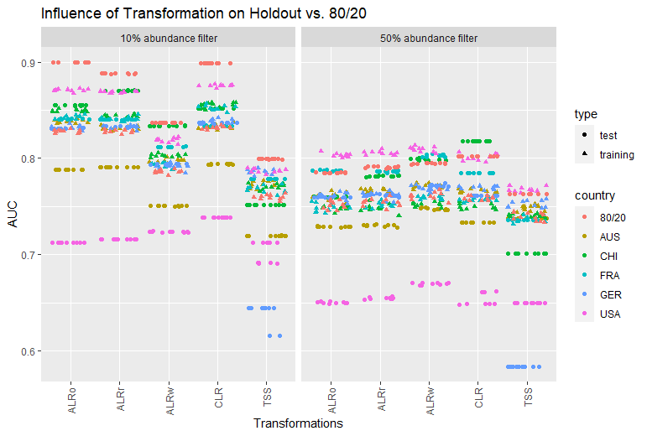
Holdout vs 80/20
Overloaded version
(in supplementary?)
Data: D:\Master\Master Biologie\Sommersemester 2022\Master thesis\Github\out\CRC_holdout
Notes:
That’s the same graph as on slide 18, but the boxplots removed so one is able to differentiate between test and training set per transformation.

Slide 22
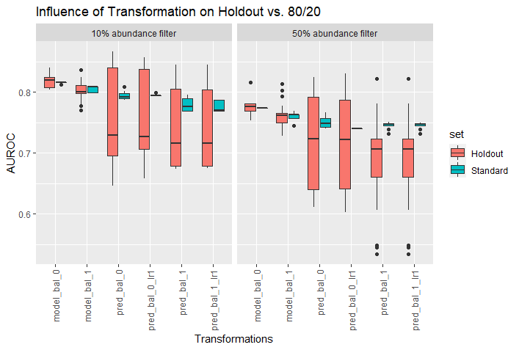
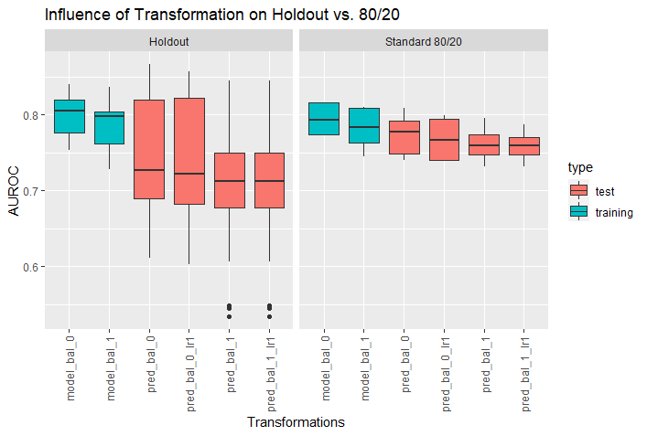
Holdout vs 80/20 CODACORE
Data: D:\Master\Master Biologie\Sommersemester 2022\Master thesis\Github\out\CRC_holdout
My evidence to use standard 80/20 for all further models
A
B
Notes:
A: all countries were holdout set once and for this graph all performances were taken together under „holdout“ and separates into abundance filters
B: since 10% abundance filters clearly shows better performances, only this data was taken and the performances per transformation separated into test and training performances.

Slide 23
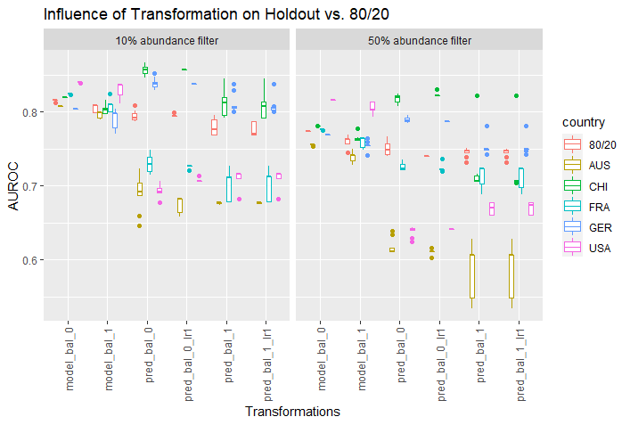
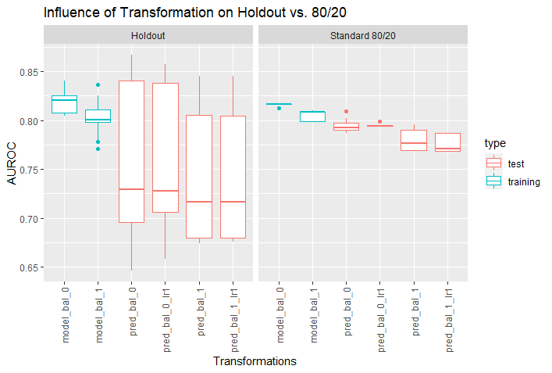
Holdout vs 80/20 CODACORE
Data: D:\Master\Master Biologie\Sommersemester 2022\Master thesis\Github\out\CRC_holdout
My evidence to use standard 80/20 for all further models
A
B
Notes:
10% abundancey

Slide 24
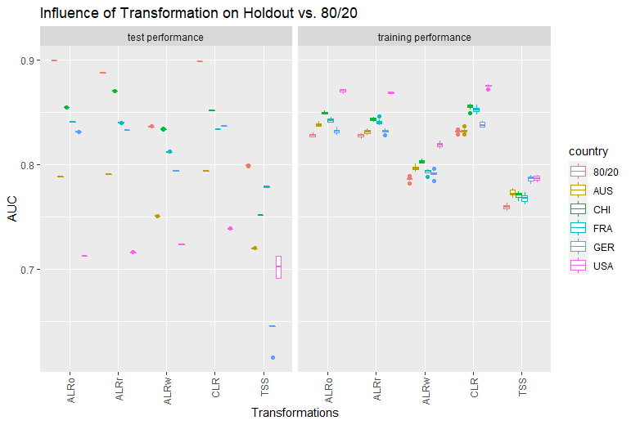
Holdout vs 80/20
Data: D:\Master\Master Biologie\Sommersemester 2022\Master thesis\Github\out\CRC_holdout
10% abundance

Slide 25
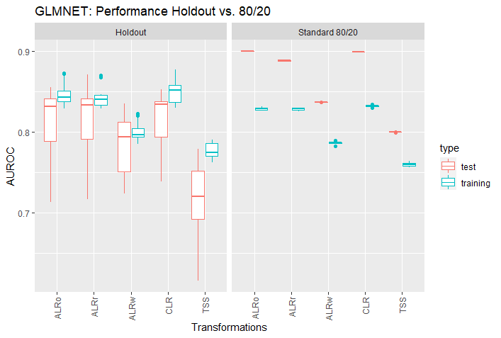
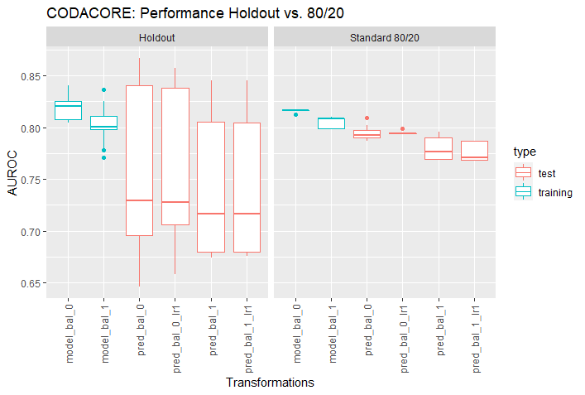
Holdout vs 80/20 THESIS
Data: D:\Master\Master Biologie\Sommersemester 2022\Master thesis\Github\out\CRC_holdout
Notes:
10% abundance

Slide 26
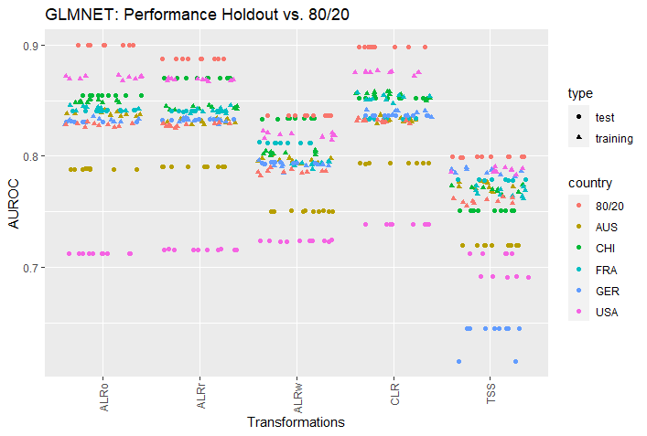
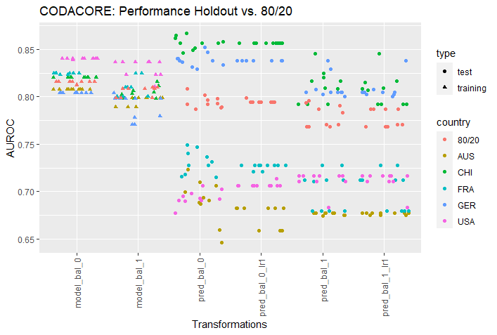
Holdout vs 80/20 DETAILS
Data: D:\Master\Master Biologie\Sommersemester 2022\Master thesis\Github\out\CRC_holdout
My evidence to use standard 80/20 for all further models
A
B
Notes:
10% abundances
AUS and USA show in both glmnet and codacore bad predictions as test set -> choice of holdout test set affects ml models and also codacore (which makes sense, as it is also a linear model in the background)

Slide 27
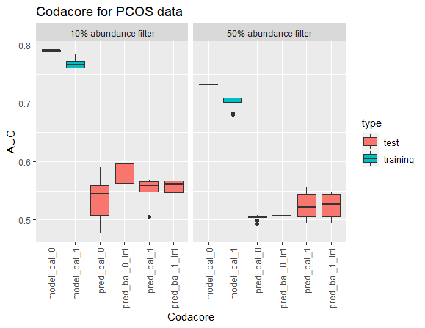
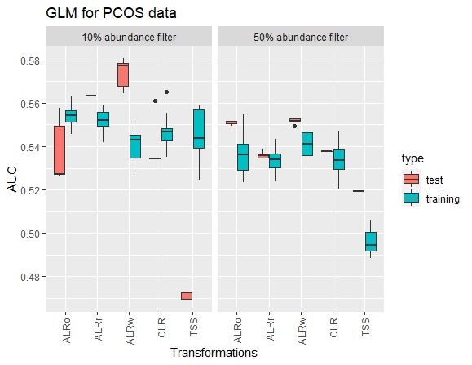
PCOS classification
Data: D:\Master\Master Biologie\Sommersemester 2022\Master thesis\Github\out\PCOS\glmnet
A
B

Slide 28
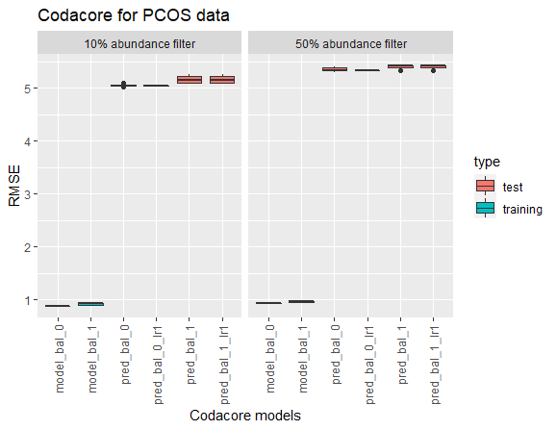
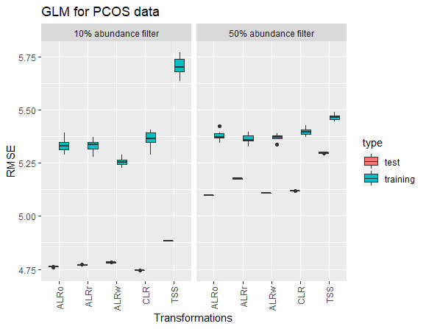
PCOS regression
Data: D:\Master\Master Biologie\Sommersemester 2022\Master thesis\Github\out\PCOS\glmnet
A
B

Slide 29
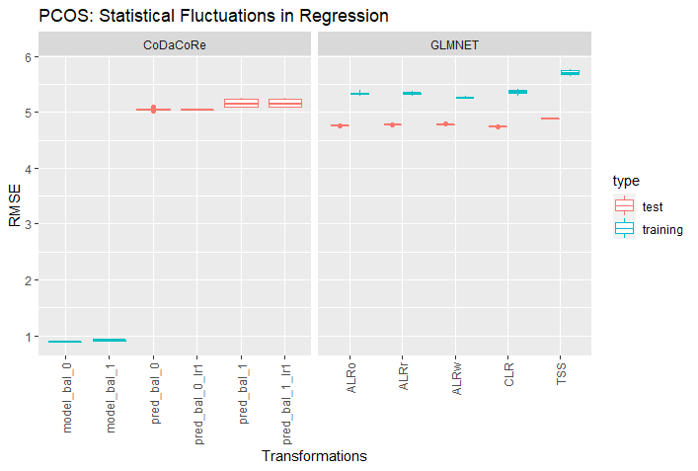
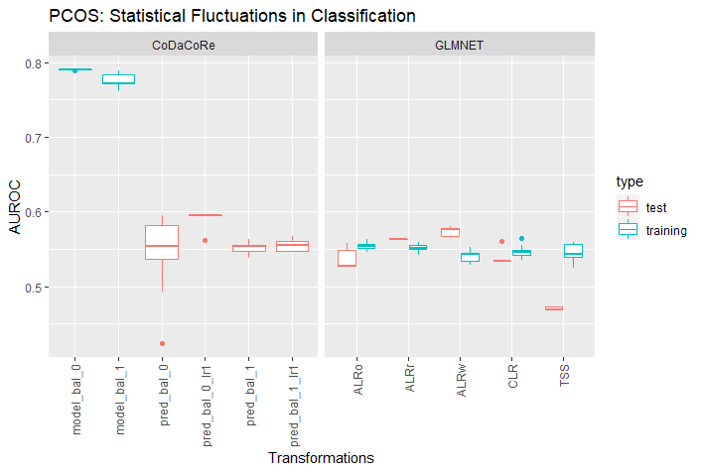
PCOS thesis
Data: D:\Master\Master Biologie\Sommersemester 2022\Master thesis\Github\out\PCOS\glmnet
Notes:
10% abundance filter

Slide 30
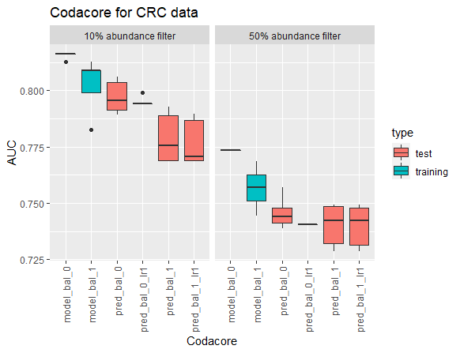
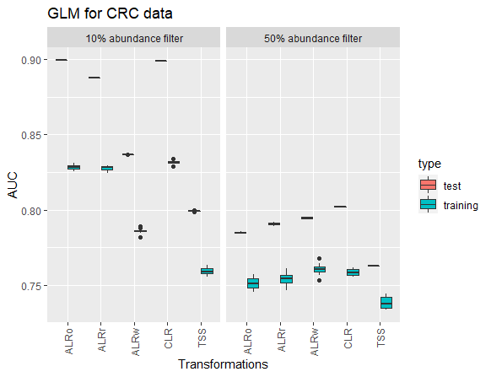
CRC classification
Data: D:\Master\Master Biologie\Sommersemester 2022\Master thesis\Github\out\CRC\glmnet
A
B

Slide 31
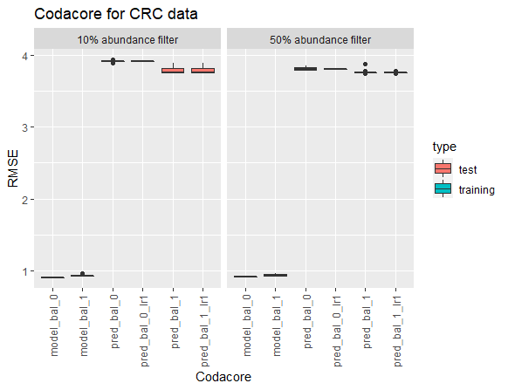
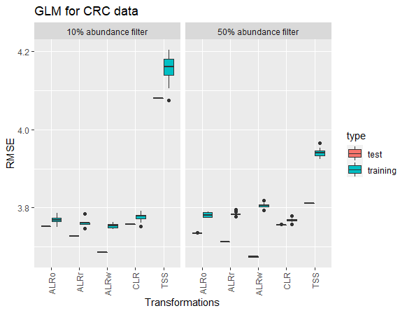
CRC regression
Data: D:\Master\Master Biologie\Sommersemester 2022\Master thesis\Github\out\CRC\glmnet
A
B

Slide 32
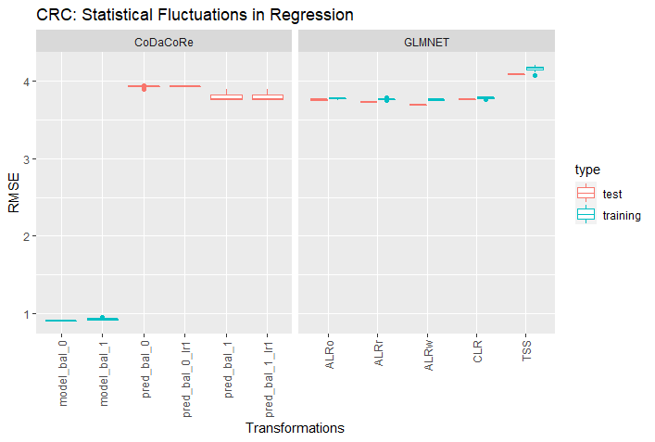
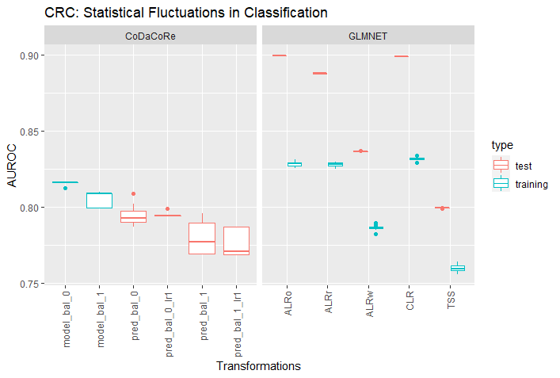
CRC thesis
Data: D:\Master\Master Biologie\Sommersemester 2022\Master thesis\Github\out\CRC\glmnet
Notes:
10% abundance filter

Slide 33
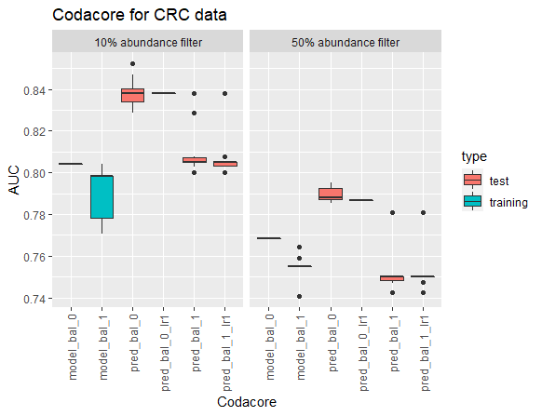
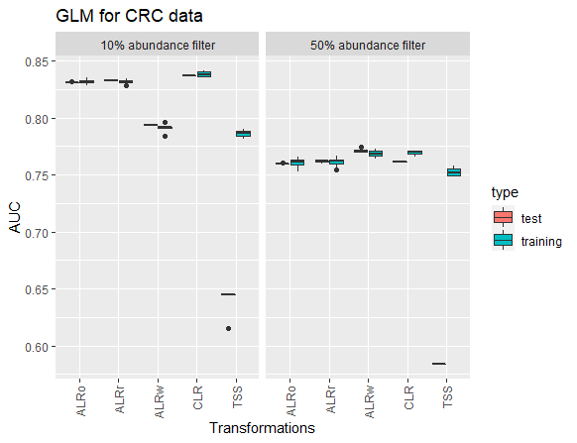
CRC classification
Data: D:\Master\Master Biologie\Sommersemester 2022\Master thesis\Github\out\CRC_holdout

Slide 34
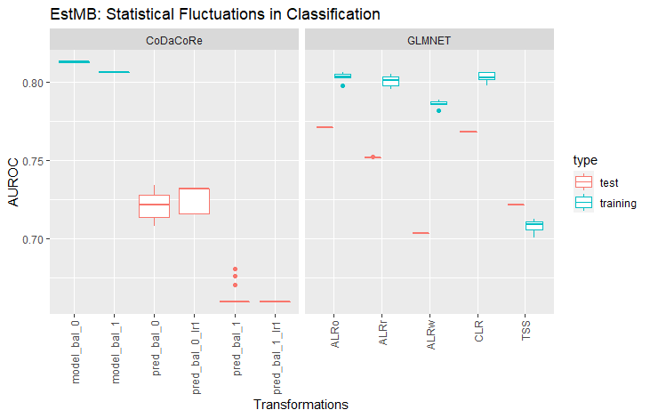
EstMB classification
Data: D:\Master\Master Biologie\Sommersemester 2022\Master thesis\Github\out\EstMB\E11\glmnet
Notes:
90% abundance filter

Slide 35

EstMB regression
Data: D:\Master\Master Biologie\Sommersemester 2022\Master thesis\Github\out\EstMB\E11\glmnet

Slide 36
Concept
Xgbtree takes awfully long
Check if xgbtree with 2 cv is faster (no)
Check out nonlinear alternatives for run_ml:
Rf: random forest
Rpart2: decision tree
Svmradial: support vector machines -> is significantly faster than xgbtree -> run 5x repeat and 2x cv
Impute and Transform both new abundances

Slide 37
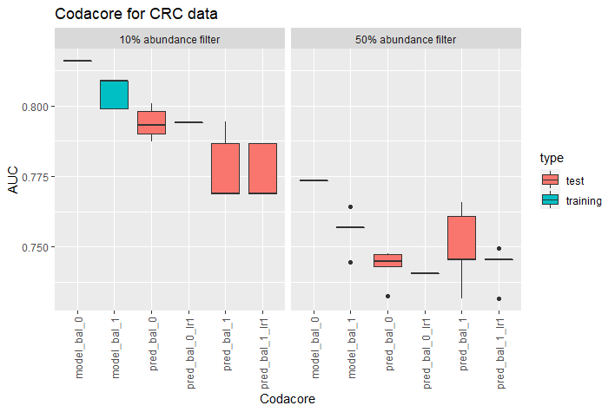
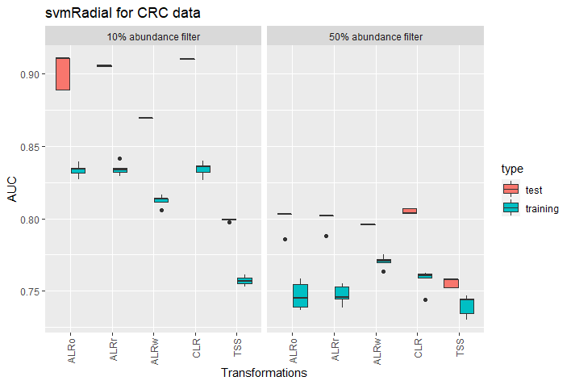
CRC classification
Data: D:\Master\Master Biologie\Sommersemester 2022\Master thesis\Github\out\CRC\svmRadial
A
B
Notes:
Only 2x CV and 5x repeats due to longer training times

Slide 38
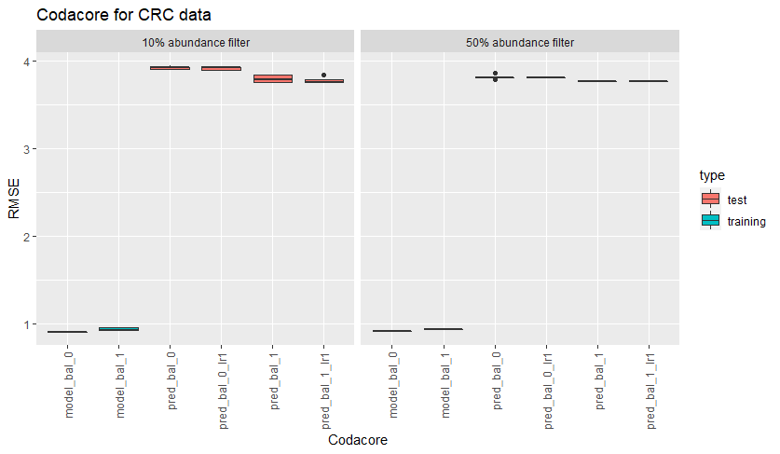
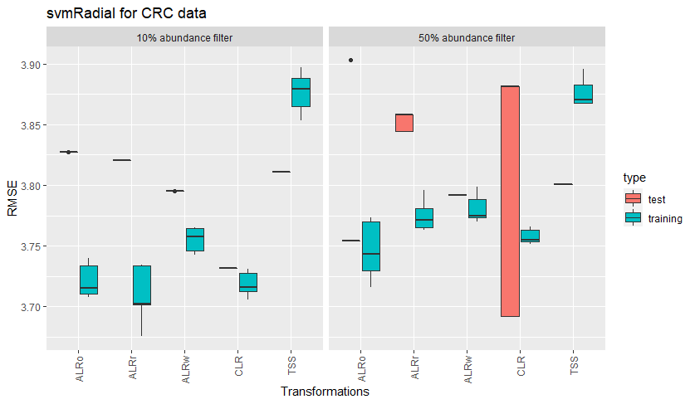
CRC regression
Data: D:\Master\Master Biologie\Sommersemester 2022\Master thesis\Github\out\CRC\svmRadial
A
B
Notes:
Only 2x CV and 5x repeats due to longer training times

Slide 39
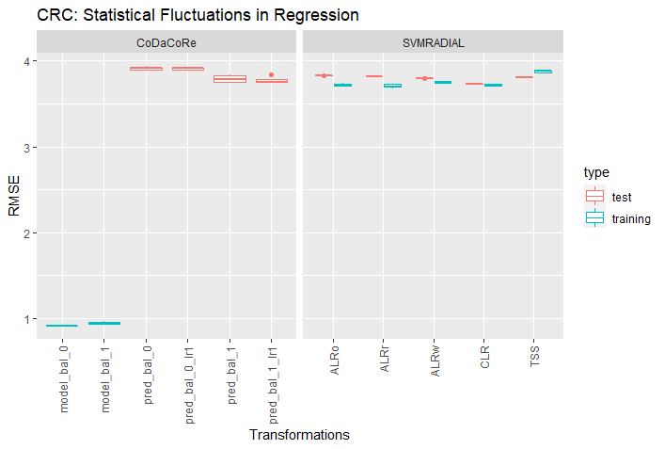
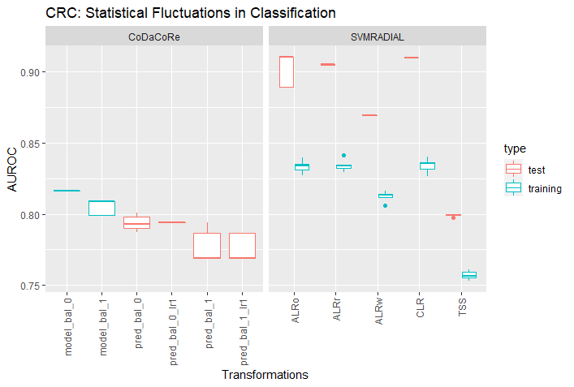
CRC thesis
Data: D:\Master\Master Biologie\Sommersemester 2022\Master thesis\Github\out\CRC\svmRadial
Notes:
10% abundance filter

Slide 40
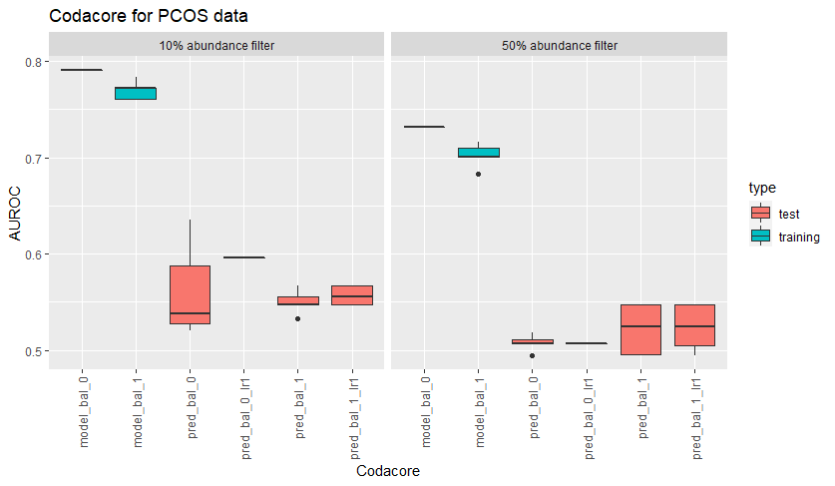
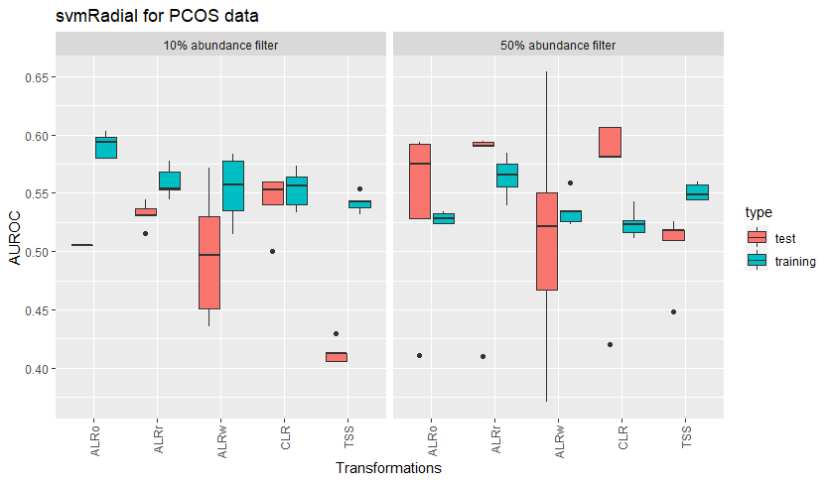
PCOS classification
Data: D:\Master\Master Biologie\Sommersemester 2022\Master thesis\Github\out\PCOS\svmRadial
A
B
Notes:
Only 2x CV and 5x repeats due to longer training times
Choose one abundance filter and combine boxplots

Slide 41
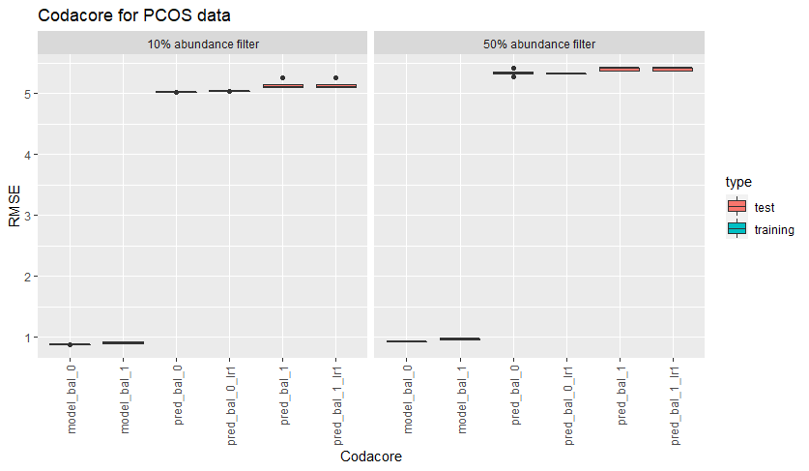
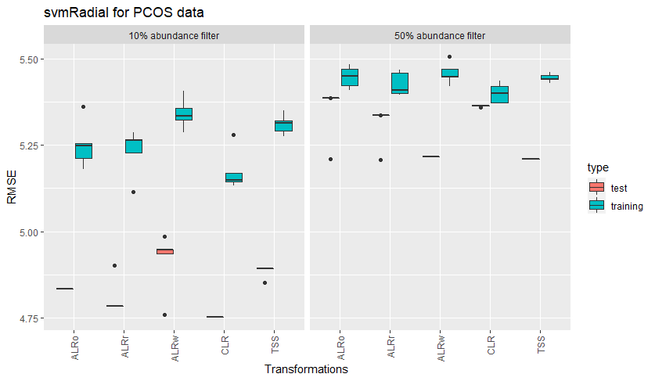
PCOS regression
Data: D:\Master\Master Biologie\Sommersemester 2022\Master thesis\Github\out\PCOS\svmRadial
A
B
Notes:
Only 2x CV and 5x repeats due to longer training times

Slide 42
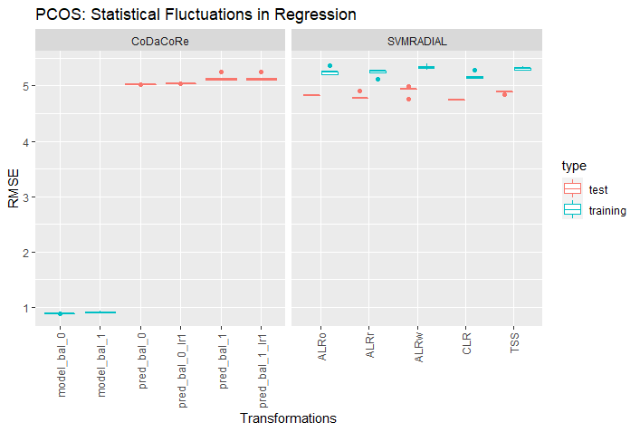
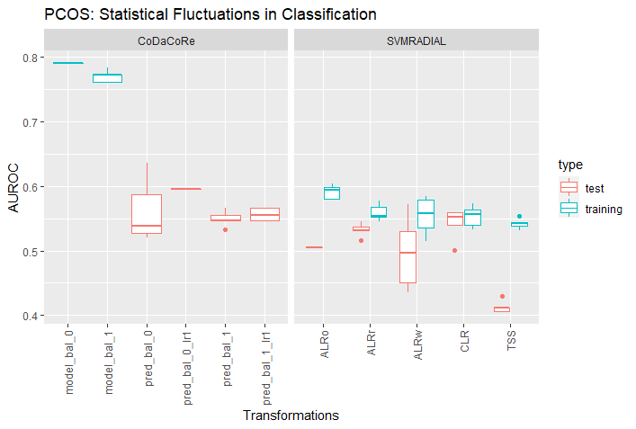
PCOS thesis
Data: D:\Master\Master Biologie\Sommersemester 2022\Master thesis\Github\out\PCOS\svmRadial
Notes:
10% abundance filter

Slide 43

EstMB thesis
Data: D:\Master\Master Biologie\Sommersemester 2022\Master thesis\Github\out\EstMB\E11\svmRadial
Notes:
90% abundance filter

Slide 44
IDEA
Data: D:\Master\Master Biologie\Sommersemester 2022\Master thesis\Github\out\leaky_nonleaky
Direct comparison if transformations are a big influence on leaky data
Take CRC data set as it has clear correlations and gives nice control over test set via country codes
Compare glmnet models with transformation separate on test/train set and on full data set
Test first with two countries and TSS/CLR/ALR
Main interest in ALR
Note: possibility that different denominator is chosen for test set and train set -> code needs to adjust for that -> especially later in PCOS? -> both denominators should be discarded from data set!

Slide 45
Concept
NB! Imputation will be conducted on whole data set, as test data does not have enough data to hypertune t in GBM
Non-leaky
leaky
Data set
Data set
Only 10% abundance filtering used
Merging with metadata
Transformations on whole data set
Splitting data
Merging with metadata
Transformation separately on test and train set
Splitting data
Modeling
Modeling
Notes:
Error was only in PCOS, but as a lot of data sets in biology are on the smaller side, it should be carefully decided when to use imputation on test sets.
For CRC, imputation on test set works, so starting around 500 features, it seems to be possible.

Slide 46


CRC
Predicted once on GER and once on FRA and then combined
Predicted once on standard 80/20

Slide 47

PCOS

Slide 48
Concept
Non-leaky
leaky
Data set
Data set
Merging with metadata
Imputation on whole data set
Only 10% abundance filtering used
Splitting data
Transformations on whole data set
Imputation separately on test and train set
Merging with metadata
Transformation separately on test and train set
Splitting data
Modeling
Modeling
Notes:
NB! Got error for test set that its not enough data to use GBM -> Imputation will be conducted on whole data set

Slide 49

CRC
Notes:
NB! Variance reduces in nonleaky the more steps are included in preprocessing -> test set is more biased in leaky procedure (if data set is big enough (more than 100 samples roughly) and no ALR used, training and test set can be split using transformations
Other idea: getting ALR on train data and giving same denominator to test data
-> not enough data to compute t hyperparameter for GBM in test data

Slide 50

PCOS
Notes:
NB! Imputation in test set nonleaky faulty as it could not impute

Slide 51

IDEA
Analyse qualitatively which features were most important for the models for all transformations vs codacore
Something like this ˇ
https://egr95.github.io/R-codacore/inst/misc/guide.html#training-the-model -> repeat models and also change x-axis from codacore plots to be more descriptive
Comparison to find_feature_importance of mikropml?

Slide 52




Comparison of feature overlap in models (PCOS)
Venn_den_10
Venn_num_10
Venn_den_50
Venn_num_50
Notes:
Lambda 0 or lambda 1 is not that effective in choosing different denominators/numerators

Slide 53



Comparison of feature overlap in data sets (PCOS)
Venn_den_model_0
Venn_num_model_0
Venn_den_model_1
Venn_num_model_1
Notes:
Both model types decide on different numerators and denominators depending on data set size

Slide 54



Comparison of feature overlap in models (CRC)
Venn_den_10
Venn_num_10
Venn_den_50
Venn_num_50
Notes:
Lambda 0 or lambda 1 is not that effective in choosing different denominators/numerators

Slide 55



Comparison of feature overlap in data sets (CRC)
Venn_den_model_0
Venn_num_model_0
Venn_den_model_1
Venn_num_model_1
Notes:
Both model types decide on different numerators and denominators depending on data set size
- Compared numerators/denominators with svmRadial split -> results are very close

Slide 56




10% abundance
10% abundance
50% abundance
50% abundance
Notes:
Numerators and denominators found by codacore over 10 rounds per model type from glmnet split -> split is set by seed (2022) -> all splits are the same

Slide 57


Notes:
2x ALR top 20 in ALRo CLR vs 2x codacore denominators
-> no intersect
Are they directly comparable? Codacore uses pairwise AND a model

Slide 58





PCOS
Notes:
2x ALR top 20 in ALRo CLR vs 2x codacore denominators
-> no intersect
Are they directly comparable? Codacore uses pairwise AND a model

Slide 59





CRC
Notes:
2x ALR top 20 in ALRo CLR vs 2x codacore denominators
-> no intersect
Are they directly comparable? Codacore uses pairwise AND a model

Slide 60


EstMB E11 healthy

Slide 61
Pre-Processing
Imputation:
mbImpute needs phylogenetic tree -> ignored for now
EstMB dataset: pseudocount inserts decimal values between 0 and 1
Solution for now: all these values were rounded up to 1
Possibly in a later run keep decimal values, because some papers suggest sensitivity to pseudocount in machine learning models
Problems and Notes
CRC:
128 rows removed due to NA in BMI
DE saved separately as holdout
All tests were done with country sets: USA, China, Austria, France
PCOS:
6 rows removed in abundance table because they were not included in metadata
EstMB:
21 rows removed in metadata due to NA
21 patients cut out of abundance table due to metadata
Added 75% abundance filter as data was otherwise not practically processable

Slide 62
Transformations
More complex is ILR (isometric log-ratio), which transforms the data with respect to an orthonormal coordinate system that is constructed from sequential binary partitions of features (Quinn et al. 2018). The ILR-transform maps a composition in the D-part Aitchison-simplex isometrically to a D-1 dimensional Euclidian vector, with clr(x) the centered log-ratio transform and V a matrix which columns form an orthonormal basis of the clr-plane (Greenacre et al. 2022).
Problems and Notes
CLR/ALR:
What to do with LR.wt?
What to do with part.names and part.wt?
Column names ALR?
EstMB:
Needs a lot of time for ALR -> solved in HPC?

Slide 63


Simplex Space and Compositional Data
Problems and Notes
Comparing the last equation with (15), we see that we would
get exactly the same expression using the modi_ed DeSeq normalization. The
median, trimmed mean and geometric mean lead thus to quite similar proce-
dures, making it clear that the clr transformation can be used as a normalization.
The iqlr transformation [3] as used in ALDEx2 would be even more in spirit
of the trimmed mean used in edgeR. For a comparison of e_ective library size
normalization methods, see [4]. It should be emphasized, however, that the
focus in CoDA is not on scaling parts to become common-scale quantities that
are comparable on absolute terms. Rather, when the within-sample ratios are
compared between samples, the denominators in them have to be taken for what
they are when interpreting results. (supplementary, 2018)
Notes:
https://leadertutor.com/equivalence-relations-composition/
https://math.stackexchange.com/questions/600978/equivalence-relation-composition-problem
https://laboratoriomatematicas.uniandes.edu.co/cursocoda/04-Vera-geometry.pdf
https://hal.archives-ouvertes.fr/hal-03379935v2/document

Slide 64
Hierarchy dimensionality reduction
Problems and Notes
PCA:
Microbiome Preprocessing Machine Learning Pipeline (2021)
Proposes to use PCA as hierarchy reduction
Families can be clustered and genus is not necessary

Slide 65
mikropml
Testing out mikropml as it already has a function run_ml() that incorporates nested cross-validation for several standard supervised machine learning models:
Logistic/multiclass/linear regression ("glmnet")
Random forest ("rf")
Decision tree ("rpart2")
Support vector machine with a radial basis kernel ("svmRadial")
xgboost ("xgbTree")
Test it here for linear regression and xgboost.
Function run_ml has several parameters:
dataset,
method,
outcome_colname = NULL, (standardized the first column)
hyperparameters = NULL,
find_feature_importance = FALSE, (`TRUE` is recommended if you would like to identify features important for predicting your outcome, but it is resource-intensive.
calculate_performance = TRUE,
kfold = 5, (standard at 5)
cv_times = 100, (standard at 100)
cross_val = NULL, (cross_val a custom cross-validation scheme from `caret::trainControl()` (default: `NULL`, uses `kfold` cross validation repeated `cv_times`). `kfold` and `cv_times` are ignored if the user provides a custom cross-validation scheme.)
training_frac = 0.8, (standard at 0.8)
perf_metric_function = NULL,
perf_metric_name = NULL,
groups = NULL,
group_partitions = NULL,
corr_thresh = 1,
ntree = 1000, (For random forest, how many trees to use (default: `1000`). Caret doesn't allow this hyperparameter to be tuned)
seed = NA (set seed for reproducibility)

Slide 66
Data set
Compare what Thomas P. Quinn uses (13 datasets) and take out from estonian biobank
prediction/classification tasks
One with continuous and one with discrete variables
one with high correlation and one with low to microbiomes
one small and one large data set
EstMB, colorectal cancer, PCOS
CRC data set preparation and models:
https://github.com/zellerlab/crc_meta/blob/master/src/prepare_data.R

Slide 67



Amalgams

Slide 68
Problems
Microbial features are not independent
Some microbial features are found in correlation!

Slide 69
Notes 30.01. meeting
Review paper ML for microbiome paper
COST action paper
Confidentiality form, sign, scan and send to Elin
Meeting Oliver Friday, 4th February
Literature Review: ~10-20 pages, include Figures and Tables, equations for major transformations, write for biologists

Slide 70
Notes: 01.04. meeting
Pipeline:
Test models and codacore on the same training&test split (and set seed)
Take out training and test split from run_ml?
K_folds and CV_folds don‘t have to be the same for every data set
Time comparison?
CRC:
Keep one country cohorts for extra validation
BMI as outcome_column for continuous
GROUP for classification

Slide 71
Literature
https://www.youtube.com/watch?v=j1IbfQrT2Cs (12.01.2022)
https://www.youtube.com/watch?v=fQPCeV4MUe4 (12.01.2022)

Slide 72

Project holder
Elin Org ()
Supervisor
Oliver Asmets ()
Supervisor Kiel
Tal Dagan ()
Bioinformatics
Lucas Moitinho-Silva (l.silva@ikmb.uni-kiel.de)

