Slide 1
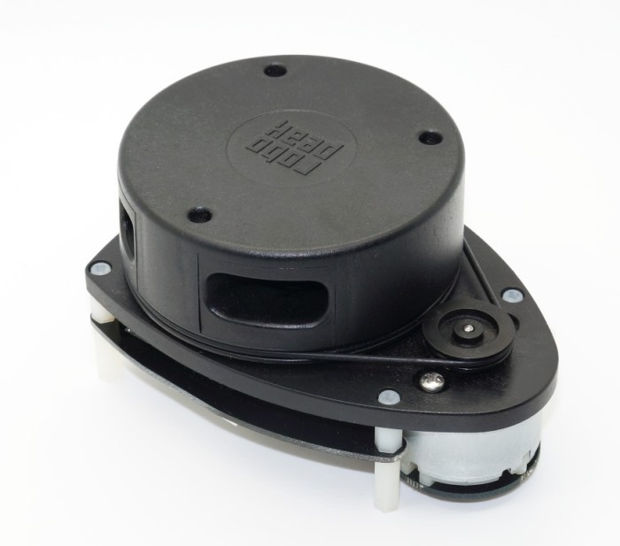
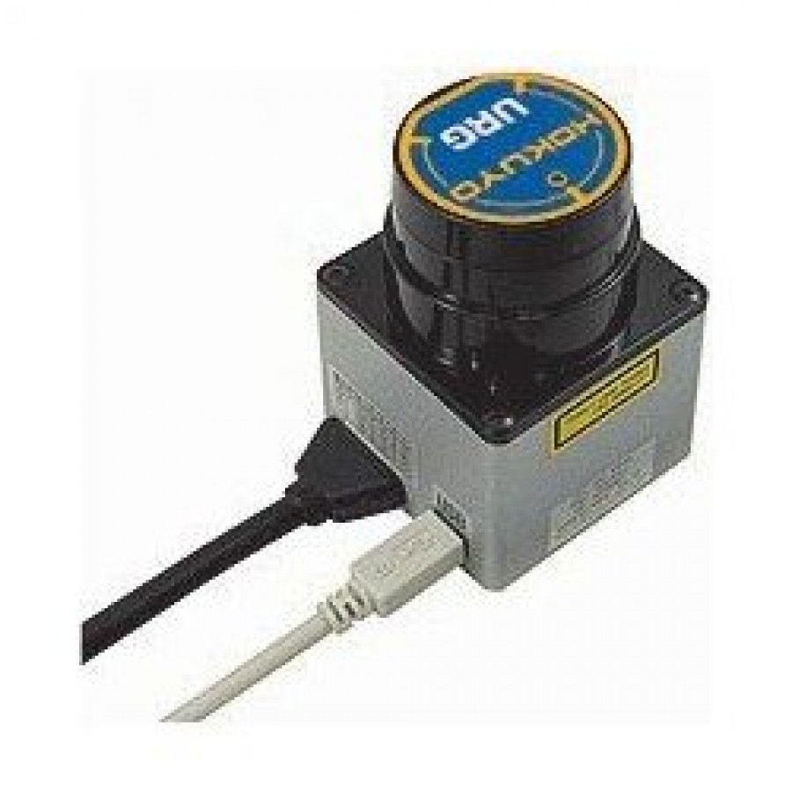
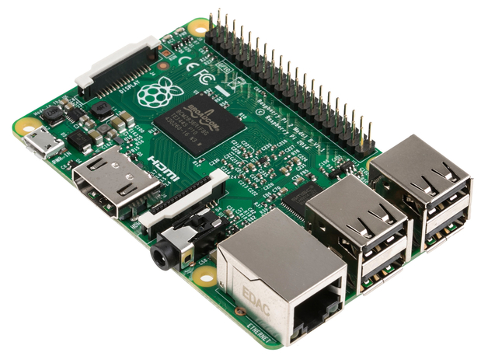
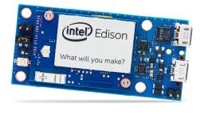
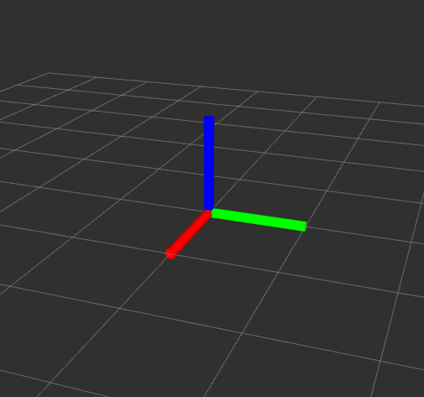
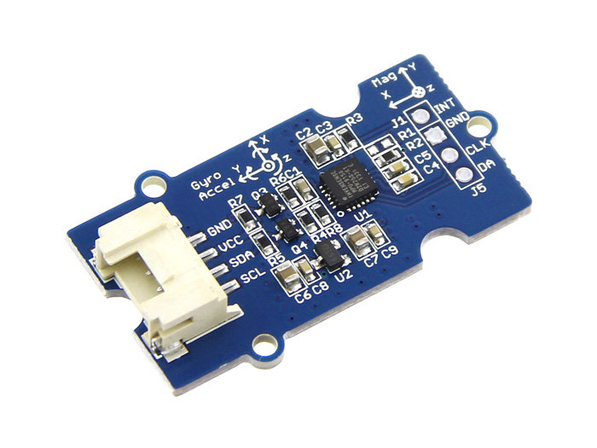
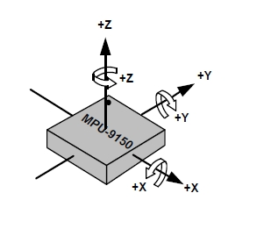
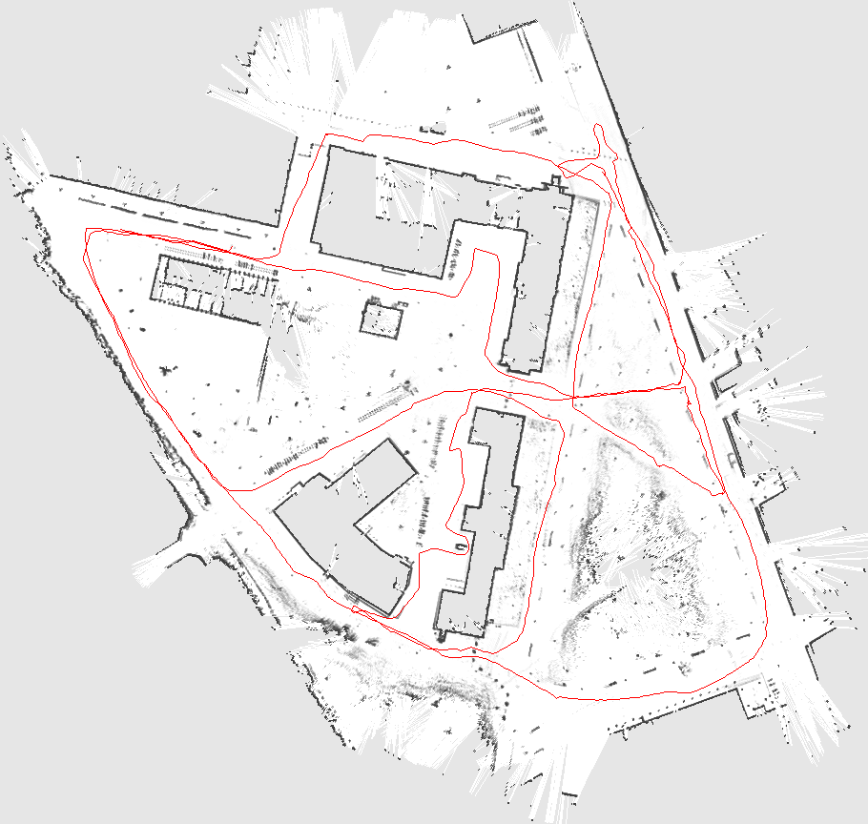
WearLoc
A Wearable Indoor Localization Device
This is Arial bold
This is Arial bold
This is Arial bold
This is Arial bold
This is Arial bold
This is Arial, Orange, 233 131 0
This is Arial, Dunkel-Rot, 123 41 39
This is Arial, Mittel-Blau, 42 110 187
This is Arial, Mittel-Grün, 115 150 0
This is Arial, Anthrazit, 77 79 83
Lukas Gemein
gemeinl@cs.uni-freiburg.de
David Speck
speckd@cs.uni-freiburg.de
Rick Gelhausen
rick.gelhausen@gmail.com
André Biedenkapp
biedenka@cs.uni-freiburg.de
Jennifer Nist
nistj@cs.uni-freiburg.de
RPLIDAR
Hokuyo URG-04LX
This is Arial bold
This is Arial bold
This is Arial bold
This is Arial bold
This is Arial bold
360° omnidirectional laser scanner
Scan range 0.2 ~ 6m
Resolution: angular 1°, distance 2cm
240° laser scanner
Scan range 0.02 ~ 4m
Resolution: angular 0.34°, distance 20mm
This is Arial, Gelb, 239 198 71
This is Arial, Hell-Rot, 222 56 49
This is Arial, Hell-Blau, 167 193 227
This is Arial, Hell-Grün, 146 212 0
This is Arial, Dunkel-Grau
This is Arial bold
This is Arial bold
This is Arial bold
This is Arial bold
This is Arial bold
Raspberry Pi Model 2B
Intel Edison
This is Arial, Pastell-Gelb, 248 228 152
This is Arial, Pastell-Rot, 255 129 141
This is Arial, Pastell-Blau, 218 227 234
This is Arial, Pastell-Grün, 208 235 138
This is Arial, Mittel-Grau, 178 180 179
On the Raspberry Pi all the software components are running, including hector_slam. The resulting map is send via WLAN to a laptop to visualize it.
We use the Edison to read out the scan and IMU data. Which is then send via WLAN to a laptop running hector_slam
This is Arial bold
Grove IMU 9DOF v2.0
This is Arial, Hell-Grau, 213 214 210
The IMU is used to get the bearing of the laser scanner, so we can keep track of it's / the users rotation
This is Arial bold
Area of application
Area of application
This is Arial, Pastell-Grau, 234 235 231
This device could be used in a search and rescue type situation.
In such a scenario the rescue team would be able to map out the area they have already visited.
Obstructed paths, due to possible debris, could possibly be marked as such.
This would enable new rescuers to find the best route to their intended destination.
Here, best could mean the quickest or the safest route, depending on the given environment.
A possible area of application for such a device is cartography of caves.
It would enable a Speleologist to get the accurate data about the size of a cave.
An extension for this device could be a camera that also takes images of the surroundings during the slam process.
These images then could be projected on the resulting 3D map.
This would enable the Speleologist not only to see the dimensions of the cave at a given point but also the composition of the cave floor and walls, enabling virtual exploration of a cave.
Implementation Publicly Available at https://github.com/JenniferNist/Wearloc

